Slide 1
Managing Uncertainty with Professionalism
Members of the Working Party
GIRO Workshop October 2015

Slide 2
Agenda
Introduction
Uncertainty Principles
Uncertainty vignettes
Conclusions and next steps

Slide 3
Agenda
Introduction
Uncertainty Principles
Uncertainty vignettes
Conclusions and next steps

Slide 4
Notes:
Certainty
The brain is a pattern-recognition machine that is constantly trying to predict the near future. For example, the motor network is useless without the sensory system. To pick up a cup of coffee, the sensory system, sensing the position of the fingers at each moment, interacts dynamically with the motor cortex to determine where to move your fingers next. Your fingers don’t draw on fresh data each time; the brain draws on the memory of what a cup is supposed to feel like in the hand, based on expectations drawn from previous experiences. If it feels different, perhaps slippery, you immediately pay attention (Hawkins, 2004). The brain likes to know the pattern occurring moment to moment, it craves certainty, so that prediction is possible. Without prediction, the brain must use dramatically more resources, involving the more energy-intensive prefrontal cortex, to process moment-to-moment experience.
Even a small amount of uncertainty generates an ‘error’ response in the orbital frontal cortex (OFC). This takes attention away from one’s goals, forcing attention to the error (Hedden, Garbrielli, 2006).
If someone is not telling you the whole truth, or acting incongruously, the resulting uncertainty can fire up errors in the OFC. This is like having a flashing printer icon on your desktop when paper is jammed – the flashing cannot be ignored, and until it is resolved it is difficult to focus on other things. Larger uncertainties, like not knowing your boss’ expectations or if your job is secure, can be highly debilitating.
The act of creating a sense of certainty is rewarding. Examples are everywhere in daily life: music that has simple repeating patterns is rewarding because of the ability to predict the flow of information. Meeting expectations generates an increase in dopamine levels in the brain, a reward response (Schultz, 1999). Going back to a well-known place feels good because the mental maps of the environment can be easily recalled.

Slide 5
The threats to good decision making
We have an inherent desire for certainty. But there are challenges for both decision-makers and experts:
How might decision-makers and experts manage uncertainty with greater professionalism?
Different perspectives
Understanding
Bias
Communication
Question Clarity
Recognition of Uncertainty
Role of analysis and quantification
Notes:
This affects both decision-makers and advisors. Actuaries are part of the problem.
Add understanding?

Slide 6
Working Party scope and ambition
Decision makers and experts
Technical and social aspects
Practical and constructive
Relevant beyond insurance
Aiming to help and influence behaviours

Slide 7
Agenda
Introduction
Uncertainty Principles
Uncertainty vignettes
Conclusions and next steps

Slide 8
Uncertainty Principles
Aim: A set of high level principles for all
Criteria:
Themes
Catchy and memorable
Meaningful and useful
A little provocative?
Face up to uncertainty
Deconstruct the problem
Don’t be fooled (un/intentional biases)
Models can be helpful, but also dangerous
Think about resilience
Bring people with you

Slide 9
Agenda
Introduction
Uncertainty Principles
Uncertainty vignettes
Conclusions and next steps

Slide 10
1. Face up to Uncertainty Start with a decision…
Is the problem well defined?
Clear context, objectives and scope
Inherently vague or poorly explained / understood
Notes:
Two sets of examples which can be used over the next 3 slides:
Capital:
What are my capital requirements?
What is my Solvency II 1 in 200 number?
Motor
What should my Motor strategy be?
What is the expected loss of a specific Motor risk?

Slide 11
1. Face up to Uncertainty Start with a decision…
How much the problem can be quantified?
Unquantifiable
Quantifiable
Unquantifiable
Quantifiable
A modelling challenge
A resilience challenge
Notes:
Examples in notes of previous slide
Unquantifiable aspects of each example:
Capital: dependencies, extreme tail risk
Motor: competitor behaviour, legal change…

Slide 12
1. Face up to Uncertainty What decisions fit where?
How should typical insurance decisions be categorised?
Do decision makers and experts agree? And are they right?
A simplified framework but how do we face up to uncertainty?
VAGUE SCOPE
CLEAR SCOPE
MODELLING
RESILIENCE
Notes:
Examples in notes of previous slide (but one)
Potential to open into a discussion with audience?

Slide 13
2. Deconstruct the problem Frameworks and Taxonomies
Uncertainty is an inherently complex subject. More constructive guidance and techniques can be achieved from deconstruction into more manageable issues.
The primary taxonomy identified follows the process of decision making:
Framing
What is the context, the question and are both understood properly?
Analysis and Modelling
What are the results and how should they be interpreted? (In light of the question and analysis)
Reporting results
Is the work understood: approach and key uncertainties/ limitations? (In light of the question)

Slide 14
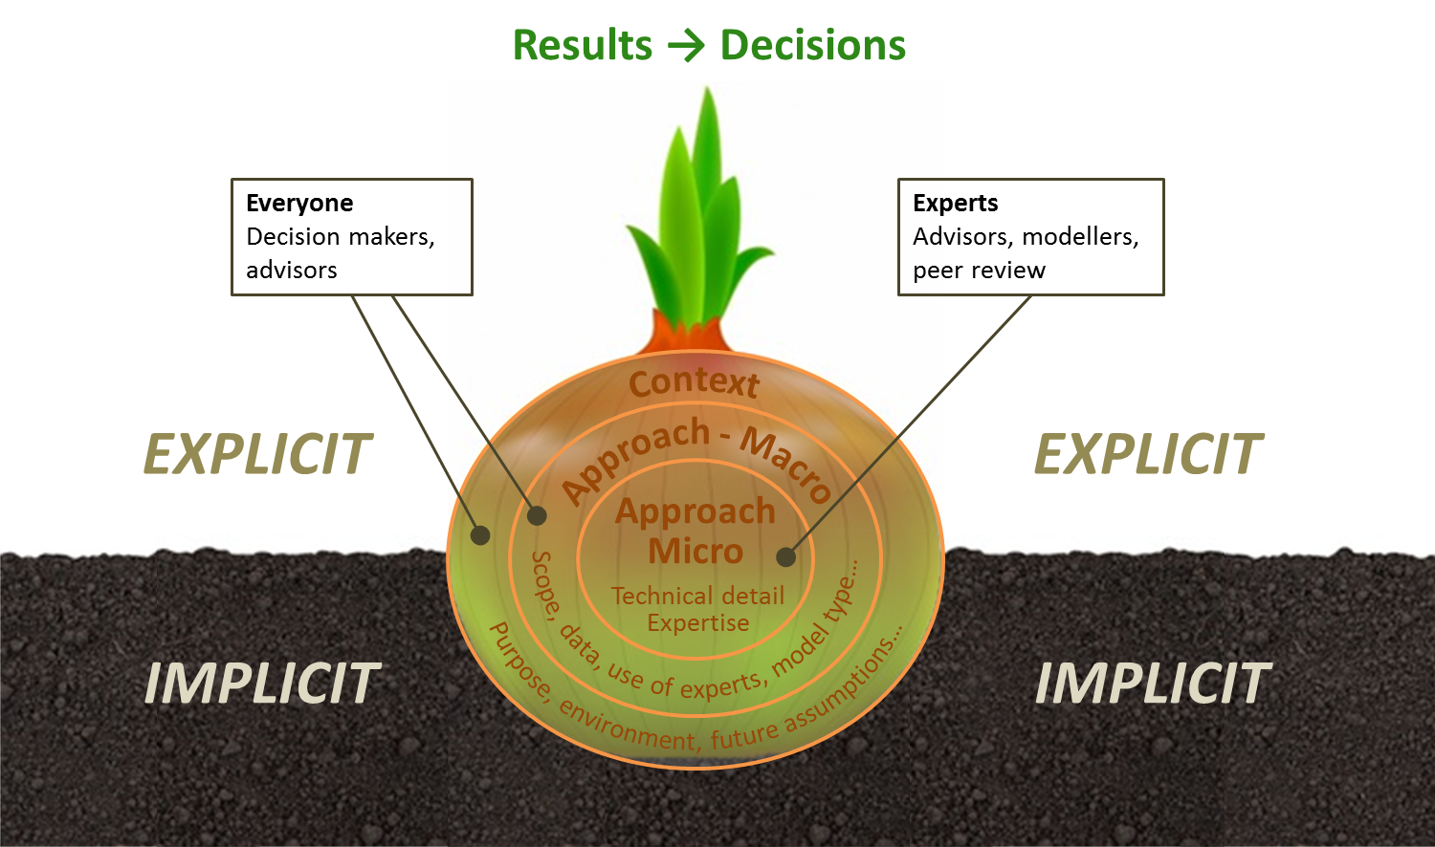
2. Deconstruct the problem Frameworks and Taxonomies
Other taxonomies of potential use include “The Assumption Onion”, seeking to highlight different types of assumptions (and associated sources of uncertainty)
A key point here is the many assumptions which are implicit and often overlooked

Slide 15
2. Deconstruct the problem Frameworks and Taxonomies
Another deconstruction, “The Ladder”, looks at the difference between risk (traditionally managed through ERM) and uncertainty (requiring a different approach?)
People: Emotive or unpredictable reactions by stakeholders; many unaligned stakeholders
Biases: Existence of biases that may be known or unknown - might include commercial, political, organisational or other bias
Obscurity: underlying risk exposures are unknown or obscured, “worst” outcome is unknown
Complexity: of the system or the model being investigated
Context: for decision is not well understood
[…]
Understanding: of the underlying risks and their distribution
Stability: of the regime, no latent risks
Data: credible data set(s)
Uncertainty
Risk

Slide 16
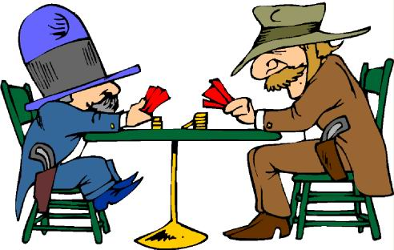
3. Don’t be fooled Two way communication: playing the game
Real life negotiations are often characterised by:
Different information and perspectives
Complex payoffs
or incentives
It might not be optimal for either party immediately to disclose all facts to the other.
How does this fit with professionalism and, in particular, the need for clear communication?

Slide 17
3. Don’t be fooled Unintentional biases and traps
The overarching technique for responding to biases and traps is to stimulate Slow Thinking (Thinking Fast and Slow, Kahneman 2011)
Useful to consider in three categories:
Latent Framing
Traps
Over-interpretation
Biases and heuristics that influence the perception of a problem and expectations of the outcome
Biases and heuristics that can deceive the decision maker and advisor
Biases and heuristics (rules of thumb) relating to reading too much or too little into data

Slide 18
3. Don’t be fooled Unintentional biases and traps
The overarching technique for responding to biases and traps is to stimulate Slow Thinking (Thinking Fast and Slow, Kahneman 2011)
Latent Framing
Traps
Over-interpretation
Affect heuristic the tendency for people to use their personal likes and dislikes to form beliefs about the world.
Anchoring the process of using a starting point for evaluating or estimating unknown values.
Confirmation bias tendency to seek evidence that is compatible with a given view.
Halo effect the tendency to like (or dislike) everything about a person, including their opinions.
Myopic loss aversion a phenomenon whereby investors are particularly concerned with the potential for a short term loss, even in the context of long-term investments.
Trusting intuition the tendency for people to have a lot of confidence in their intuition.
Status quo bias the preference for things to stay the same.
Sunk cost bias costs incurred in the past are used as a justification to continue investing in suboptimal projects or strategies in the future.
Survivor’s Curse tendency for the lucky to survive and have misplaced optimism.
Gambler’s fallacy the tendency of decision makers to underestimate the probability of a repetition of an event that has just happened.
Illusion of validity the use of evidence to make confident predictions even after the predictive value of the evidence has been disproved.
Law of Least Effort the tendency for people to seek the easiest way possible to complete a task.
Mean-reversion bias when decision makers assume that over time, a trend has to return to the mean.
Planning myopia the tendency to consider consequences over a too restricted time horizon.
Priming purposefully triggering thoughts or ideas.
Temporal discounting the greater the delay to a future reward, the lower its present, subjective value.
Winner’s Curse tendency for winning bidders to overpay where incomplete information.
As if bias the potential to be optimistic when restating historic behaviour due to exposure revisions or past misfortune.
Availability heuristic the tendency for people to respond more strongly to risks when instances of those risks are more available to them (from memory, imagination, media, general social discourse, beliefs about the world).
Causal thinking bias tendency for people to seek patterns and explanations rather than believe in chance.
Hindsight bias the false belief that events are more predictable than they actually are.
Illusion of skill the tendency for people to mistake good luck for skill.
Small probabilities a group of biases that can arise when people reason about rare events. Small probabilities tend to receive too much, or too little weight depending on the decision context.

Slide 19
3. Don’t be fooled Reserving scenario example
Apparent scenario
Q. What should the level of reserves be?
Actuary’s knowledge and perspective:
Assumptions, stated and unstated, underlying a proposed outcome
Sensitivity of analysis to different modelling approaches
Level of diligence in performing the work
View on how far prepared for answer to move but still sign off

Slide 20
3. Don’t be fooled Reserving scenario example
Actual scenario?
Q. What should the level of reserves be given currently X and pressure on profits for results announcement?
Questioner’s knowledge and perspective:
How much information relating to the business has been disclosed to the actuary, and what has been withheld
How a particular outcome affects the bonus and career prospects of the questioner and other colleagues
Guesses at the outcome from other colleagues (actuarial or not)
The acceptable range for the answer, beyond which the actuary will be replaced by someone else more accommodating

Slide 21
3. Don’t be fooled Reserving scenario example
Actual scenario?
Q. What should the level of reserves be given currently X and pressure on profits for results announcement?
Questioner and Actuary especially vulnerable to these unintentional biases and traps:
Latent Framing
Anchoring
Confirmation bias
Status quo bias
Trusting intuition
Traps
Gambler’s fallacy
Illusion of validity
Law of Least Effort
Mean-reversion bias
Over-interpretation
Availability heuristic
Hindsight bias

Slide 22
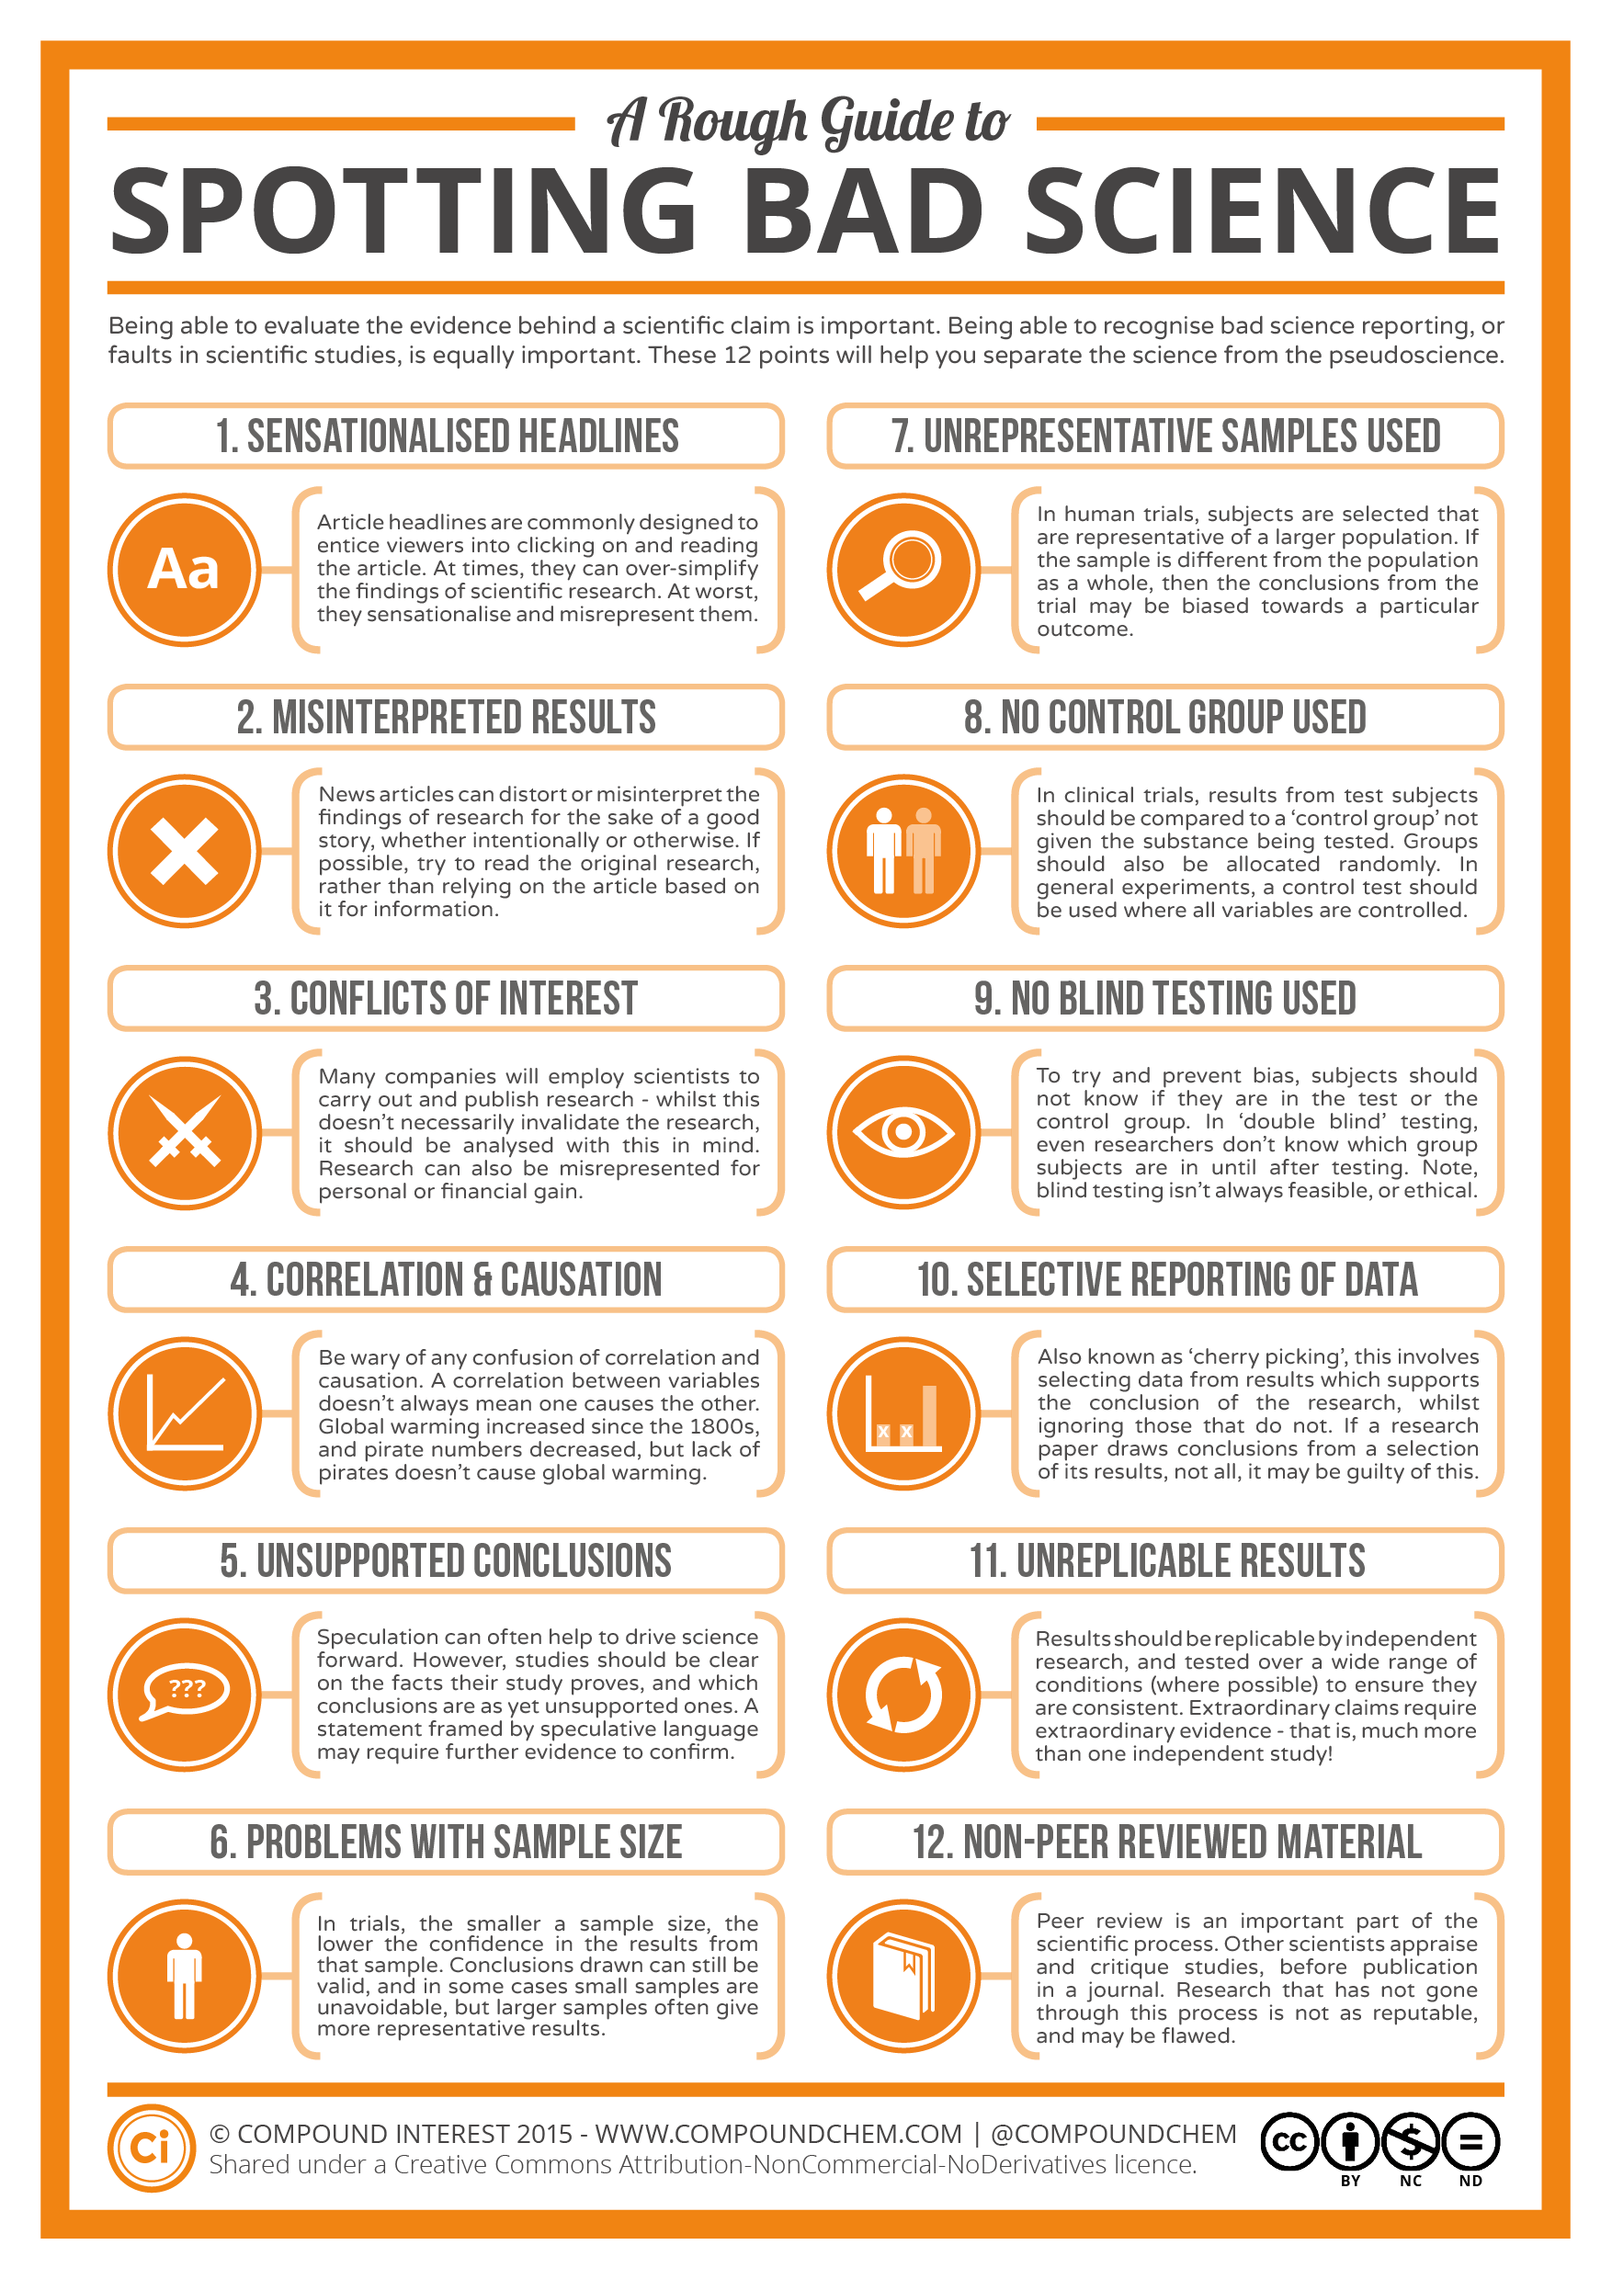
4. Models can be helpful, but also dangerous Honing your “unknowability radar”
Important to
Identify limits to knowledge
Spot bad (actuarial) science
Spot hard problems
Smooth v knotty v unknowable
Work hard to make this instinctive…
Source: Compound Interest
http://www.compoundchem.com/2014/04/02/a-rough-guide-to-spotting-bad-science

Slide 23
4. Models can be helpful, but also dangerous Honing your “unknowability radar”
Spotting hard problems…
Smooth | Knotty | Unknowable
Reserving a stable book with good data | Assessing reserve risk | Predicting “1 in 200” events
Assessing scenario severities, based on assumed events | Assessing relative scenario likelihood | Assessing scenario return periods

Slide 24
4. Models can be helpful, but also dangerous Prudence and Best Estimates
Ten losses: 10, 20, 21, 34, 48, 82, 84,167, 241, 293
What is the 1 in 100 loss exceedence estimate?
Extra uncertainty in the red and amber scenarios relates to a lack of knowledge, rather than inherent randomness. Can this be quantified?
Scenario | Information | 1 in 100
GREEN | Losses from an exponential distribution with mean of 100 | 461
AMBER | Losses from an exponential distribution with unknown mean | Higher? True mean may be higher than 100
RED | No more information | Further concerns that true distribution may be different and also may change over time

Slide 25
5. Think about resilience Resilience thinking in action
It’s the beginning of the credit crisis you are reviewing your company’s exposure to financial guaranty insurance, providing ‘credit enhancement’ for issuers of CDO’s relating to residential mortgage backed securities
…. the underlying securities have started to downgrade and default
…. it’s clear that existing views on the risk and valuation need to radically change. Available pricing and valuation models are no longer credible
You are given one weekend by the Board to value a potential sale of these securities. What do you do?
Notes:
https://en.wikipedia.org/wiki/Bond_insurance

Slide 26
5. Think about resilience The Resilience Toolkit
Controlling “exposures to adverse scenarios” - even those that are unknown, and highly unlikely – is known as resilience. Resilience can be overlooked in ERM …
Governance
Identify & assess risk
Risk limits
Stress & scenario tests
Risk mitigation
Resilience
Facing uncertainty
Strategies for the unknown
Building in redundancy
Communication
Reducing complexity
Learn from mistakes
ERM
Resilience
Notes:
Know how much you have at stake;
Know your business and identify potential risks;
If you use resilience then you can take appropriately sized risks and benefit from the upside
http://www.pbs.org/thisemotionallife/topic/resilience/what-resilience

Slide 27
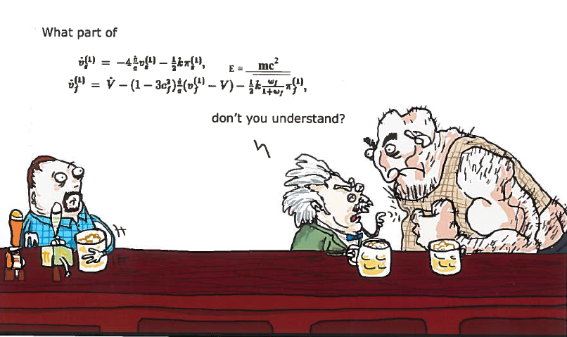
6. Take people with you Understanding, engagement and trust

Slide 28
6. Take people with you Engaging others: framing (1)
Two key elements:
The need for engagement of questioner
Importance of clarity over scope (context, question and approach)
Engagement top tips:
Ask rather than just tell
Put in broader context (what are the upside, downside implications?)
Seek input on key judgements (e.g. advice on use of experts)
Bring out “carrots” (positive benefits) and “sticks” (negatives to avoid)

Slide 29
6. Take people with you Blip or Trend?
Scenario
Q. You are an actuary addressing the reserving committee at a commercial insurer. You have observed a spike in claims in a particular quarter and make a recommendation on whether this is a “blip” or a “trend”?
Current financial pressures may colour management views and perspectives
Ideally this possibility should have been addressed with the committee prior to this quarter. Important to educate on the range of possible outcomes and possible responses in advance
If this is the first time the committee is exposed to this issue, its too late …

Slide 30
6. Take people with you Understanding perceptions
Analysis Essential
How the Actuary believes the decision maker should perceive the analysis
Problem Simple
Problem Complex
The way the decision maker currently perceives the analysis
Analysis Not useful

Slide 31
6. Take people with you Engaging others: discussing results (2)
Engage a range of specialists and non specialists in how to communicate
Share a basic cognitive map of the problem
Listen to users, fill in their understanding
Revisit scope, objectives (upside?)
Discuss where experts agree, as well as where they differ
Avoid vagaries, use scenarios, numbers
People tend to do better if things are kept simple.
How have results been validated against the real world?
I think X, but the outcome is very uncertain. It could be Y or Z.
Don’t provide certainty where there is none
Notes:
Working from the Pidgeon and others’ ideas:
Revisit framing, confirm risk appetite/ strategic objectives of model users
‘Respectful’ communication – if a model is used, share a basic cognitive map of the model, remember to talk about what is known/agreed by the experts, as well as what is not – allow the user to engage
Listen to users – seek to understand their goals and ‘fill in’ their understanding, seek feedback
Beware of the need for and temptation to give certainty where it does not exist
Keep it simple
Avoid vagaries (‘probable’, ‘likely’, ‘unlikely’) in favour of scenarios, numbers and probabilities
Results under different sets of assumptions (optimistic, pessimistic) vs risk appetite? what’s the worst possible outcome, are there knock-on / ripple effects?
What uncertainties have emerged through the analysis i.e. differences in expert’s opinions, if sensitivity to key assumptions, simplifying assumptions, strengths and limitations of the work performed
How the result or recommendation has been ‘validated’ against the real-world, what are the underlying exposures?
Engage a range of specialists and non-specialists in the issue and the way it is communicated
Try to use clearly defined terminology

Slide 32
Agenda
Introduction
Uncertainty Principles
Uncertainty vignettes
Conclusions and next steps

Slide 33
Benefits of managing uncertainty
Better decisions, including:
Ensuring relevant information is used
Appropriate understanding of risks
Saving time
Reduced risk of misunderstanding
Increased trust (eg Actuary of CEO; CEO of Actuary)

Slide 34
Uncertainty Principles
Aim: A set of high level principles for all
Criteria:
Themes
Catchy and memorable
Meaningful and useful
A little provocative?
Face up to uncertainty
Deconstruct the problem
Don’t be fooled (un/intentional biases)
Models can be helpful, but also dangerous
Think about resilience
Bring people with you

Slide 35
Any questions or comments? Please get in touch
Chris Bird
Andrew Cox
Tom Durkin
Henry Johnson
Tim Jordan
Tony Jordan
Neil Hilary
Paul Kaye (co-chair)
Natasha Regan
Andrew Smith (co-chair)
Richard Stock
Melinda Strudwick (co-chair)
James Turner
Martin White (co-chair)
Stuart White
Robin Wilkinson

Slide 36
Any questions or comments? Please get in touch
Co-chair email addresses:
Paul Kaye paul.kaye@aonbenfield.com
Andrew Smith andrewdsmith8@deloitte.co.uk
Melinda Strudwick melinda.strudwick@uk.pwc.com
Martin White Martin.White@RESMSL.co.uk

Slide 37
Questions
Comments
The views expressed in this presentation are those of invited contributors and not necessarily those of the IFoA. The IFoA do not endorse any of the views stated, nor any claims or representations made in this presentation and accept no responsibility or liability to any person for loss or damage suffered as a consequence of their placing reliance upon any view, claim or representation made in this presentation.
The information and expressions of opinion contained in this publication are not intended to be a comprehensive study, nor to provide actuarial advice or advice of any nature and should not be treated as a substitute for specific advice concerning individual situations. Unpaid volunteers have produced this presentation to promote discussion in the public interest. You are free to redistribute it or quote from it (with acknowledgement) without further permission or payment but you should quote from our work accurately and in context.

