Slide 1
What’s Happening to Interest Rates?
Members of the Extreme Events Working Party Contact: andrewdsmith8@deloitte.co.uk

Slide 2
AntiTrust Notice
The Casualty Actuarial Society is committed to adhering strictly to the letter and spirit of the antitrust laws. Seminars conducted under the auspices of the CAS are designed solely to provide a forum for the expression of various points of view on topics described in the programs or agendas for such meetings.
Under no circumstances shall CAS seminars be used as a means for competing companies or firms to reach any understanding – expressed or implied – that restricts competition or in any way impairs the ability of members to exercise independent business judgment regarding matters affecting competition.
It is the responsibility of all seminar participants to be aware of antitrust regulations, to prevent any written or verbal discussions that appear to violate these laws, and to adhere in every respect to the CAS antitrust compliance policy.

Slide 3
Presentation Overview
Interest rate history: long term and the recent past
Arguments for lower bounds
Interpreting prices of interest rate options
Drivers for recent behaviour
Implications for Investment
Conclusions & lessons learnt

Slide 4
History of Interest Rates

Slide 5
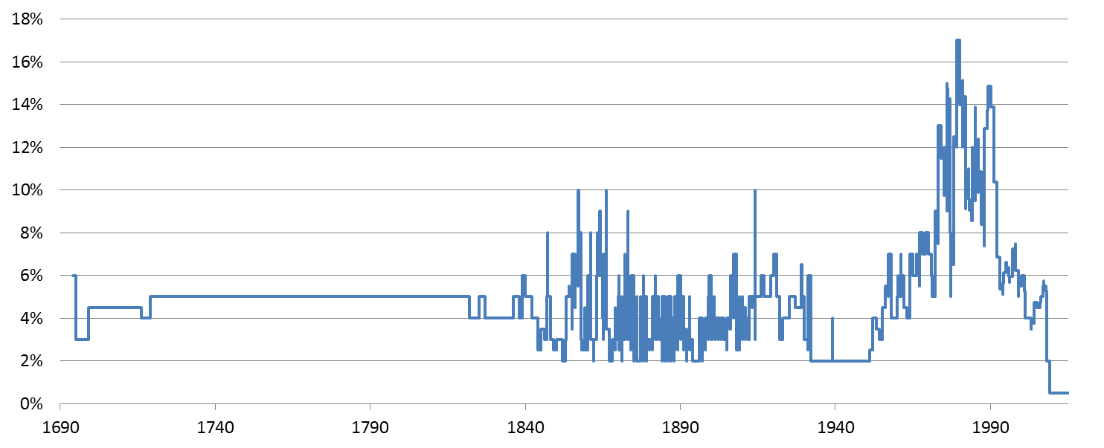
UK Base Rates since 1694
Source Bank of England
Notes:
Source: http://www.bankofengland.co.uk/monetarypolicy/Pages/decisions.aspx

Slide 6
Why Interest Rates Matter for Investors?
Interest rates explain market prices of fixed income instruments
Key factor in calculating the value of liabilities for pension schemes and insurance companies
At the heart of any building block framework for explaining asset returns (e.g. equity returns expressed as risk-free + risk premium)
A policy instrument that may be used to target inflation or the general level of economic growth
At a corporate level - rate for lending and borrowing for companies
Infrastructure and development - Hurdle rates for project investments

Slide 7
UK Market Rates (2 Year Term)
16%
14%
12%
Gilts
10%
LIBOR
OIS
8%
6%
4%
2%
0%
Source: Bank of England
70
75
80
85
90
95
00
05
10
15

Slide 8
International Comparison: 2 Year Gov Yields
15.0%
12.5%
10.0%
USD
7.5%
DEM
GBP
5.0%
2.5%
0.0%
70
75
80
85
90
95
00
05
10
15
Source: Fed, BoE, Buba

Slide 9
Recent Yields on German Bonds
1.00%
0.75%
0.50%
5 year
4 year
0.25%
3 year
2 year
1 year
0.00%
2012
2013
2014
2015
2016
-0.25%
-0.50%
Source: Buba

Slide 10
What do the Examiners Say? (CT8, Apr 2012, Q 6)
[1]
[1]
[5]
[1]
[3]
[1]
(i) Write down a stochastic differential equation for the short rate r_{t} for the Vasiček model.
(ii) State the type of process of which the Vasiček model is a particular example.
(iii) Solve the stochastic differential equation in (i).
(iv) State the distribution of r_{t} for t given.
(v) Derive the expected value and the second moment of r_{t} for t given.
(vi) Outline the main drawback of the Vasiček model.
Examiners’ Model Solution to part (vi):
“The process may become negative which is undesirable in a nominal interest rate model”

Slide 11
What does EIOPA say about negative rates?
QIS 5 – there was a minimum down stress of 1% but a floor on the stressed (down) rates of 0%
Current basis from EIOPA:
Negative rates are a feature of EIOPA Term Structure
credit default adjustment increases likelihood of negative rates
Downward Interest Rate stress in the Standard Formula
If the pre-stressed rate is negative there is no further stress down
If the pre-stressed rate is positive then the proportionate EIOPA Down stress ensures the Downward Interest Rate is also positive

Slide 12
What is the lower bound for interest rates?
Supply and Demand Considerations

Slide 13
Could Interbank Rates become Negative?
Short government bond yields have become negative in several currencies
LIBOR (inter-bank unsecured borrowing) has remained positive
Typically settled as two cash flows (deposit, followed by redemption + interest)
No particular administrative issues with the interest rate becoming negative – it would mean banks had to pay other banks to look after their money.
Negative swap rates have occurred – currently CHF & SEK
What about negative perpetuity yields?

Slide 14
Are Negative Interest Rates Logical?
Investors can choose to hold physical banknotes.
It could be argued that the option to hold banknotes should keep market interest rates above zero.
But this ignores:
Cost of storage
Risk of theft
Damage from floods, fire
Cost of moving cash, especially across borders
Various other issues, e.g. legal tender
Notes:
Serious studies have been completed about costs of securely storing banknotes- not surprisingly varies by currency – depending upon largest denomination notes £50, $100, €500, CHF1000.

Slide 15
Interest Rate Option Pricing Models
Diffusion models
Black, Bachelier and Related Models

Slide 16
Random Walk Models for interest rates
Brownian Motion is the building block of choice when modelling asset classes and time series. Equivalent to random walks in discreet time.
Two main extensions commonly used:
Geometric Brownian Motion - The default model for positive economic series (such as share prices or foreign exchange rates)
Mean reversion – Incorporated by the Ornstein Uhlenbeck expansion (effectively assuming that a mean exists, and has a certain magnetic force)
Interest rates have an additional complexity in terms of at least two dimensions of time, which results in a large range of potential models.

Slide 17
What is the Lower Bound for Interest Rates?
The lower bound is an artefact of the model we choose.
Model / Family of models | Interest Rate Lower Bound
Vasicek family of models | No lower bound
Hull-White family of models | No lower bound
Bachelier (normal implied volatility); Johnson curves | No lower bound
Displaced geometric random walk (Piterbarg DDSV LMM) | -3.48% or other estimated constant
Cox, Ingersoll and Ross (CIR) models | Theoretically no lower bound, but fitting to a term structure can result in a negative lower bound
Black-Karasinski models | Zero
LIBOR Market Models | Zero
Bank of England (Shimko method of extrapolating Black / LogNormal implied volatility) | Zero

Slide 18
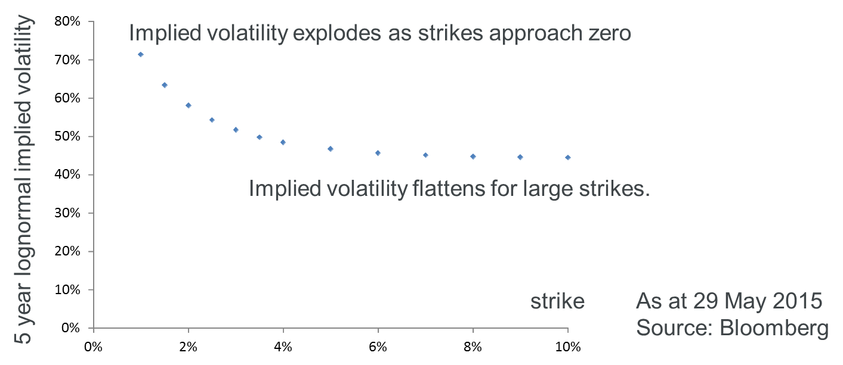
Challenging the Market Conventions used for Volatilities
Black volatilities is the market standard convention for interest rate volatility data.
Under the Black model, the evolution of the forward swap rate $F_{\left[T_{0},T_{n}\right]}(t)$ for a swap with term $T_{0}$ and tenor $T_{n }− T_{0}$ is modelled through the following stochastic differential equation.
$\frac{{dF}_{\left[T_{0},T_{n}\right]}(t) }{F_{\left[T_{0},T_{n}\right]}(t) }=σ_{LN}dW\left(t\right)$
The forward swap rate is assumed to evolve according to geometric Brownian motion with a Black volatility $σ_{LN}$.
However, this valuation formula breaks down technically as it contains terms such as log(F/K) that are only defined for positive forward swap rates, F.
The negative interest environment results in the need for an alternative to Black volatilities e.g. Normal volatilities.

Slide 19
Drivers for recent behaviour
Quantitative Easing and “flight to quality”

Slide 20
Conventional Monetary Policy
Government
Open Market Operations
Government
Government
Central Bank
Inflation Target
Interest Rates
Consumption
Investment
Asset Prices
Exchange Rate
Confidence
Aggregate Demand
Inflation
Unemployment
Aggregate Demand

Slide 21
In a Perfect world:
Crisis
Fall in AD
Output Gap
Inflation below target
Central Banks cut interest rates
Aggregate Demand
Close output gap
Inflation back to target

Slide 22
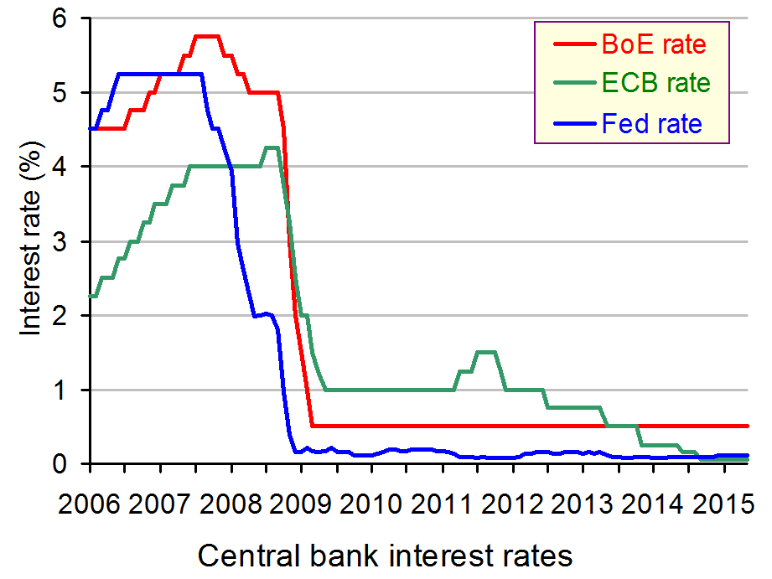
What did Central Banks do during the 2008-09 financial crisis?

Slide 23
Problems:
Central bank cuts bank rate
Arbitrage mechanism Impaired
Financial crisis
Cut to almost 0 (if not lower!)
Interbank market
Banks don’t pass on low interest rates
Zero Lower Bound
Cannot increase demand enough

Slide 24
Quantitative Easing
Central Bank
Create new money electronically
Purchase longer dated assets on secondary markets
Drive down long term interest rates

Slide 25
Central Bank Expands Its Balance Sheet
New Money
Asset Purchases
Government Bonds
Private Sector Assets
Central Bank Liabilities
Central Bank Assets

Slide 26
QE – amounts and timing
USA
QE1 –Nov 2008, the Fed started buying $600Bn mortgage backed securities(MBS). The Fed also bought Treasury Securities(TS) (it already held $700Bn of these) and total holding was $2.1Tn at Jun 2009
QE2 – Nov 2010 the Fed started buying another $600Bn of TS
QE3 – Sept 2012 – Fed started buying another$40Bn/month of TS. Raised to $85Bn/month. Tapering started in Feb 2014 & new purchases ceased Oct 2014
UK
Mar 2009 BoE started buying gilts and had accumulated £175Bn by Oct 2009
Subsequent additional purchases of £75Bn (Oct 2011), £50Bn (Feb 2012) and £75Bn (July 2012)
EU
ECB (Jan 2015) announced would start buying €60Bn/month of central govt debt and EU institution debt. Started Mar 2015 and will continue to at least Sept 2016
Notes:
We can never really know what would have happened without QE
Large corporations held cash rather than invested

Slide 27
Evidence
Event studies: General consensus QE in U.S.A and U.K significantly reduced long term interest rates and increased asset prices
Seems to work primarily through the portfolio rebalancing channel
However, no consensus as to size of the effects on financial markets and the extent this was reflected in economic activity
Does anyone fully understand QE?
Other factors – such as a “Safe Haven” suggest, at times of greatest uncertainty, returns are not the primary considerations - Switzerland?
Notes:
We can never really know what would have happened without QE
Large corporations held cash rather than invested

Slide 28
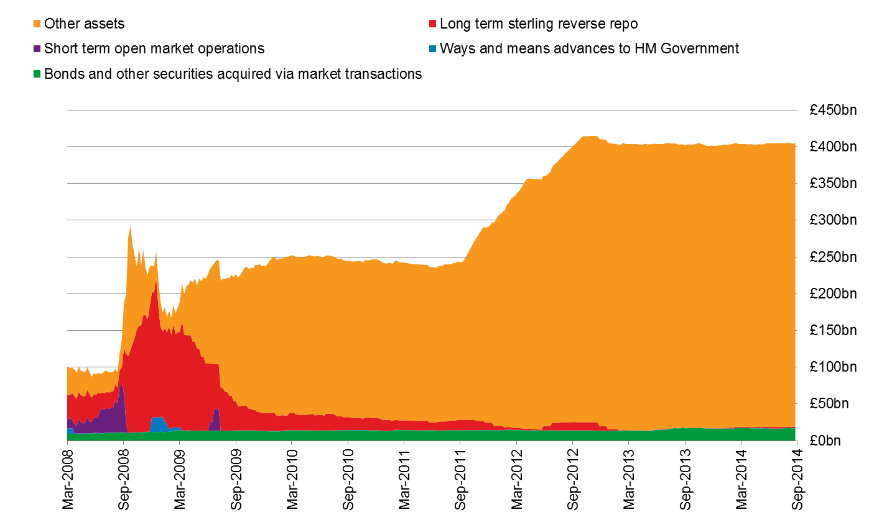
Bank of England Balance Sheet: assets
Source: Bank of England

Slide 29
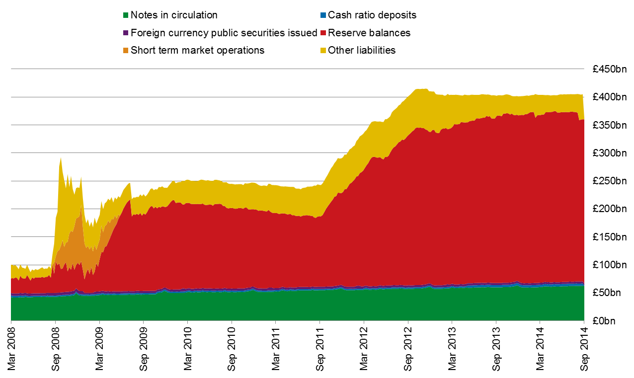
Bank of England Balance Sheet: liabilities
Source: Bank of England

Slide 30
Implications for Investment

Slide 31
Unwinding of Quantitative Easing
Will unwinding QE have the opposite effect of its introduction?
UK - in the Feb 2014 BoE Inflation Report - statement that the £375Bn of QE gilts on BoE Balance Sheet would be maintained, including reinvesting the cash flows associated with any of those assets that mature, at least until the Bank Rate has been reached a level from which it could be cut materially, if that was needed
Conclusion – no imminent “unwinding” – Source: BoE QE FAQ
US Federal reserve – things will return to normal as recovery progresses
St Louis Fed (2014) – calming words on US QE (relative size of US QE to others, the range of options for Fed for unwinding)
Notes:
We can never really know what would have happened without QE
Large corporations held cash rather than invested
Here “unwinding” is reversing QE - sale of the Central Bank holding. In the past just stopping adding to the QE pile led to a (taper) tantrum – actual reversal (rather than just stopping) is likely to be …..

Slide 32
Net effect of QE in UK – Total Gilts outstanding
Notes:
We can never really know what would have happened without QE
Large corporations held cash rather than invested
Notes on DMO Quarterly Review
BoE Asset Purchase Facility wasn’t separately identified until Q4 2009
There were classification changes over the period (e.g. Banks & BSocs to MFIs)

Slide 33
Implications for Investment
Quantitative Easing Impact – comment on previous chart
Net (of BoE APF holdings) Gilts in issue still show substantial growth
Even allowing for data being Market Value and not Nominal
QE does not tell the whole story
Long term rates have been declining for 30 years (at least – some argue much longer)
Decline evident in real rates and has been global (& was not predicted)
“Long Term Interest Rates: A Survey” by Office of the US President has reviewed
Economic Frameworks suggest interest rates settle at level that balances supply of savings and demand for investment
Most Economic Frameworks suggest long term rates closely related to productivity growth – with other factors also playing a role
Notes:
We can never really know what would have happened without QE
Large corporations held cash rather than invested
Other factors identified as playing a role:
population growth
technological advance
aggregate demand
stance on fiscal and monetary policy

Slide 34
Implications for Investment
The US Survey identifies a number of factors, transitory and longer-lived, that have contributed:
Transitory factors
Longer lived factors
Conclusion is that analysis of many the factors suggests that long-run equilibrium interest rates have fallen
Ultimately the Survey concludes
“there is no “optimal” long term interest rate of interest. Rather, policy should support long-run growth, maintain price stability and support a stable financial system”
Notes:
Transitory Factors
Global fiscal and monetary policies
Shifts in the term premium and inflation risk
Post-crisis private-sector deleveraging
Longer Lived Factors
Lower potential output and productivity growth
Shifting demographics
Global “savings glut”
Is conclusion quote from Survey consistent with quote from BoE statement on unwindiing QE when rates at a level which would allow a meaningful cut? BoE anticipates a return to “normal”/pre Crisis world – but perhaps not because Haldane is already talking about a cashless society so negative rates would be effective

Slide 35
Implications for Investment
Investment in a low interest world
When the search for yield has pushed expected down returns
Do you respond by
Increasing your risk?
Accept lower returns and await “normalisation”?
In meantime traditional portfolio construction process challenged by:
Correlations are very different to pre-crisis levels - temporary or the “new normal”?
Non-traditional assets with higher yields – generally have poor data
Non-traditional portfolio construction techniques:
Look through to underlying sources of return so that you can compare all assets on a consistent basis
Use stochastic scenarios and “game play” historic and future stresses
Notes:
Transitory Factors
Global fiscal and monetary policies
Shifts in the term premium and inflation risk
Post-crisis private-sector deleveraging
Longer Lived Factors
Lower potential output and productivity growth
Shifting demographics
Global “savings glut”
Is conclusion quote from Survey consistent with quote from BoE statement on unwindiing QE when rates at a level which would allow a meaningful cut? BoE anticipates a return to “normal”/pre Crisis world – but perhaps not because Haldane is already talking about a cashless society so negative rates would be effective

Slide 36
Conclusions

Slide 37
Lessons Learned from Recent Rate Moves
Negative rates are possible, and not necessarily temporary!
The complexity of interest rate models was hidden under a number of well used models across the industry (e.g. LMM)
Model output is a function not only of input parameters but also the chosen model structure. Consider several alternative models.
If a single model says negative rates (or rates above 100%) can’t happen, this does not mean these rates can’t happen.
Think about fundamental supply and demand in the broader economy, and the practicalities and frictional costs

Slide 38
Questions
Comments
Expressions of individual views by members of the Institute and Faculty of Actuaries and its staff are encouraged.
The views expressed in this presentation are those of the presenter.

