Slide 1
Infrastructure Resilience and Adaptation
Infrastructure Working Group

Slide 2
Infrastructure: Managing Resilience and Adaptation
Infrastructure Working Group
Chris Lewin

Slide 3
What is resilience?
Continuation of service to acceptable standard despite adversity
Ability to recover loss of service quickly
Ability to adapt the infrastructure to restore resilience when necessary

Slide 4
Storm-damaged house (by Thomas R. Machnitzki, thomas@machnitzki.com)

Slide 5
Hurricane Katrina, Mississipi, 2005

Slide 6
Landslip near Neath and Brecon railway 2012

Slide 7
Flooding in Hyderabad 2020

Slide 8
Resilience ideas from other groups

Slide 9
Resilient Buildings (UNEP report)
Resistance to heatwaves in urban areas (urban forests, green spaces, reflective structures)
Resilience against drought (roof tanks to collect rainwater and reduce flood risk, plant trees)
Coastal communities – buildings on stilts
Protection from strong winds – strong connections between roof and building, install shafts
Resistance to cold – thick walls and water walls absorb heat during day and radiate it at night, install insulation, paint external surfaces dark

Slide 10
Infrastructure - ICE Principles
Able to adaptively transform
Environmentally integrated
Protected by design
Conducive to social engagement
A shared responsibility
Will require continuous learning

Slide 11
NIC recommendations
Anticipate, React, Recover
UK Government should set national resilience standards every 5 years for energy, water, digital and transport services
Regulators should be given more power over future investment plans
There should be regular “stress testing” of infrastructure systems, supervised by regulators
Engineering standards for new infrastructure should take account of future climate change

Slide 12
Government’s response
Commitment to a National Resilience Strategy with a “whole of society approach”
Will consider threats and hazards in the round
Review approaches to risk assessment
Better assess cross cutting, complex risks
Have careful and effective management of emergencies
New Resilience Directorate in the Cabinet Office
Take account of risk areas identified in the UK Climate Risk Assessments

Slide 13
Our resilience framework

Slide 14
Resilience framework
Envisage adverse events and scenarios
Plan for mitigation
– in advance
- when performance deteriorates
- when serious events occur
Aim to continue a standard of service which is acceptable to users
Establish a long-term plan to monitor performance with trigger points for action

Slide 15
Recovery plans
Have well-tested crisis management plans
Prepare for an inevitable cyber crisis, e.g. by keeping manual operating systems in reserve and training staff to use them
Know how to get spare parts quickly
Keep supplies in external locations
Be prepared to advise users on alternative options
Have back-up communication systems

Slide 16
Acceptable performance
What is the minimum standard of performance acceptable to users?
No need to pay more for a higher standard?
Acceptability is subjective and will be judged comparatively.
Acceptability may change.
Lower standards of performance may be acceptable temporarily if communication good.

Slide 17
Measures of performance
For example –
Percentage of times when service fails or is late
Length of time before service is restored
Causes (underlying) of failures or deterioration
Number of people adversely affected
Extent of pollution caused
Size of carbon emissions

Slide 18
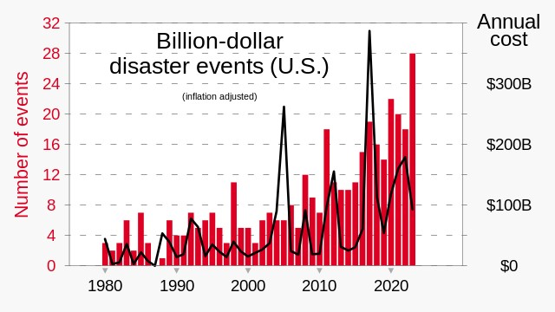

Slide 19
Hot weather in Nigeria 2023 – cooling fruit (Nwonwu Uchechukwu P)

Slide 20
Severe Drought, Iberian Peninsula, June 2023

Slide 21
Forest Fire around Houses

Slide 22
Climate change impacts on new projects
Plan for “worst case scenarios”?
Plan for reasonable minimum protection initially, with ability to increase protection later?
Make new builds more flexible (e.g. modular construction)
Uncertainty of when climate change will occur that needs additional protection – use DCF techniques to examine options

Slide 23
Fukushima 2011

Slide 24
Waste Management in Iran

Slide 25
Interdependence
Knock-on effects, when failure of system A may cause failure of systems B, C, D, etc.
Example: a waste collection system needs unblocked roads, fuel for lorries, a supply of electricity and water, staff at work.
Types of interdependency – physical, geographical, cyber, or all affected by same external event. These “chains of resilience” must be sought out by stress testing etc., so that weaknesses can be addressed.
Mitigation may include holding higher buffer stocks, finding new sources of supply, location changes, joint emergency plans

Slide 26
Information needs
Knowledge of past events and what worked
Knowledge of existing chains of resilience, to identify priorities for recovering different systems if any widespread failure occurs
Knowledge of possible alternative sources of supply
Continuous monitoring of performance and causes
Information flows for users of services, so that they can be personally resilient

Slide 27
Financial resilience
Operators must be able to meet maintenance costs of the structure
There must be enough money to take action to prevent continual degradation of the service
There must be funds to meet major recovery costs if necessary, either from insurance or from the Government

Slide 28
Role of Government
“Think big” about the future and give leads on the kinds of infrastructure which will be needed. Underground? Limited life? Flexible?
Regulate new infrastructure in public and private sectors to accommodate climate change
Provide leadership on water , electricity and food supply systems
Identify chains of resilience, encourage action to reduce weaknesses and encourage collaboration between systems
Get public support for allocating more finance to infrastructure resilience

Slide 29
Role of private investors
Finance resilience improvements for existing assets
Insist that property surveys consider resilience
Ensure that resilience options are fully explored
Ask for any potential flooding problems affecting assets to be rectified by the local authority
Consider chains of resilience for a new investment
Do risk modelling and stress analysis
Ensure there is financial resilience for maintenance
Practice disaster plans every 2 years
Establish a continuous data flow on performance

Slide 30
Knitting the framework together
Climate change
Government
Private companies and investors
Environ-
ment
Plan for resilience
Climate
Financial
Recovery
Perform
ance
Interdep-
endence
Cyber

Slide 31
Conclusion
More needs to be done by all concerned
Climate change uncertainties create new risks with unknown timings
Resilience planning is needed
Exploration of options could use actuarial techniques and advice
Interdependencies need to be better understood
Resilience will cost more but may save money eventually and will make people happier

Slide 33
We focus on Resilience against..
Climate Risk
Cyber Risk
Consequences for human or ecological systems due to physical and natural capital impact
Digital Transformation, Internet of Everything and the development of smart cities
Notes:
Climate results into natural catastrophies, and it is an evident risk for infrastructure assets and a challenge to their resilience.
Cyber risk on the other hand, is more silent and insidious. As the catastrophic effects of cyber-attacks become more evident and frequently, the need for a sound and comprehensive cybersecurity strategy, improving security and resilience, is no longer an after though.

Slide 34
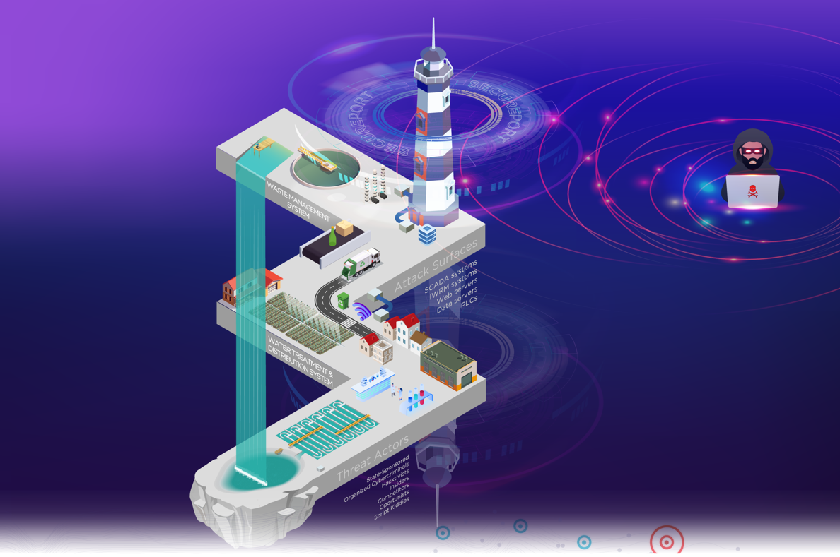
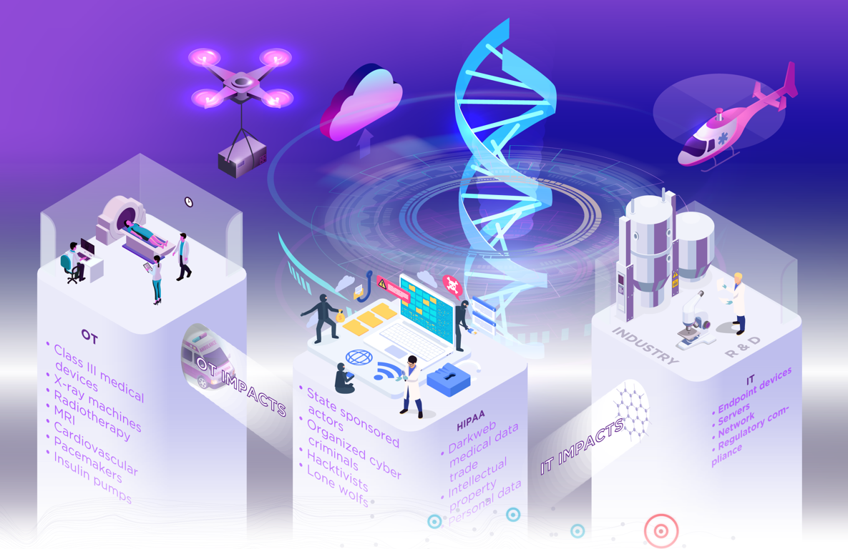
Smart Cities and Security
WATER AND WASTE MANAGEMENT LANDSCAPE
HEALTHCARE THREAT LANDSCAPE
ENERGY AND TRANSPORTATION THREAT LANDSCAPE
Notes:
hold-on…
So, my trash is following a smart waste management process, controlled by a cyber-physical system…!
Cyber-physical systems provide an opportunity to positively improve our quality of life in many domains, ranging from transportation, to healthcare, energy, farming, manufacturing, smart grids, and everyday living. According to studies (Globe Newswire, 2020), the global smart building market is forecast to grow to $127.09 billion by 2027, with a compound annual growth rate of 12.5%. As a result, the dependency on the Internet and the IoT technology will increase, along with the risk of attacks. Industry reports (Unit 42, 2020) state that 57% of the IoT devices are vulnerable to medium or high severity attacks, 72% of healthcare networks mix IoT and Information Technology (IT) assets, allowing malware to spread from individual to vulnerable IoT devices on the same network, and 98% of all IoT device traffic is unencrypted, exposing personal and confidential data on the network to exploitation.

Slide 35
Cyber Risk
Hazards
Tangible: Financial, Operational hazards
Intangible: Reputation
Adaptation pathways
Identifying and assessing risks, implementing controls, network monitoring and detection solutions, response plans, etc.
What is
Any risk that emanates from the use of electronic data and its transmission, including technology tools such as the internet and telecom networks
Impact
Malfunctioning operating assets, infrastructure chaos in smart cities, increased cyber pirates in maritime, etc.
Notes:
Cyber risk is the probability of exposure or loss resulting from a cyber attack or data breach on your organization. Cyber risk can affect the confidentiality, integrity, and availability of your data and systems, as well as your reputation, compliance, and financial stability. And this is what makes it a business risk.
Some of the common sources of cyber risk are:
Malware and ransomware: malicious software that can infect, encrypt, or damage your data and systems
Phishing and social engineering: fraudulent emails or messages that trick users into revealing sensitive information or clicking on malicious links
Third-party vendors: partners or suppliers that have access to your data or systems but may not have adequate security measures
Insider threats: employees or contractors that intentionally or unintentionally compromise your data or systems
Natural disasters and human errors: don’t forget: a digital asset has its physical presence somewhere. And this must be protected
To manage cyber risk effectively, an organization needs to follow a systematic process of Identifying and assessing risks, implementing controls, network monitoring and detection solutions, response plans. Additionally, you need to educate and train your staff on cyber security best practices and conduct regular audits and tests to evaluate your security posture.

Slide 36
Information Technology VS Operational Technology
The critical infrastructure required for data processing.
Monitoring and securing core business functions
Front-end informational activities
IT
Network of devices and software used in manufacturing and industrial systems
Connecting, monitoring, managing industrial operations
Back-end production
OT
Notes:
When it comes to infrastructure projects, the term Information Technology is not sufficient to cover the range of technologies used in order to deliver the end product. Some less famous terms – although not new – will be defined so that we can discuss how to protect those assets and minimize the effects of malicious actions.
IT is the technology backbone of any organization. It's necessary for monitoring, managing, and securing core functions such as email, finance, human resources (HR), and other applications in the data center and cloud. They are usually connected, standardized and replaceable.
OT is for connecting, monitoring, managing, and securing an organization's industrial operations. Businesses engaged in activities such as manufacturing, mining, oil and gas, utilities, and transportation, among many others, rely heavily on OT. OT systems are often isolated, specialized and durable. Robots, industrial control systems (ICS), Supervisory control and data acquisition (SCADA) systems, programmable logic controllers (PLCs), and computer numerical control (CNC) are examples of OT.
The key difference between IT and OT is that IT is centered on an organization's front-end informational activities, while OT is focused on their back-end production (machines).

Slide 37
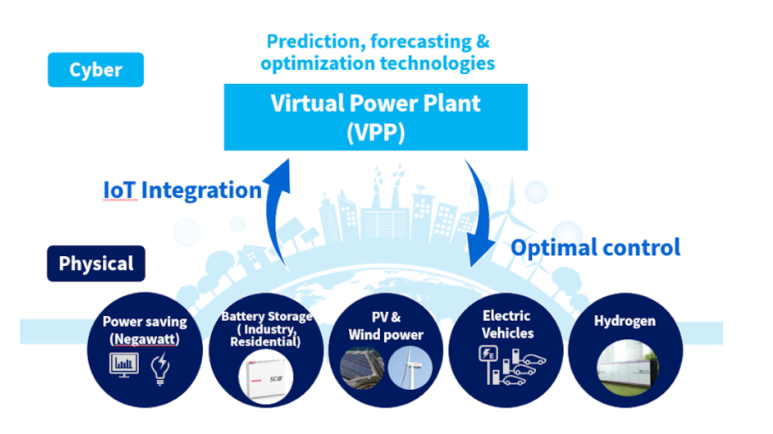
Cyber Physical Systems
Cyber-Physical Systems, or CPS, integrate computational components (information processing) with physical processes, which interact through a network (ISO Definition)
Example: Virtual Power Plants coordinate distributed power sources
solar, wind and hydrogen power generation sites
Electric cars, rechargeable batteries
Operations are coordinated as if they were a single power plant
Source: Toshiba Clip
Notes:
The term “cyber-physical systems” or in short, CPS, was coined more than 15 years ago, but it is now entering the mainstream as digital transformation intensifies, and operational technology (OT) environments become increasingly interconnected with IT systems and Internet of Things (IoT) devices.
In Virtual Power Plants, IoT is used to coordinate distributed power sources, such as solar, wind and hydrogen power generation sites
By utilizing IoT in areas such as power saving, companies are working on creating mechanisms for controlling distributed power sources and equipment on the customer side and optimizing power supply.
Other examples of CPS are found in utilities, where smart grids collect data across regions to derive insights into power consumption patterns and enable predictive maintenance. This allows energy companies to enhance demand response efforts and avoid blackouts. In the automotive and transportation industry, predictive analytics allows automakers to forecast potential machine and vehicle breakdowns to improve maintenance planning and safety. In healthcare, institutions apply AI to analyze massive datasets and improve disease diagnosis as well as deliver personalized treatment recommendations.

Slide 38
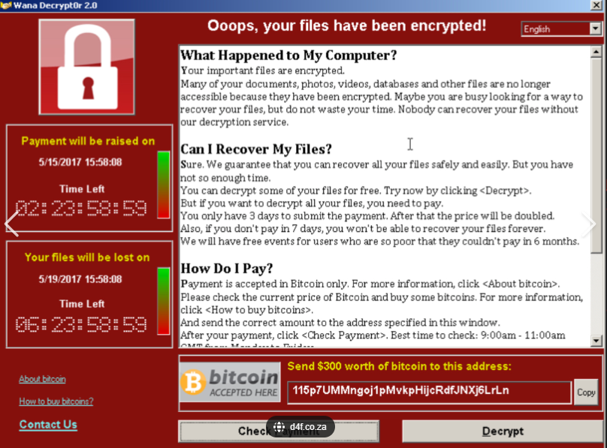
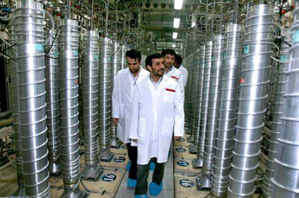
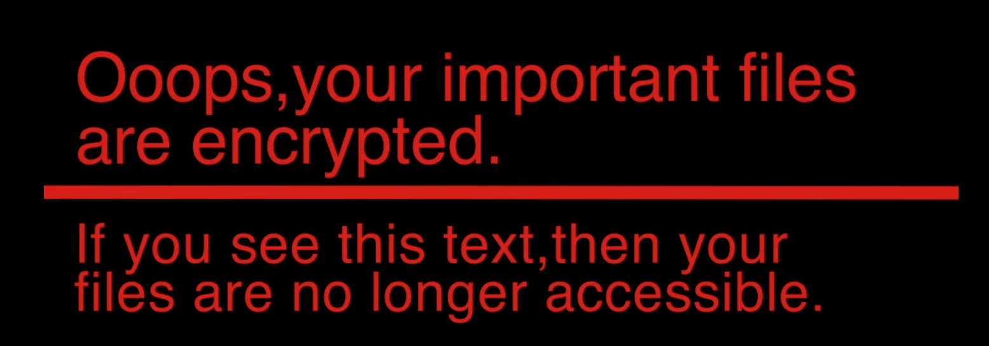
Famous Attacks
British Library
wanacry
stuxnet
notpetya
The most devastating attack in history
The paralysis of NHS
The first true cyber-kinetic weapon
Notes:
A successful attack does not indicate – necessarily - the lack of protective and preventive measures. It is though a discouraging factor for the attackers as it makes them work hard to earn their stolen money.
The cases that we will refer to are examples of attacks that challenged the business continuity, the CIA of the data and the services and that some of those cases were able to continue offering services despite the disruption.

Slide 39
British Library – the “22 carat” disaster
Started in October 2023
Impacted the reading rooms in London and Yorkshire as collection items could not be retrieved – a fundamental services was put on hold
Popular EThOS collection with more than 600,000 doctoral thesis is unavailable
Personal data from employees and researchers were stolen and sold to the dark net
Incidence response plan was in place and allowed business continuity
Visiting fellowship has been suspended for 2024 and 2025
20,000 public authors will have their payments delayed
Estimated cost for the library of GBP 7 million
Ransom: GBP 600,000
Threat actors: Rashida Ransomware Group
Notes:
. According to The Guardian, the British Library suffered a cyber attack that resulted in a data theft
.
The impact of the attack was felt in our Reading Rooms in London and Yorkshire, where collection items could no longer be retrieved,. Essential digital services including our catalogue, our website and our online learning resources went dark, with research services like our popular EThOS collection of more than 600,000 doctoral theses suddenly unavailable.
The library is still in the process of restoring its digital services, and it may take time to fully recover. However, one of the priorities is to restore accessibility to the online library, ceasing the use of paper and pensil for accesing the catalogue
the data stolen was sold onto the dark web. Library officials continue to collaborate with the Metropolitan Police and professional cyber security advisors to investigate the situation, and are receiving additional support from the National Cyber Security Centre (NCSC)
Very positive outline the fact that the library was prepared. An incident response plan was in place and the proof is that in the very week of the cyber-attack they were able to successfully host a five-day fringe event on AI in the Knowledge Centre.
The library has been very open to the collaboration with the authorities in order to bring light to the incident. The communication of the officials is frequent and provides updates to the readers, along with advice, promoting the National Center of Cyber Security for finding information on staying secure online.

Slide 40
WannaCry
Started in May 2017
The ransomware locked all the files in the infected computers and demanded $300-$600 in bitcoin to regain control.
It Surfs the internet looking for vulnerable- unpatched computers. Users don’t even need to download a file or click a link
EternalBlue:
a penetration tool created by the NSA but leaked during a breach of the agency’s secret files in 2017.
Exploits a security loophole in Windows operating systems that allows malicious code to spread through structures set up to share files
NHS hospitals and organization remained unpatched after Wannacry, according to a report by members of the parliament
NHS: 19,000 appointments cancelled costing GBP92 milion
Spread among 150 countries affecting 230,000 computer
Victims: Telefonica, NHS, Renault, Deutsche Bahn, Megafon and Sperbank
Target: vulnerable individual computers
Prevention: updated OS, risk awareness
Notes:
Somewhere in Europe, an unwitting computer user opened an email and an attachment to that email, a compressed zip file, allowing WannaCry into their system. A command in WannaCry’s code told the ransomware the following:, each time you infect a new machine, try to communicate with an obscure web address: a long string of characters seemingly created by someone running their fingers across a keyboard. The domain was inactive, the communication failed, and so WannaCry’s code told it to carry on. Later, this prove to be tha Attack’s Achilles heel, as a researcher activated the domain and it stoped searching.
While it affected information systems more than cyber-physical ones, physical hospital equipment was compromised in some locations, forcing delays or cancellations of medical procedures.
Over 19.000 appointments were cancelled because of the wannacry attack, which cost the NHS an estimated amount of 92mln pounds
How could it be prevented?
awarebess: 6.5 years after the attack, with countless examples and victims, users’ awareness has increased
simply update your OS to the most recent version. Ironically, the necessary patch was available before the attack

Slide 41
NotPetya – The most devastating attack in history
Merck Pharmaceuticals - $870.000.000
FedEx Delivery - $400.000.000
Saint-Gobain Construction – 384.000.000
Maersk shipping - $300.000.000
Snack Mondelez - $188.000.000
Reckitt Benckiser - $129.000.000
Overall, proxy $10bln
Threat Actor: Nation-State
Target: Ukrainian Critical Infrastructure
Prevention: updated OS
Started in Ukraine in June 2017 and spread very quickly
Computers worldwide were infected and irreversibly locked
“Patient Zero”: Ukrainian tax software was infected and quickly spread the malware
Hackers hijacked the servers giving them a hidden back door. The back door was then used to release malware called NotPetya in 2017
It used 2 powerful exploits
EternalBlue: a penetration tool created by the NSA but leaked during a breach of the agency’s secret files in 2017. based on a Microsoft vulnerability
Mimikatz: a research tool developed in France to show that left users’ passwords in computer memory
EternalBlue allowed the malware to run malicious instructions using admin access gained through Mimicatz
The worm spread quickly beyond Ukraine and out to countless machines around the world
Notes:
Started in Ukraine in June 2017, one month after the wanacry ransware. and quickly spread, paralysing major companies and causing more than 10bln in damage. The malware infected computers all around the world.
Computers were irreversibly locked. Restarting only returned them to a black screen
Ukrainian tax software was infected and quickly spread the malware
Hackers hijacked the servers giving them a hidden back door. The back door was then used to release malware called NotPetya in 2017
It used 2 powerful exploits
EternalBlue: a penetration tool created by the NSA but leaked during a breach of the agency’s secret files in 2017. based on a Microsoft vulnerability
Mimikatz: a research tool developed in France to show that left users’ passwords in computer memory
EternalBlue allowed the malware to run malicious instructions using admin access gained through Mimicatz
The worm spread quickly beyond Ukraine and out to countless machines around the world
Although it was much more complicated and robust in the method of attack compared to wannacry, the ability to collect the ransom was exceptionally poor. The threat actors have used only one bitcoin address and the victim needs to communicate through the email as a way of getting the decryption key if they pay. The email was taken offline shortly after the attack began and it would suggest that perhaps there was a different motivation behind the attack, and not gather money

Slide 42
Stuxnet - the first true cyber-kinetic weapon
Discovered in 2010 in an Iranian nuclear facility
Believed to have been conceived in 2005 or 2006
Targeted 3 layers of a cyber-physical system.
cyber layer for malware distribution and target identification
control system layer for physical process control
physical layer for physical damage.
Cost: $Billions in lost revenue, repairs and delays
Threat Actor: Nation-State
Target: Iranian Nuclear Facilities
Prevention: awareness to avoid social engineering, physical security to avoid portable devices to connect to machines
Notes:
Stuxnet is believed to have been conceived jointly by the US and Israel in 2005 and 2006 to cripple Iran’s nuclear program without Iran even realizing that it had been attacked. An early version appears to have been deployed in 2007, but it didn’t reach its target.
There are many scenarios as to how the air-gapped fascility was infected; In conclusion, Stuxnet’s developers were able to upload and command the malware through 2010, even though they did not have a direct connection with it
Stuxnet successfully targeted each of the three layers of a cyber-physical system. 1) It used the cyber layer to distribute the malware and identify its targets. 2) It used the control system layer (in this case, PLCs) to control physical processes. 3) Finally, it affected the physical layer, causing physical damage. Stuxnet thus was 1) a cyberattack 2) that created kinetic impacts 3) that resulted in physical destruction.

Slide 43
How do we protect against such events?
Retain – Acknowledge the risk and accept it, but do not take action unless it occurs
Reduce – actions to reduce the probability of occurrence or impact
Remove – eliminate the threat to avoid the impact of the risk
Transfer – shift the impact of the threat and the response to a third party
Retain
Remove
Response to Risk
Reduce
Transfer
Notes:
So, how can we protect ourselves against such threats? Threat actors, especially when they are state-sponsored have unlimited resources and – almost – unlimited attack surface.
We don’t have to reinvent the wheel. Actuaries, and other risk professionals, know that there are different ways to respond to risk:
Retain
Remove
Reduce
Transfer
As the rest are self explanatory, we will focus on how we can reduce the risk of a successful attack, and therefore improve its resilience.

Slide 44
Cyber Resilience and Security
Cyber resilience refers to the ability of an organization to identify, respond and recover from cyber attacks that disrupt normal business operations. Cyber resilience aims to minimize the impact and damage of cyber incidents and restore the functionality and trust of data and systems
Cyber security refers to the methods and processes of preventing or reducing the risk of cyber attacks, such as malware, phishing, or ransomware. Cyber security aims to protect the confidentiality, integrity, and availability (CIA triad) of data and systems
Complementary concepts orchestrated by a sound cybersecurity strategy
Notes:
Cyber resilience is the ability of an organization to continue delivering intended outcomes despite experiencing challenging cyber events1234. It refers to an organization's ability to identify, respond, and recover swiftly from an IT security incident2. Building cyber resilience includes making a risk-focused plan that assumes the business will at some point face a breach or an attack2. Cyber resilience is essential to IT systems, critical infrastructure, business processes, organizations, societies, and nation-states3.
Cyber security refers to the methods and processes of preventing or reducing the risk of cyber attacks, such as malware, phishing, or ransomware. Cyber security aims to protect the confidentiality, integrity, and availability of data and systems
In other words, cyber security focuses on preventing cyber threats, while cyber resilience focuses on responding and recovering from cyber threats. Both are important and complementary aspects of a comprehensive cyber defense strategy.

Slide 45
Design and Implement – On Paper
Periodic Cycle
Identify The Context
Identify the Risk
Analyse Risks
Assess Likelihood and Impact
Prioritize Risks
Plan and Execute Response Strategies
Monitor, Evaluate and Adjust
Understanding of the risk context and objectives against which risk will be managed
List of Risk
Risk Register with risk events, likelihoods of occurrence and impact levels
A prioritized risk register; key risks are selected for response and reporting
Risk Response Strategies are developed
Risk Tracker – A risk register with current status of response strategies
Risk Assessment
Notes:
To manage cyber risk effectively, you need to follow a systematic process of identifying, assessing, prioritizing, mitigating, and monitoring the potential threats and vulnerabilities that affect your organization. You also need to implement appropriate security controls and policies, such as encryption, backup, firewall, antivirus, and access management. Additionally, you need to educate and train your staff on cyber security best practices and conduct regular audits and tests to evaluate your security posture.
Regulations, standards exist providing principles and models. It is important that each company tailors those models and methods to address the risks that arise from the implementation of the business strategy

Slide 46
Design and Implement – Best Practices
Network segmentation
Multi-Factor Authentication
Back-up system data and configurations
Identify, minimize and secure all network connections to ICS
Disable unnecessary services, ports and protocols
Enable available security features and implement robust configuration management practices
Leverage both application whitelisting and antivirus software
Provide ICS cybersecurity training for all operators and administrators
Maintain and test an incident response plan
Implement a risk-based, defense-in-depth approach to securing ICS hosts and networks
Cross functional teams
Notes:
Segmentation divides a computer network into smaller parts. The purpose is to improve network performance and security. It works by controlling how traffic flows among the parts. The 2015 attack to the Ukrainian power grid, despite the fact that it resulted into blackout, it was very difficult target as forensics showed that their network was well segmented and created difficulties to the attackers
Multifactor authentication - Multi-factor authentication (MFA) is a security method that requires users to provide two or more pieces of evidence to verify their. MFA can reduce the risk of cyber attacks and data breaches by making it harder for hackers to steal or guess passwords.
Zero trust protocol-Zero trust protocol is a security model that assumes no network or user is trustworthy by default, and requires continuous verification of identity and access rights for all data and systems. Zero trust protocol aims to prevent or reduce the impact of cyber attacks by implementing strict security policies and controls, such as multi-factor authentication, encryption, segmentation, and monitoring123.
Training and awareness -

Slide 47
Design and Implement – Design Principles
The following design principles are suggested by the UK National Cyber Security Centre:
Establish content prior to system design
Make compromise difficult
Make disruption difficult
Make compromise detection easier
Reduce impact of compromise
Notes:
The following is an outline of the NCSC design principles:
Establish the context before designing a system: In other words, determine the elements in the system so that defensive measures will have no blind spots.
Build “attack trees” or Cyber Kill Chain models of how systems would need to be attacked
Group systems into zones to better understand the impact of theoretical compromise. The Purdue model is suggested.
Map and understand vulnerabilities at zone boundaries
Agree on network design and documentation
Make compromise difficult: Attackers can only target devices and systems they can reach.
Any data coming from a lower trust zone is potentially dangerous
Enforce a one-way flow of data
Reduce the attack surface
Implement crucial security controls in stages to gain confidence. For example, initially running an IPS in detection mode only.
Make disruption difficult: Design a system that is resilient against denial-of-service attacks and usage spikes.
Make compromise detection easier: Design systems so that suspicious activity is easy to spot
Log collection
Malware detection
Mask detection techniques to hide them from attackers
Keep authorized communications simple to make unauthorized communications easier to detect
Understand all required use cases for access to control systems and decrease attack surface
Reduce impact of compromise: Make lateral movement in a network as difficult as possible.
Remove unnecessary functionality from systems at boundaries
Design, architect, and configure administrative systems, such as Active Directory, to reduce attack surface
Enforce separation of duties
Treat all design documentation as confidential
Plan for a smooth recover

Slide 48
A Hypothetical Hospital case study for adaptive pathway
Proposal - To built a new Hospital at capital cost of £500 million.
Location - The Hospital is situated where severe storms would take place (1 in 100 years)
Additional Cost – £200 million at outset for roof-top and structural cost , £25 million for hospital makeover.
Benefits – An amount of £100 million pa is set towards community well-being provided by the hospital.
Assumptions – Discounted cashflow technique , 4% interest rate, No Inflation
A three Climate scenario analysis is performed under four options.
Scenario a : No Climate change, probability of storm = 1% pa, Repair Cost - £20 million per storm
Scenario b : Climate worsens gradually in 20 years, probability of storm is 1 % pa increasing to 20 % pa by year 20, Repair Cost - £20 million per storm increasing to £ 80m by year 20 and remain same thereafter.
Scenario c : Same as scenario b, Climate worsens further after year 20. A total climate protection is carried with the cost of £255 million (£25 million at the outset and £230 million at year 20)

Slide 49
Benefit Costs Ratio
-A discounted cashflow analysis is conducted under four options.
Results-
Option (1) is the best option in scenario A and B and worst in scenario C.
Option (3) is the best option in Scenario C.
Option (4) is not the best option under any scenarios.
In all options under various scenarios the benefits are worth more than the costs.
Fig: Benefit cost ratio (Benefits/Total Costs)
To know about types of options please see the Appendix of the paper- https://doi.org/10.1080/23789689.2023.2241728
Note – All Figures are shown only for illustration purpose.
 |  | Amount in £ million
Scenarios | Option(1) | Option(2) | Option(3) | Option(4)
A | 4.95 | 4.72 | 3.95 | 3.57
B | 3.86 | 3.72 | 3.64 | 3.57
C | 2.44 | 2.34 | 3.64 | 3.57

Slide 50
Thank you!

