Slide 1
Making Sense of Cyber Risk Panel discussion
IFoA GI Asia/International Working Party
Peter Cashin (Partner, Kennedy’s Law)
Allan Learoyd (SVP, Casualty Underwriting, Peak Re)
Chiew Yee Ng (Actuary, KPMG)

Slide 2
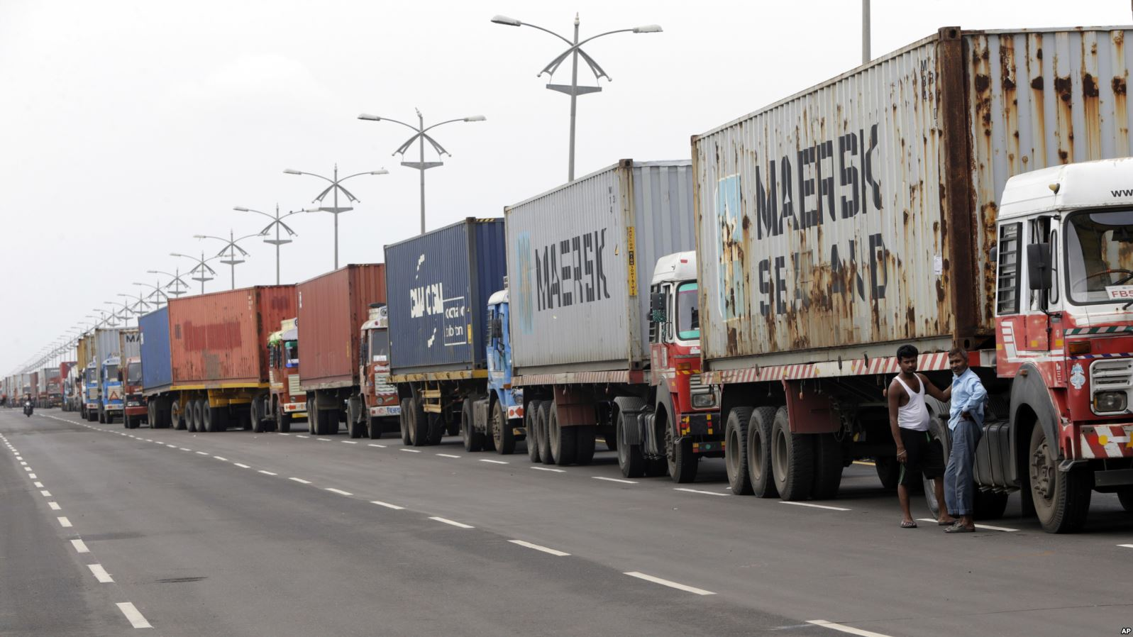
Notes:
Maersk operations disrupted, operations at ports around the world disrupted for days

Slide 3
The first major cyber catastrophe: NotPetya (June 2017)
NotPetya was: A state-sponsored cyber attack on a Ukrainian accounting software firm. Designed to infect users and spread through corporate networks, corrupting equipment and deleting data.
What made this a catastrophic event? NotPetya spread quickly, disrupting multinationals such as Maersk, FedEx and Merck
In various industries
Across geographical borders
Causing insured losses across multiple lines of business
Many companies affected did not have standalone cyber cover.
Merck loss: pharmaceutical giant Merck’s production lines disrupted.
Standalone cyber limits expected to be exhausted. Also may lead to claims on its Property policies, though potential disputes with insurers on coverages noted.
[Placehold’ NotPetya market loss estimate diagram
Pending response from PCS’ (Global Cyber Cat index) on breakdown / insights regarding recently published USD 3bn estimated insured loss from NotPetya incident.
Alternatively to quote FedEx, Maersk and Merck insured losses
Source: PCS, A Verisk Business
“ NotPetya had negatively impacted 3Q results, including an unfavorable revenue impact of approximately $135 million from lost sales and approximately $175 million in costs. This will be repeated in Q4. ”
Merck CFO, 3Q2017 earnings call
Notes:
A catastrophe is: a large event impacting multiple insureds.
Highlight – cyber risks transcend geo
NotPetya, June 2017 - state sponsored attack that ground the operations of shipping firm Maersk in Ukraine to a halt in 60 minutes as every single piece of its IT equipment was infected – forced to reinstall 4000 servers and 45000 PCs, millions of dollars damages. Impact spread far beyond Ukraine.
US pharmaceutical Merck filed a large property claim.
Disrupted users (in Ukraine) -> spread through international networks -> down the value chain / supply chain of these users
Merck loss -> lost sales, inability to meet demand for key HPV vaccine (had to borrow from gov stockpile), remediation costs
Impact on actuaries (reserving (unexpected loss in non-cyber LOB), pricing in this cover, risk management)

Slide 4
‘Silent cyber’ – cyber exposures within traditional P&C
Traditional P&C insurance policies may not implicitly include/exclude cyber perils.
Predominant driver of ‘silent cyber’ losses from the NotPetya event were Property business interruption losses – though some financial lines (E&O, kidnap and ransom) were also triggered.
Challenges: customer demand for clarity of coverage, unknown exposures for insurers, increasing regulatory pressure
“ The insured losses from NotPetya are estimated at USD 3 billion, with ~90% of the loss coming from silent cover.
PCS Global Cyber Industry Loss Index estimate
as at September 2018
“ Until recently, the general (re)insurance market treated cyber as a product.
Increasingly, cyber is viewed as a distinct peril, as risk carriers realise that it cannot be avoided ”
Capsicum Re Cyber white paper, May 2018
In which LOBs are ‘silent’ exposures material, given the exclusions / wordings in place?
What can we do as an industry to address the risks arising from silent cover?
“ NotPetya had negatively impacted 3Q results, including an unfavorable revenue impact of approximately $135 million from lost sales and approximately $175 million in costs. This will be repeated in Q4. ”
Merck CFO, 3Q2017 earnings call
Notes:
Intangible data, but insurance policies designed historically for physical assets, injury but silent cyber exposures in:
Liability lines: D&O, kidnap and ransom
Also property
Marine (hull and cargo)
Motor
Property (note there are usually non-physical damage)
Question: what can/should the industry do re silent cover? [Any legal perspectives / concepts e.g. cause,]
Tightening wording, in a soft market with increasing competition?
Has this been observed (in insurance and reinsurance) – [Allan any thoughts?]
Extensions?
Does this drive demand for standalosne cyber?

Slide 5
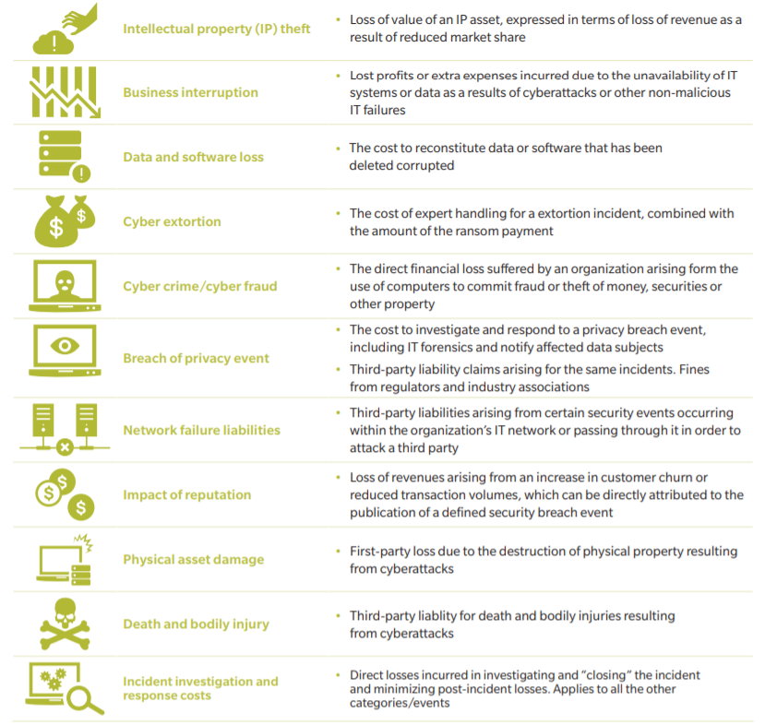
Affirmative Cover: Demand and Supply
Demand: largely from MNCs. Still getting used to the concept of needing to purchase standalone cyber cover.
Supply: Standalone policies and extensions/packages.
Strong growth but divergent products across providers..
Coverage provided for losses to digital assets, for:
First party costs: Data/software recovery, crisis response, notification costs, ransom, cyber crime, business interruption?
Third party costs: liability for data breach, fines
Moving beyond pure insurance to cyber solutions risk prevention, management and cyber incident response
c
Moving beyond ‘basic’ cyber cover…
Source: KPMG, Embracing the cyber insurance opportunity
Why don’t more companies buy cyber cover, especially in Asia? What needs to change?
How do ‘value-add’ offerings such as cyber incident response impact claims experience?
: Recovery costs, crisis response, notification costs, ransom payments, business interruption, IP theft?
Third party costs: Data breach costs, regulatory fines, media liability?
“ NotPetya had negatively impacted 3Q results, including an unfavorable revenue impact of approximately $135 million from lost sales and approximately $175 million in costs. This will be repeated in Q4. ”
Merck CFO, 3Q2017 earnings call
Notes:
The business case to purchase cyber cover is complicated
by the large differences in types of cover available, non-standardized wordings.
The global cyber insurance market is expanding quickly, with annual growth of around 20-25 percent. It is predicted to rise from US$2.5 billion in 2015 to US$7.5 billion by 2020, reaching US$20 billion in premiums by 2025.9,10 This growth is driven by both regulatory changes (especially in Europe, where the GDPR follows the US example of imposing heavy fines on companies that suffer data breaches11), and an increasing awareness of threat types and levels among businesses. However, these estimates account primarily for traditional cyber insurance products, such as data breach, cyber crime and fraud, extortion, data and software loss and network and services liability – in other words, products meant to protect digital assets against losses caused by cyber perils.
Not just cyber attacks – data loss, data breach also covered
Scale up -> lower expense ratios, grow the market (lower rates, larger market, more standardized product?_
Largest risk is reputational risk -> is this covered or insurable?
channels beyond typical intermediaries – partnership w cyber security firms but also banks to lend credibility, scale and

Slide 6
Development of the cyber insurance market
US market (USD 1.8 billion) is 90% of global premiums
Chubb is the biggest writer in 2017
Loss ratio has improved to 32.4% (from 40s)
Despite 2017 events, both claim frequency and severity seem to have reduced
Asia (USD 100+m) : Little traction outside of Japan/Korea
Recent events (though no large insured losses):
Singhealth hack July 2018: 1.5 million records stolen
Taiwan Semiconductor Manufacturing Co (Aug 2018) virus outbreak: ~USD 170m in lost revenue
“ Cyber is three times more expensive than General Liability, and six times more expensive than Property”. Acquisition costs for cyber products are at an estimated 40%”.
2018 London cyber insurance conference panel
Source: Japan External Trade Organisation (2016), Axco
Notes:
In the light of the attack, all of Singapore's Smart Nation plans, including the mandatory contribution to the National Electronic Health Record (NEHR) project - which enables the sharing of patients' treatment and medical data among hospitals here - have been paused.
TSMC, the world’s largest contract chipmaker and one of Apple’s top suppliers, has warned of a $170m hit to revenue and delays to shipments after its factories were struck by a computer virus at the weekend. Taiwan Semiconductor Manufacturing Co, which supplies the core processors for Apple’s iPhones, said parts of its major production facilities in Taiwan were forced offline after the outbreak of a virus on Friday night.
Korea: Cyber liability insurance for financial institutions and most types of data-handling organization is compulsory
Cyber insurance
Cyber insurance is receiving a lot of attention in Korea, partly because the country's financial institutions seem extraordinarily vulnerable to hacking, and partly because of the robustness of the government's legislative counter-measures. These include what is said to be the most stringent data protection regime in Asia and the introduction of statutory and punitive damages for grossly negligent data leakage. Virtually every type of data handling organisation is now required to take out low-limit cyber liability insurance. Demand for fully-featured, voluntary cyber insurance is still low, however.
At present, under the Use and Protection of Credit Information Act, financial institutions in South Korea are required to maintain liability insurance with regard to personal information leakage and the limits are KRW2 billion, KRW1 billion and KRW0.5 billion, depending on the sizes of the institutions.

Slide 7
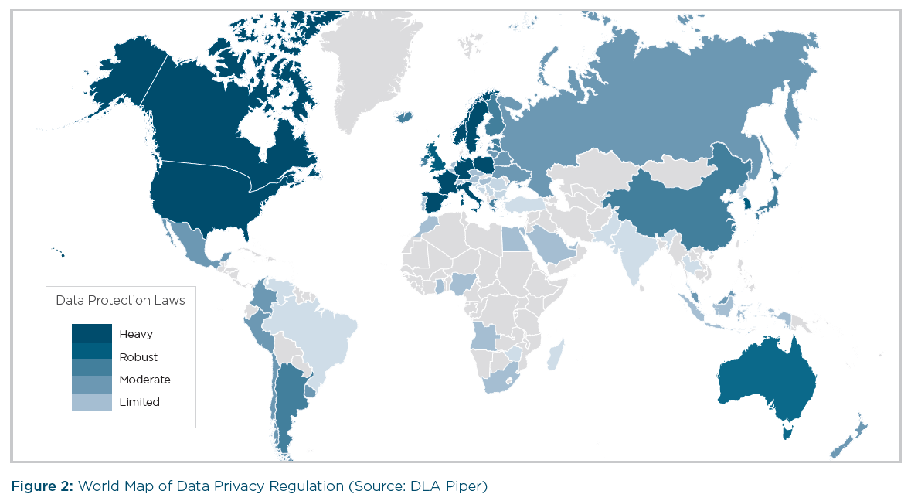
Data protection & cybersecurity regulations on the rise
UK: GDPR expected to drive frequency/severity of cyber claims
Singapore: MAS Cybersecurity Bill, Personal Data Protection Act 2014, currently consulting on legally-binding cyber hygiene requirements for Fis
Hong Kong: Personal Data (Privacy) Ordinance 2016
Korea: compulsory cyber liability insurance introduced in 2016
China: Cybersecurity Law 2017
Malaysia: National Cyber Security Act, Personal Data Protection Act 2010
Australia: Various laws from Australia Privacy Commissioner and APRA
Extracted from RMS Cyber Risk Outlook 20180305
What are the implications of the rise in cyber hygiene regulations / guidelines?
Can/should compliance with regulations be used as a condition of coverage, or rating factor?
Notes:
Singapore currently consulting on cyber hygiene requirements. Simply put, these would take 6 cyber guidelines that are currently within prescribed ERM guidance for financial institutions and make these legally binding
Cyber guidelines in HK from HKMA, SFC, IA (upcoming)
Asia: Segmented levels of regulation that are evolving

Slide 8
Discussion
In which LOBs are ‘silent’ exposures material, given the exclusions / wordings in place?
What can we do as an industry to address the risks arising from silent cover?
Why don’t more companies buy cyber cover, especially in Asia? What needs to change?
How do ‘value-add’ offerings such as cyber incident response impact claims experience?
What are the implications of the rise in cyber hygiene regulations / guidelines, including for insurers and other financial institutions?
Can/should compliance with regulations be used as a condition of coverage, or rating factor?
Discussions with our panelists and practitioners in HK/Greater China including (re)insurance underwriters and cybersecurity experts have informed the thinking in this session. The working party would like to express our sincere appreciation for their contributions. We also thank PCS, a Verisk business for providing insights on the NotPetya loss.
[Working Party members list]
Notes:
Also invite questions from audience

Slide 9
[For Ref only] Q&A Prep
In which LOBs are ‘silent’ exposures material, given the exclusions / wordings in place?
IT exclusions, non-physical damage BI
What can we do as an industry to address the risks arising from silent cover?
Exclusions / clarity of coverage – esp given rising pressure from regulators / rating / stock analysts
Is this doable given soft market conditions?
Would this drive demand for affirmative cover?
Alternatively, reinsure it? (noting recent market developments on silent cyber RI facility)
Is this an insurable risk? [Which] Government as backstop? Compare to terrorism?
Why don’t more companies buy cyber cover, especially in Asia? What needs to change?
Cost and ‘commoditisation’: Scale – grow market size / risk pool, increase efficiencies, reduce exp ratio
Standardisation and wording: make product easier to understand, business case for purchases etc
Wording: typical areas where claims get disputed – e.g. cause of event, reputational damage?
Supply: availability of meaningful limits given recent large losses appear to have breached -> the exchange of more information / insurer involvement in cybersecurity arrangements for higher limits may aid modelling efforts.
Distribution channels: partnerships with cyber security firms? Not via typical agent/ broker channels
What are the implications of the rise in cyber hygiene regulations / guidelines, including for insurers and other financial institutions?
IAIS / various regulators driving pressure, though fairly light touch – more of governance / risk management best practices
Credibility: insurer data breach would be costly as well as impact credibility as a risk transfer solution
Can/should compliance with regulations be used as a condition of coverage, or rating factor?
Some details on particular aspects of regulations
What are the post-loss mitigation / crisis response actions that can be undertaken to manage the loss costs, and how can these be sold modelled?
Besides modelling

Slide 10
[For Ref/Discussion] Cyber risk characteristics
Exposure measure: Turnover, number of employees
Rating factors: industry of insured, country, cyber security infrastructure, human element
Moral hazard / Anti-selection?
Frequency / severity: Both high-frequency, low severity attritional losses as well as low-frequency high severity losses.
Long-tailed / short-tailed? Short reporting delay (from a large attack – though some breaches harder to discover). Settlement delay – case by case.
Claims basis: claims-made or date of loss? Risk-attaching reinsurance
Event definition: no commonly-accepted definition at present
c
Can/should compliance with regulations be used as a condition of coverage, or rating factor?
Notes:
Aka Describe cyber risk to an insurance person

