Slide 1
Data availability in health and care Working Party Update – December 2023

Slide 2
Agenda
Working Party – Who’s Who?
The Brief
Considerations
Proposed Solution
Future Developments
Recommendations

Slide 3
Working Party – Who’s Who?
Andrew Barry (Chair)
Head of Pricing Innovation at Bupa
Expertise in Pricing and Proposition Development. Previous experience in Life roles for Zurich, Axa and Nationwide Building Society.
Wendy Yeap
Head of Risk Pricing at Legal and General
Experience in assumption setting, product development, experience analysis. Previous experience in AIG, Just, Munich Re.
Niall Fennelly
Senior Principal Data Scientist at UnitedHealth Group
Application of Data Science techniques to U.S. Healthcare & Medical data. Previous roles in L&H at Lloyds Banking Group, Irish Life, Aviva.

Slide 4
The Brief
Top tips
Text only opt. A
To format the text, the formatting styles have already been set up. Go to the Home tab and click on the Increase List Level or Decrease List Level buttons to change text levels. This will toggle through headings, body copy and bullet styles.
Identify datasets from across the globe that may be of value to actuaries working in health and care. This will include datasets that are e.g.:
Publicly available (either with or without fee)
Provided by private companies where a contract may be needed and use may be restricted
Available in certain circumstances only e.g. by partnership with non-commercial entities
Are they hiding behind an image or object? Have you changed the Security classification using the Footer functionality? Are they the same across all of your slides?
DD MM YYYY
4
Check your footers

Slide 5
Considerations
Intended Purpose
What would actuaries be interested in?
How to have relevant data sets?
Every user may have a different requirement from a data set
Academia or industry?
How do we advertise it?
Is it for research within IFoA or should it become external?
Accuracy / Credibility
How can we trust the data?
How can you be certain to have latest data?
May want different time periods or information from someone else
Ongoing management of Data Sets
Where to make people aware
Any legal considerations of naming particular companies
Are they hiding behind an image or object? Have you changed the Security classification using the Footer functionality? Are they the same across all of your slides?
DD MM YYYY
5
Check your footers

Slide 6
Dataset Inclusion Criteria
There have been huge increases in the availability of alternative Life & Health data sources in recent years.
Also rapid advancements in tools used to aggregate and analyse this data.
The main criteria for inclusion of data sources in this list was that they may be of interest to IFOA members when considering how to augment traditional actuarial L&H processes
Aim was to:
Include datasets suitable for exploratory analysis of a particular disease area
Sign post to relevant resources that show the breadth of datasets available.
Majority come from the UK & United States as this is where WP members have most experience

Slide 7
Proposed Solution
Top tips
Text only opt. A
To format the text, the formatting styles have already been set up. Go to the Home tab and click on the Increase List Level or Decrease List Level buttons to change text levels. This will toggle through headings, body copy and bullet styles.
Focused on: Creating a catalogue of health & care data sources Audience: Only IFoA members Initial Focus: UK data sources For each data source identify key information, creating a simple sign-post system for actuaries to use as a starter for data sources.
Are they hiding behind an image or object? Have you changed the Security classification using the Footer functionality? Are they the same across all of your slides?
DD MM YYYY
7
Check your footers

Slide 8
Proposed Solution – Benefits
Top tips
Text only opt. A
To format the text, the formatting styles have already been set up. Go to the Home tab and click on the Increase List Level or Decrease List Level buttons to change text levels. This will toggle through headings, body copy and bullet styles.
Established and trusted, initial catalogue of data sources for the IFoA community
Increases awareness of potential data sources that are available
new data accessible for actuaries, thereby improving knowledge, enhancing risk assessments and ultimately leading to enriched decision making
Community discussions and collaborations on particular data sources for future work
Are they hiding behind an image or object? Have you changed the Security classification using the Footer functionality? Are they the same across all of your slides?
DD MM YYYY
8
Check your footers

Slide 9
Proposed Solution – Limitations
Top tips
Text only opt. A
To format the text, the formatting styles have already been set up. Go to the Home tab and click on the Increase List Level or Decrease List Level buttons to change text levels. This will toggle through headings, body copy and bullet styles.
The catalogue is for information only, users proceed at their own risk. No responsibility is taken by either the working party, Health & Care Board or IFoA to the accuracy of either the catalogue, or underlying data provided
There maybe limitations as to who can access and/or the indented use of the data, e.g. academics only, not allowed for commercial gain etc
Any costs to access data are incurred by the user
The catalogue is not indented to be an exhausted list, future iterations will include new or remove sources
The catalogue is primarily UK based
No ‘approval’ or ‘agreements’ have been attempted with the sources of the data sets mentioned on the table to be displayed.
Are they hiding behind an image or object? Have you changed the Security classification using the Footer functionality? Are they the same across all of your slides?
DD MM YYYY
9
Check your footers

Slide 10
Working Party Member Disclaimer
Working Party member Niall Fennelly works for UnitedHealth Care, part of the UnitedHealth Group (UHG).
The catalogue contains information on Optum® Clinformatics® Data Mart (CDM). The Optum CDM is owned and maintained by Optum, which is part of UHG.
The catalogue also contains information on the Clinical Practice Research Datalink (CRPD). CRPD collects data from EMIS software systems. UHG is currently in the process of a proposed acquisition of EMIS Group Plc which supplies EMIS software systems.

Slide 11
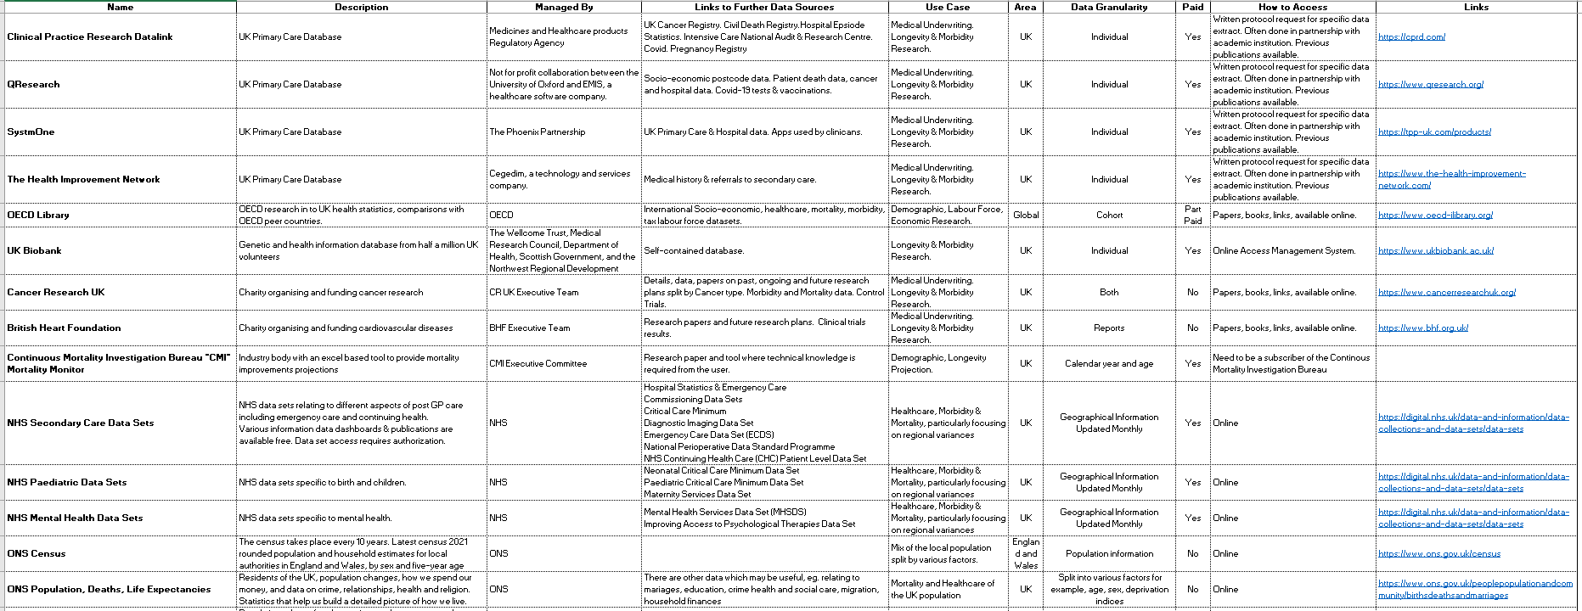
Data Source Catalogue (Page 1 of 2)
Top tips
Text only opt. A
To format the text, the formatting styles have already been set up. Go to the Home tab and click on the Increase List Level or Decrease List Level buttons to change text levels. This will toggle through headings, body copy and bullet styles.
Are they hiding behind an image or object? Have you changed the Security classification using the Footer functionality? Are they the same across all of your slides?
DD MM YYYY
11
Check your footers

Slide 12
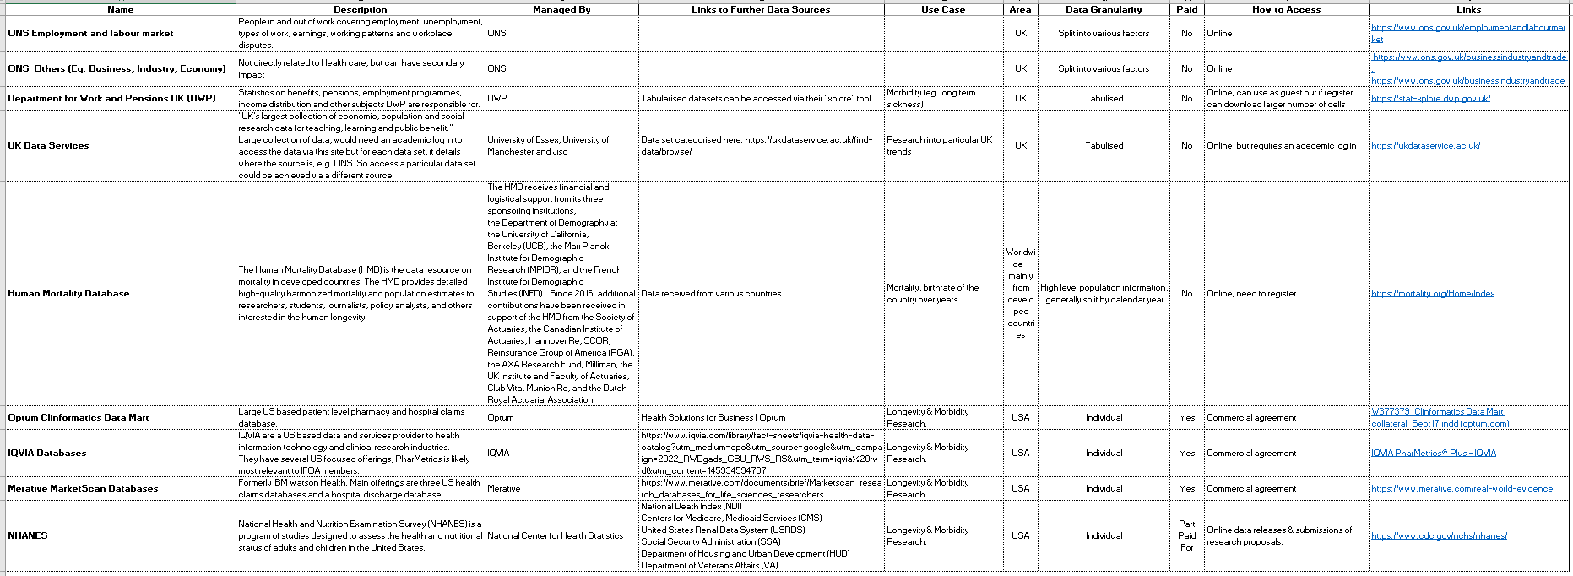
Data Source Catalogue (Page 2 of 2)
Top tips
Text only opt. A
To format the text, the formatting styles have already been set up. Go to the Home tab and click on the Increase List Level or Decrease List Level buttons to change text levels. This will toggle through headings, body copy and bullet styles.
Are they hiding behind an image or object? Have you changed the Security classification using the Footer functionality? Are they the same across all of your slides?
DD MM YYYY
12
Check your footers

Slide 13
Future Developments
Top tips
Text only opt. A
To format the text, the formatting styles have already been set up. Go to the Home tab and click on the Increase List Level or Decrease List Level buttons to change text levels. This will toggle through headings, body copy and bullet styles.
More data sources A structure around monitoring and updating list Consideration of referencing companies, is this ok or do we need their permission?
Are they hiding behind an image or object? Have you changed the Security classification using the Footer functionality? Are they the same across all of your slides?
DD MM YYYY
13
Check your footers

Slide 14
Recommendations:
Top tips
Text only opt. A
To format the text, the formatting styles have already been set up. Go to the Home tab and click on the Increase List Level or Decrease List Level buttons to change text levels. This will toggle through headings, body copy and bullet styles.
To host Data Source Catalogue on IFoA website for IFoA members only
Becomes responsibility of the H&C Board to potentially delegate authority for management of list
Working Party carries on with members to monitor and update catalogue
Working Party produce a short presentation as part of a conference to display work and generate interest in using catalogue
Are they hiding behind an image or object? Have you changed the Security classification using the Footer functionality? Are they the same across all of your slides?
DD MM YYYY
14
Check your footers

Slide 15
Thank you

