Slide 1
IFoA Thought Leadership Series: Artificial Intelligence Keynote Session – Felicity Burch 11 March 2024

Slide 2
Chair
Speaker
Kalpana Shah
President of the Institute and Faculty of Actuaries
Felicity Burch
Executive Director of the Responsible Technology Adoption Unit (RTA)

Slide 3
Felicity Burch, Executive Director
Responsible Technology Adoption Unit
Tools for Trustworthy AI:
Implementing the UK's AI Governance Strategy

Slide 4
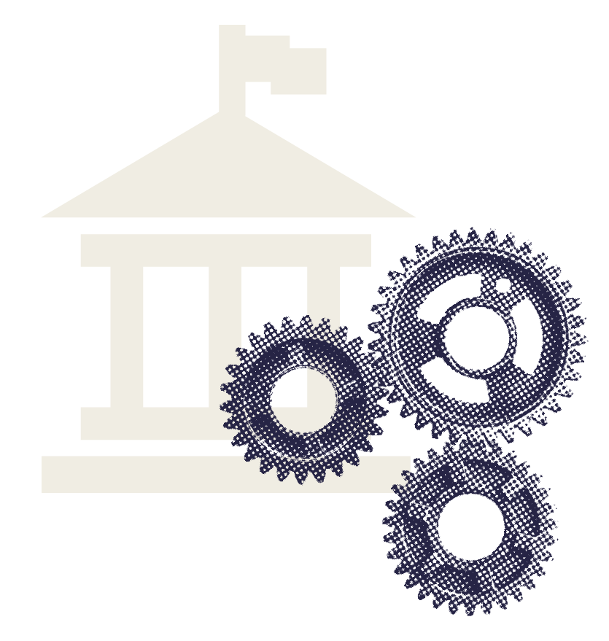
About the RTA
The Responsible Technology Adoption Unit (RTA) leads the government’s work to enable trustworthy innovation using data and AI.
RTA is a directorate in the Department for Science, Innovation and Technology.
RTA works with partners across the public sector, industry and academia, in the UK and internationally, to identify and tackle barriers to responsible innovation.
Notes:
The CDEI is a government expert body enabling the trustworthy use of data and AI.
multidisciplinary team of specialists
supported by an advisory board of world-leading experts
AI assurance - CDEI has developed a roadmap which sets out how the UK can become a global leader in the emerging AI assurance industry

Slide 5
What is AI governance
What is AI governance?
AI governance refers to mechanisms including laws, regulations, policies, institutions, and norms that set out processes for making decisions about AI.
The goal of AI governance is to maximise the benefits of AI systems, while mitigating potential risks and harms.

Slide 6
UK APPROACH
Key elements of our pro-innovation framework
Cross-sectoral principles
Our framework will be underpinned by a set of cross-sectoral principles including concepts such as transparency, safety and security, to guide how actors in the AI ecosystem approach responsible AI and AI risk
Leveraging existing regulator expertise
We will leverage the sector expertise of our world-class regulators, focusing on outcomes rather than the technology itself. We balance the economic and societal potential benefits of AI against its risks.
Context-specific
We acknowledge that AI is a dynamic, general-purpose technology and that the risks arising from it depend principally on the context of its application. The same AI used in different context may need regulating differently
Central functions to drive coherence
To ensure that the overall framework offers a proportionate, coherent and effective response to risk while promoting innovation across the regulatory landscape

Slide 7
The proposed cross-cutting principles
Existing regulators will be expected to implement the framework underpinned by 5 values-focused cross-sectoral principles, based on OECD AI Principles
Safety, Security & Robustness | Ai systems should function in a robust , secure and safe way throughout the AI life cycle, and risks should be continually identified, assessed and managed.
Appropriate Transparency & Explainability | AI systems should be appropriately transparent and explainable
Fairness | AI systems should not undermine the legal rights of individuals or organisations, discriminate unfairly against individuals or create unfair market outcomes. Actors involved in all stages of the AI life cycle should consider definitions of fairness that are appropriate to a system’s use, outcomes and the applicant of relevant law
Accountability & Governance | Governance measures should be in place to ensure effective oversight of the supply and use of AI systems, with clear lines of accountability established across the AI life cycle. AI life cycle actors should take steps to consider, incorporate and adhere to the principles and introduce measures necessary for the effective implementation of the principles at all stages of the AI life cycle.
Contestability & Redress | Where appropriate, users, impacted third parties and actors in the AI life cycle should be able to contest an AI decision or outcome that is harmful or creates material risk of harm.

Slide 8
UK APPROACH
Tools for trustworthy AI
What is AI governance?
Tools for trustworthy AI will play a critical role in enabling the responsible adoption of AI by supporting the implementation of regulatory framework and boosting international interoperability.
These tools include:
Assurance Mechanisms
SDO-developed standards

Slide 9
Assurance techniques
What is AI governance?
The goal of assurance techniques, is to measure, evaluate and communicate whether AI systems are trustworthy.
There are a range of different techniques for assuring AI systems, that can be used in combination with one another across the AI lifecycle.

Slide 10
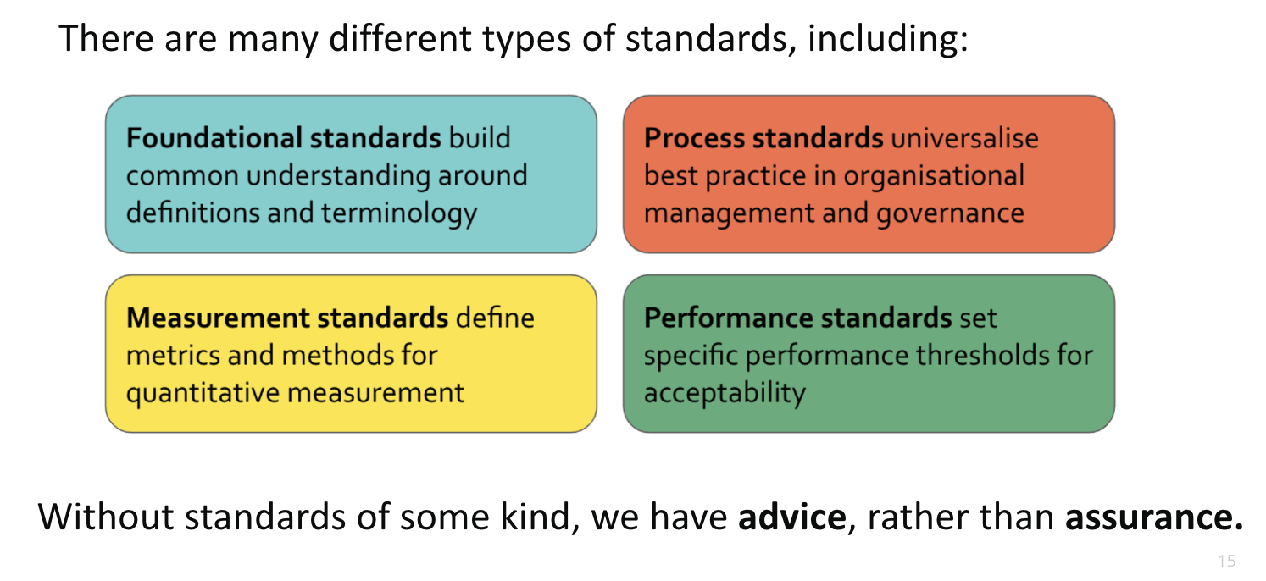
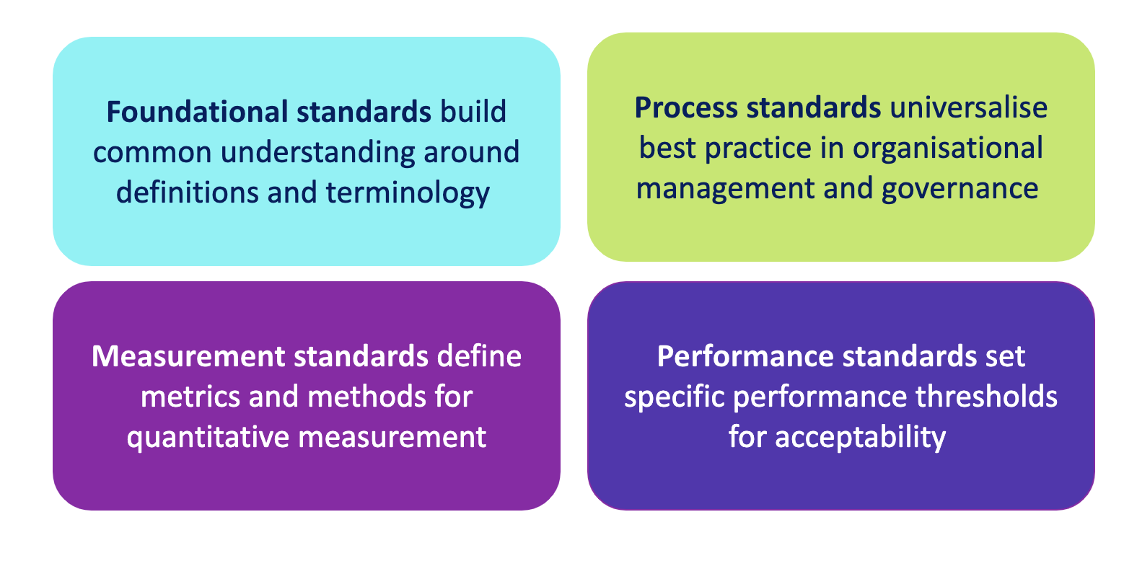
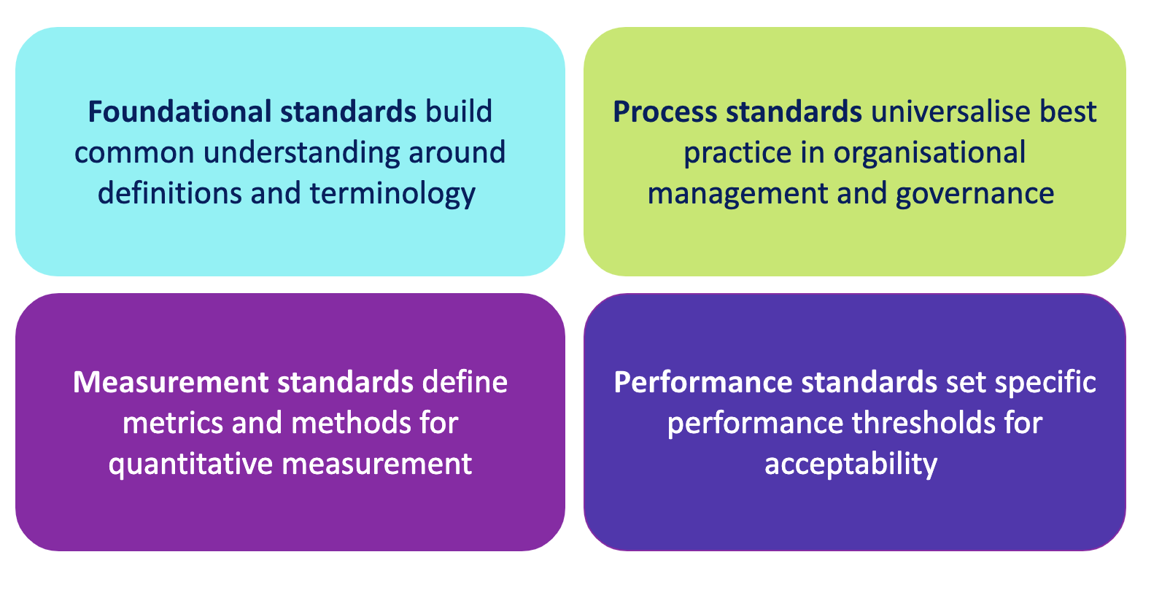
UK APPROACH
Technical standards

Slide 11
Fairness Innovation Challenge
Objectives:
The Fairness Innovation Challenge aims to drive the development of novel solutions to address bias and discrimination in AI systems. ​
The challenge will:
Encourage the development of socio-technical solutions
Test how strategies to address bias and discrimination comply with data protection and equalities law
Provide greater clarity around context-specificity; what interventions or assurance techniques should be used and why?

Slide 12
Thank you
For more information please contact rtau@dsit.gov.uk

Slide 13
Questions
Comments
Expressions of individual views by members of the Institute and Faculty of Actuaries and its staff are encouraged.
The views expressed in this presentation are those of the panellists.

