Slide 2
Managing Inflation Uncertainty Cian Creedon (Chair) Richard Stock Marcus Schofield Shane Lenney Erin Bargate

Slide 3
Introduction

Slide 4
Agenda
Introduction to the Inflation Working Party
2023 Inflation Survey
Study of inflation estimation methods
Data used in estimation research
Inflation estimation scenarios
Individual and aggregate claims methods
Evaluation of methods
Ancillary considerations
Summary and next steps

Slide 5
Introduction to The Working Party
To comprehensively explore and produce pragmatic guidance on the challenges posed by claims’ inflation, across all areas of actuarial involvement in general insurance

Slide 6
Forecasts of UK & US CPI Inflation

Slide 7
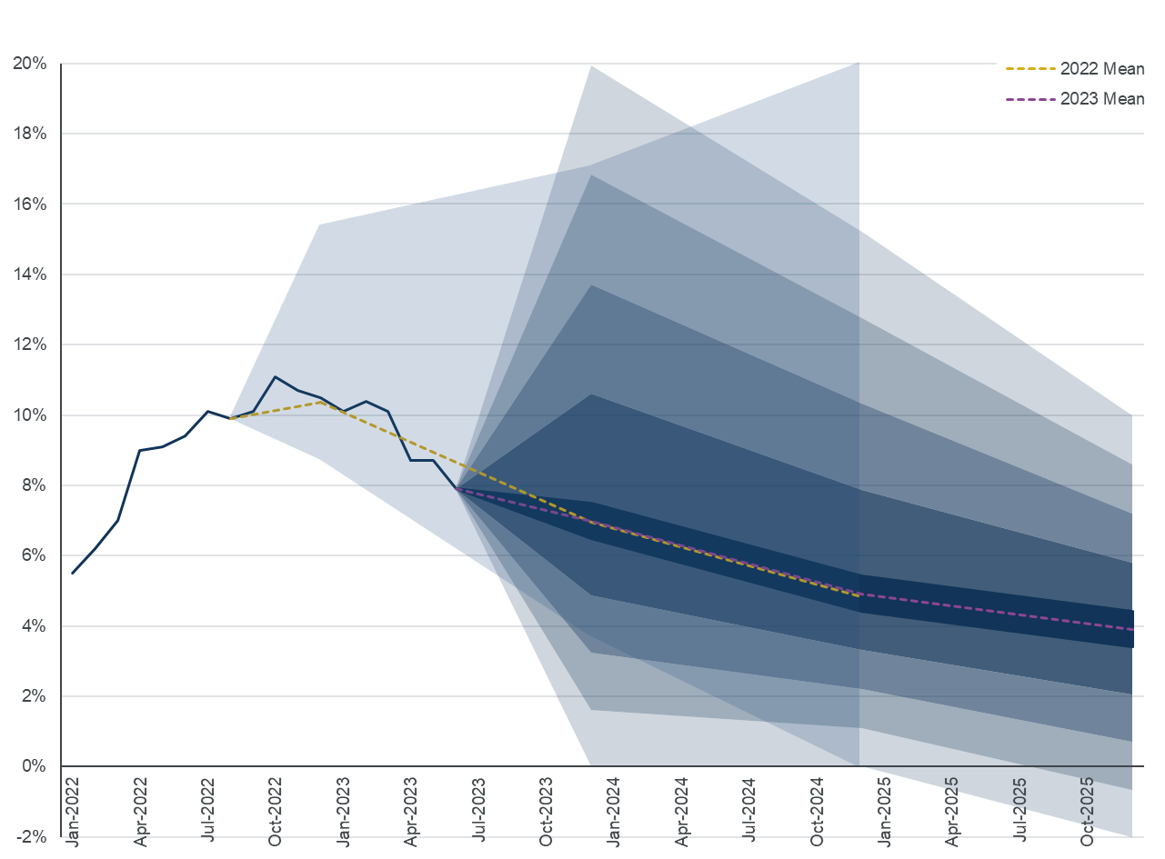
UK CPI inflation forecast – 2022 and 2023 surveys
Outturn since 2022 survey quite close to central view
Much greater apparent uncertainty for upcoming year-end vs 2022 equivalent
Central estimates very close to last year’s …
… reassuring consistency given inflation has followed central expectations
Source: Inflation and price indices - Office for National Statistics (ons.gov.uk)

Slide 8
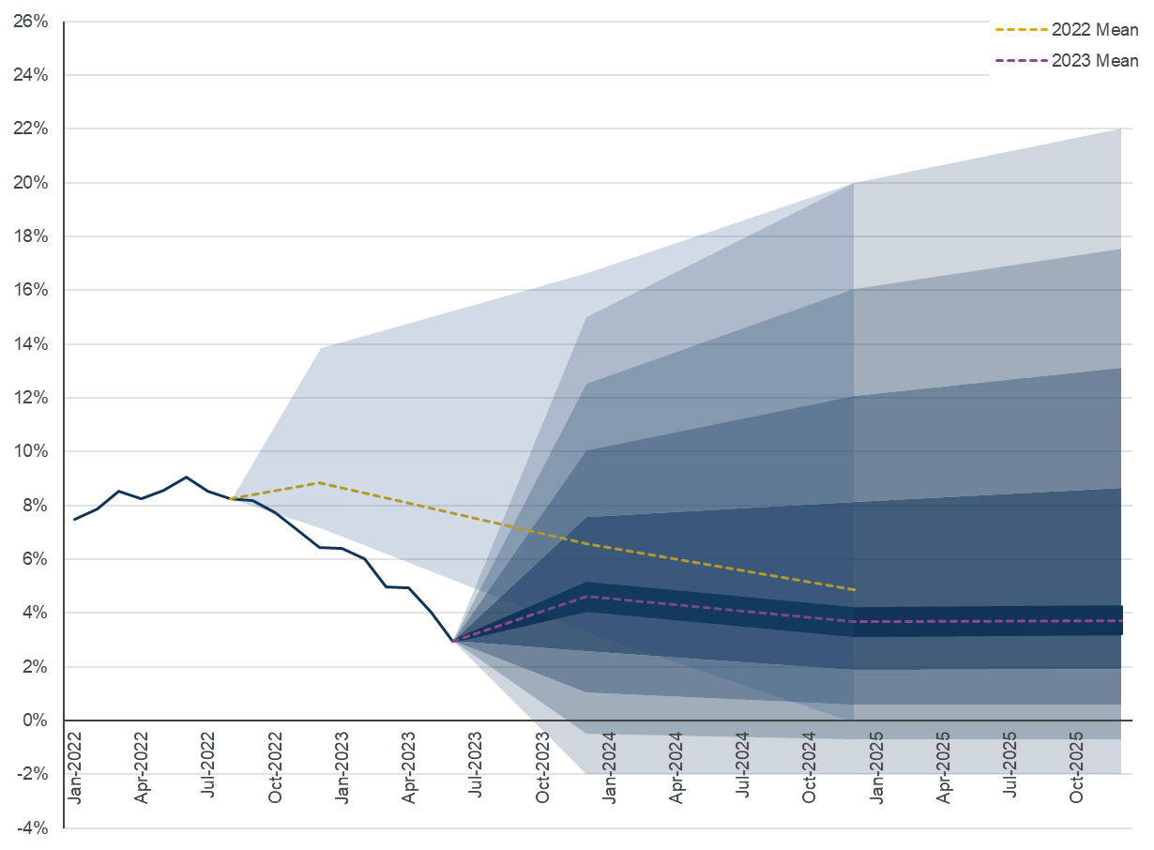
US CPI inflation forecast – 2022 and 2023 surveys
US CPI has trended much lower than expected over past year
Even lower than the lowest predictions!!
Quite a small range of estimates last year
Does this reflect much lower understanding of US economy
Wider range of estimates this year at short end vs 2022
Similar range of estimates at long end vs 2022
Source: CPI Home : U.S. Bureau of Labor Statistics (bls.gov)

Slide 9
Background questions on CPI and interest rates in the UK

Slide 10
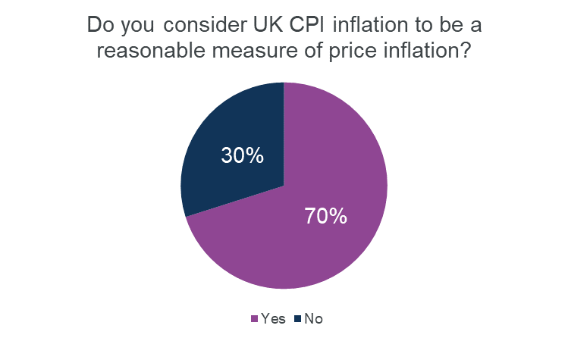
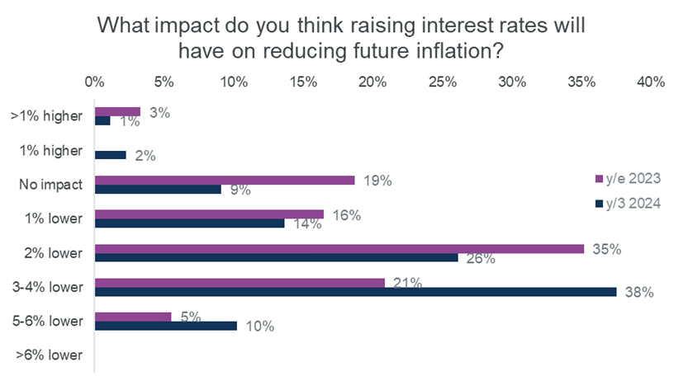
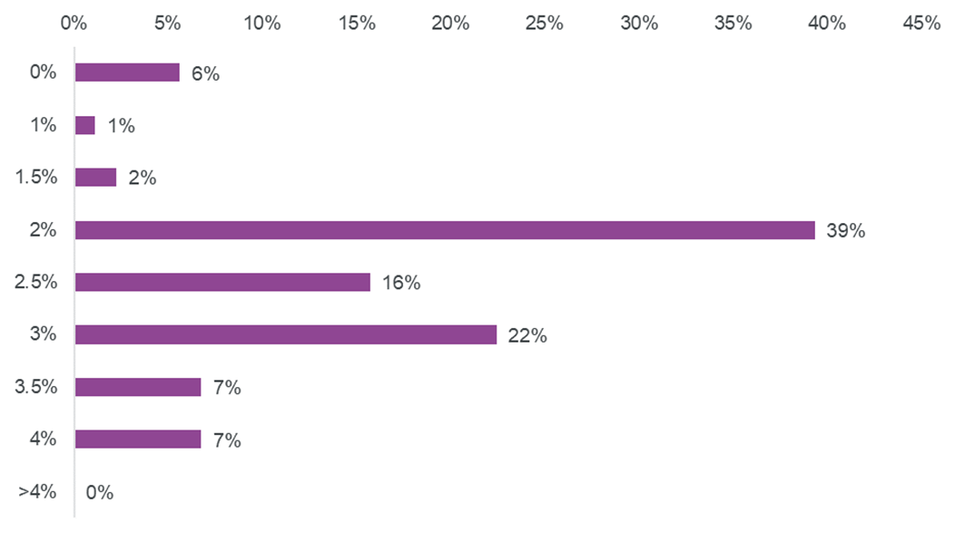
CPI and interest rates in the UK
What should the Bank inflation rate target be?
CPI generally considered reasonable and most reliable guide to general UK price inflation
Most respondents believe raising interest rates will reduce future inflation, but not significantly in the short term
More respondents think the Bank inflation rate target should be higher than lower

Slide 11
Exhibits on inflation uncertainty

Slide 12
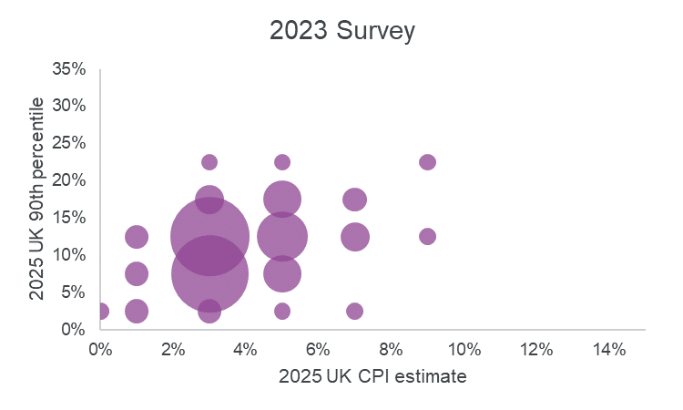
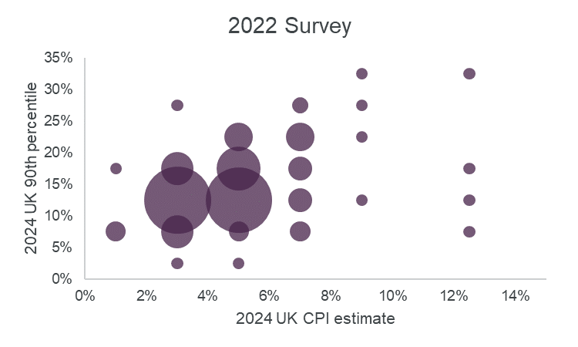
Short-term UK CPI 90th Percentile
Charts show short-term inflation expectations vs 90th %ile (looking 18 months ahead)
Larger bubble = More respondents
More bunching towards bottom-left in 2023 survey indicates lower expected inflation paired with sentiment of lower uncertainty

Slide 13
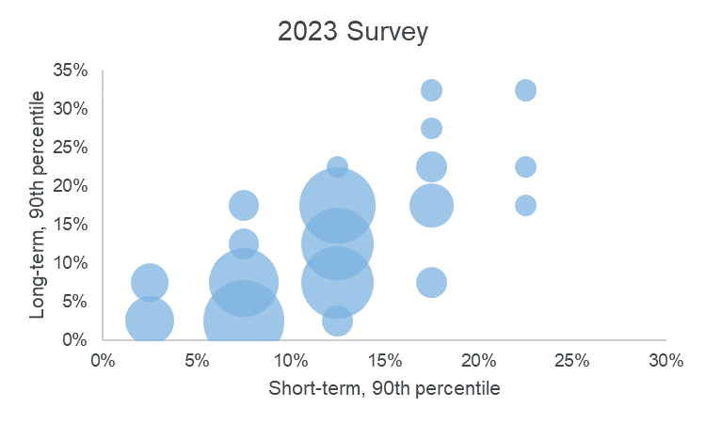
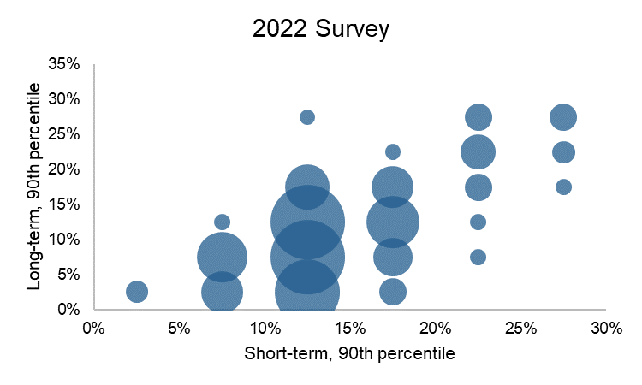
Short-term vs Long-term UK CPI 90th Percentile
Charts show views of long-term inflation uncertainty (vertical axis) vs short-term equivalent
Last year, short-term considered more uncertain than long-term
This year, if anything, it’s slightly the reverse

Slide 14
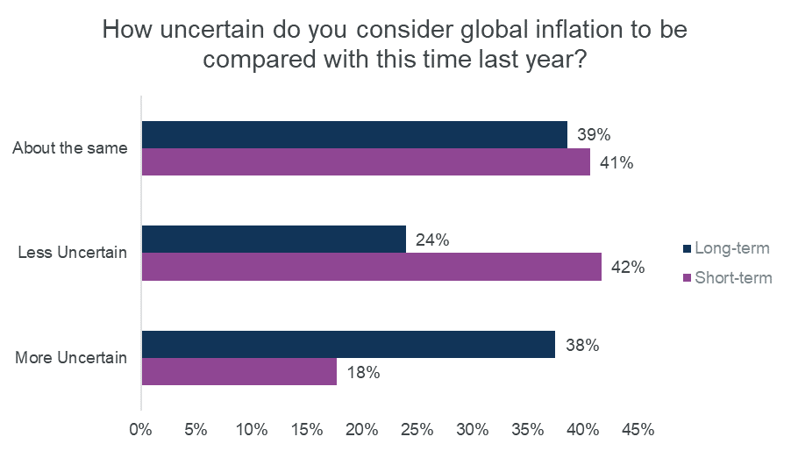
Views on inflation uncertainty vs last year
Views on Short-term inflation uncertainty are consistent with the previous charts
Less perceived uncertainty
Views on long-term inflation uncertainty appear to have risen
Surprising to see majority of respondents expecting long-term uncertainty to be different
What new info does anyone really have about the long-term to make it more or less uncertain?

Slide 15
Class of business inflation estimates

Slide 16
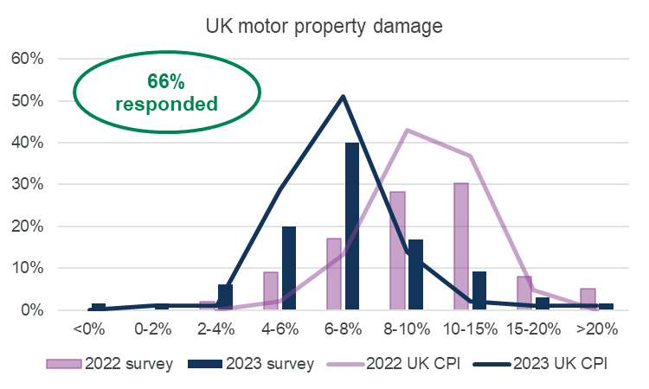
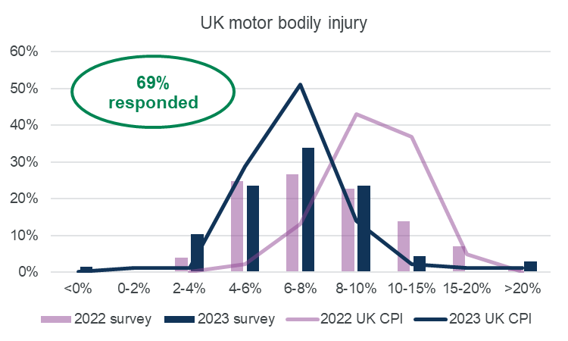
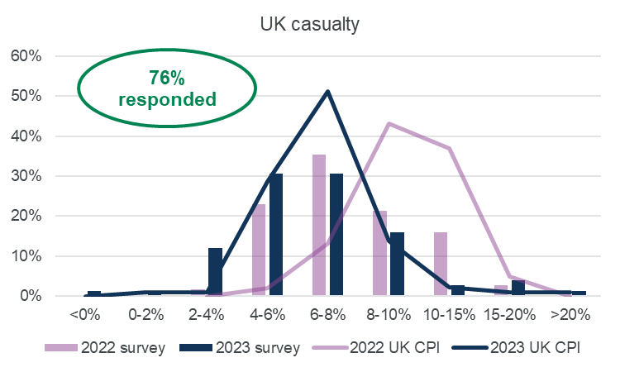
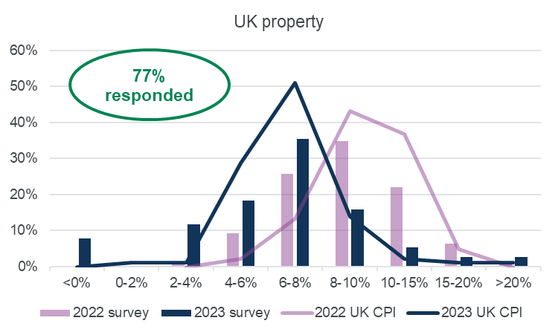
Comparisons of UK Business Line Inflation Estimates
Bars show Ins Class inflation estimates for 2023 year-end
Lines show CPI inflation estimates for 2023 year-end
Purple = 2022 survey Dark Blue = 2023 survey
Motor PD: lower vs 2022 & similar to CPI
Motor BI: Below CPI last year vs in line this year
UK Cas: Similar to last year but also less skewed
UK Prop: Similar to Motor PD
Notes:
Motor PD
Moved down substantially over 2022 view
Arguably in-line with CPI both years
Displaying more Gaussian distribution vis-a-vs 2022
Motor BI:
Model estimate largely unchanged year-on-year (evidence for non-property inflation decoupling from CPI)
Tighter spread compared with 2022
Below CPI last year, in-line this year
UK Cas
Model estimate perhaps very slightly below CPI or exactly in-line, perhaps
Similar pattern observed here to Motor BI
UK Property
Now largely in-line with UK Motor PD whereas last year we could observe the “parts’ shortage” effect in Motor PD
Note that some respondents believe inflation to be negative

Slide 17
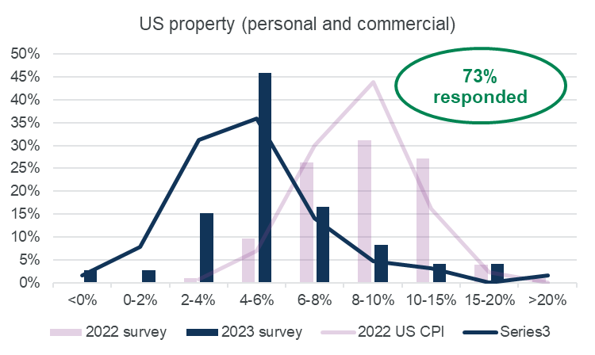
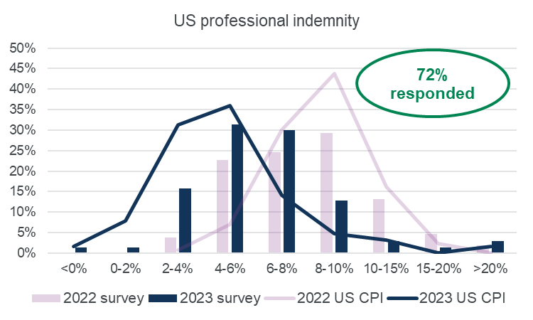
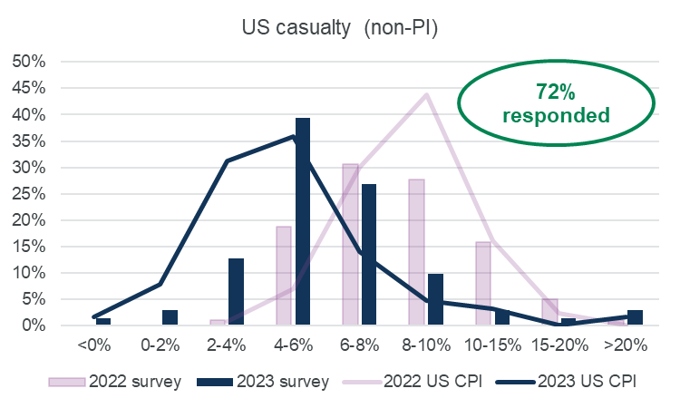
Comparisons of US Business Line Inflation Estimates
Modal estimate appears to be the same on all lines of business
US Prop: Above CPI and substantially lower inflation + uncertainty vs 2022, with more of a right tail compared to UK Prop
US PI: Largely unchanged, and more in-line with CPI this year
US Non-PI Cas: Much tighter spread than US PI though similar other observations
Notes:
US prop
Very clear difference with 2022, with substantially lower inflation and lower uncertainty (clear modal estimate)
Above CPI with this LoB, unlike UK equivalent
More of a right tail than evident in UK
Some proponents of negative inflation here too
US PI
Largely unchanged over 2022, though somewhat lower
More in-line with CPI than 2022
US non-PI Cas
Much tighter spread than PI, though with similar other observations

Slide 18
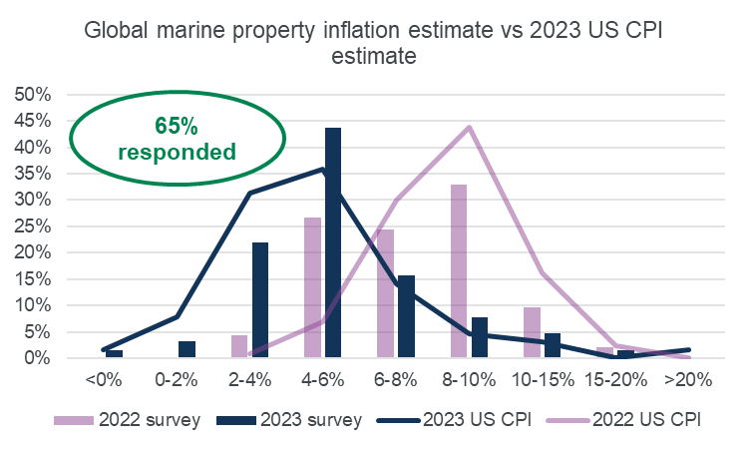
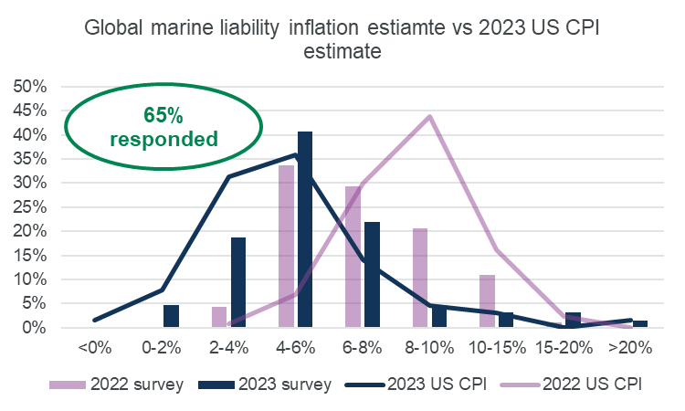
Comparisons of Global Marine Inflation Estimates
Marine is trickier to assess, due to wide variety of exposures and geographies, as well as myriad of drivers and claims’ costs
Marine property in line with 2023 CPI
Views on Marine Liability similar to other types of liability, with a tighter spread vs 2022 although modal estimates largely unchanged

Slide 19
Study of Inflation Estimation Methods

Slide 20
Data, Methods and Scenarios

Slide 21
Estimation Data
Stochastic claims’ generation via VBA
10 years per simulation with mean 50 claims per year
10 simulations run – each represents an individual insurer’s data
Pareto severity with fixed seed for reproducability
Development pattern applied to create triangles
User specified economic, social and shock inflation applied to incremental development

Slide 22
Scenarios
Scenario A
Constant, stable inflation
Scenario B
Emerging social inflation
Scenario C
Sudden shock inflation
Scenario B with additional shock of 6% in year 9 and 4% in year 10
Scenarios D1 and D2
Scenario E
4% for all years
Total = 4% in years 1-5, 6% in years 6-10
Total = 4% in years 1-4, 6% in years 5-8, 12% in year 9, 10% in year 10
Non-inflationary frequency trends
Starting point same as Scenario C
D1 = 5% decreasing mean frequency
D2 = 5% increasing mean frequency
Not revealed to analysts
Constant economic inflation of 5.5%
Social inflation of 1% in years 1-4, 2% in years 5-8, 3% in years 9 and 10
First inflation shock at 3% in year 1, 4% in year 2 and 2% in year 3
Secondary inflation shock of 2% in year 9 and 8% in year 10
Scenario A with social inflation of 2% in years 6-10

Slide 23
Individual vs Aggregate Claims Methods
Individual
Large severity trend
Large frequency trend
Aggregate
Inflation adjusted chain ladder (IACL)
Separation method
Trend in burning cost to a theoretical layer
Calendar year development ratio (CYDR) 12-60 method

Slide 24
Evaluation of Methods

Slide 25
Scenario A
All methods perform reasonably well, although frequency trend an outlier in over-estimating.

Slide 26
Scenario B

Slide 27
Scenario C
Frequency trend found to be most responsive with regards changing inflation in period.

Slide 28
Scenario D1
Aggregate and frequency methods were poor at distinguishing frequency trend from claim cost (severity) inflation.

Slide 29
Scenario D2
Reasonably consistent performance across all methods and more robust at dealing with rising vs. falling frequency.
Frequency trend method best performer.

Slide 30
Scenario E
Broad range to be expected, given varying, unknown parameters.
BC overcompensates for decreasing inflation.
Severity trend, perhaps unsurprisingly, most adept at picking out long-run claim cost trend.
Notes:
Both aggregate methods were unreliable. This is because the frequency trend was reducing and the user couldn’t gather this information from a triangle. Hence if you don’t know your frequency trend then looking at aggregate claims is not going to be a reliable way to estimate inflation. Therefore, for this exercise, the IACL and Separation method did not work well.
Frequency trend highlighted negative inflation as expected given frequency of claims was reducing by 90% p.a. This was not a good measure of actual inflation.
BC method better than the aggregate methods, but still not ideal as it is understating the true inflation for the early years and then it is completely out of line from 2019 onwards.
Best performing is the large severity trend, even though overall it is still generally understanding the true inflation and it doesn’t capture any upswings/downswings given it’s a flat average.

Slide 31
Closing Comments

Slide 32
Closing Remarks
“Unfortunately, claims inflation is notoriously difficult to measure with any degree of certainty”
Various methods require considerable care and judgement
Large dataset required to separate the effects of inflation from random variability or process error
Generally, individual claims methods performed better than aggregate claims methods but may be time-consuming
BC method impactful, but of dubious use, given gearing considerations
Settlement vs. origin year inflation challenges

Slide 33
Next Areas of Research
Using indices
What would you like to see?
Reserving during inflationary change

Slide 34
Acknowledgements
In addition, we would like to thank:
Melanie McDowell of Marcuson Consulting;
Vignesh Balaji of Marcuson Consulting;
Steffan Xenios of Hymans Robertson;
Siddhant Chopra of Hymans Robertson;
Megan Clarke of Hymans Robertson; and
Ryan Farnes of Hiscox.

Slide 35
Questions
Comments
Expressions of individual views by members of the Institute and Faculty of Actuaries and its staff are encouraged.
The views expressed in this presentation are those of the presenters.

Slide 36
Appendices

Slide 37
2023 General Insurance Claims Inflation Survey

Slide 38
Overview
99 responses (2022: 145)
Even split between insurer and consultancy vs mainly insurer last year
More evenly spread by area of work vs 2022

Slide 39
Background questions on CPI and interest rates in the UK

Slide 40
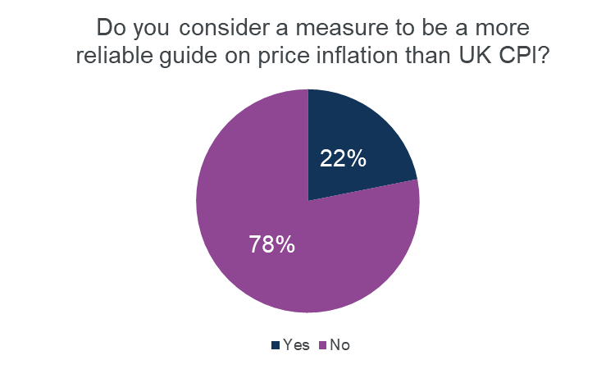
Reliability of CPI as an inflation measure
CPI generally considered reasonable and most reliable guide to general UK price inflation
No consistent view on target level or better alternative or loadings (appendix)
2% p.a. most popular, but more respondents feel it should be higher

Slide 41
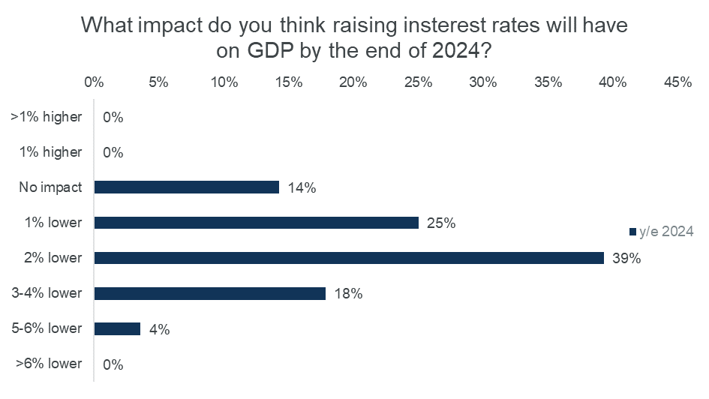
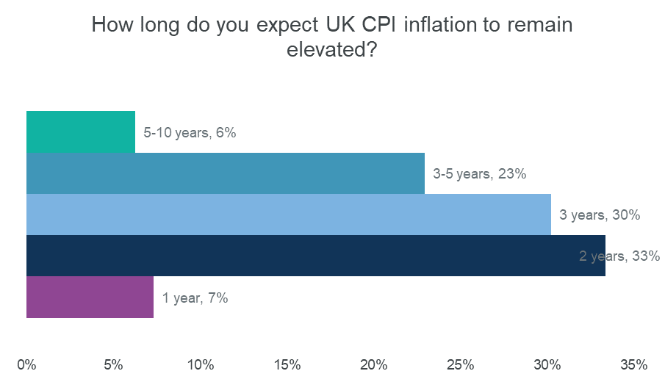
Impact of raising interest rates
Significant impact on GDP expected
Is this a necessary / acceptable “cost” given uncertainty of “benefit” of raising interest rates?
Most respondents believe raising interest rates will reduce future inflation:
But not significantly in short-term (vs high level at time of survey - 7% p.a. approx.)
Greater expected impact by eo2024, but not back to target 2% p.a.
Most respondents expect that to take 3 years or more

Slide 42
What should the Bank inflation rate target be?
2% is the most popular choice, but not a majority
More respondents think it should be higher than lower.
But there is also a cluster of responses around 0%. One respondent commented that they would have said 0.5% had it been an option

Slide 43
Alternative UK inflation measures and CPI loadings
29 respondents
14 respondents
No obvious central view on alternative to CPI

Slide 44
Claims Inflation Around the World

Slide 45
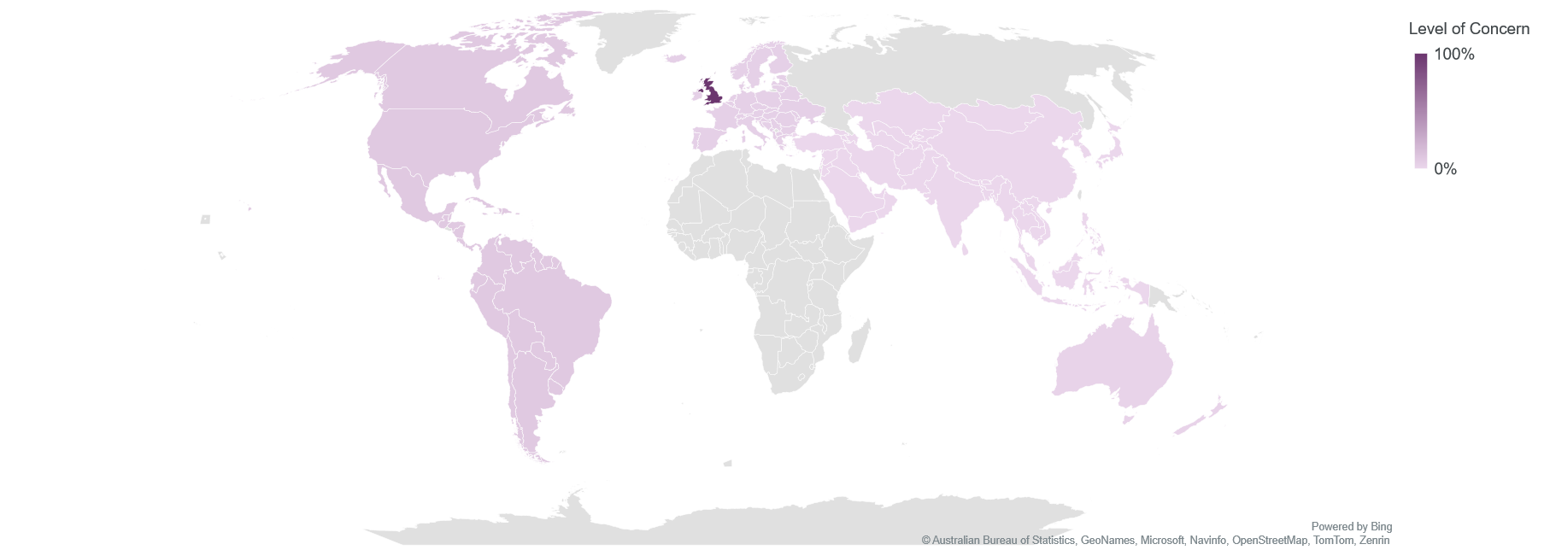
Regions of Concern Map 2022 vs 2023 Surveys
2022
2023
Notes:
Now the UK is the geographic area of most concern, with much less of a graduation than was seen last year.
{Mention of saying this in a concise way or cutting the slide}
Last year’s presentation noted a potential bias toward respondents areas of greatest focus.

Slide 46
Ancillary Considerations

Slide 47
Using External Indices
Benefits
Independent
Easy to communicate
Usable in absence of own data
Can blend/load as appropriate
Challenges
Correlation with actual claims?
Cost/availability of relevant indices?
Settlement year basis
False sense of security
Future area of study for WP!

Slide 48
Settlements Vs. Origin Year Inflation
‘Cleaner’ to estimate inflation using settled claims.
Indices effectively measure settlement year inflation.
But need to apply inflation on origin year (AY or UWY) basis.
Hence need estimates of future inflation.

Slide 49
FGU vs. Geared Inflation
Casts doubt on BC method:
Need to know severity distribution to convert from geared to FGU inflation…
…but don’t know severity distribution unless we trend the FGU losses!
Neat Pareto rule, but severity often not Pareto and gearing effect can vary significantly with distribution (even for same mean, CV) and layer.

