Slide 2
Addressing challenges and new dimensions in the insurance market
John Crooks

Slide 3
Challenges and new dimensions in insurance
Will share thoughts on:
Some of the key challenges in the industry today and in the future
General insurance (P&C) focus
Viewpoint from a reserving perspective
UK and global lens
Opportunities for actuaries, including thoughts for actuaries in India.
John Crooks
Chief Actuary, RSA Insurance Group

Slide 4
Challenges and new dimensions in general insurance
Data
Artificial Intelligence
Technology
Softening Markets
Economic Uncertainty
Geopolitics and Societal Change
Climate Change
Regulation and Reporting

Slide 5
Data

Slide 6
Data is a key performance lever for insurers
To support future performance, insurers need to transform into data-driven organisations. Data and modern analytic techniques are used to support superior pricing and risk selection. More good quality granular data is captured and connected to enhance predictive power that can be rapidly deployed and appropriately governed.
Issues today …
Data vision for the future …
Establishing robust data value chain and trust in data through strong data governance, quality and compliance frameworks
1
Insurers hold a large amount of data, but there are trust issues stemming from inconsistent data quality, some missing data, or a lack of a reliable source
Providing a scalable and leading-edge cloud-based single data platform accessible to all to support our business ambitions
2
Business teams experience challenges consuming data due to a fragmented data landscape, which requires time-consuming workarounds
Involving everyone in end-to-end transformation (not just the journey but also the mindset of continuous improvement)
Supporting our business in making smarter decisions faster through scalable and reusable Data / ML Products
3
Varying processes and governance across teams have resulted in data silos and increasing architectural debt within the group
Enabling unlocking business insights through advanced analytics
Creating a hub for innovation and experimentation to govern and support AI initiatives

Slide 7
Data capabilities required for success
Establish trust in data
Robust data governance, quality, and compliance frameworks to ensure data accuracy and trust across the organisation
Data
Management Foundations
Data & AI
Labs
Data
Platform
Support and govern AI initiatives
Scalable and leading-edge data infrastructure
A hub for innovation and experimentation, offering advisory AI/ML (Responsible AI framework, guardrails, tooling and best practices) and supporting business units in AI use case development
Scalable, secure and flexible cloud-based data infrastructure, tools, and technologies to support the firm’s data strategy
Chief
Data Office
Data
Analytics & Insights
Data & AI Transformation
Unlock business insight
Provide firms with data capabilities required
Enabling the use of advanced analytics to generate actionable insights that inform strategic decision-making, optimising performance and identifying growth opportunities
Enabling everyone in the organisation to make decisions with data & insights, by instilling a data culture, uplifting data literacy and adopting new ways of working to achieve the firm’s business outcomes
Data & ML Products
Make smarter decisions faster
Scalable and reusable Data Products and ML solutions that support business objectives and drive value through innovative data applications, for specific business purposes

Slide 8
Data flows in P&C reserving
Reserving Data
Data A
Data B
Data C
Data D
Data E
Data F
Data G
Data H
Data I
…
Data Z
Database infrastructure
Lowest level of granularity
Available 1st Working Day
Single Source of Truth
Reserving Data
Manual Data Processing & Reconciliations
Touchless processing
Automatic reconciliations
MORE TIME FOR ANALYSIS, DEVELOPMENT AND ADDING VALUE TO THE BUSINESS

Slide 9
Reporting and Management Information
Results File, Exhibits and Presentation
Spreadsheet Tables
File 1
Spreadsheet Tables
File 2
Spreadsheet Charts
File 3
Outputs from Software package
Spreadsheet Tables
File 4
…
Spreadsheet Tables
File 10
Ad-hoc e-mail requests from the business
Multiple exhibits at different levels of aggregation
RESULTS DASHBOARD (Central Repository)
Self-serve (less e-mail requests)
High quality diagnostics
Slice and dice flexibility for aggregation
Manual Consolidation into exhibits and single presentation.
Lots of manual reconciliations required
Automatic refresh with less interdependency
Modern data visualisation
Automatic reconciliation
Limited use of visuals
High level of interdependency
MORE TIME FOR ANALYSIS, DEVELOPMENT AND ADDING VALUE TO THE BUSINESS
Version control issues

Slide 10
Artificial Intelligence

Slide 11
(Generative) AI presents both risks and opportunities
Opportunities
Risks
Efficiencies in claims processing
Fraud (deepfakes, ghost broking)
Support to underwriters and serving customers
Hallucinations, bias, inadequate governance
Portfolio performance analysis
Failing to keep pace with competitors
Expense savings
Impact on the workforce

Slide 12
Artificial Intelligence – AI Enhanced Actuary*
Actuary
Use of Increased Predictive Power
Use of Increased Automation and Streamlining
Increased focus on judgement
Increased focus on communication
Changing needs and considerations:
Data
Skills and techniques
Professional
Ethics
*Richman, R. (2024): An AI vision for the actuarial profession

Slide 13
Artificial Intelligence – ethical considerations
Ethics: moral principles that determine how we make decisions and lead our lives.
Ethical Frameworks
Virtue Ethics – pursue positive qualities over negative traits
Utilitarianism – maximise goodness & minimise harm
Deontology – predefined rules
Ethical principles for managing AI:
Responsibility:
Organisation (accountability)
Professional
Promotion of human values:
Fairness and non-discrimination
Rule of Law
International norms of behaviour
Societal benefit
Human Control:
Human centred design and Community involvement
Transparency & Explainability
Human oversight
Safety:
Privacy
Safety & Security
Labour practices
Environmental sustainability

Slide 14
Technology

Slide 15
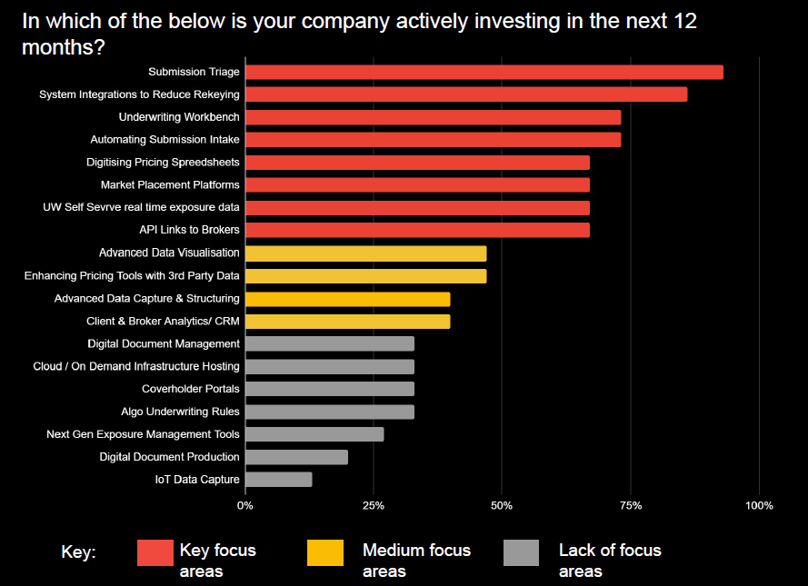
Market insight on technology trends
The technology landscape is evolving
Insurers need to act fast to remain relevant and outperform in the market
Some insights extracted from the London market Underwriting Transformation Survey 2024 shown to the right.
Biggest risks to successful implementation of technology transformation:
Delivery and execution risk
Underwriter adoption
Unsuitable configuration
Poor data
Cost versus budget
Change in management priorities

Slide 16
Responsive and agile technology
Many firms have a long history of evolution, and point-in-time decisions, which adds up to too much:
Duplication
Manual re-keying
Workarounds
Inefficiency
Delay
Cost
Risk
Frustration
Too many spreadsheets!
Cyber risk is a key consideration for all firms, and an opportunity for insurers as well as a risk

Slide 17
Softening Markets

Slide 18
London Market: market cycles in the last 20 years
The Market has experienced 4 cycles between 2004 and 2023.
Cycles often driven by external events (or lack thereof), causing market reaction.
Events are often triggers for changes in market cycles, but not all events will trigger a change. Events must be taken in the context of market profitability, the point in the cycle and the market’s ability to absorb losses.
Brief Hard Market
Hard Market
Responding to increased reinsurance costs and capital costs
The market began to harden due to several factors such as CAT events, Climate uncertainties and the impact of Covid-19.
Soft Market
Soft Market
Market Cycle Turning?
Intense competition saw rate reductions in most lines with wide availability of capacity.
This period saw prolonged soft conditions resulting from low interest rates and benign CAT environment.
Certainty returns to the market, and hard market appears to have run its course
Property
2004-2008
2009 - 2010
2011-2017
2018-2023
2024
Events:
2005 Katrina
2008 Global Financial Crisis
Events:
2017 Hurricanes
2020 Covid-19

Slide 19
Navigating a soft market
Attributes of Success in a Soft Market
Current market conditions
Softening (P&C), with hard conditions (MAT/Energy/Motor)
Robust Reserving
Throughout previous cycles, the top performers often have adequate reserves on prior years and avoid the need to strengthen prior year estimates and further challenge COR% performance when facing into softer current years.
Market Responsiveness
Top performers demonstrated agility and responsiveness to the rate environment across segments, allocating capacity based on pricing strength and profitability. Clear view of risk appetite and strategy.
Underwriting Culture and Ethos
Top Performers maintained conservative views to growth, stipulating the importance of underwriting quality as opposed to increasing GWP and top line performance.
Market Drivers
Events drive rate, rate drives capacity
Risk Trends
Technological influence and natural CAT events

Slide 20
Economic Uncertainty

Slide 21
UK economic recovery – continues?
Inflation cooling?
Will interest rates continue to fall?
The economy returns to growth … will it continue?
Will employment continue to increase?

Slide 22
Geopolitical and Societal Uncertainty

Slide 23
Geopolitical uncertainties
Conflict Escalation
Geopolitical Landscape
Oil prices and inflationary risk
Uncertain foreign policy
Supply chain disruption
Risk of tariffs and isolationist policies
Risk to Recovery
Financial market disruption
Reduction in international trade

Slide 24
Demographic change
Changing Employee Mix
Proportion of the global population aged over 60 by 2050
Number of individuals over 50 years old across the EU and the UK in 2025
Number of households occupied by someone aged 85 or above in the UK by 2037
The value of the silver economy across the EU and the UK by 2025
Healthcare
Funding the Ageing Wallet
22%
222m
Silver Economy
State Pension
Financial Planning
1.42m
€5.7tn

Slide 25
Geopolitical and societal changes: impacts
Regulatory focus
Political instability
Greater acceptance of litigation.
Increased jury awards and settlements.
Expanded definitions of liability and damages.
Claims from conflicts
Economic sanctions
Supply chain delays
Cost inflation
Litigation trends
Increased jury awards and settlements
Expanded definitions of liability and damages
Political pressures
Social inflation
Societal changes
Geopolitical environment
Remote working/return to office
Demographic shifts
Rise of GenZ
Greater acceptance of litigation.
Increased jury awards and settlements.
Expanded definitions of liability and damages.
‘Shifts in societal norms, values, and behaviour’
Changes in consumer behaviour can lead to fluctuations in demand for insurance
Increased awareness of social issues may lead to higher claims in liability insurance (e.g. discrimination cases)
Shifts in population characteristics
Changing demographics mean changing insurance needs
Impacts for insurers
Gen Z preference for digital products
Technology can lead to new types of claims
Adjustments in underwriting strategies
Remote working gives challenges like:
Information security
Impact on learning and experience
Opportunities – true for India in the global market
Return to office could change the landscape again
Insurers must remain agile and adaptive, employing advanced analytics to monitor and respond to these evolving factors in their reserve strategies.

Slide 26
Climate Change

Slide 27
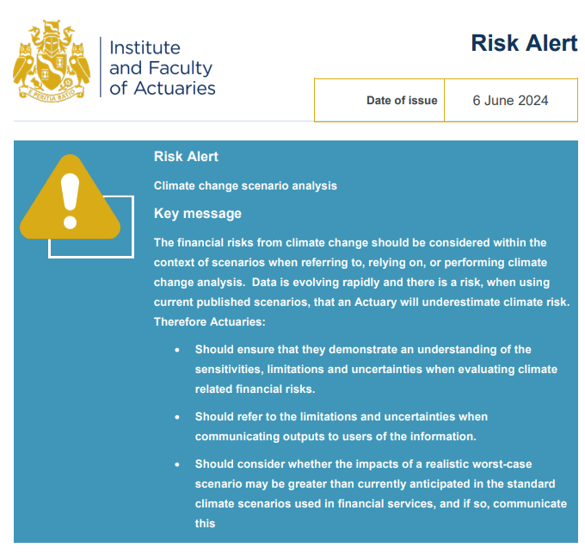
Risk alerts
The IFoA issue risk alerts to draw the attention of members to specific “hot topic” issues where they need to think about the consequences of actions they are (or are not) taking. It is important we consider them in our work. Recent risk alerts include:
June 2024: Climate change scenario analysis
September 2023: Development and use of Artificial Intelligence (AI) techniques and outputs by actuaries
August 2022: Impact of high inflation on actuarial practice
April 2022: Climate change and sustainability related issues

Slide 28
Climate Litigation
Climate Change Litigation: Cases before judicial and quasi-judicial bodies (e.g. arbitral tribunals, national human rights institutions, consumer watchdogs etc.) that involve material issues of climate change science, policy, or law.
Litigation will typically fall into one of seven categories;
Framework cases (Government and Corporate),
Integrating Climate Considerations,
Finance,
Failure to adapt,
Compensation Cases (Climate Damage)
Climate Washing / Greenwashing
Personal Responsibility.
There has been an increase in frequency of climate litigation cases filed, with 129 cases filed in the US in 2023.
Since the Paris Climate Agreement, 1,866 climate litigation cases have been filed across 55 countries and international boards/courts.
Around 57% of decided cases globally have had favourable rulings.
Most cases have been filed against governments because of inaction or failure to implement targets.
Recently there has been an increase in the number of activists and shareholders suing companies, particularly on the grounds of mis-advertisement or not supporting the transition.

Slide 29
Energy Transition
Global energy landscape is undergoing a significant transformation, and the insurance industry has a crucial role to play in enabling its transition.
Insurers have an important role to play in helping drive the broader energy transition through effective underwriting and portfolio management.
Having a clear underwriting policy is crucial to positioning a company as a trusted and respected partner in the industry.
Collaboration between insurers and their customers will be required to support a smooth transition.

Slide 30
Regulatory and Reporting Changes

Slide 31
IFRS17 Accounting Standard
Transparency
Consistency and Comparability
Better Information on Profitability
Objectives
Pros and Cons
Financial Statements
Business Operations
Finance Transformation
Pros
Business Management
Investors and Market
Customer
Strategic Decision Making
Cons
Complex requirements
Costs of implementation
Multiple options
Performance Measurement
Revenue
Multiple Line Items
Reinsurance
Underwriting Result

Slide 32
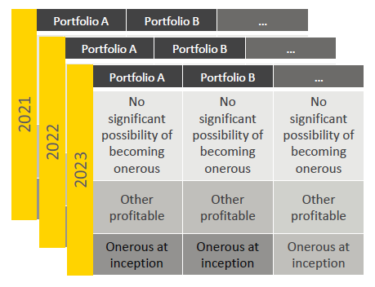
IFRS17: some of the big changes for actuarial
Measurement Model
Level of Aggregation
GMM
Default Model
PAA
Simpler Model for Short-term contracts
General Measurement Model
Premium Allocation Approach
Life insurance
General insurance
Consistency in portfolio segregation.
Better identification of profitability by portfolio to improve strategy decisions.
Transparency in financial statements as no cross -subsidies across portfolios (which happened under IFRS 4).
Risk Adjustment
Discounting
Compensation an entity requires for bearing the uncertainty about the amount and timing of cashflows arising from non-financial risks.
IFRS 4
IFRS 4 Risk Margin
Management decision
IFRS 17 Risk Adjustment
Only non-financial risks considered
Ambiguity in terms of risks covered
Choice of method – VaR, cost of capital
Percentile disclosure requirements
Difficult to compare across market
Only applied to long-term liabilities
Discount rates based on asset returns
IFRS 17
Applicable to all liabilities
Choice of discount rates - reflect the characteristics of cashflows and liquidity characteristics of insurance contracts
Disclosure requirements

Slide 33
Consumer duty: what does it mean?
Become our culture – Deliver Good Customer Outcomes
2. Avoid causing foreseeable harm to retail customers
Review products for foreseeable harm
Identifying potential harm when withdrawing or changing our products
1
Consumer Duty Principle
A Firm must act to deliver good outcomes for retail customers
1. Act in good faith towards retail customers:
Standard of conduct characterised by honestly, fairly and openly dealing and meeting the reasonable expectations of our customers – it does not mean taking advantage of behavioural bias
3. Enable & support retail customers to pursue their financial objectives
Ensure customers have the information/support they need
Remove barriers
Do not take advantage of customer bias
3
Cross-cutting rules
Products and Services
Identify/test the target market
Consider the needs of customers, e.g., reduced miles, European Breakdown cover
1. Act in good faith towards retail customers
Consumer understanding
Ensure communications are likely to be understood by the average customer
2. Avoid causing foreseeable harm to retail customers
3. Enable & support retail customers to pursue their financial objectives
Price and Value
Relationship between the price paid for a product and the overall benefit
1. Products and services
3. Consumer understanding
Consumer Support
We must avoid harmful barriers
4
Outcomes
2. Price and value
4. Consumer support

Slide 34
Consumer duty: why firms must pay attention
FCA considerations:
benefits to consumers
Firm considerations:
why firms should get it right first time
The harms reduced via Consumer Duty regulations include:
(1) Reduced financial harm
(2) Enhanced consumer confidence and participation in financial markets
(3) Consumers receive fair value products
(4) Enhanced competition leads to improvements to product offerings
(5) Time saved and reduced psychological stress to consumers
(6) Consumers can purchase or switch to more suitable products or services
Financial and Operational costs
Increase in FOS overturns:
increased cost of redress and remediation, impact on complaints.
Ongoing operational costs:
increased costs such as updating processes, regulatory intervention.
Raising the bar
SMCR- higher stakes:
the FCA will hold senior managers against the higher bar that has been set.
Prudent firm “test”:
the FCA will consider if the firm acted prudently.

Slide 35
Questions
Comments
Expressions of individual views by members of the Institute and Faculty of Actuaries and its staff are encouraged.
The views expressed in this presentation are those of the presenter.

