Slide 2
Questions for you - Slido Participants can join at slido.com with #3571016
Do you have a view on when the new Ogden discount rate will be announced in England and Wales?
If the next ODR is a single rate, what do you think it will be?
If a dual rate system were to be introduced, what term do you think would be considered the most appropriate ‘switch over’ point?

Slide 3
Introductions – Working Party Members
Badar Ali
Medical Protection Society
Ricky Childs
Apollo
Andrew Corner
PwC
Alex Hamilton
Aviva
Lauren Keenan
Allianz
Mohammad Khan
PwC
Nancy Li
Zurich
Eoin Lynch
PwC
Grant Mitchell
Soteria Insurance
Francisco Sebastian
Independent
Gower Wisdom
AUL Assurance

Slide 4
Agenda
Introduction
Background to the Ogden Discount Rate (ODR)
Dual / Multiple rate systems for the ODR
Our ODR WP 2023 Survey Results
What might the ODR be now?
Conclusion

Slide 5
Introduction
Mohammad Khan

Slide 6
Background to the Ogden Discount Rate (ODR)
Andrew Corner

Slide 7
Timelines for discount rate reviews
England and Wales
Scotland and NI
UK General Election due - may impact the timing of any ODR announcements
July 2023
15 July 2024
11 Jan 2025
Review has commenced with initial publication of call for evidence responses
Latest date for < 180 day ODR review to begin (5yrs after the prior rate concluded)
Expiry of < 180 day review period i.e. latest date for new ODR(s)
1 July 2024
29 Sep 2024
1 Oct 2024
Day specified for <90 day review to begin (5yrs after previous review began)
End of <90 day review period
Likely date for new ODR(s) (5yrs after previous rates set)
Notes:
MK

Slide 8
Ogden Discount Rate expert panel Appointed by the Lord Chancellor
Due to takeover as Government Actuary from the end of 2023
Fiona Dunsire
Government Actuary
Martin Clarke
Charl Cronje
Donald Taylor
Dr Rebecca Driver
Edward Tomlinson
Actuarial
Investment Management
Economics
Consumer matters

Slide 9
Setting the new Discount Rate Considerations
Fairness to all stakeholders
Single vs multiple rate(s)
Economic, long term inflation, financial forecasts
Investment portfolio – mix and duration
Tax and investment management costs
Consultation of a panel and the Lord Chancellor with different areas

Slide 10
Dual / Multiple rate systems for the ODR
Grant Mitchell

Slide 11
Background to Dual / Multiple rates Current single rate methodology may be changing
The current, single rate methodology may:
overcompensate those with long expected life spans
And undercompensate those with short ones.
GAD explored the issue of dual/multiple rates during the last ODR review in 2019
The review noted that a dual rate may lead to more equal outcomes and there were good technical reasons to adopt a dual rate
However, the Government decided that there was a lack in the quantity and depth of evidence available at that time to conclude that a dual rate was more appropriate than a single rate
A commitment was, therefore, made to seek additional data and evidence on this issue to inform future ODR reviews.

Slide 12
Evaluating approaches to a Dual/Multiple Rate system Understanding the impacts
Varies with duration | Varies depending on the heads of loss | Both
Advantages: More accurately reflects expected investment behaviour Allows for varying attitudes to risk for short and long term claimants Allows for variations in short and long term economic conditions Leads to fairer outcomes for both sides | Advantages: Can more accurately reflect the different inflation measures Could lead to increased data capture for compensators | Advantages: The legislative framework already allows for the introduction of a dual/multiple rate system.
Disadvantages: Short-term discount rate is likely to be more volatile than the current single rate Could lead to the need for more frequent reviews of the short-term rate at least The availability of PPOs means that a dual/multiple rate is unnecessary A dual rate could produce a short-term rate which is very low | Disadvantages: Arguments that each heads of loss would need a separate rate which could become very complex or result in “gaming the system” | Disadvantages: Multiple rate structures will introduce additional complexity Will require an increased number of assumptions to be made Implementation costs and increased operational complexity

Slide 13
Switch-over point A key choice when implementing a multiple rate system varying by duration
If the switch-over point is too short (for example, 5 years), this would result in two very differentiated segments:
the very short one (0 to 5 years), in which any form of risk taking would be discouraged for lack of investment horizon
a very long one (over 5 years), which would likely lead to differentiated investment strategies for different types investment horizons, so the longer-term rate would have to reflect a very heterogeneous mix of strategies.
If the switch-over point is too long (say 20 years), this would result in heterogeneous grouping in the first segment.
The average economic cycle in the UK since 1970s has been 9.6 years, although cycle lengths can vary greatly.
A switch-over point a little shorter or longer than this optimal point might be acceptable – within a range of perhaps 7-15 years.
The aim would be for the longer-term rate to be relatively stable and not influenced by cyclical effects, whereas the short-term rate is reflective of current conditions.

Slide 14
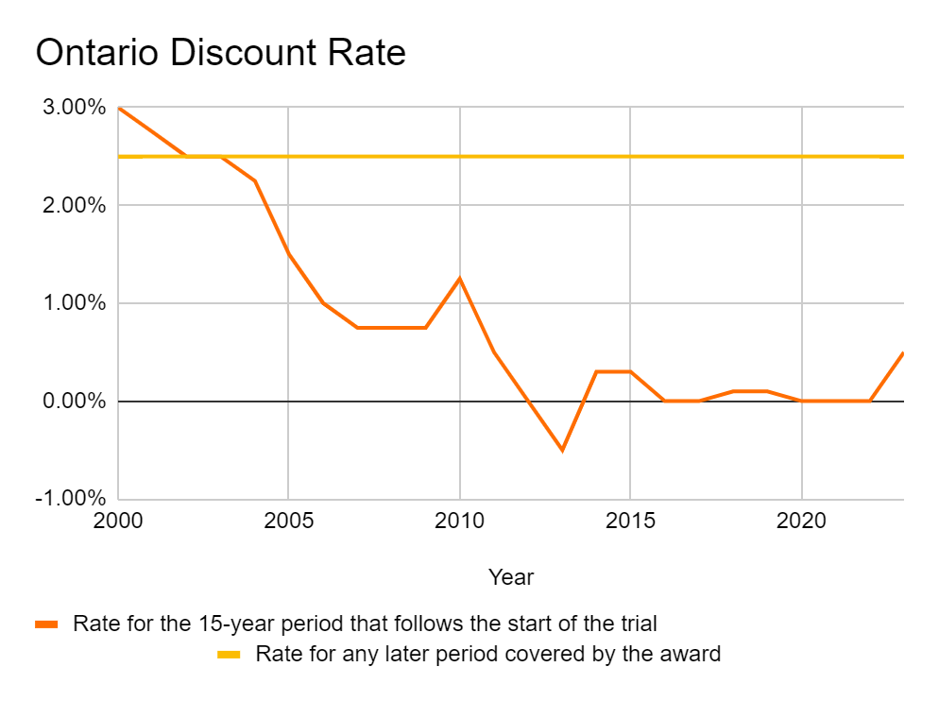
Ontario Discount Rate Real world case study on a dual rate system
The Canadian province of Ontario has had a dual rate system for calculating the ODR since 1999. This consists of a short-term rate and a long-term rate, with the switching point period fixed at 15 years.
The Ontario model is designed to blend one component that is current economic conditions (the short-term rate) with a second element that anticipates reversion to a long-term average (the long-term rate).
The short-term rate is calculated on the basis of whichever is greater for the 15-year period following the start of the trial of either:
the average of the value of the real rate of interest on long-term Government of Canada real return bonds, in the year before the year in which the trial begins, less half a per cent and rounded to the nearest tenth of a per cent; or
Zero
The current short-term rate (2023) is 0.50%, and the long-term rate is plus 2.5%. It is instructive to note that in the 22 years since the dual rate system was introduced, the short-term rate has been amended 16 times, but the long-term rate has remained unchanged.
Notes:
The rationale for the stability of the long-term rate is that while historically real risk-free yields on Government bonds in Canada experience significant fluctuations, the long-term average is between 2-3% and so a steady rate of plus 2.5% has been adopted.
In 2018, the Canadian Institute of Actuaries recommended^{[footnote 10]} that, while the dual rate was more complex and harder for the public to understand than a single rate, it should be retained as it offered a more precise match to short and long-term economic factors.
There have been cases^{[footnote 11]} in which the Ontario Superior Court has departed from the prescribed discount rate. These have been in response to expert evidence that future health care costs were expected to rise faster than the rate of general inflation over the life of the damages award.

Slide 15
Government Call for Evidence MoJ issued a Call for Evidence in Jan 2023 to explore dual / multiple Discount Rates
On 11 September 2023 the Government issued a response document summarising the 65 responses received, however, this document did not issue formal advice
The Scottish Government and the Department of Justice for Northern Ireland have also been consulting on this and other aspects of the Discount Rate calculation ahead of the next formal review.
Key takeaways:
Publications from the reviewing panel have yet to offer any opinions or formal guidance on the introduction of a dual/multiple rate
Views from the (re)insurance industry do not appear as well aligned as those from the claimant lobby
The volume and diversity of views presented is indicative of the challenges ahead

Slide 16
Our ODR WP 2023 Survey Results
Nancy Li

Slide 17
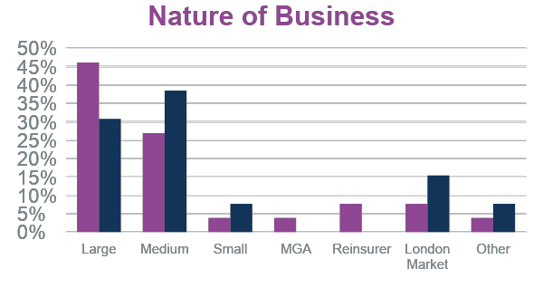
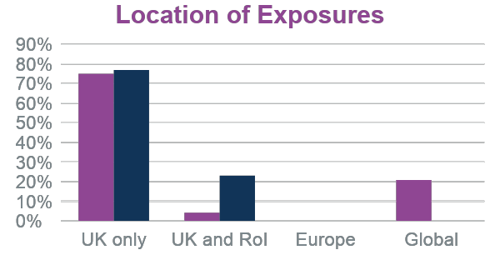
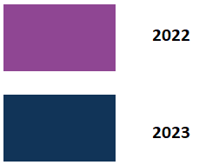
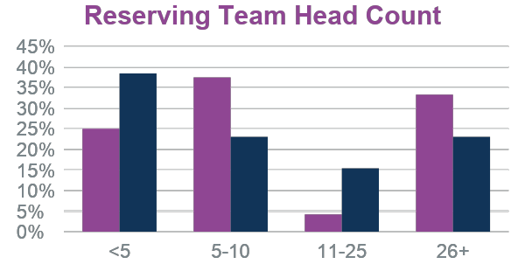
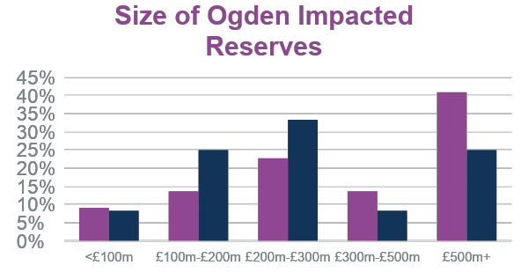
Respondents primarily medium-sized insurers
Compared to 2022 survey:
Reduced no. of responses
Greater proportion of Medium and London Market responses reflected in the lower Reserving Team Headcount and smaller Ogden reserves.

Slide 18
Survey themes
Respondents felt that a dual/multiple rate would be fairer for both claimants and (re)insurers…
…with the Ontario method considered optimal by the majority of respondents
Respondents felt the ODR is likely to increase…
…while no respondents have yet allowed for a change in ODR in their current reserving or pricing for England and Wales exposure
A greater proportion of respondents felt that the ODR had more impact in driving settlement discussions…
…it may be that as the review approaches, it becomes more of a consideration in settlement discussions.

Slide 19
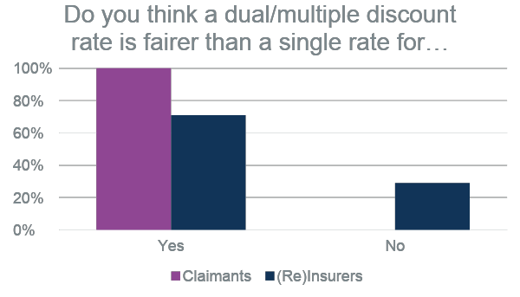
A dual rate is fairer to all parties but not necessarily preferred over a single rate
Respondents felt that a dual/multiple rate would be fairer for both claimants and (re)insurers
However, owing to the added complexities of a dual/multiple rate, a small majority would prefer a single rate
We asked respondents if a multiple rate were to be introduced what method would be the optimal way of doing so, and the most popular response was the Ontario method
As was the case in 2022 no respondent said that they explicitly quantify their reserves under a dual rate scenario
Most respondents said that they were not yet ready to implement a dual rate in their processes but there is a small improvement in responses since last year

Slide 20
Mixed engagement with MoJ call for evidence
Around half of the survey respondents responded to the MoJ’s call for evidence either directly or through another industry body
However no respondents said that they were definitely intending to lobby the Expert Panel, half saying they wouldn’t and half saying they were unsure
Respondents believe that the Expert Panel will have influence over almost all aspects of the discount rate framework with specific mention of the 0.5% prudency margin, the dual discount rate method and investment and inflation assumptions.
Respondents also believe that the 0.5% prudency margin will remain static but some felt it should not be included at all.
“[Does] the extra 0.5% for uncertainty… remain”
“What inflation rates to assume both short and long term”
“The type of dual discount rate method applied”
“Investment portfolio and assumptions”
“In principle [it] shouldn't be needed as [it] deviates from [the] 100% compensation principle.”
“… also consider that if a claimant is very risk adverse, the PPO option remains a viable option”

Slide 21
Slido Participants can join at slido.com with #3571016
If a dual rate system were to be introduced, what term do you think would be considered the most appropriate ‘switch over’ point?
Less than 5 years
5 - 10 years
10 - 15 years
15 - 20 years
20+ years

Slide 22
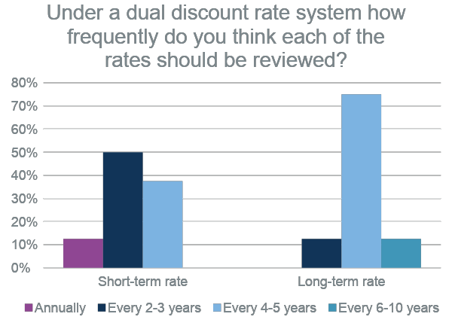
10-15 years is generally seen as the most appropriate ‘switch over’ point
Respondents were fairly unanimous in suggesting that an appropriate ‘switch over’ point would be between 10-15 years
The consensus is that the framework of a dual/multiple rate should be considered less frequently than the standard review cycle
Respondents suggested that the short term rate should be reviewed every 2-3 years, while the long term rate should be reviewed every 4-5 years

Slide 23
Slido Participants can join at slido.com with #3571016
Question:
Do you have a view on when the new Ogden discount rate will be announced in England and Wales?
Q1 2024 / Q2 2024 / Q3 2024 / Q4 2024 / Q1 2025 / Q2 2025
Question:
If the next ODR is a single rate, what do you think it will be?

Slide 24
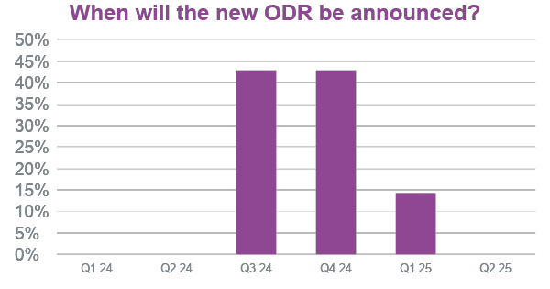
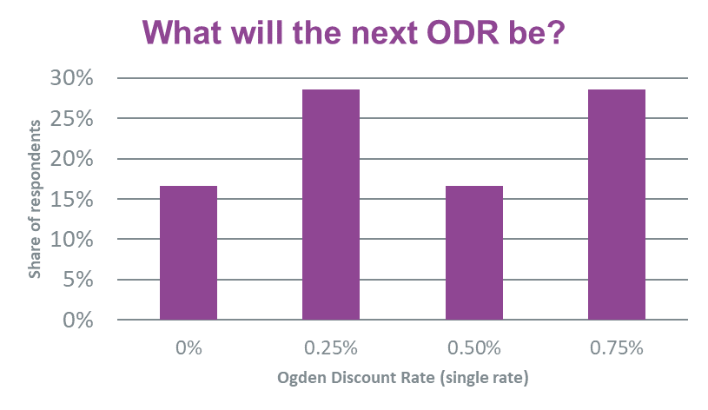
Expectations of an increased ODR to be announced in Q3 or Q4 2024
Most respondents felt the ODR is likely to increase
However no respondents have yet allowed for a change in ODR in their current reserving or pricing for England and Wales exposure
Almost 90% of respondents expect to start allowing for a change in ODR in 2024 with the remaining 10% expecting to allow for a change only when the new ODR is announced
Respondents were split on whether the new ODR would increase or have an immaterial impact on the no. of PPOs settled.
“No change at [the] moment. [We] will consider sensitivities for year-end depending upon [our] own view and what [the] Working Party say in their 2023 GIRO paper”
“There is still a lot of potential variability”

Slide 25
What might the ODR be now?
Andrew Corner

Slide 26
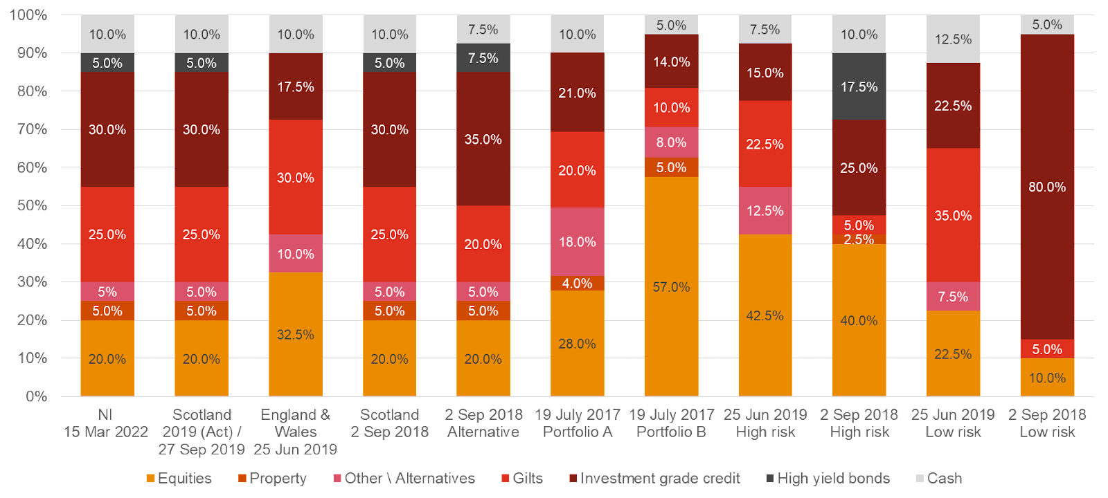
Government Actuary’s Department approach (2019) Portfolio mix as at previous review
Source: PwC

Slide 27
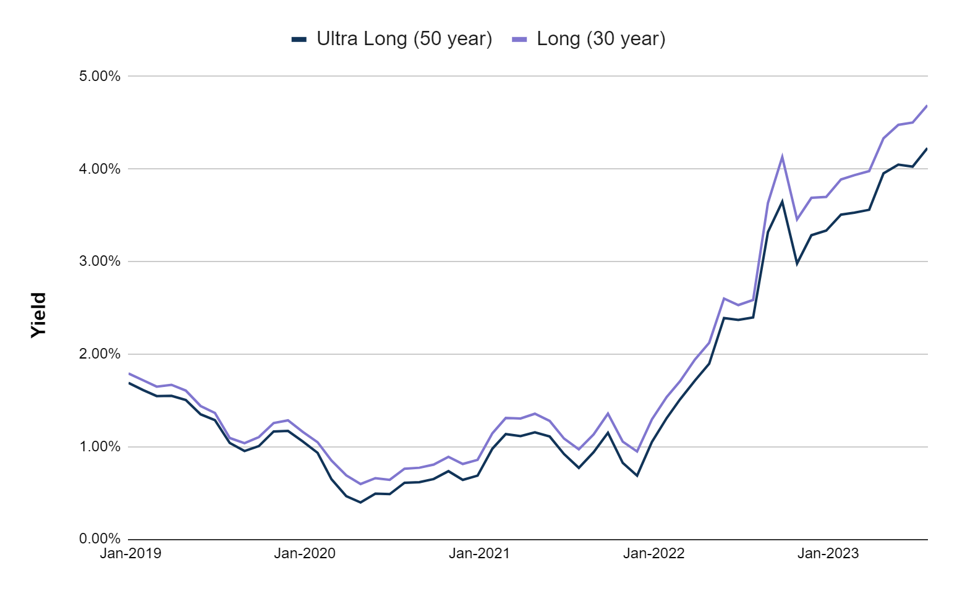
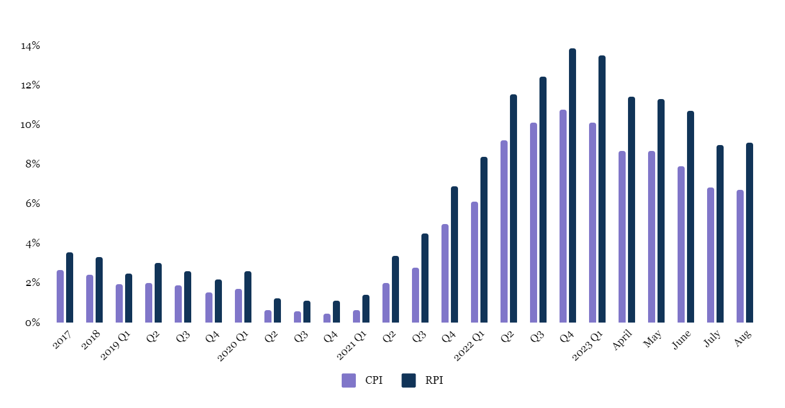
Economic indicators
UK CPI and RPI annual inflation rate data: Inflation remains high, however Bank of England, IMF and OECD forecasts all anticipate a return to the 2% level in 1-2 years time
Comprising roughly 30% of the GAD portfolio, gilts would represent a key driver of the updated ODR if calculated using the same approach as used in the 2019 review
Source: Office for National Statistics

Slide 28
Potential Updated ODR (assuming unchanged methodology)
If re-estimated now, the ODR for England and Wales would likely be positive.
 | GAD’s conclusions (2019) | Working Party Oct 2023 view
Expected return | 4.00% | 5.00%
Inflation (CPI) | -2.00% | -2.00%
Real Expected Return | 2.00% | 3.00%
Tax and Expenses | -0.75% | -0.75%
Damage inflation | -1.00% | -1.00%
Return post DI, T and E | 0.25% | 1.25%
Political adjustment (extra margin) | -0.50% | -0.50%
Estimated ODR | -0.25% | 0.75%
Having risen by roughly 3% at the 43 year duration, nominal gilts alone could add roughly 1.00% to the Expected return today
Our estimation assumes GAD’s methodology remains unchanged from 2019 and that only gilts are driving changes in this expected return.
There are significant other uncertainties on other potential changes including on inflation and the Political adjustment as well as whether dual-rate is used.

Slide 29
Impact of a ODR change in England and Wales
We have modelled the reduction in the average premium per policy if the ODR was to increase
We applied the Ogden tables using average multipliers for 20 to 50 year olds and assumed that the reduction in large claim amounts due to a ODR increase would be passed on in full to policyholders
We assumed an average cost per claim, average premium per vehicle year and average frequency of large claims per vehicle year based on the PwC Market Views and a PPO propensity of 10% (PPO Working party).
Increase in ODR | 0.25% | 0.75% | 1.25% | 1.75% | 2.25% | 2.75%
Estimated impact per policy (%) | -1% | -4% | -6% | -8% | -9% | -10%
Estimated impact per policy (£) | -£5 | -£13 | -£20 | -£26 | -£30 | -£34
Estimate industry wide impact (£) | -£180m | -£490m | -£750m | -£960m | -£1,140m | -£1,290m
- £17
Per policy impact
Our Estimate:
+1.00%
Change in ODR vs 2019 rate
- £620m
Industry wide impact

Slide 30
Conclusions
Mohammad Khan

Slide 31
Overall Conclusions
Assuming unchanged methodology, a possible range for the ODR is between 0% and +1.5%
The timing of the calculation can affect results meaningfully
Long term inflation expectations are a key part of the calculation
Most respondents to our survey believe the ODR will be a single rate between 0% to +0.75% at the time of the survey (August 2023), with an announcement expected in H2 2024
No respondents are currently allowing for a change in discount rate in their reserving / pricing, and most expect to start allowing for changes in 2024 (ahead of the announcement)
Most firms processes and systems are not ready or are only “partially” ready to handle dual/multiple discount rate, however, there are indications of progress compared to last year
The Ontario method is considered an optimal dual rate system by most respondents.

Slide 32
Next Steps
Monitor any announcements on a change to the ODR
Review government / GAD publications and expert panel meeting minutes
Consider how to reserve in a dual rate environment

Slide 33
Questions
Comments

Slide 35
The Ogden Discount Rate Working Party

