Slide 1
IFoA Review Team update - Equity release thematic review and future review topics
Alan Marshall David Gordon
Review Actuary Senior Review Actuary
19 January 2023

Slide 2
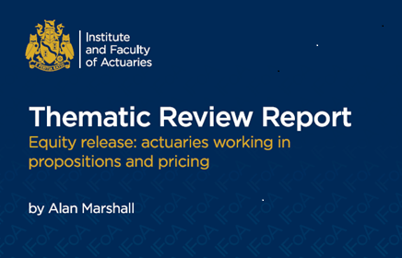
What we will cover today
Thematic Review Programme
Future topics preview
Equity release - scope and approach
Equity release - report highlights
Questions (please use Q&A button)
Polls – no right/wrong answers!

Slide 3
Thematic Review Programme

Slide 4
Objectives of the Thematic Review programme
Quality
Promote best practice
Highlight the work of actuaries
Career-long learning
Standards / Guidance

Slide 5
Benefits for Organisations and Members
To benefit from independent objective feedback
To support the IFoA to build a meaningful picture of actuarial work being undertaken in review areas
To help reinforce IFoA’s credibility as a member-led regulator serving the public interest

Slide 6
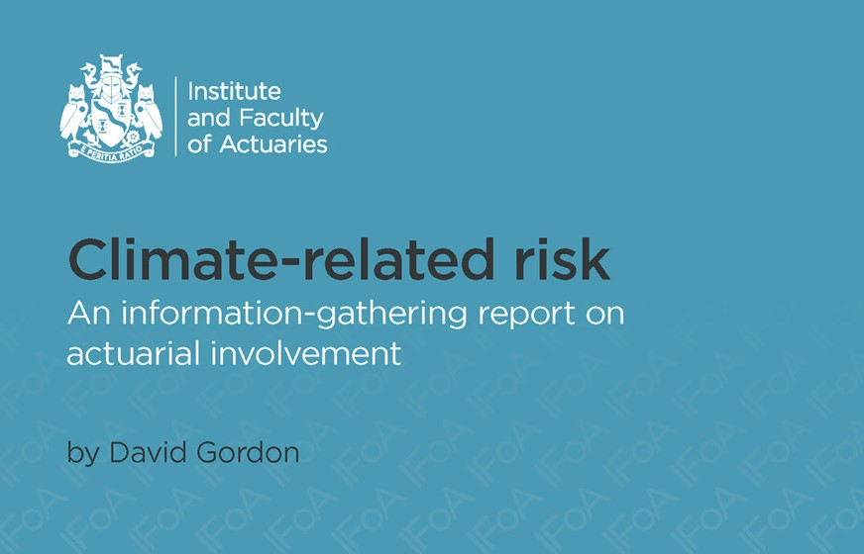
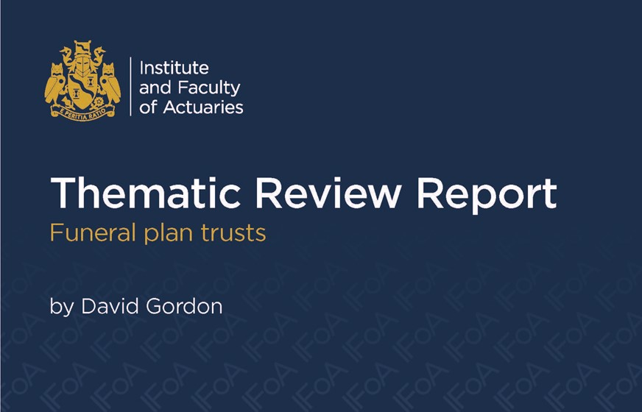
Our work to date
Pensions actuarial factors December 2020
General Insurance pricing June 2021
Climate-related risk November 2021
Funeral plan trusts March 2022
In progress
Corporate pensions advice to sponsors of UK DB schemes relating to valuations and strategy
(report planned for Q2 2023 publication)

Slide 7
Delegate Poll 1
How many of our Thematic Review reports have you read (at least part of, even just the Exec Summary)?

Slide 8
Future activity
Future reviews:
Topic | Brief description | Planned Launch
Data Science | Use of data science in actuarial work for analysis and modelling in traditional fields and wider domains. | Q2 2023
Pensions on divorce | Advice given to individuals to assist with treatment of pensions on divorce. | H2 2023
Cyber risk | Treatment and quantification of cyber risk by actuaries, including insurance of risks. | 2024
Pension scheme design | Advice given to trustees or sponsors on changes to member benefits. | 2024

Slide 9
Equity release review - Scope and approach

Slide 10
Some background on equity release
Key product features
Customer given lump sum which tends to roll-up with interest, repayable on death, or movement to long-term care, using sale proceeds of the property.
Size of lump sum depends on value of the property and age of the customer at time the loan is taken out.
Products have a ‘no-negative equity guarantee’ (NNEG).
Many products allow for early repayments to be made, although this may attract an early repayment charge.
Customer considerations
What other sources of savings or income do they have access to?
Are there tax or welfare benefit implications?
Are there other options they could consider in relation to their property, eg downsizing?
Is it important to them that their family inherit the property?

Slide 11
Delegate Poll 2
What experience do you have working on equity release products?

Slide 12
Published scope – announced December 2020
Equity-release mortgage product design and pricing
The actuarial inputs to the design and pricing of equity release mortgages have a direct impact on long-term financial products that are provided to the public. This is a broad and complex area, utilising a wide range of actuarial skills, including market and product knowledge, technical competency in areas such as option-pricing, property risk and longevity risk, as well as the requirement for clear communication.
The review will look at current actuarial practice to understand the processes adopted and challenges faced when providing advice in this area.

Slide 13
Review Scope and Approach
Business and Regulatory environment
Education and Lifelong Learning
Existing standards and guidance
Interviews and work examples
Involvement of actuaries - questionnaire responses

Slide 14
Submissions
We asked organisations in the equity release market to submit to us questionnaire responses and examples of actuarial advice.
We received 7 questionnaire response from these organisations (which represent a significant proportion of both equity release backbooks and ongoing sales):
There was limited appetite to provide work examples, although we did receive 3 examples from 2 of the participating organisations.
We also held discussions with actuaries at participating organisations for further insight.
Scottish Widows ~ L&G ~ Aviva ~ LV= ~ Key Group ~
Pension Insurance Corporation ~ Just Group

Slide 15
Report highlights

Slide 16
Main findings
High level of involvement by actuaries
Extends beyond more traditional areas of valuation and capital, into propositions and pricing work
Significant market capacity
Very high levels of equity in UK property in over 55s, and evidence of growing volumes of Lifetime Mortgages in 2021 and 2022
Changing economic environment
Moving from low interest rate / low inflation to far higher levels will impact propositions, pricing and potential customer outcomes.
High level of regulatory focus
PRA and FCA have been and continue to be heavily focused on this product
Potential legacy issues
Common with other products, although no evidence to date of significantly worse issues
Career-long learning
Further support on complex illiquid assets, curation of lifelong learning material

Slide 17
Key insights from submitted questionnaires
Actuaries highly involved in equity release proposition and pricing work
Senior Manager roles means influence on outcomes and oversight
Chief Actuary (team) tends to be in an oversight capacity
Examples of actuaries with overall responsibility for pricing and/or propositions
TAS considered applicable to pricing work
Customer treatment, investment, and property underwriting specialists
Actuarial standards provide good framework for pricing work
Strong customer focus, but compliance responsibility tends not to lie with actuaries

Slide 18
Delegate Poll 3
What is your view of equity release products?

Slide 19
Finding – High level of actuarial involvement
Beyond valuation and capital work
Not as involved in customer treatment
Awareness of importance
Particularly pricing teams

Slide 20
Finding – Large potential market for equity release
Significant property wealth of over-55 population
May lead to increased actuarial involvement
Importance of public interest role highlighting long-term risks
Demand from customers and providers

Slide 21
Finding - Rapidly changing economic environment
Material changes in inflation and interest rates
Impacts on propositions and pricing as firms reassess risk appetite
Effect on decision-making of customers, and advice they receive
Knock-on impacts to wider economy

Slide 22
Finding – Significant regulatory focus
Both PRA and FCA heavily focused on equity release market
FCA focused on fair customer outcomes and quality of advice
Upcoming FCA Consumer Duty likely to have a key impact
PRA continue to interact on valuation and capital approaches

Slide 23
Finding - Potential legacy issues
Consumer group, financial media and regulatory interest in customer-fairness outcomes
Although actuaries may be more involved in non-customer-facing roles, professional and organisational risk still exists.
Awareness of issue but not seen as worse than other products

Slide 24
Finding - Career-long learning
Equity release is covered in the current IFoA pre-Fellowship pathway, and a range of wider third-party learning materials.
Some curation of career-long learning material was also mentioned as potentially beneficial.
Competencies relating to wider property risk and complex illiquid assets are areas where further support could be provided.

Slide 25
Delegate Poll 4
What level of involvement do you think actuaries will have in this product in 5 years time?

Slide 26
Going forward
Customer and commercial balance
Important that all actuaries consider this in the work they do
Professionalism
Possible development of specific equity release scenarios for CPD
Supporting fellow regulators
Consider what the IFoA can do to ensure actuaries continue to play their part supporting this market
Career-long learning
Continue to liaise with education colleagues
Highlight the range of existing material available

Slide 27
Questions
Comments
The views expressed in this presentation are those of the contributors and not necessarily those of the IFoA. The IFoA do not endorse any of the views stated, nor any claims or representations made in this presentation and accept no responsibility or liability to any person for loss or damage suffered as a consequence of their placing reliance upon any view, claim or representation made in this presentation.
The information and expressions of opinion contained in this publication are not intended to be a comprehensive study, nor to provide actuarial advice or advice of any nature and should not be treated as a substitute for specific advice concerning individual situations. On no account may any part of this presentation be reproduced without the written permission of the IFoA.

