Slide 1
IFoA Thought Leadership Series: Alternative Economic Thinking Five Times Faster - The Invisible Infrastructure of Climate Change 4 April 2023

Slide 2
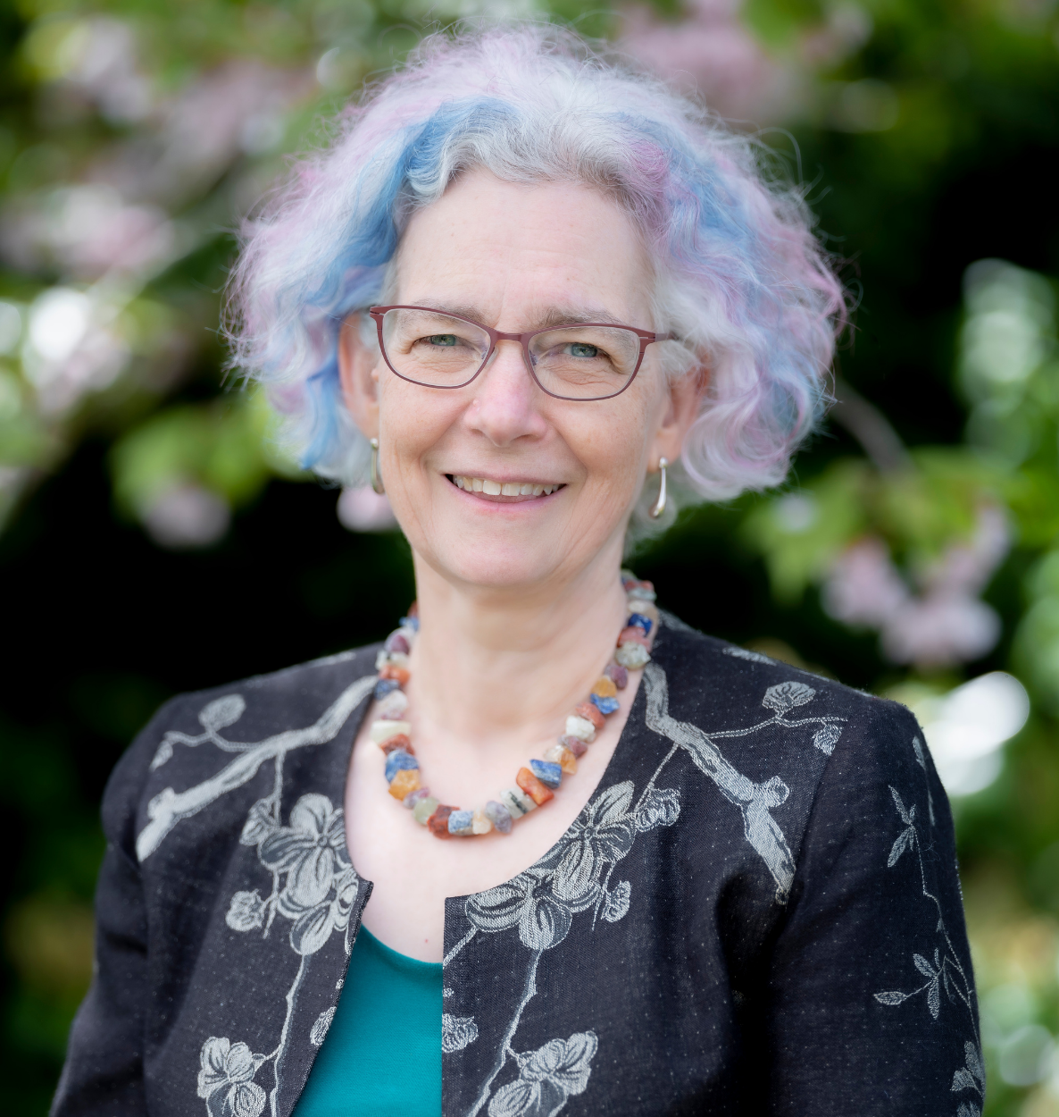
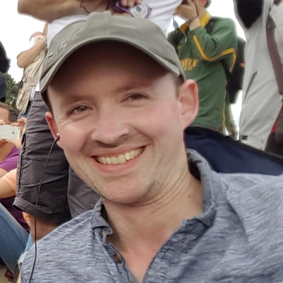
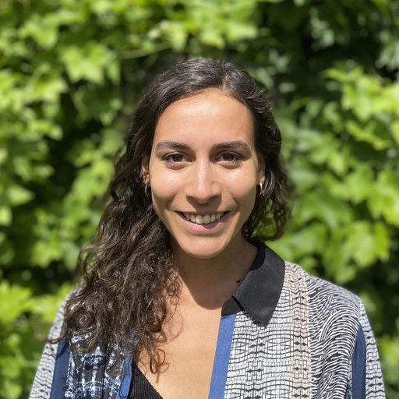
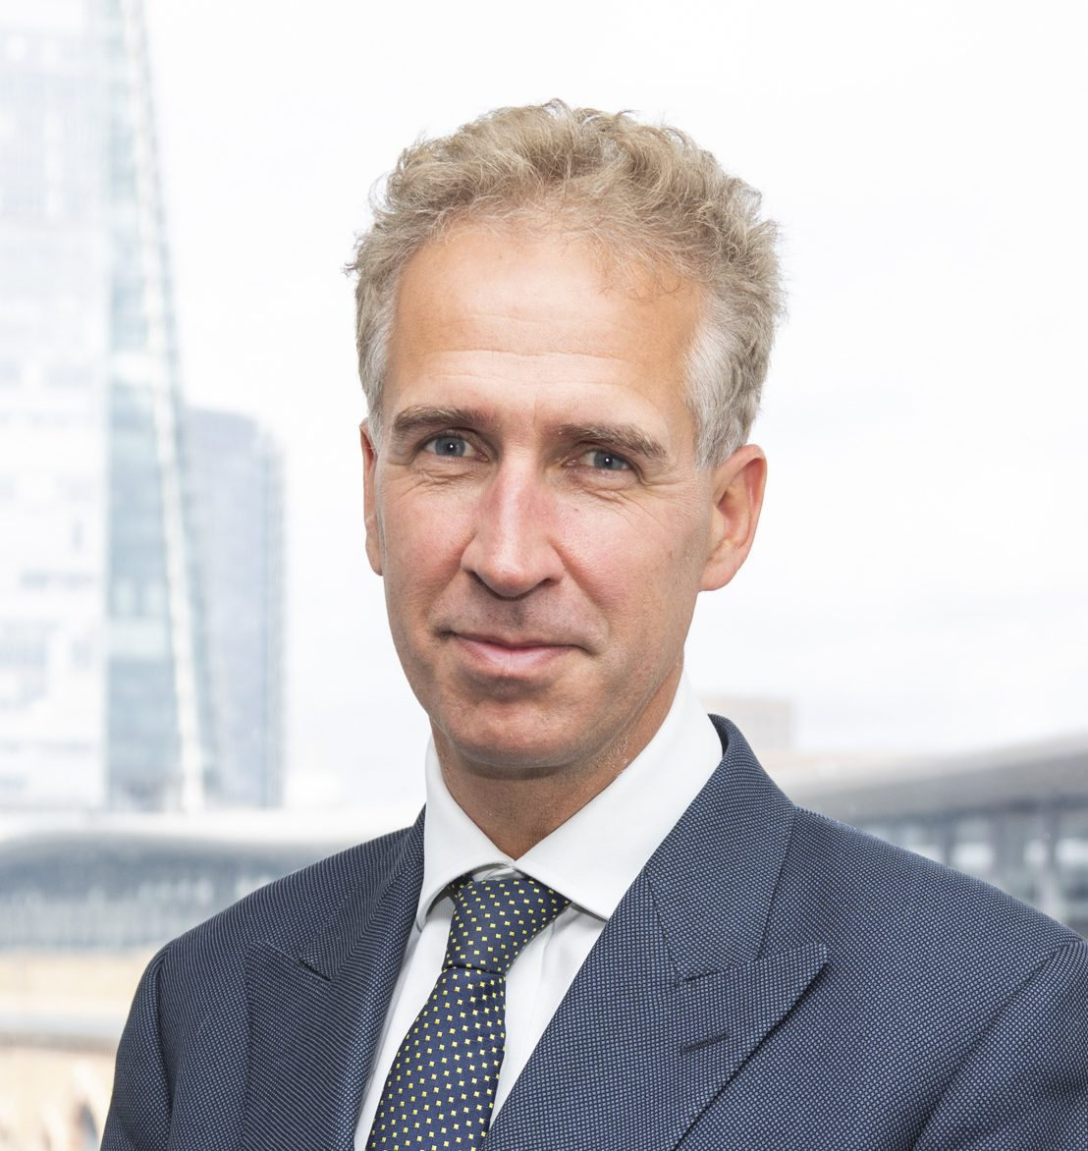
Chair
Speakers
Louise Pryor
Immediate Past President of the Institute and Faculty of Actuaries
Simon Sharpe
Director of Economics for the UN Climate Champions, and a Senior Fellow at the World Resources Institute
Katie Kedward
Economist and Policy Fellow in Sustainable Finance at the Institute for Innovation and Public Purpose, University College London.
Kingsmill Bond
Energy Strategist for Rocky Mountain Institute

Slide 3
Overview of the ‘Alternative Economic Thinking’ Presidential Speaker Series
‘The Power of Purposeful Business’ (Thursday 20 April, 4-5pm)
Speakers: Matt Saker and Alex Edmans
‘New Capital Consensus’
Speaker: Peter Scolly

Slide 4
Questions
Comments
Expressions of individual views by members of the Institute and Faculty of Actuaries and its staff are encouraged.
The views expressed in this presentation are those of the panellists.

Slide 5
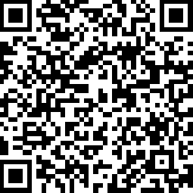
Please scan the below QR Code to complete the feedback survey

Slide 6
END

