Slide 1
Dynamic Discount Rates Considerations for pension scheme funding
IFoA sessional meeting 27 February 2024
Gareth Connolly, Andrew Dodd, Phil Hardingham and Luke Stratford-Higton

Slide 2
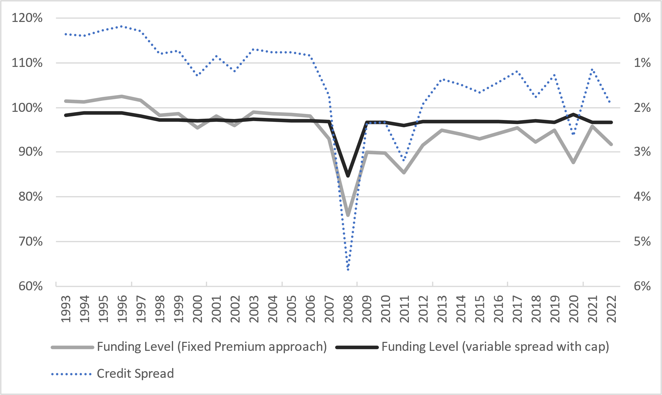
Background to the formation of the Working Party
The actuarial profession should sponsor research into the use of dynamic discount rates for the technical provisions of schemes. This will help remove funding volatility that is artificial in nature and will become increasingly relevant for schemes with a low-dependency [Target End States] that adopt asset strategies that more closely address matching of assets and cash flow liabilities. Gilts+ type discount rates can achieve this, as long as all agree the “+” is variable.”
Source - Target End-States for Defined Benefit Pensions Schemes Working Party, 2021 report
The chart below (taken from the WP paper) highlights the issue of artificial volatility

Slide 3
Composition of the Working Party
 | Assets | Liabilities | Insurance | Regulation | Scheme Actuary | ALM/ Modelling
Gareth Connolly (WTW)
Luke Stratford-Higton (Clara-Pensions)
Phil Hardingham (Hymans)
Kenny McIvor (Phoenix)
Owen McCrossan (arbdn)
David Fink (LCP)
Andrew Dodd (TPR)

Slide 4
Objectives of the Working Party
Define DDR and review current practice
Stakeholder considerations
When is DDR beneficial
Learning from insurers
What does DDR look like in practice
Implications for other areas
New skills and next steps
Dynamic Discount Rate (DDR) approach is one whereby the discount rate used for funding purposes moves in sympathy with the expected return on the asset portfolio that is backing the liabilities
Primary focus of the report is the use of the DDR approach for well hedged and cash flow matched schemes

Slide 5
Objectives of the Working Party
Define DDR and review current practice
Stakeholder considerations
When is DDR beneficial
Learning from insurers
What does DDR look like in practice
Implications for other areas
New skills and next steps
Dynamic Discount Rate (DDR) approach is one whereby the discount rate used for funding purposes moves in sympathy with the expected return on the asset portfolio that is backing the liabilities
Primary focus of the report is the use of the DDR approach for well hedged and cash flow matched schemes

Slide 6
Stakeholder considerations: what’s the prize?
Sponsors
Reduction in funding level volatility from moving asset yields
Trustees
A cleaner signal around a future cashflow shortfall
More explicit alignment between the investment approach and funding methodology
Members
If assets are invested to generate high quality cashflows matching benefit payments, there is good member security…
…but ongoing support from sponsor covenant is a necessary underpin
An alternative way of funding a pension scheme alongside insurance risk transfer

Slide 7
Interaction with 2024 FIS Regulations and DB Funding Code
New legislative requirements
Mature Schemes
Immature Schemes
1) Low dependency funding consistent with a low dependency investment allocation by a relevant date, no later than significant maturity.
2) TPs consistent with first requirement and journey plan to get there
Fits well with cashflow matched strategies
Wider scope for alternative DDR approaches

Slide 8
Interaction with 2024 FIS Regulations and DB Funding Code
Fast Track
‘Gilts +’ parameters
Bespoke
TPR’s tolerated risk
Greater flexibility
More likely route for DDR
Statement of Strategy

Slide 9
Putting theory into practice: potential DDR framework
Initial discount rate
① | Asset portfolio based on best-estimate liability cash flows
② | Adjustment for investment costs
Buffer above liabilities discounted at initial discount rate
③ | Allowance for asset-side risks
④ | Allowance for asset-liability mismatch risk
⑤ | Allowance for liability-side risks
⑥ | Consideration of risk diversification
Scheme Actuary & investment consultant work together to optimise
Buffer approach considers prudence margins explicitly

Slide 10
Example derivation of the funding buffer and liability discount rate
Discount rate
① | Asset portfolio based on best-estimate liability cash flows | Gilts + 1.4%
② | Adjustment for investment costs | Gilts + 1.2%
Buffer above liabilities discounted at Gilts + 1.2%
③ | Allowance for asset-side risks | 9.3%
④ | Allowance for asset-liability mismatch risk | 9.4% (+0.1%)
⑤ | Allowance for liability-side risks | 11.2% (+1.8%)
⑥ | Consideration of risk diversification | 9.5% (-1.7%)

Slide 11
Example derivation of the funding buffer and liability discount rate
Discount rate
① | Asset portfolio based on best-estimate liability cash flows | Gilts + 1.4%
② | Adjustment for investment costs | Gilts + 1.2%
Buffer above liabilities discounted at Gilts + 1.2%
③ | Allowance for asset-side risks | 9.3%
④ | Allowance for asset-liability mismatch risk | 9.4% (+0.1%)
⑤ | Allowance for liability-side risks | 11.2% (+1.8%)
⑥ | Consideration of risk diversification | 9.5% (-1.7%)
Optimise

Slide 12
Example derivation of the funding buffer and liability discount rate
Discount rate
① | Asset portfolio based on best-estimate liability cash flows | Gilts + 1.4%
② | Adjustment for investment costs | Gilts + 1.2%
Buffer above liabilities discounted at Gilts + 1.2%
③ | Allowance for asset-side risks | 9.3%
④ | Allowance for asset-liability mismatch risk | 9.4% (+0.1%)
⑤ | Allowance for liability-side risks | 11.2% (+1.8%)
⑥ | Consideration of risk diversification | 9.5% (-1.7%)
Optimise
Ongoing: sensitivity analysis can be used to create a formula that captures the impact on the funding basis for changes in specified parameters (e.g., credit spreads and credit ratings)

Slide 13
Modelling considerations
Assets
Cash flow matching / hypothecation
Employer deficit contributions
Liabilities
Future accrual
Discretionary increases
Buffer
Risk identification
Assumptions vs. experience
Allowance for diversification of risks
Allowance for asset / liability risks
Future changes to investment strategy

Slide 14
New skills
Considering both asset and liabilities in tandem isn’t new…
But this approach entails a tighter coupling of asset and liability sides
Entails a new dimension of judgement and communication
Traversing both asset and liability detail, underpinned by the funding philosophy
Data flows often more complex
…so need to design monitoring processes around data availability practicalities
Assets
Liabilities
Judgement and Communication
Asset data maturity

Slide 15
Next steps
IFoA
Review of curriculum
Guidance on typical asset classes
TPR
DDR information capture
Scheme Actuaries
Understanding of benefits
Encourage data cleansing
Further research

Slide 16
Questions
Comments
Expressions of individual views by members of the Institute and Faculty of Actuaries and its staff are encouraged.
The views expressed in this presentation are those of the presenters.

Slide 17
Disclaimer
The views expressed in this presentation are those of invited contributors and not necessarily those of the Institute and Faculty of Actuaries. The Institute and Faculty of Actuaries do not endorse any of the views stated, nor any claims or representations made in this publication and accept no responsibility or liability to any person for loss or damage suffered as a consequence of their placing reliance upon any view, claim or representation made in this publication. The information and expressions of opinion contained in this publication are not intended to be a comprehensive study, nor to provide actuarial advice or advice of any nature and should not be treated as a substitute for specific advice concerning individual situations. On no account may any part of this publication be reproduced without the written permission of the Institute and Faculty of Actuaries.

