Slide 1
The blind spots of risk modelling: What you’re missing and why it matters
Jacob Shah, LCP
Laura Hobern, LCP

Slide 2
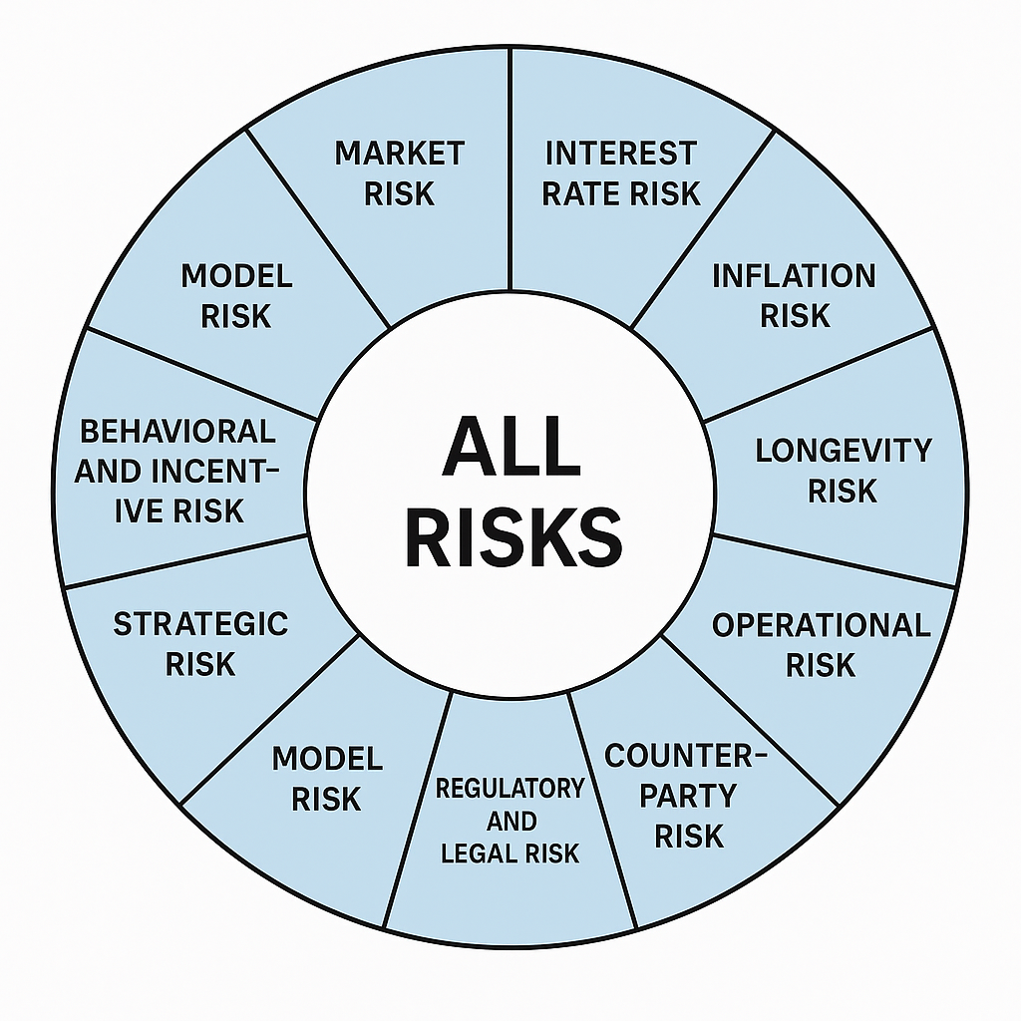
Our call to action
These risks can knock you off course. But there is something you can and should do about them.
UNDERWRITING RISK
SYSTEMIC RISK
Notes:
What we’re going to do is try to set the scene, highlight the issues, and get everyone on the same level. Then when we get to the discussion, we can hopefully tease out some of the solutions to these issues.
These risks are difficult to do something about. But me and Laura are here to change your mind…
When we ignore systemic risks or treat them as inevitable it leaves us vulnerable. Everyone has their part to play.
I’m going to talk about what we mean by systemic risks, then Laura is going to take over to talk about human biases and flawed data sets.

Slide 3
Section 1
Systemic risks – Why the “nothing can be done” mindset is wrong

Slide 4
Examples of systemic risks
Risks that do not just affect the financial performance of one company, or asset class, but can instead impact the performance of an entire financial system and even undermine the stability of financial markets
Herding of assets
Longevity
Climate change
LDI leverage spiral
Deflation & impact on index-linked gilts
Societal upheaval
Notes:
When we talk about systemic risks today…
£1.5tr of DB pension schemes are heading to a small number of insurers.
Systemic risks can originate outside the financial system, like anti-microbial resistance.
Systemic risks are interdependent, like climate change.
Poll of systemic risks & climate change.
It’s not enough to just acknowledge these risks exist, there needs to be action as well.
Why should you? It’s good risk management, it’s right for members and it’s your duty.

Slide 5
1) It’s good risk management
1
“Risk” is volatility with no consideration of the causes of such risk
Return
2
Assumptions are backward looking
3
Lack of consideration of tipping points
Risk
Notes:
You reduce risk through diversification
Problem -> Nowhere in this chart does it allow you to consider and manage systemic risks.
The manifestation of risk is variability of prices … These models ignore liquidity, reinvestment and counterparty risk.
Based on historical data.
Lack of full understand on how these risks might play out or consideration of tipping points, where trends can’t be fully reversed.
Modelling systemic risks is difficult and not captured by traditional risk modelling.
We need to focus on managing long-term risks, rather than maximising risk-adjusted returns in the medium term.

Slide 6
2) It’s right for beneficiaries
Covenant longevity
£m
Liabilities Current plan
Time
Market shock Systemic shock
Notes:
Your job is to make sure your members pensions get paid.
Explain chart.
Severe market shock leads to my asset value to fall, worse funding position, but I still get to full funding.
It’s a challenging situation to be in, but I care about permanent loss of value and not being able to deliver the returns I need.

Slide 7
2) It’s right for beneficiaries
Covenant longevity
?
£m
3
?
2
1
Liabilities Current plan
Time
Market shock Systemic shock
Notes:
Systemic shocks impact all parts of your portfolio
Systemic shocks can disrupt the entire financial ecosystem, economic stability and damage economic growth.
Systemic risks can be interconnected -> Longevity, corporate Britain impacting covenant.
It is not just the asset value that changes, the entire financial system is in flux. Tube example.
Systemic risks can also impact quality of life. Trustee responsibilities extends beyond paying promised benefits.
You can improve the chance of paying pensions and contribute to a stable financial future (real purchasing power, economic stability and better quality of life).

Slide 8
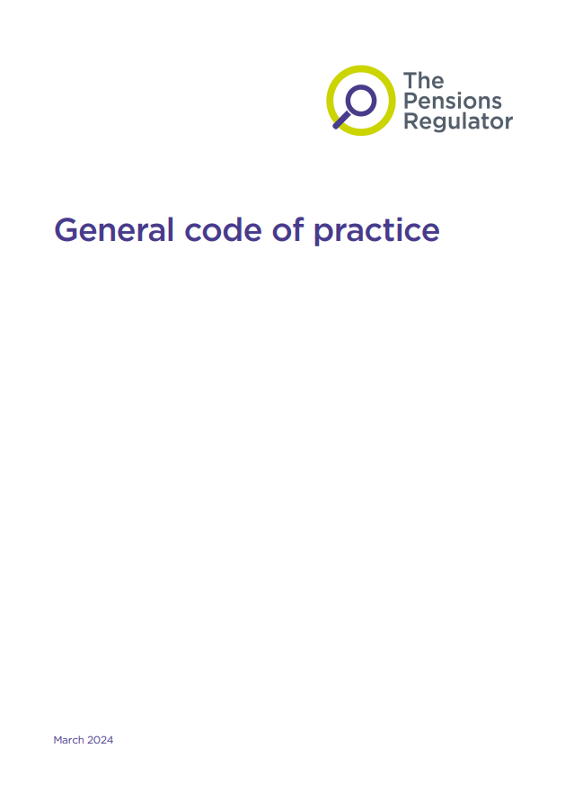
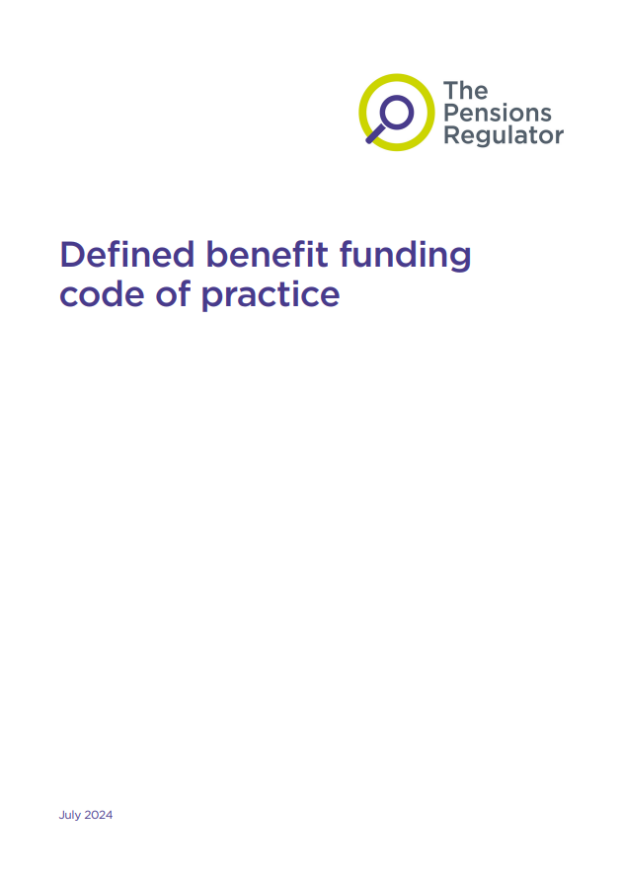
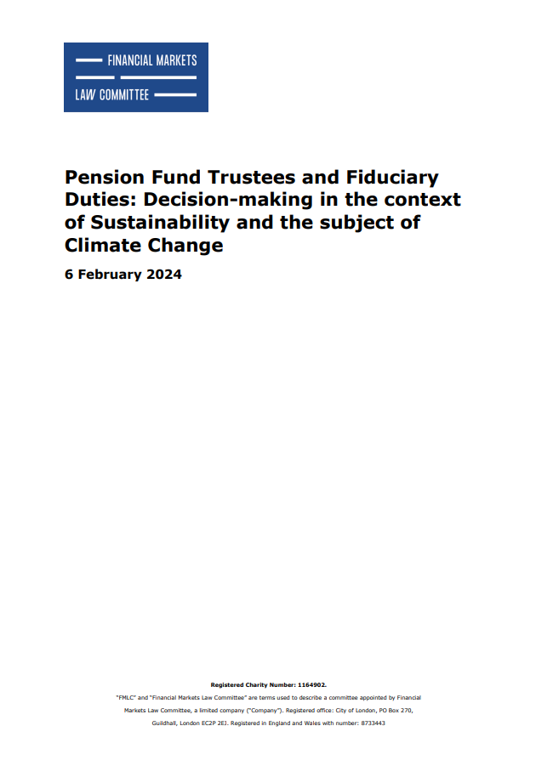
3) It’s part of your duty
Notes:
If I haven’t managed to convince you so far, then hopefully my last slide will. It is not just me & Tom who are shouting about this.
This year alone, we’ve had three pieces of guidance released that all mentioned systemic risk. The General Code, the new DB Funding Code and the Financial Markets Law Committee report.
So, this is not just nice to do, it is also part of your duty, and I don’t think pension scheme trustees and sponsors could be given a clearer sign.

Slide 9
Thinking in a different way
Inward looking
Outward looking
What impact does the system have on me?
What impact can I have on the system?
Notes:
…we have an inward looking view on the world. Ie what can I do to reduce the impact of a shock on me? Let’s say it’s a recession. How do I make myself most resilient?.
But I want us to try and re-frame things. I want us to think outwards. What are the things I can do the impact the system, to help reduce the likelihood or severity of a systemic shock.

Slide 10
Dealing with systemic risks
Evaluate Have a plan
Mitigate
Reduce and protect
Systems mindset
Advocate
Use your voice
Collaborate
Work together
Allocate time
Notes:
Balance -> If I want the best outcome for me, I want weak regulation. But that can lead to poorer long-term outcomes.
With a systems mindset, I might choose to argue against my own immediate short-term objectives because it facilitates a better oucome.
With that balance, there’s four key actions.
Evaluate -> Identifying systemic risks allows you know what they are and to understand the impact these risks can have. Insurance pricing example.
Advocate -> Be proactive about making noise. Examples include signing global investor statements, endorsing LCP’s climate policy asks, or responding to an industry consultation.
Collaborate -> When it comes to navigating our journeys, we’re all trying to get to the same place even if we take different paths. Examples of this include multi-party advocacy.
Mitigate -> comes back to what I said on the earlier slide. For example, we have clients investing in climate solutions and renewable energy – these are technologies that are helping slow down climate change and therefore reducing the severity.
So if you want that easy win, if you want to take that next small step, if you want to start somewhere: allocate time. Give systemic risks the space they need on your agendas and in your priorities to be properly part of your process.

Slide 11
Section 2
How human biases and incentives distort models
Notes:
Another risk that doesn’t always get the attention it deserves is around human behaviour and how these can distort models

Slide 12
Behavioural bias
Behavioural biases distort models by introducing irrational human behaviour that deviates from the assumptions of traditional models.
Incentives also influence behaviour.
It is essential to understand the behavioural side of risk modelling.
Cognitive errors
Emotional biases
Notes:
Most traditional actuarial models assume people behave rationally. But we know that’s not the case.
People have cognitive limitations and emotional impulses, that drive their behaviour - this includes unconscious bias and mental shortcuts.
Research has demonstrated that when people face complex decisions, they often rely on basic judgments and preferences to simplify the situation rather than acting completely rationally.
And when these behaviours aren't accounted for, our models can miss the mark entirely.
Behavioural biases therefore distort models by introducing irrational human behaviour that deviates from the assumptions of traditional models.
In addition, incentives can influence behaviour and these are not always aligned to optimal outcomes, think about an underwriter whose bonus is purely based on the volume of business they write, they may be less concerned about adequate pricing or whether a product is suitable for a particular customer.
It is therefore essential to understand the behavioural side when modelling risk.
These are both cognitive errors, based on flawed statistical, information-processing, and emotional biases stemming from impulse or intuition.

Slide 13
Why should we care?
Consequences of behavioural bias
Skews fairness
Negatively impacts decision-making
Noise and systemic error - less clarity / insight
Result in ‘broad stroke’ rules on what we think we know
Unreliable predictions
Costs money
Distorted inputs = distorted outputs
Notes:
But why should we care?
The things Jacob mentioned are just as relevant to the other two risks we are discussing also. It is good risk management, the right thing for beneficiaries and your duty.
But more specifically:
1. It negatively impacts decision-making. If our inputs are distorted by biases, the decisions that come out of our models will be distorted too.
2. It creates noise and systemic error. Instead of providing clarity and insight, biased models generate more uncertainty — making it harder to truly understand the risks we're managing.
3. Behavioural bias leads to unreliable predictions. Models lose their predictive power if they’re anchored to flawed assumptions.
4. It skews fairness. Certain groups may be treated systematically better or worse based not on actual risk, but on biased perceptions of risk.
5. Bias can cause models to apply 'broad stroke' rules — where we oversimplify complex behaviours based on what we think we know, instead of what is real.
6. And all of this costs money. Tackling behavioural bias is not just nice and the right thing to do, distorted models lead to financial inefficiency, mispriced risk, lost business opportunities, and regulatory exposure.
At the heart of it all is this simple principle: Distorted inputs = distorted outputs. Garbage in garbage out.
If we don't address behavioural bias, we're building risk models on really shaky foundations.

Slide 14
Examples of behavioural biases that impact modelling
Incentives influence how people behave and input data.
Misaligned incentives can introduce strategic behavior.
Example: Underreporting claims to maintain lower premiums.
Incentives also shape how actuaries or stakeholders interpret results.
Present Bias – Favouring immediate rewards over future gains.
Availability
heuristic
Anchoring bias
Loss aversion
Status quo bias
Framing effect
Confirmation bias
Overconfidence
Recency bias
Groupthink
Notes:
I’ll quickly run through a few common biases that show up repeatedly in our work:
Availability heuristic: We judge the likelihood of events based on how easily examples come to mind — not on actual probabilities.
Status quo bias: We prefer the current state of affairs and resist change, even when better alternatives exist.
Overconfidence: People tend to overestimate their knowledge, leading to underestimation of uncertainty.
Anchoring: Initial information can overly influence final decisions.
Framing: The way information is presented influences decisions (e.g., 90% survival vs 10% mortality).
Recency: We place too much weight on recent events or experiences when making decisions.
Loss aversion: Losses loom larger than gains, influencing risk decisions.
Confirmation bias: We seek data that supports our beliefs.
Groupthink: We conform to group opinions to avoid conflict, suppressing dissent and critical thinking.
These aren’t just academic concepts—they directly affect how people behave.

Slide 15
Case studies
2008 financial crisis
Model validation
Flood insurance uptake
Overconfidence
Confirmation bias
Availability heuristic
Notes:
To bring it to life a bit more, I have three super quick examples:
2008 Financial Crisis
Banks and rating agencies believed their models could accurately price mortgage-backed securities and collateralized debt obligations (CDOs).
They assumed housing prices would never decline nationally.
Impact was a massive underestimation of tail risk and a financial crash.
Linking back to earlier, the lesson here is that overconfidence in assumptions and models can lead to systemic risk.
Model Validation
Situation here is that an actuarial team tests the performance of a new model.
The same team that built the model design the validation tests, focussing on the main risks they thought of as part of the initial model build, and only on segments where the model already performs well.
Impact was an underestimation of risks and weaknesses, especially in minority and edge cases.
Lesson here is that confirmation bias in validation procedures can give a false sense of model robustness.
Flood Insurance Uptake
Following a major flood event, sales of flood insurance spike dramatically — even among people outside high-risk zones.
After a while if no major floods occur, flood insurance uptake drops back down, even though the actual underlying flood risk hasn't changed.
Impact is that people overestimate the probability of future flooding when it’s front of mind — then underestimate it once the vividness fades.
This is an example of availability heuristic. Insurance models relying on recent uptake or behavioural response data may overestimate long-term demand for flood policies if they don't correct for availability bias.
We need to recognise that demand spikes are emotional, not necessarily rational.
Models that ignore human behaviour risk being misleading.
Understanding people is just as important as understanding data.

Slide 16
What can we do about behavioural biases?
Acknowledge the biases exist and foster a culture of questioning
Challenge anchors and assumptions
Stress-test behavioural scenarios
Use quantitative bias detection tools
Diversify the decision-making group and protect against groupthink
Document cognitive risks
Notes:
What can we do about them?
Don’t expect you to do all of this, all of the time but I’ll run through a few examples of tangible things you can actually do.
1. Acknowledge the Biases Exist
First step is awareness.
Recognise that overconfidence, anchoring, confirmation bias, etc., are not rare — they're built into how we think.
Train teams to expect these biases during assumption setting, model design, and interpretation.
Encourage an environment where challenge is welcomed — not punished.
2. Challenge Anchors and Assumptions
Force a habit of justifying starting points not only the movements.
Use blank-slate exercises: have teams forecast outcomes without seeing previous figures first.
Build review points where teams actively try to disprove their assumptions.
Or create red teams: small groups tasked with finding flaws or alternative interpretations.
3. Stress-Test Behavioural Scenarios
Model not just “rational” responses, but also irrational behaviours:
Panic-driven lapses in insurance
Herd behaviour in financial markets
Build behavioural scenarios into your stress testing framework.
4. Use Quantitative Bias Detection Tools
Techniques like Bayesian updating, bootstrapping, or sensitivity analysis can show how robust your model is to small changes in assumptions.
Scenario analysis can reveal if model outputs are disproportionately influenced by cognitive shortcuts.
5. Diversify the Decision-Making Group
Cross-functional teams reduce groupthink.
Bring in people with different perspectives — underwriters, claims experts, actuaries, data scientists, external reviewers.
There are lots of techniques to help identify and prevent group think, happy to chat further later.
Diversity of thinking reduces the risk of everyone being trapped by the same bias.
6. Document Cognitive Risks
Alongside technical risks, document behavioural risks
In summary:
Traditional models assume rational agents.
In reality, people often act irrationally due to cognitive biases.
This gap can lead to flawed predictions and poor decision-making.
Behavioural factors must be accounted for in model design and interpretation.

Slide 17
Section 3
The dangers of flawed datasets and unfair algorithms
Notes:
Another risk, that is linked, is around data bias and unfair algorithms

Slide 18
Flawed datasets
Data is imperfect, it may be biased, incomplete, outdated, or unrepresentative.
Data bias is a systematic distortion in data that leads to skewed model outcomes.
It’s not just an ethical issue – it's a modelling and business risk.
As actuaries, we have a responsibility not just to model risk, but to model it fairly and accurately.
Notes:
Data is imperfect, it may be biased, incomplete, outdated, or unrepresentative.
Data bias refers to systematic distortion in your dataset that leads to inaccurate or unfair model outcomes.
It can lead to unfair algorithms, a model that systematically disadvantages certain groups.
As actuaries, we have a responsibility not just to model risk, but to model it fairly and accurately.
Data bias occurs when the data we use systematically misrepresents reality. The result? Models that encode and perpetuate those flaws. And as we'll see, this isn't just about fairness—it's about performance and trust.

Slide 19
Why should we care?
Consequences of data bias
Inaccurate predictions – mispriced risk
Missed business opportunities
Model drift and instability
Loss of trust
Regulatory risk
Inequitable outcomes
Notes:
But why should we care?
When data is biased or incomplete, models can make systematically wrong predictions and lead us to misprice risk.
Biased models may systematically overlook certain customer segments — for example, safe drivers from underserved communities or viable loan applicants. This means losing out on profitable, low-risk opportunities that could strengthen your portfolio.
When your models are built on skewed data, they tend to perform worse over time — especially as real-world conditions change. You might notice increasing error rates, or widening performance gaps between groups.
If customers perceive your models as unfair, opaque, or biased, you lose credibility. And once trust is lost — with customers, regulators, or even your own internal teams — it’s very difficult to regain. Trust is a competitive advantage.
As regulators pay more attention to fairness and explainability — especially under frameworks like the FCA’s Consumer Duty or the EU AI Act — failing to address bias exposes you to enforcement action, fines, and mandatory corrective measures.
Ultimately, biased models reinforce social and economic disparities. This isn’t just a reputational or ethical issue — inequitable outcomes creates real-world harm and contributes to systemic risk across industries.
Overall, Data Biases embed fragile assumptions into systems
Data biases create flawed models and mispricing of risk across whole industries.
When biased models are used widely (e.g., across insurers, banks, governments), they create hidden systemic vulnerabilities.

Slide 20
Types of data bias
Past data reflects unfair systems or outdated practices
Historical bias
Underrepresentation of key groups
Sampling bias
Outcome labels based on flawed decisions
Label bias
Proxies that encode hidden bias (eg postcode)
Measurement bias
Feedback loops –
Biased outcomes reinforce themselves over time!
Notes:
A few types of Data Bias we might see in our modelling
1. Historical Bias - Data reflects past inequalities or outdated practices.
2. Sampling Bias - Data doesn’t represent the full population you are interested in.
3. Label Bias - Labels we define (e.g., fraud/no fraud) are based on flawed decisions.
4. Measurement Bias - Variables are proxies that introduce hidden bias.
Now feedback loops
Those who know me know how much I bang on about needing feedback loops. I love a good feedback loop.
However, in data bias context, biased outcomes reinforce themselves over time!

Slide 21
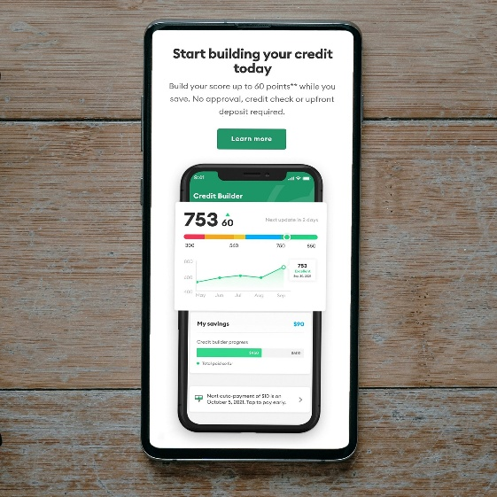
Case studies
Amazon’s AI recruitment tool
Facial recognition software
Credit-based insurance scores
Historical / label
Sampling
Measurement / proxy
Notes:
As before, I’ll cover three quick case studies to bring it to life:
1. Amazon’s AI Recruitment Tool
Amazon built a hiring algorithm trained on Cvs from previous successful hires — who were mostly male.
The AI learned to downgrade CVs that indicated the applicant was a female, like “women’s chess club,” effectively biasing against female applicants.
Example of historical and label bias.
When historical data reflects social bias, AI simply amplifies it.
2. Facial Recognition software
Studies found that facial recognition software had much higher error rates for dark-skinned women compared to light-skinned men.
This was caused by training datasets that were heavily skewed towards white male faces.
Example of sampling bias. Lesson here is that representation in data matters — models reflect who they’ve “seen.”
3. Credit-Based Insurance Scores
Credit scores are used in a number of jurisdictions as part of insurance pricing.
However, credit scores are correlated with socioeconomic status and race.
The impact is that consumers in poorer areas or with thin credit files may face higher premiums, even if their actual risk is low.
This is an example of measurement bias or proxy bias.
Despite being predictive, they raise regulatory and ethical concerns. In some U.S. states, their use is now banned or restricted.

Slide 22
What can we do about flawed data and unfair algorithms?
Design models that reflect risk not bias.
Audit for disparate impact across demographic groups.
Always question assumptions and data sources.
Avoid proxy variables for protected classes.
Work with legal, ethical, and data science teams.
Use interpretable, transparent models.
Notes:
So what can we do about it?
Design models that reflect risk, not bias. Our goal must be to build models that genuinely capture the underlying risks — not models that simply reflect historical inequalities or hidden prejudices. A technically strong model that embeds social bias isn't a strong model at all — it's a liability.
Audit for disparate impact across demographic groups. Once the model is built, we need to ask: are the outcomes fair? Regularly audit model outputs across demographic groups. If certain groups consistently receive worse outcomes without clear risk justification, that's a sign that bias — not true risk — could be at play.
Always question assumptions and data sources. Every model rests on assumptions and data. Treat these with healthy skepticism. Ask: where did this data come from? Who was left out? What assumptions am I making that might no longer hold true?
Avoid proxy variables for protected classes. Variables like postcode, educational level, or even hobbies might seem neutral — but they can act as hidden stand-ins for race, gender, or income. Always check if a 'neutral' variable is carrying discriminatory baggage.
Work with legal, ethical, and data science teams. Bias mitigation isn’t just a technical task. It needs collaboration across legal, compliance, ethics, and data science teams. Building fair models is a multidisciplinary effort — and it’s becoming a regulatory expectation, not just a moral choice.
Use interpretable, transparent models. Finally, if we can't explain why a model makes a decision, we can't defend it — to regulators, to customers, or to ourselves. Favor models that are interpretable and transparent. Complexity should never come at the cost of accountability.
In summary:
Data is not perfect, it may be insufficient or contain errors or biases
This can lead to flawed assumptions or modelling algorithms
We can and must do something about it.

Slide 23
Wrap up

Slide 24
Key takeaways
These risks can knock you off course
But you can and should do something about them
Start by giving these risks the time they need to be addressed
Notes:
The risks we have discussed today can knock you off course.
They are tricky to deal with.
But you can and should do something about them.
We’ve mentioned various techniques and considerations today.
Start by giving them the time they need to be addressed.

Slide 25
Questions
Comments
Expressions of individual views by members of the Institute and Faculty of Actuaries and its staff are encouraged.
The views expressed in this presentation are those of the presenter.

Slide 26
Appendix

Slide 27
Evaluate
Is there a reward available for taking the risk?
Can we reduce the likelihood of the risk occurring?
NO
NO
Reduce impact
Improve resilience
Eg: climate change
YES
YES
Find the risk / reward balance
Reduce likelihood
Improve resilience
Eg: solvency regime
Eg: global food shortage

Slide 28
Advocate
Examples of policy advocacy
Global investor statements
LCP’s climate policy asks
Responding to industry consultations

Slide 29
Collaborate

Slide 30
Collaborate
Working together amplifies your collective voices

Slide 31
What can we do about behavioural biases?
Acknowledge the biases exist and foster a culture of questioning
Challenge anchors and assumptions
Stress-test behavioural scenarios
Use quantitative bias detection tools
Diversify the decision-making group and protect against groupthink
Document cognitive risks

Slide 32
Identifying groupthink?
Warning signs and symptoms
Censorship
Censorship and self-censorship
Peer pressure
Stigma
Stereotyping and scapegoating
Moral high ground
Denial
Complacency and excessive optimism
Rationalisation and ignoring warnings
Illusion of unanimous decisions
Adapted from: “Victims of Groupthink: A Psychological Study of Foreign-Policy Decisions and Fiascoes” – Irving Janis, 1972

Slide 33
How can we protect against groupthink?
Leverage diverse personalities
Facilitator
Emotion / intuition
Cautious / risks
Optimist / benefits
Creative / ideas
Facts / data
Process / planning
Neutral facilitation
Contingency plans
Delphi method
Test assumptions
Group idea generation
Six Thinking Hats
Source: Adapted from Six Thinking Hats, Edward de Bono

Slide 34
What can we do about flawed data and unfair algorithms?
Design models that reflect risk not bias.
Audit for disparate impact across demographic groups.
Always question assumptions and data sources.
Avoid proxy variables for protected classes.
Work with legal, ethical, and data science teams.
Use interpretable, transparent models.

Slide 35
Identifying flawed data and unfair algorithms
Data audit
Impact testing

Slide 36
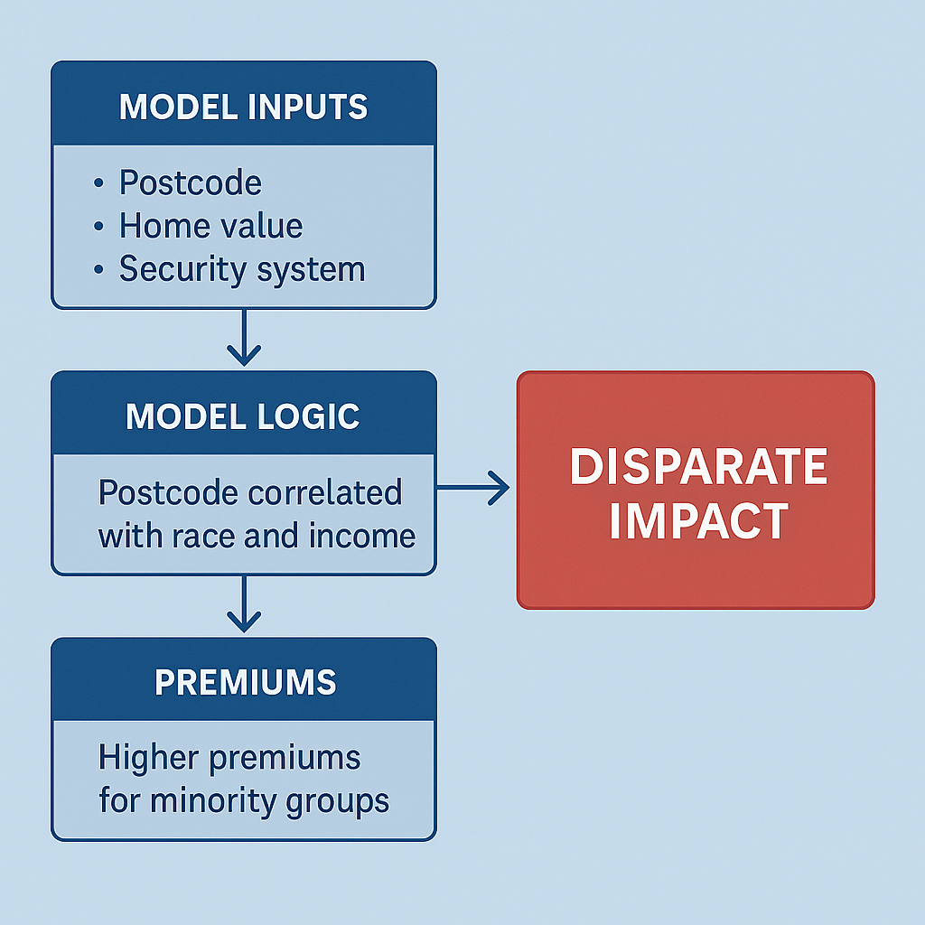
Test and adjust
Disparate impact test:
Define the groups
Define outcomes
Calculate selection rates
Apply 80% rule
Statistical testing
Feature audit
Fairness adjustment may be necessary
Disparate impact ≠ proof of discrimination

