Slide 1
Is coding critical to modern actuarial work?
Tom Durkin, LCP
30 April 2025

Slide 2
Agenda
Polling: www.ment.com
Code: 5561 0424
Or use QR code:
A bit about me
What do I mean by coding?
“Coding” vs. a “coding mindset”
Is coding critical?
Case studies
What about AI?
Where next?

Slide 3
A bit about me
General insurance actuary and NED
30+ years coding experience
Range of coding projects:
Wide range of calculation engines
Capital model design and build
Actuarial modernisation
Coding competitions and games
Actuary and coder – not a software engineer
Tom Durkin
Partner, LCP
tom.durkin@lcp.uk.com
LinkedIn

Slide 4
Where are you on your coding journey?

Slide 5
Where are you on your coding journey?

Slide 6
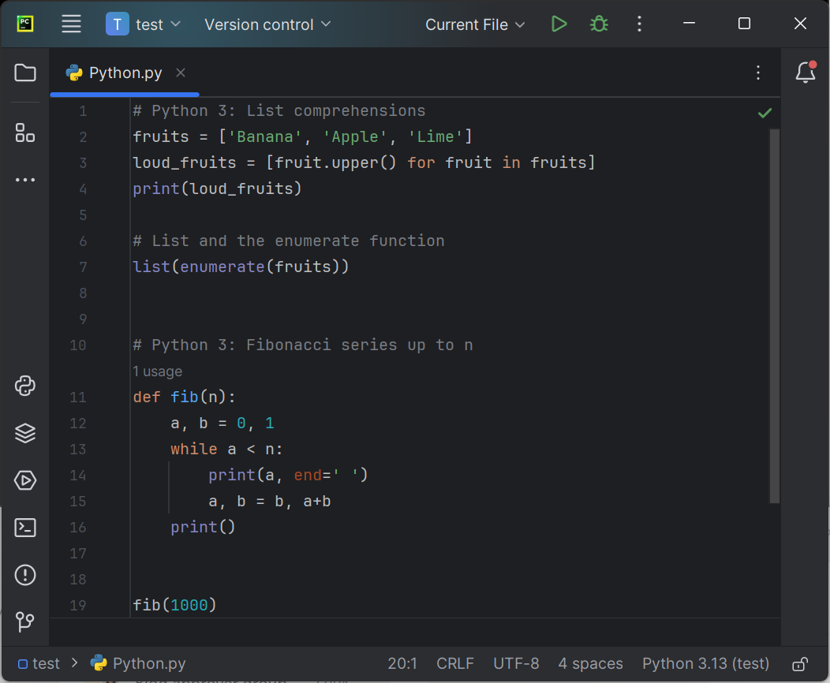
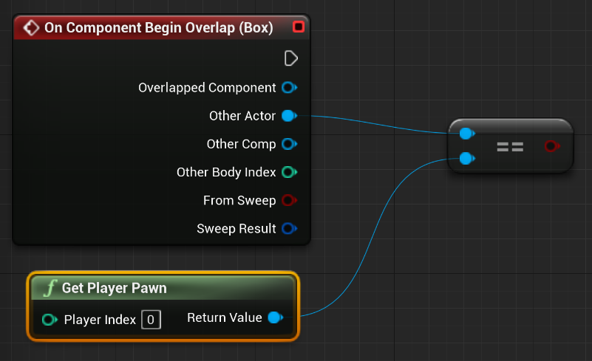
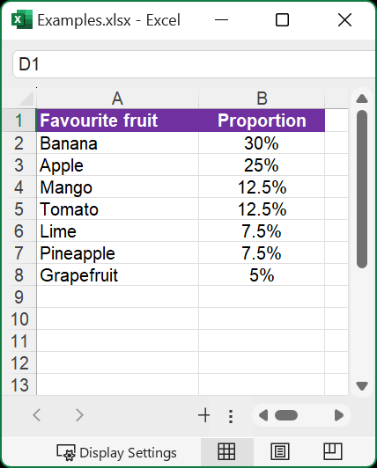
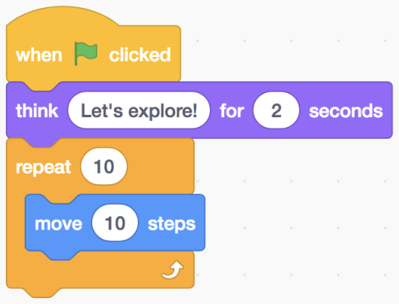
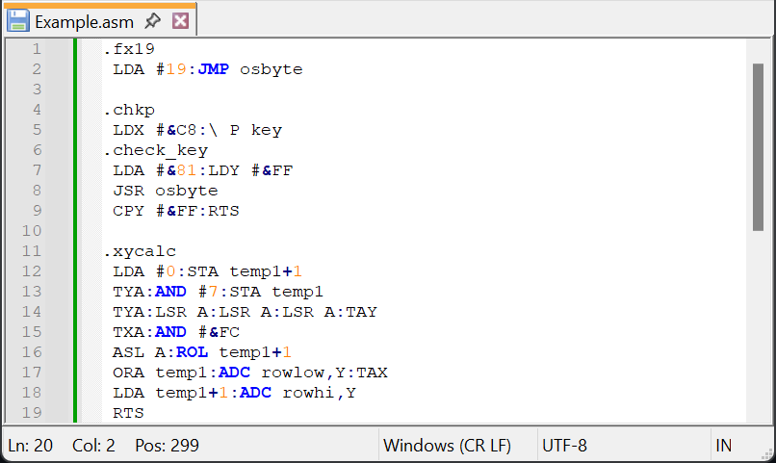
What do I mean by coding?
Sources: python.org, scratch.mit.edu, Unreal Engine, Crazee Rider 6502 (Kevin Edwards), Excel

Slide 7
“Coding” vs. a “coding mindset”
Programming languages
Problem solving
Syntax and semantics
Coding
Mindset
Systems thinking
Algorithms
Debugging
Structured approach
Development tools

Slide 8
Is coding critical?
A “coding mindset” is valuable for all actuaries
“Coding” remains a hugely valuable skill for many actuaries
Both are critical for the profession overall

Slide 9
Coding mindset – systems thinking
Assessing “size” of problem
How complex is the problem we are trying to solve?
What level of compute power/storage is needed?
Separation of concerns
What is our strategy on home grown vs. off-the-shelf solutions?
Are you clear on the inputs/output for each component?
Data model/ structure
Is the data structure clear and consistent throughout?
How often does it need to change, and why?
Symmetry
Do we routinely aim to maximise symmetry?
Where are there asymmetries, why?

Slide 10
Coding mindset – structured approach
Clear focus on the “problem”
Are we laser focused on the outcome throughout?
Are we using new tech because it’s there, or because it’s useful?
Prototyping
Do we routinely tackle the hard questions first?
How often does a “prototype” morph into the “solution”?
Testing
What parts of the work are tested? And what isn’t?
Does every test have a clear purpose?
Version control
Is version control good practice used across everything?
Have you checked that you can readily roll back?

Slide 11
Coding mindset
How often do you say it’s “not unreasonable”?

Slide 12
Getting started with coding
What programming language? | For many, a good starting point is Python, Visual Studio Code and GitHub
What development environment?
Where to start? | A specific project (eg) Codecademy (eg) Chat-GPT | A good book Advent of Code
I don’t have time! | Habit mindset 30min each day?
Additional workplace IT gotchas:
Software installation
Version control of packages
Information security/data protection

Slide 13
Taking your coding to the next level
Lots of potential ways – see what works best for you:
Work on real projects (either in or out of work)
Collaboration with other people
Build an interactive analytics dashboard
Become “native” in a second language
Technical deep dives (eg, data structures/containers)
Automate day to day tasks
Learn about unit testing
Books, articles and online course
CodeJams

Slide 14
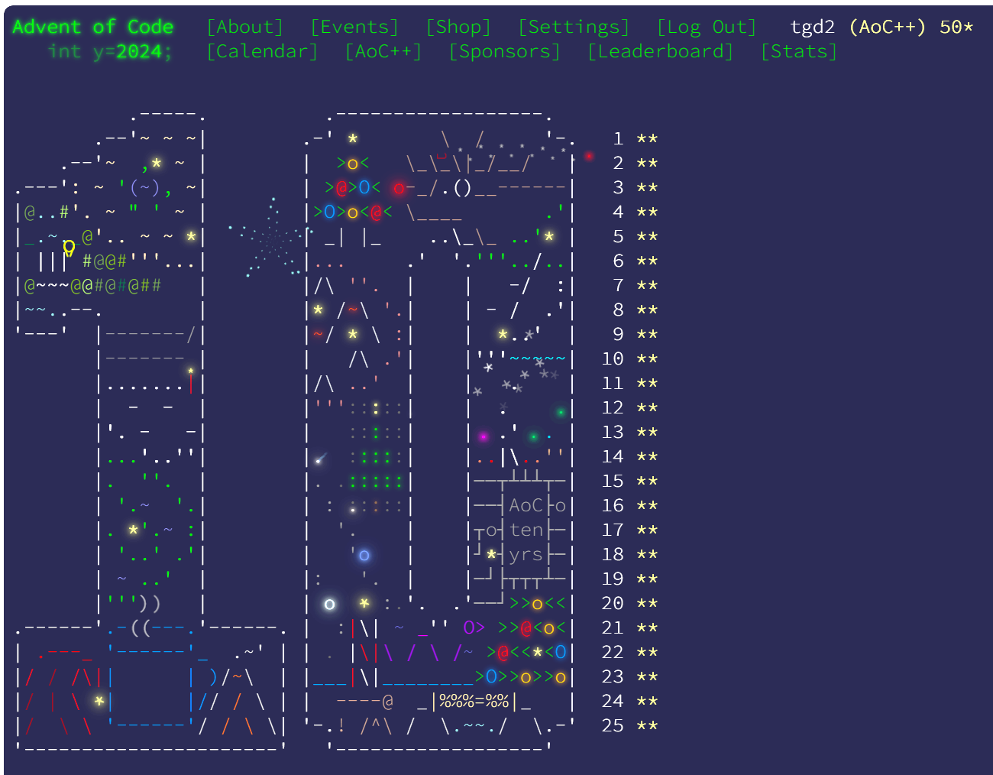
Advent of Code (highly recommended)
Daily coding puzzles released in December each year
Two parts per day – the second part typically being a lot harder!
First ten days or so relatively straightforward .. then it gets harder
No restrictions on coding language or approach
Great potential way to develop your coding skills

Slide 15
What has helped you most on your coding journey?

Slide 16
What has helped you most on your coding journey?

Slide 17
Case studies
Model review
Clear purpose Coverage Well defined tests Testing discipline
Use of Excel
Clear data structure Separating “front end” from data Structured approach to links
Deploying Python
Python engine for Technical Provisions Built in VS Code Deployed in Databricks

Slide 18
What about AI?
AI is a great tool, but the limitations need to be carefully managed

Slide 19
How to get the best from AI?
Initial code ready for human review
A great learning tool, including quickly checking syntax
Building out knowledge of programming techniques
Refactoring existing code
Interpreting error messages
Writing tests

Slide 20
Is coding critical?
A “coding mindset” is valuable for all actuaries
“Coding” remains a hugely valuable skill for many actuaries
Both are critical for the profession overall

Slide 21
Where next?
Questions to test your coding mindset
Ideas to start coding, or take it to the next level
Work collaboratively across your teams and the profession

Slide 22
Questions
Comments
Expressions of individual views by members of the Institute and Faculty of Actuaries and its staff are encouraged.
The views expressed in this presentation are those of the presenter.

Slide 23
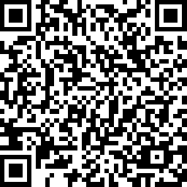
Feedback
Notes:
We would welcome your feedback on this event so we can ensure that we are delivering events that work for you, our members, so please do let us know how we are doing….

