Slide 1
A Cashless Society and a Central Bank Digital Currency-where are we now?
Ian Collier, Chairman of The IFoA Cashless Society Working Party

Slide 2
What is happening
Reduced usage of Cash
In 2008, 6 out of 10 transactions in the UK were made by cash.
By 2021 this had reduced to between 1 and 2 out of 10.
UK Payment Market Report suggests this could continue
Every previous forecast for the reduction of cash usage has underestimated the move away from cash.
We call this process of using less cash as “de-cashing”.

Slide 3
Joint Authorities Cash Strategy-JACS Safeguarding the UK’s Cash Infrastructure
Chaired by HMT and includes BoE, PSR and FCA- Formed after Call for Evidence on Cash and Digital Payments
Chancellor said government will bring forward legislation to protect cash.
9.3bn cash payments in 2019
5bn cash payments in 2022
8.6 bn contactless payments in 2019
17bn debit card payments in 2019
80% of cash withdrawals through Free To Use (FTU) ATMs
Cash withdrawals decline 21% in the year to Feb 2020
FTU ATMs decline 17.5% in two years to Feb 2020
Is legislation to protect cash necessary, sufficient or even undesirable?

Slide 4
Are Cards more expensive than Cash for retailers?
While card usage soared, so did the costs associated with accepting these payments. Retailers incurred costs of £1.3 billion just to accept card payments from customers in 2021
That works out at about 7p per transaction
Cash costs c £9.5bn to the economy of which £5bn is creating the infrastructure so cost per transaction is over £1.00 per transaction.
Why does Sainsbury offer “Cashback” to its customers?

Slide 5
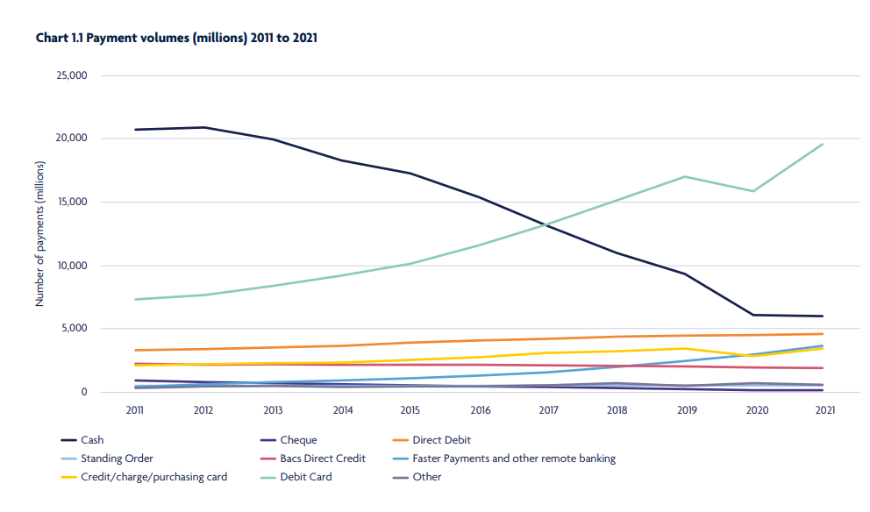

Slide 6
Benefits of a Cashless Society
Tax Evasion
Crime Reduction
Reduction of Illegal Immigration and modern day slavery
Estimate that use of cash costs 0.45% of GDP, circa £9.9 bn in UK
This includes maintaining the cash infra structure and the cost to the economy of handling cash.
Cash infrastructure costs about £5bn (LINK)
Reduction of Business Costs (why does Sainsbury’s offer cash-back?)
Negative Interest Rate Policies enabled
Automated Payment Transaction (APT) tax

Slide 7
The less use of cash will make the unit cost of cash usage uneconomic
Similar infrastructure cost of c£5n but 25% of transactions since 2008

Slide 8
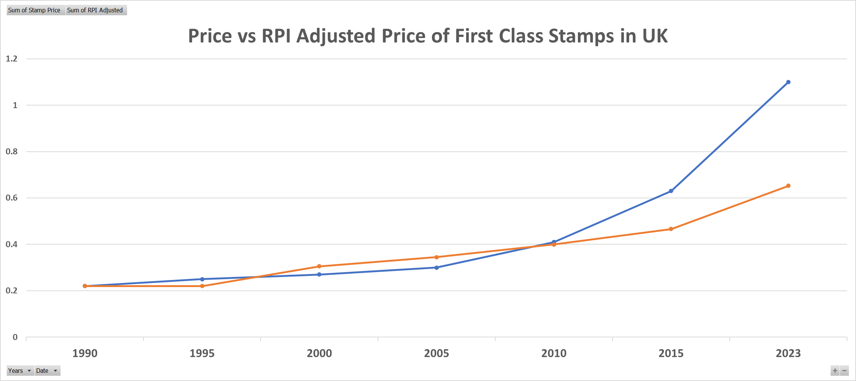

Slide 9
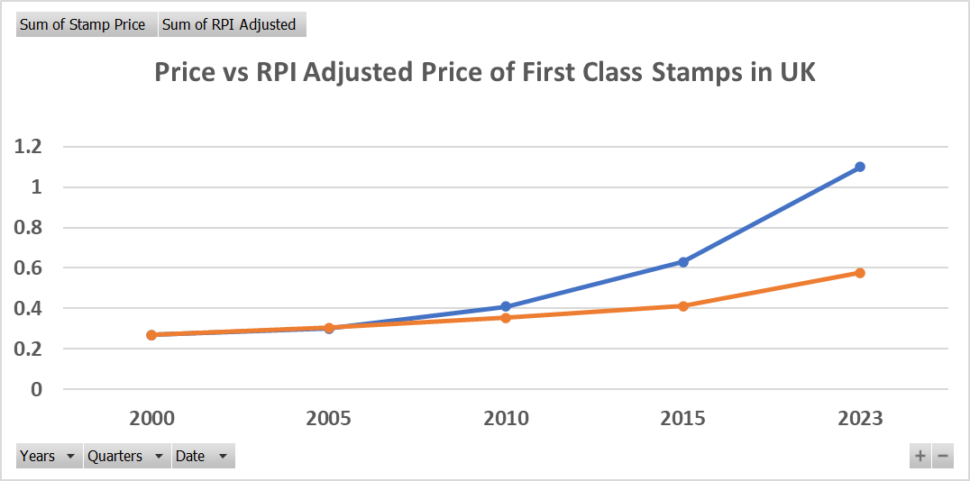

Slide 10
Risks and Issues
21 risks and issues highlighted in our interim paper “A Cashless Society- Benefits, Risks and Issues
Amongst them:
Totalitarian Society (Big Brother Syndrome).
Trust in Banks and Governments
Financial Exclusion
Digital Economy Readiness
Security of Transactions
Social Value of Cash
Sovereignty Risks and Financial Stability
Lack of competition
IT Outage

Slide 11
Political Objections to going Cashless
Totalitarian Society and invasion of privacy. This remains the largest and most difficult objection to solve.
Inconvenience to many people who rely on cash. [David Cameron vetoing the abolition of 1p and 2p coins proposed by George Osbourne]
Other problems probably solvable with a transition period of training

Slide 12
Financial Inclusion and the growth of mobile money
Difference between developed and developing countries
For developed countries, de-cashing can lead to financial exclusion, particularly for the unbanked, the technically naïve, the elderly, and often the poorest members of our society
In developing countries, it has increased financial Inclusion dramatically, although probably still leaving some people behind.

Slide 13
Financial Inclusion and the growth of mobile money
M-Pesa growth in Kenya and beyond
Safaricom, owned by Vodafone, enables SMS transactions.
Financially empowered the population, especially in rural regions and women.
No need for internet access, not smart phones.
96% of Kenyan families have access to M-Pesa.
Can developed countries learn from experience in Africa and elsewhere?

Slide 14
Consequences
Throughout the de-cashing process, the unit cost of providing cash will increase.
Access to cash will become more difficult to achieve, despite efforts to avoid that.
A poverty premium is likely to prevail as costs of cash usage increase affecting mostly the poorer elements of our society.
The CSWP has been arguing that legislation to ensure that cash remains available is not sufficient and that a de-cashing transition programme should be immediately instigated by government
Can the problem of privacy be solved?

Slide 15
Cryptocurrencies and Central Bank Digital Currencies
Cryptocurrencies, such as Bitcoin have gained much interest over the past few years.
Digital currency is a form of electronic money combined with new technology involving cryptography, peer-to-peer networking, databases and a system of consensus. We use the term digital currency to refer to cryptocurrencies like bitcoin, that is electronic money but with a blockchain component.
Central Banks are looking at Central Bank Digital Currencies.
A UK CBDC has been dubbed “Britcoin”
There are advantages regarding monetary control.
A CBDC could maintain seigniorage.
…but could jeopardise the fractional banking system.
For that reason, the BoE has suggested that “Britcoin” holders will not have accounts directly at the Bank. This weakens the ability to use a CBDC as a tool for monetary control
“Britcoin” probably held on digital wallets.

Slide 16
What would a “Britcoin” look like
It appears that the Bank has made the decision not to allow the public direct access to accounts with the BoE
So with reduced ability to affect monetary control, what is the point of its creation?
There are many doubters, including a former BoE Governor
However, if we were to go cashless then every pound note surrendered would result in the Bank requiring to pay the holder the equivalent sum into his bank account
With £80bn Notes in Circulation, that potentially is the amount of lost seignorage.
If a CBDC exists then the notes are replaced by the equivalent “Britcoins”
Britcoins could be kept in Crypto-style wallets ensuring privacy.
So is the best reason for a CBDC to prepare the Bank for a Cashless Society?

Slide 17
Questions
Comments
The views expressed in this [publication/presentation] are those of invited contributors and not necessarily those of the IFoA. The IFoA do not endorse any of the views stated, nor any claims or representations made in this [publication/presentation] and accept no responsibility or liability to any person for loss or damage suffered as a consequence of their placing reliance upon any view, claim or representation made in this [publication/presentation].
The information and expressions of opinion contained in this publication are not intended to be a comprehensive study, nor to provide actuarial advice or advice of any nature and should not be treated as a substitute for specific advice concerning individual situations. On no account may any part of this [publication/presentation] be reproduced without the written permission of the IFoA [or authors, in the case of non-IFoA research].

