Slide 1
Developing Better Retirement Products in the UK
Danni Brotherston FIA CERA
Esther Hawley FIA
Modelling Innovative Pre and Post Retirement Products Working Party

Slide 2
Agenda
01 | Introduction to the Working Party
02 | Background on the retirement market in the UK
03 | Existing and potential products for servicing consumer needs
04 | Our proposed framework for measuring success
05 | Conclusion and next steps
06 | Questions / comments

Slide 3
Introduction to the working party

Slide 4
Working Party Objectives
a selection of potential retirement products and/or investment techniques that could help improve the options available to consumers on retirement
a framework for assessing how successful the different approaches are when measured against consumer needs and wants
modelling to analyse the success of each suggested approach against the outlined framework
Paper 1
(Q1 2020)
Paper 2
(H2 2020)
Notes:
Cover off:
What our objectives are and what we’ve done so far (verbally talk about literature review and what we’ve been focusing on)
We have completed 1) which is what our focus today is on, with a paper published soon, with our focus next year being on 3).

Slide 5
Background on the retirement market in the UK

Slide 6
Background
Notes:
Cover off:
Pensions freedoms introduced – great, more choice.
BUT This has led to people moving away from purchasing annuities and instead drawing money down from their pension savings – which brings with it more risks…AND more people transferring out of DB pension schemes

Slide 7
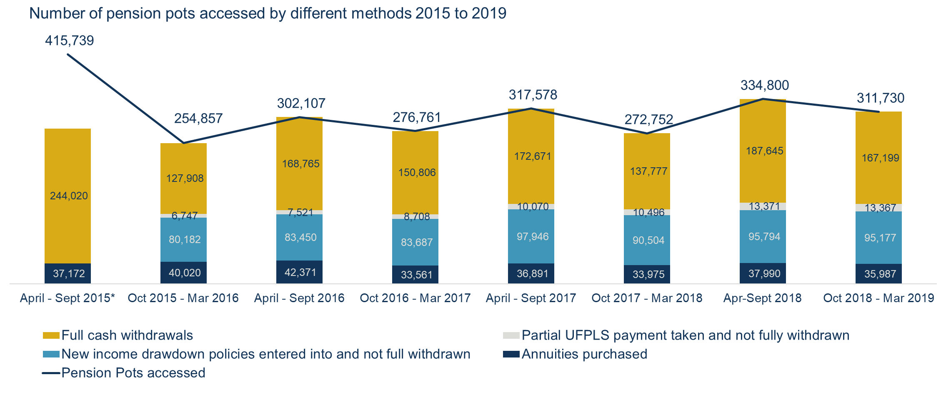
Background
Source: Barnett Waddingham; compiled from data published by the Financial Conduct Authority (FCA)
* Figures for drawdown sales and UFPLS were not collected in the same format between July and September 2015 and were therefore omitted by the FCA.
Notes:
Cover off:
Pensions freedoms introduced – great, more choice.
BUT This has led to people moving away from purchasing annuities and instead drawing money down from their pension savings – which brings with it more risks…AND more people transferring out of DB pension schemes

Slide 8
Background
Source: The Pensions Regulator (via a Freedom of Information Request from Royal London)
Notes:
Cover off:
Pensions freedoms introduced – great, more choice.
BUT This has led to people moving away from purchasing annuities and instead drawing money down from their pension savings – which brings with it more risks…AND more people transferring out of DB pension schemes

Slide 9
Background
Risks to consider in retirement:
Longevity
Inflation
Market
Interest Rate
Investor Behaviour
Sequencing Risk
Notes:
Cover off:
Cover risks that individuals are exposed to in retirement (especially those if they don’t have an annuity)
However, four years on from the introduction of the new freedoms, there remain few new, innovative, solutions available to consumers in the UK market. What are the reasons for this, and what can be done to support further innovation in this area?

Slide 10
Existing and potential products for servicing consumer needs

Slide 11
Example of products considered
Annuities
Immediate annuity
Deferred annuity
Variable annuity
Other products
Drawdown
Equity release mortgages
Tontines
With-profits

Slide 12
Products which merit further exploration
Annuities
Traditional annuity
Deferred annuity
Variable annuity
Other products
Drawdown
Equity release mortgages
Tontines
With-profits

Slide 13
Deferred annuity
Product Features
Similar to immediate annuity but payment starts after a deferral period
The terms of the future stream of income at outset
Funds are still accessible during deferral period
Available in countries such at US, Australia and Denmark
Challenges
Providers need to hold significant capital requirement to cover
longevity risk
market risk
Difficulty in sourcing sufficiently long assets to back deferred annuities

Slide 14
Variable annuity
Product Features
Seen as a crossover between annuities and drawdown products
Offers flexibility of drawdown while retaining some level of guarantees to consumers
Available in countries such as US and Japan
Challenges
Products were considered to have high guarantee charges
The design of the products are relatively more complex than alternative

Slide 15
Equity release mortgages
Product Features
Lump sum (size depends on age and property value)
Secured against property
Loan and interest (depending on product design) repaid upon death
More than one tranche is possible (up to maximum LTV)
Allows to maintain place of residence
Can be used for financing of care, financing ongoing expenses, one off large expenses (grandchildren’s education, old age care) etc.
Previous history
No debt ceiling (many pensioners were left with significant debt to repay).
Variable interest on loans
Design assumed property prices will only ever go up

Slide 16
Equity release mortgages (continued)
Market opportunities
Rising demand for old age care
Lack of pension savings
Rapidly growing market (£3.94bn lending in 2018¹)
Product risk
Borrower has no incentive to maintain the property
Behavioural/perception aspects (e.g. viewed as failure to save for retirement, reduced inheritance)
Recent expansion of providers
Product improvement: No Negative Equity guarantees
Still relatively low LTV ratio
Regulatory scrutiny
Source: (1) Equity Release Council Spring 2019 Market Report.

Slide 17
Tontines
Product Features
Pooling of a large number of individuals
Distributions are actuarially fair/equitable
Income is not guaranteed
Schemes can be designed to operate in perpetuity
Longevity risks remains with individuals, making it more affordable
Challenges
Negative perceptions linked to tontines
Immoral to be benefit from someone’s death
Lottery structure for some schemes
There are a various variations of tontines, some of which could be complex

Slide 18
Our proposed framework for measuring success

Slide 19
Some consumer needs
Management of longevity risk
Low probability of running out of funds
Reliability of income
Sufficient income to live on from year to year
e.g. inflation protection, not too volatile
Flexibility
Ability to change solution over time
Possibility of leaving a bequest
Perception of good value for money
Simplicity
Simple for consumers to understand
Low maintenance for the consumer
Requires minimal input from consumer on ongoing basis

Slide 20
Metrics for measuring success
Quantitative measures
Stochastic simulations for each combination of products and assess:
Probability of nominal income >x% of initial income
Probability of real income >y% of initial income
Probability of total value >z% of starting fund value
Qualitative measures
Level of simplicity / ease of understanding
Any ongoing requirements
Level of flexibility in early years
Longevity protection after age 95

Slide 21
Conclusions and next steps

Slide 22
Conclusions
There are opportunities in the current retirement market
The working party believes that combination of products could offer attractive solutions for consumers
Getting this right will be of great benefit to both consumers and providers

Slide 23
Next steps
Publish first paper in Q1 2020 setting out
More detailed framework for measuring success
The combination of products to perform modelling
Perform modelling on the selected combinations and share results of analysis in second paper

Slide 24
Questions
Comments
The views expressed in this presentation are those of invited contributors and not necessarily those of the IFoA. The IFoA do not endorse any of the views stated, nor any claims or representations made in this presentation and accept no responsibility or liability to any person for loss or damage suffered as a consequence of their placing reliance upon any view, claim or representation made in this presentation.
The information and expressions of opinion contained in this publication are not intended to be a comprehensive study, nor to provide actuarial advice or advice of any nature and should not be treated as a substitute for specific advice concerning individual situations. On no account may any part of this presentation be reproduced without the written permission of the IFoA.

