Slide 1
Evolution of Economic Scenario Generators
Andrew Smith & Parit Jakhria
Extreme Events Working Party
Staple Inn, 26th February 2018

Slide 2
Chair’s introduction
Andrew Chamberlain

Slide 3
Economic Scenario Generators
Evolution & Lessons Learnt from History

Slide 4
Abstract
“Some UK insurers have been using real-world economic scenarios for more than thirty years. Popular approaches have included random walks, time-series models, arbitrage-free models with added risk premiums or one-year distribution fits. Based on interviews with experienced practitioners, this workshop traces historical model evolution in the UK and abroad. We examine the possible catalysts for changes in modelling practice with a particular emphasis on regulatory and socio-cultural influences. We apply past lessons to provide a non-technical perspective on the direction in which firms may develop real world multi-period economic scenario generators in future.”
- Extreme Events Working Party

Slide 5
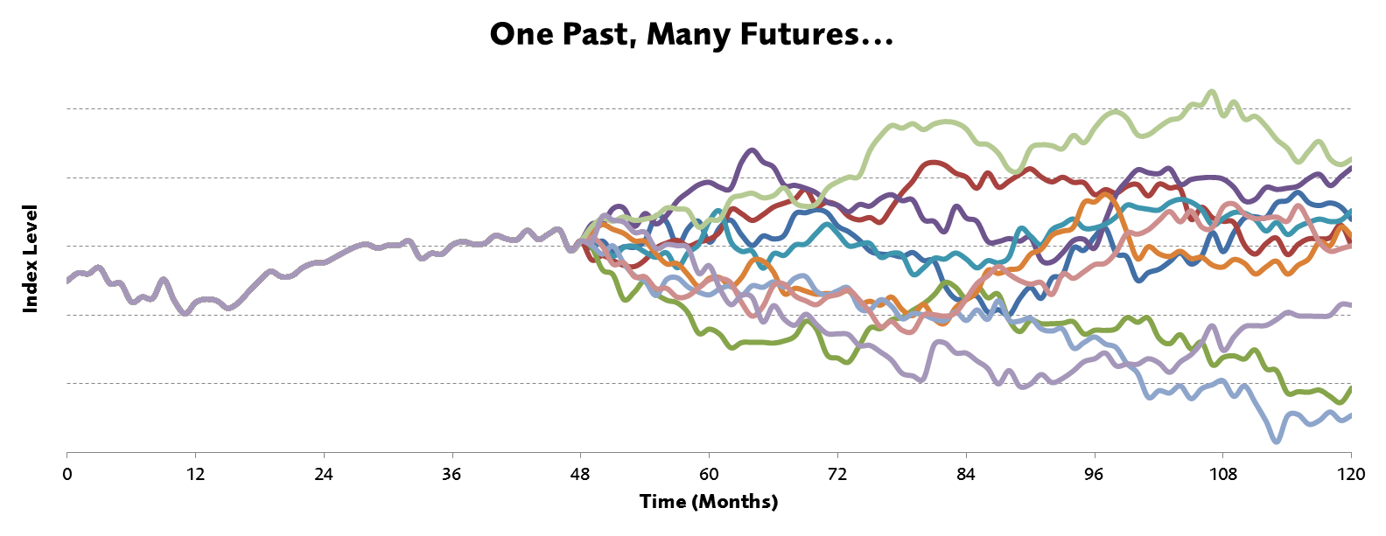
The need for stochastic models
We have only one past, but unfortunately face many possible futures…

Slide 6
Interviews & Research
Selected key individuals over an extended historical period (1970s to 2010s)
Have 14 interviews so far, with others in progress…
Gabriela Baumgartner | John Hibbert
Andrew Candland | Adam Koursaris
Stephen Carlin | Patrick Lee
Andrew Chamberlain | John Mulvey
David Dullaway | Craig Turnbull
Adrian Eastwood | Ziwei Wang
David Hare | David Wilkie
Notes:
Already spoken to folk whose ESGs activities covered a broad range of actuarial activity - not just Life Insurance work (of course, just for Life work there is a broad range from Risk Management, valuation, capital calculation & forecasting).
Broad range of Developers and Users. We chose Users who were influential at a time when use of ESGs was changing. We have already completed interviews with some of the key Developers. Noteworthy that although many of these folk no longer "Developing" they still have a keen interest, and in some cases, you suspect "unfinished business" involving ESGs. One of the later questions was about where ESGs will go next – maybe some of you will be inspired by the thoughts of our interviewees
Already a distinction between ACADEMIC models and PURCHASED models. An ACADEMIC model may be (VERY) FULLY described in a Journal and the originator doesn’t get a royalty every time the model is used – indeed the model may be used for purposes for which its Developer is unaware. A PURCHASED model often comes with updated calibrations and continuing support and access to the Developer. We will return to this distinction when going through the responses to our questions

Slide 7
Evolution of Economic Scenario Generators Phases over time
CONFIDENTIAL

Slide 8
Evolution of Economic Scenario Generators
1970s
Random Walk
1980-90s
Time Series
2000s
Option Pricing
2010s
1-Year VaR
Multi-Year?
Evolution Factors
Technical criteria (theory driven or data driven)
Social criteria, often comprised of exogenous factors
Exogenous / endogenous that drove the modelling jump across phases
EEWP Activities
Conduct interviews with key ESG players over the past few decades | We explore what lessons and themes we can learn from past developments? | Postulate what the next phase may look like?

Slide 9
Phase A – Random Walks
A significant step up from deterministic models
Leveraged the rise of computing power since the 1950s, together with the Monte Carlo processes in physics
Captures one general factoid, that asset returns in different periods are independent and identically distributed
Small number of intuitive parameters

Slide 10
Phase B – Time Series Models
Captured developments in statistics e.g. Box and Jenkins (1969) Time Series Analysis – Forecasting and Control
A. D. Wilkie (1984) – A stochastic Investment Model for Actuarial Use; Presented to Faculty of Actuaries, published in a peer reviewed journal.
Extensively used in Investment Modelling

Slide 11
Wilkie Model vs Random Walks
Wilkie Model
Published model in a peer reviewed journal, discussed by the Faculty of Actuaries, and reviewed in several other published papers.
Recommended parameters included, and easy to code in a spreadsheet
Use of static “strategic” asset allocation modestly improves expected return for an acceptable level of risk, by increasing equity allocation or making portfolios more efficient (according to the model).
Some Difficult Questions
Compared to a random walk, Wilkie’s equity volatility term structure implies shares are a better long term match for long term inflation linked liabilities.
Widespread use of Wilkie and similar models accompanied a general increase in pension scheme equity allocations in 1980-1995;
But was the increase because of the Wilkie model?
Random Walk
…
…
Wilkie
…
…
…

Slide 12
Phase C1 – Option Pricing Models
Very much theory driven
Pricing of options and other derivatives, under idealised (frictionless market conditions)
Fisher Black, Myron Scholes (1973) The Pricing of Options and Corporate Liabilities
J. Hull, A White (1990). Model of future interest rates
Often different bottom-up models for different asset classes, challenging to consider from a holistic perspective

Slide 13
Why did Option Models become Popular?
Crisis
Post Equitable Life, a general realisation that embedded “Cost of Guarantees” was a critical factor for insurance company balance sheets
Regulations
In 2003 the FSA introduced realistic reporting (for UK with-profits funds), which required ‘market consistent’ arbitrage free models
Arbitrage Free
This condition was difficult to achieve from a Wilkie Model; led to new avenues. Adding risk premia also retained some Real World benefits.
Ideas from Banking
Influence of ideas from banking option pricing models. These were more advanced at asset class level (and linked to markets).

Slide 14
Phase C2 – One Year VaR
Data driven
Use of distributions imposed by regulations requiring 1 in 200 event. ICAS, Solvency II
Focus on tails of distribution, kurtosis
Self-assessment introduced by the FSA with effect from 31.12.2004 (GENPRU 2.1.6)
Extreme Events Working Party created and published work on different asset classes.

Slide 15
Uses, Awareness and Challenges over Time
CONFIDENTIAL

Slide 16
Uses and Awareness
ESG's now used much more widely than was the case in the past in particular for valuation and reporting, although some core uses have persistent over time.
Valuation & Reporting
Capital and Risk Modelling
Investment Strategy
Product Development / Pricing
Business Strategy
Others
Core Model

Slide 17
The challenge inherent in stochastic asset models
The increasingly global nature of the assets
Long dated liabilities, which require extrapolation in time
Capital regulations, which require extrapolation in terms of probability

Slide 18
The Challenge
A truly accurate model of the (asset) world would potentially be as large as the asset world itself! The problem is compounded by the need to extrapolate in time and probability. Beware of complexity, challenge to summarise the universe efficiently

Slide 19
Have ESGs captured material risks?
These are difficult to predict, and often results in over or underestimation of risks
!! Negative rates + have been completely missed by some models, and large fall in rates significantly underestimated
Regime Changes
Negative Rates
Broadly captured material economic risks over time.
“A continual learning process to develop models against the backdrop of real world experience”.
Parameterisation of extreme events

Slide 20
Factors Driving Change Historically & What the Future Holds
CONFIDENTIAL

Slide 21
Factors Influencing Change in the Past
Most interviewees have suggested changes regulatory led, e.g. move to market consistent valuations led by the FSA
Some changes have been driven by unforeseen changes in the economic environment, e.g. negative interest rates currently
Some user led by shortcomings in ESG's and some have been developer led, e.g. the Wilkie model introducing stochastic modelling for the reserving of guarantees

Slide 22
Examples of Technical and Social Criteria
Technical Criteria
Social Criteria
Goodness of fit
Goodness of fit to empirical Data
Mathematical Tractability
Closed form solutions, tractable computations
Accuracy
Replicating prices of financial instruments
Statistical Properties
Desirable properties e.g. unbiasedness, robustness and efficiency
Back-testing
Predicting power outside the sample used for calibration
Comparison
e.g. regulatory requirements via comparison of firms
Simplicity
e.g. ease of design, coding, parameter estimation.
Control
Ability to control model output
Compatibility
model output and input comparable with requirements
Auditable
model output can be intuitively explained to layperson
Commercial
Commercial timescale and budget constraints.

Slide 23
What will determine Future Models?
The history of scenario generators is not one of steadily increasing technical sophistication, but is impacted by occasional jump processes
New Asset Classes
(e.g. alternative assets)
Economic Cycles
Multi-Period Real World
Structure and Granularity
Evolutionary Factors
New Regulations
Market Crises
Disruptive Influences
(e.g. developments in Big Data)
Social Influences
(e.g. “factor” modelling)
Exogenous Jumps

Slide 24
Bridging Data and Economic Theory
Random Walk
Empirical Data driven
Time Series
Economic Theory Driven
Option Pricing
1-Year VaR
Multi-Year??

Slide 25
Can we Dust off the Time Series Model for Multi Year?
Realism
Business needs
Leptokurtosis
Serial correlation
Volatility clustering
Parameter / model risk
Economic cycles
Intuitive Parameters
Visibility of key judgment
Business impact
Validation
Flexibility
24

Slide 26
Topics / Discussion points
- Stories of ESG success or failure?
- Any international experience to share?
- how do procurement processes affect the available models?
- What is your view of publication vs proprietary models?
- How do you decide on the complexity for different purposes?
- What is the relative importance of judgement on model design vs parameter choices?

Slide 27
Thanks
A large thanks to the members of the Extreme Events Working Party, in particular Parit Jakhria, Sandy Sharp, Andrew Smith, Andrew Rowe, Ralph Frankland and Tim Wilkins.
We also owe large debt of gratitude to a number of key players in the stochastic modelling space who have been generous with their time and thoughts as we seek to uncover some of the historic drivers of change.

Slide 28
Questions
Comments
The views expressed in this [publication/presentation] are those of invited contributors and not necessarily those of the IFoA. The IFoA do not endorse any of the views stated, nor any claims or representations made in this [publication/presentation] and accept no responsibility or liability to any person for loss or damage suffered as a consequence of their placing reliance upon any view, claim or representation made in this [publication/presentation].
The information and expressions of opinion contained in this publication are not intended to be a comprehensive study, nor to provide actuarial advice or advice of any nature and should not be treated as a substitute for specific advice concerning individual situations. On no account may any part of this [publication/presentation] be reproduced without the written permission of the IFoA [or authors, in the case of non-IFoA research].

Slide 29
Closer
Paul Fulcher, Nomura

Slide 30
Thank you for attending

