Slide 1
Emotional Intelligence and Professional Success – the other side of the equation?
Clive Elwood
Richard Galbraith

Slide 3
What are you hoping
to get from this webinar?

Slide 4
Structure
What is Emotional Intelligence?
Why is it useful?
Noticing emotions in ourselves and others
Noticing emotions in ourselves
Emotions in the workplace
How can we develop it?
How do we apply it?
Self management
Regulating our emotions

Slide 6
Self regulation
Empathy
Motivation
Social skills
Emotional intelligence
Self awareness

Slide 7
Biology of Emotion
Mirror Neurons
Resonance
Chemical Reactions – Dopamine, Oxytocin, Serotonin, Endorphins, Adrenaline, Cortisol*
Mindful Coaching – How Mindfulness can Transform Coaching Practice (Liz Hall, 2013), p59
*How the chemical reactions in your brain can make you super emotional and how it get over it ? | LinkedIn

Slide 8
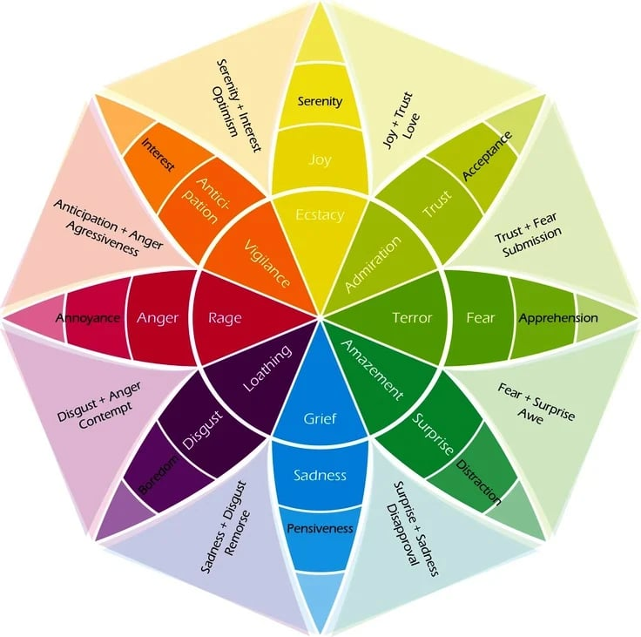
Wheel of Emotion
Emotion Wheel: What it is and How to Use it to Get to Know Yourself (betterup.com)

Slide 9
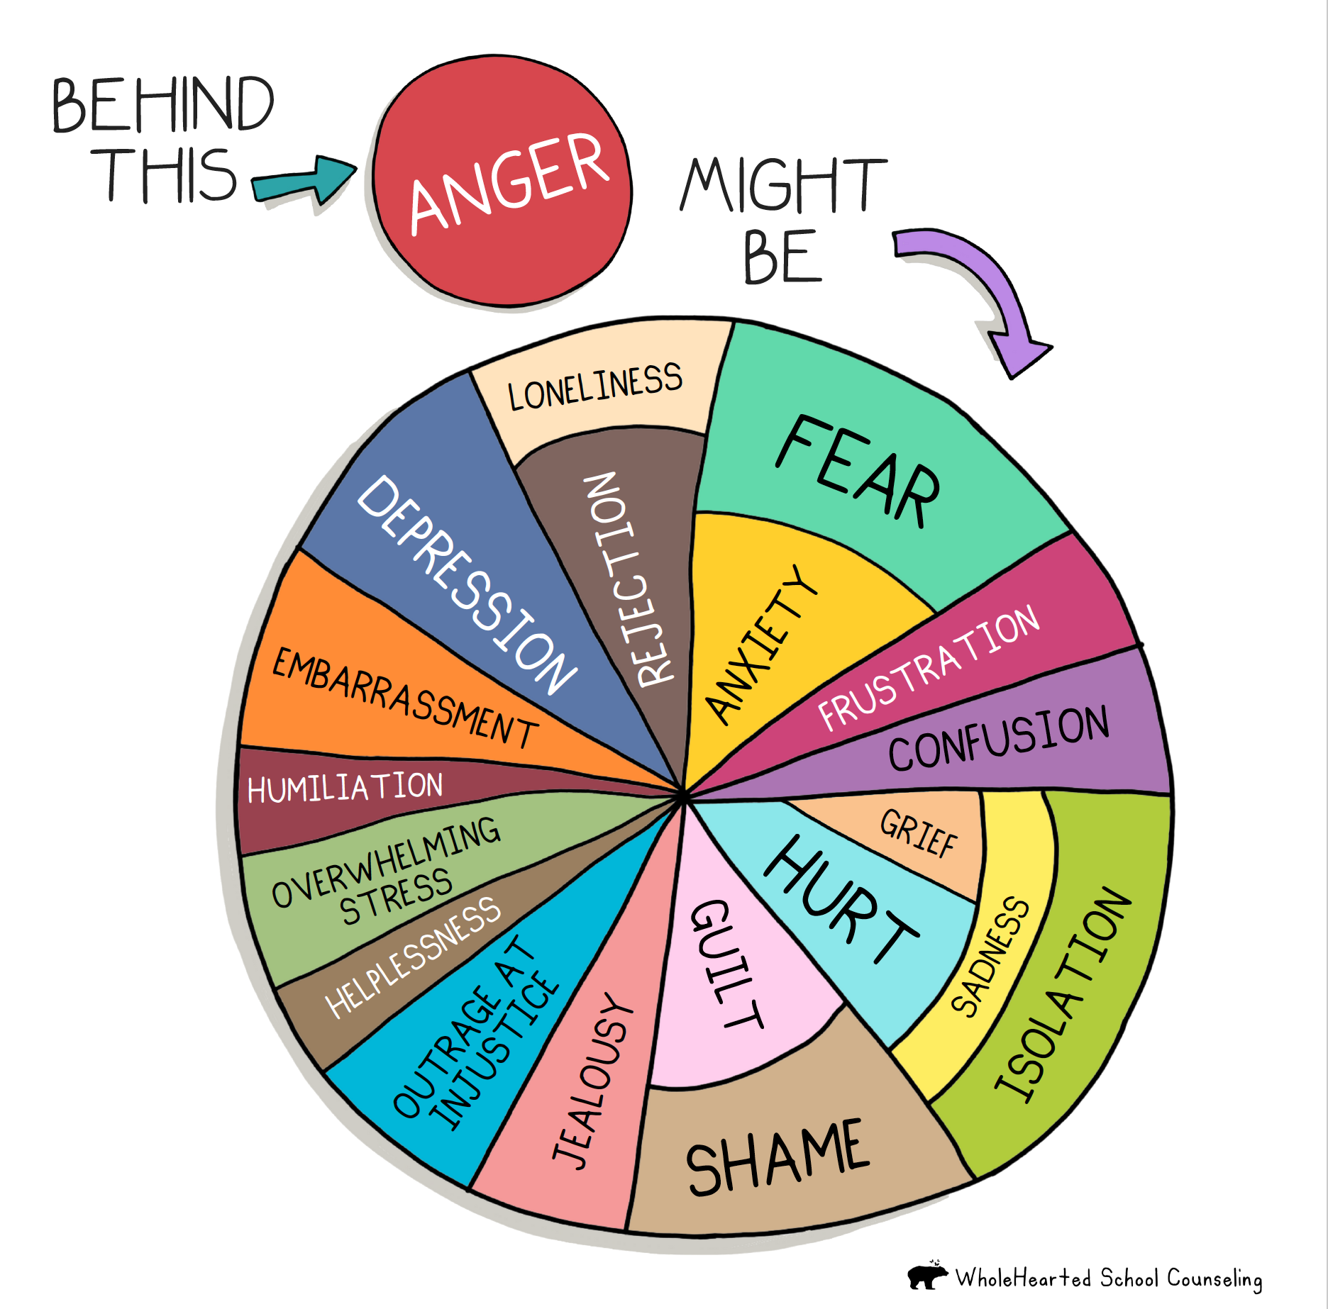

Slide 10
Diversities in EI
Noticing
Interpreting
Empathising
Responding
Regulating

Slide 11
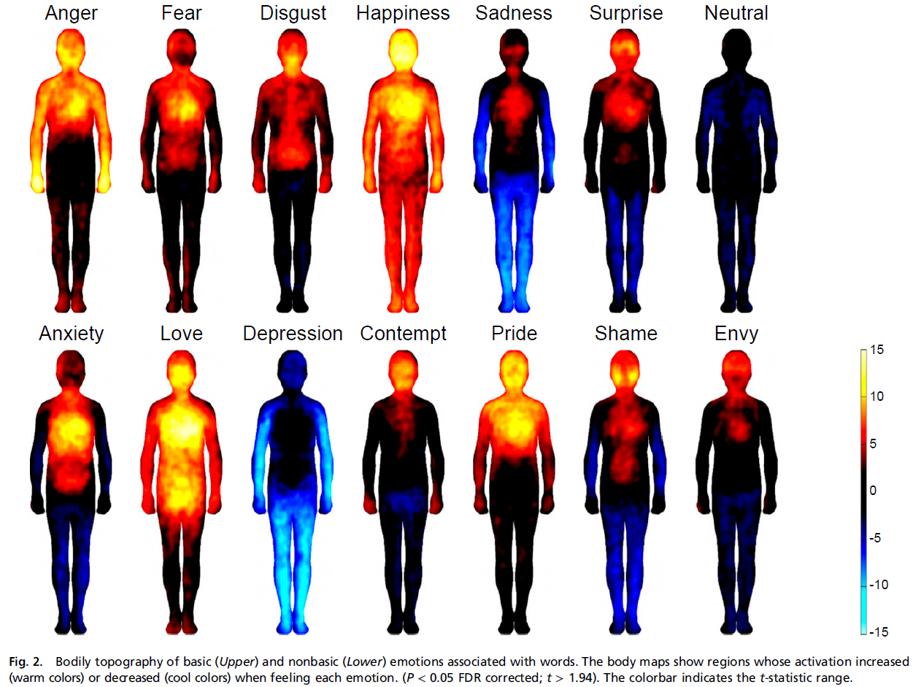
Feelings – Bodily Maps of Emotion
In 5 experiments, participants were shown two silhouettes of bodies alongside emotional words, stories, movies or facial expressions.
They were asked to colour the bodily regions whose activity they felt increasing or decreasing.
Different emotions were consistently associated with statistically separable bodily sensations across experiments.
Bodily maps of emotions – Nummenmaa, Glerean, Hari, Hietanen, 2013

Slide 12
A mindful minute
Camera/microphone on or off
Sit or Stand, feet flat on the floor
Hands in lap (or by side) shoulders and jaw relaxed
Close your eyes or relax gaze and focus on the breath
Breathe normally, and count breaths
Notice thoughts and feelings
Accept them without judgement

Slide 13
What did you notice?

Slide 14
Drivers
Data

Slide 15
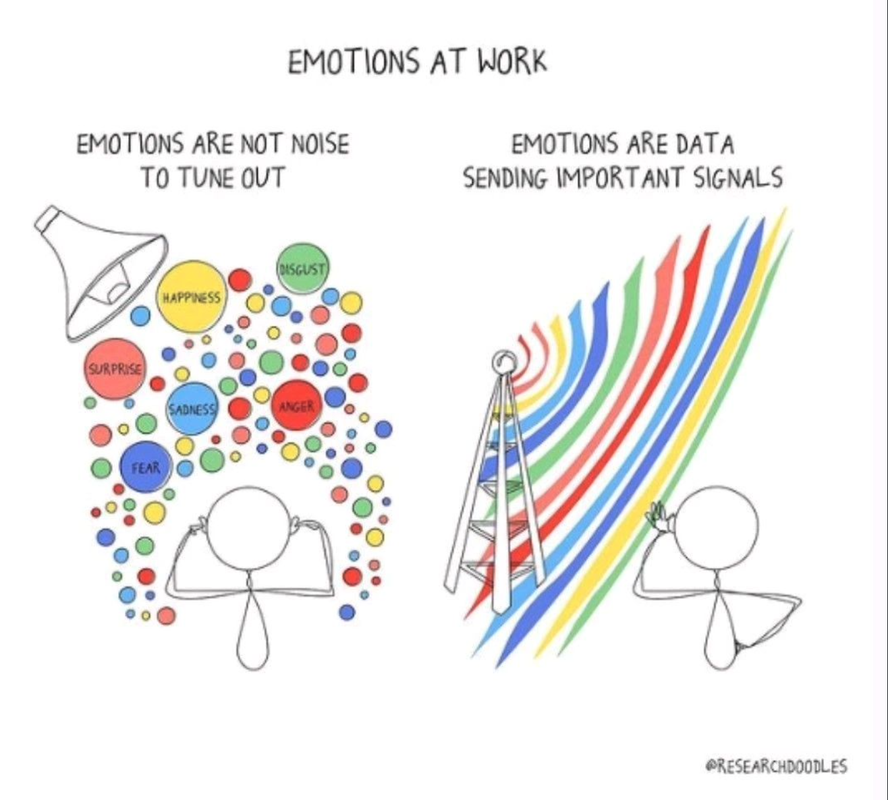

Slide 16
Introduction – Emotional Intelligence and Empathy
What is Emotional Intelligence?
The ability to perceive, understand, and regulate emotion.
Why is it important for us in business?
Studies show that people with high EI have greater mental health, job performance, and leadership skills
Can we develop EI?
One framework (Lynn’s model* of EI) is:
Self-awareness and Self-Control
Empathy
Social Expertness
Personal Influence
Mission, vision and Guiding principles.
^https://en.wikipedia.org/wiki/Emotional_intelligence
*The EQ Difference, Adele B. Lynn, 2005

Slide 17
Biology of Emotion
“You never really understand a person until you consider things from his point of view…until you climb inside of his skin and walk around in it.” – Atticus Finch, To Kill a Mockingbird (Harper Lee)
There is a biology of emotion
Can we sense Emotion?
Can we learn this?

Slide 18
Emotional Intelligence at Work
The Role of Emotional Intelligence in Professional Success
Emotional Intelligence and High IQ Professions
Vision
Focus
Social Skills
Influence
EI?
IQ?

Slide 19
The Role of Emotional Intelligence in Professional Success - Leadership
Influence
Team Leadership
Organizational Success
Self-Confidence
Achievement drive

Slide 20
Mindfulness Practice for Developing Emotional Intelligence
Centering
Come to a standing position
Take a few deep breaths
Mindful Minute
Sit or Stand, feet flat on the floor
Hands in lap (or by side) shoulders and jaw relaxed
Three Minute Breathing
Body Scan
Imagine a vertical line from head through body to feet
Move arms out to the sides so you occupy space
Imagine some space behind you
Tune in – take some deep and relaxed breaths and tune into what matters to you.
Close your eyes or relax gaze and focus on the breath
Start the timer, and breath normally, and count breaths
Start with 10 mins
Invite yourself to be open, gentle and curious, to let go
Sit down (or lie down if comfortable to do so)
Relax shoulders, take a few deep breaths
Squeeze each muscle as you work down your body (face, eyes, mouth, arms, hands, to feet)
Focus on each muscle, what do you sense?
Note what you feel but don’t judge or linger
Sitting, lying or standing, adjust posture so your shoulders are relaxed, jaw loose.
Close eyes or gaze gently downwards, set motivation for practice
During the 1st minute: what are your thoughts? What are your feelings? What are your sensations?
During the 2nd minute, focus on the in and out breath as an anchor
During the 3rd minute, widen perspective and sense whole body, and environment, sounds and smells.

Slide 22
What stories can you share about EI in the workplace?

Slide 23
Emotional Contagion
Definition – Emotional Contagion is a form of social contagion that involves the spontaneous spread of emotions and related behaviours. Such emotional convergence can happen from one person to another, or in a larger group. Emotions can be shared across individuals in many ways, both implicitly or explicitly.
Mirroring Emotion
Conscious or Subconscious
Good day or bad day
Meetings
One-to-Ones
Office Environment

Slide 24
Types of empathy
Cognitive (Awareness)
Active (Compassion)
Emotive (Resonance)

Slide 25
Empathy v Being Empathetic
Empathetic - Showing an ability to understand and share the feelings of another
Empathy - The ability to recognise, appreciate and be compassionate towards the feelings of another
Notes:
Empathy is descriptive, empathetic is active

Slide 26
Can we develop Emotional Intelligence?
What is EI at its core?
Noticing, accepting and regulating our emotions
Mindful awareness, acceptance and curiosity
“Mindfulness meditation is an effective way of training EI. Mindfulness is a form of meditation based on the ability to bring one’s attention to what they are currently experiencing in the present moment, accepting it without judgement and identifying the sensations, emotions and thoughts”*

Slide 27
Using the coaching relationship for developing EI

Slide 28
What are you taking away
from today?

Slide 29
Questions
Comments
The views expressed in this [publication/presentation] are those of invited contributors and not necessarily those of the IFoA. The IFoA do not endorse any of the views stated, nor any claims or representations made in this [publication/presentation] and accept no responsibility or liability to any person for loss or damage suffered as a consequence of their placing reliance upon any view, claim or representation made in this [publication/presentation].
The information and expressions of opinion contained in this publication are not intended to be a comprehensive study, nor to provide actuarial advice or advice of any nature and should not be treated as a substitute for specific advice concerning individual situations. On no account may any part of this [publication/presentation] be reproduced without the written permission of the IFoA [or authors, in the case of non-IFoA research].

Slide 30
Resources for Emotional Intelligence
https://www.betterup.com/blog/emotion-wheel
https://wholeheartedschoolcounseling.com/free-resource-library/
Bodily maps of emotionsLauri Nummenmaa, Enrico Glerean, Riitta Hari,and Jari K. Hietanen PNAS 111 (2) 646-651 https://doi.org/10.1073/pnas.1321664111
(2) The Relationship between Emotional Intelligence and Work-Life Balance | LinkedIn
The EQ Difference, Adele B. Lynn, 2005
Jiménez-Picón N, Romero-Martín M, Ponce-Blandón JA, Ramirez-Baena L, Palomo-Lara JC, Gómez-Salgado J. The Relationship between Mindfulness and Emotional Intelligence as a Protective Factor for Healthcare Professionals: Systematic Review. Int J Environ Res Public Health. 2021 May 20;18(10):5491. doi: 10.3390/ijerph18105491. PMID: 34065519;
Mindful Coaching – How Mindfulness can Transform Coaching Practice (Liz Hall, 2013), p59
How the chemical reactions in your brain can make you super emotional and how it get over it ? | LinkedIn
Coaching for Emotional Intelligence, The secret to Developing the Star Potential in Your Employees, (Bob Wall, 2007)
Peace of Mind, Becoming Fully Present (Thich Nhat Hanh, 2013)
Coaching and Mentoring for Work-Life Balance (Dr Julie Haddock-Millar and Eliot Tom, 2020)
Hot to Help| Greater good https://greatergood.berkeley.edu/article/item/hot_to_help

Slide 31
Thank you!

Slide 32
Formatting your presentation
Page setup
This presentation is set to 16:9 screen size. Do not reset the size to any other screen size
Do not alter anything in the master slides.
Type and typography
Only use the font Arial and never use type smaller than 10pt
Headings and sub-headings should always be in gold and body copy and chart text should always be dark grey
Page titles are pre-set to gold. Page text, text blocks and chart text are pre-set in the correct dark grey
Top level bullets should be round and second level bullets should be dashes. Further levels should alternate accordingly
Always write in sentence case unless a proper noun is used and do not use ampersands (&)
Only use a full stop at the end of a bullet list.
Content styling
A selection of different title slides is offered, all accessible via the layout tab
Do not use clip art. If you need guidance regarding imagery please consult the brand guidelines.
Colour palette
The full colour palette is to the left hand side of every slide. Do not use non-palette colours.
Please delete this slide after use.

