Slide 1
LPI Risk Working Party
Alexandra Miles, John Southall

Slide 2
LPI risk working party: Terms of reference
Column title | Column title
What research topic is the working party trying to address? | Improving understanding and transparency around the assessment of the inflation sensitivity of LPI-linked liabilities Limited public research and general understanding to date has led to a divergence in methods
What industry representation has the working party got? | Working party members from across the industry, including asset managers, insurers, investment consultants, pension actuaries and academics
What does the working party expect as its main output/deliverable? | An audit of existing methodologies including worked examples to show their application and relative advantages and disadvantages A simple framework for use by all interested parties covering key aspects of the valuation of LPI-linked liabilities and the inflation sensitivity of resulting present values and cashflows A range of papers for different audiences covering data sources, models, approach to model parameterisation, practical implementation issues and key communication aspects

Slide 3
Key industry players
Pensions Actuary
Investment consultant
Asset manager
Insurer
Trustees
Set valuation assumptions
Prepare and provide scheme summary information to third parties
Construct an investment strategy to hedge pension scheme liabilities
Implement benchmark designed by consultant or Actuary
Construct benchmark if required to do so
Set up sufficient reserves
Structure capital to meet liabilities
Oversee scheme delivering pensions as promised to members
Minimise amount and volatility of employer contributions

Slide 4
Valuing the inflation sensitivity of LPI-linked liabilities
Binary approach
Holding a reserve
LPI assets
Delta-hedging approach
If expected inflation is above the cap, liability cashflows are assumed to behave like a fixed cashflow
If below the cap, liability cashflows are assumed to behave like a fully inflation-linked cashflow
There is an underlying cost of guarantee when inflation earned by assets is lower than the actual increases awarded to the liabilities
Ideally hedging instruments are LPI swaps
Limited supply (swaps, debt and property) and expensive
Difficult to match more esoteric LPI-linkages e.g. LPI(2.5,7)
Option-pricing models are used to estimate the value of the sensitivity of LPI benefits to changes in RPI
Inflation-linked assets bought to match the calculated inflation sensitivity
Mix of assets held regularly reviewed and rebalanced
When actual inflation falls below the floor there is a cost, when actual inflation rises above the cap there is a negative cost. The inflation reserve held is the aggregate net cost

Slide 5
Reasons for picking a certain approach
Short-term or long-term outlook?
Cashflow matching or risk matching?
What is the client trying to achieve?
Regulatory requirements applicable?
LPI swaps held in the investment strategy?
Requirements to replicate methodologies?

Slide 6
Jargon buster
Key words
Delta
Smile
Autocorrelation
Real world
Market consistency
Skew

Slide 7
Market-consistent vs Real-world
Market-consistent
Real-world
Objective
Good if you want to execute LPI swap trades
Arguably unrealistic
Increasingly difficult to calibrate
Data must be paid for
Market-consistent arguably unrealistic, especially on floor. If so RW will achieve better hedge over longer-term
Lack of data; hard to calibrate accurately
Unclear how bad some simplifying assumptions are e.g. no skew or no autocorrelation
More subjective exercise

Slide 8
Key properties of the main models
Market-consistent
Market-consistent
Real-world
Property | Black | Jarrow-Yildrim | Typical commercial ESG | SABR
Market-consistency | Can be fitted to market prices but only one strike per term can be fitted | Can be fitted to market prices but only one strike per term can be fitted | Weak or strong | Strong
Stochastic interest rates
Autocorrelation of LPI
Skew | Could use different volatility assumptions for cap/floor
Multi-period

Slide 9
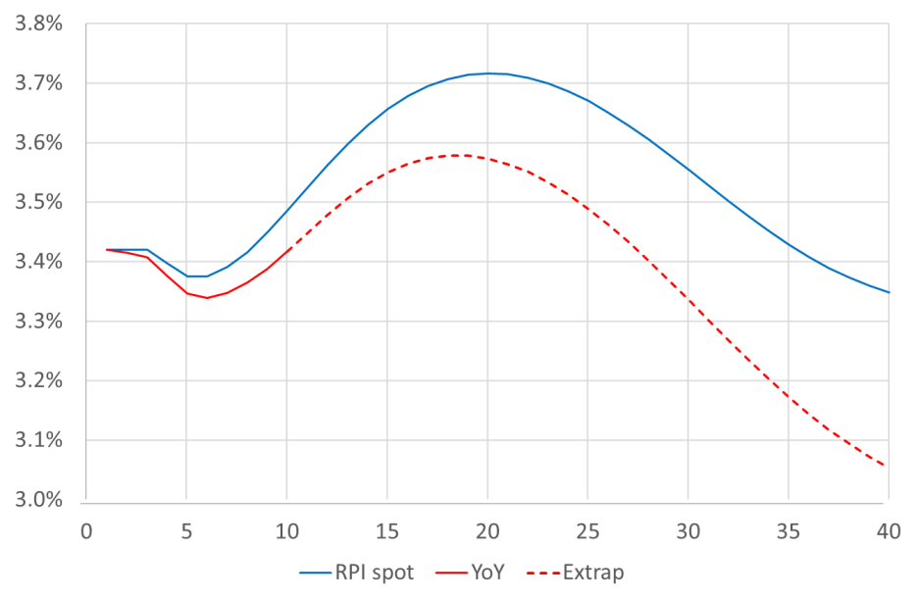
Autocorrelation of LPI
Effect of autocorrelation on spot LPI
If zero autocorrelation these lines would be the same
Higher blue line implies positive autocorrelation
Impact on LPI curves is smaller because realised LPI volatility < realised RPI volatility
But differences matter for another reason – calibrate LPI model to ZC RPI swaps or YoY RPI swaps?

Slide 10
Skew
Yearly RPI print since 1992
Inflation targeted began in 1992
Realised inflation broadly symmetric …
… Other than blip reflecting Financial Crisis
Financial Crisis
Source: LPI risk working party

Slide 11
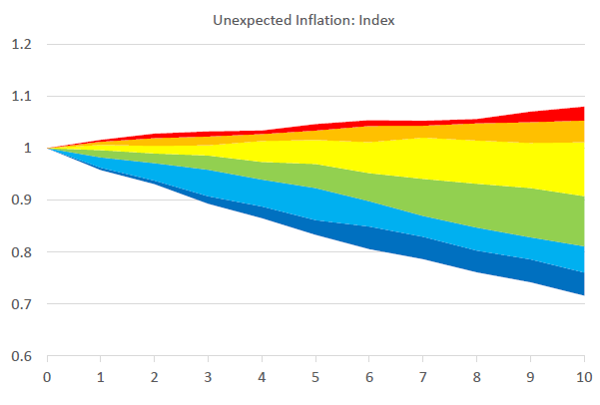
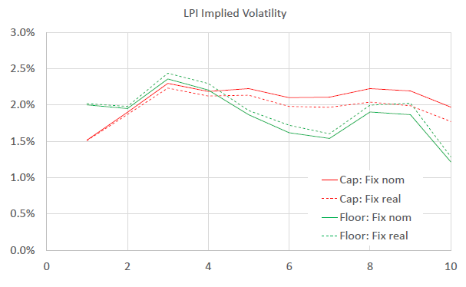
Calibrating the Black Model
Burning cost analysis: LPI if historic inflation repeated itself?
Re-running history of limited use
Instead look at historic inflation outcomes relative to what was implied in gilt/ILG markets at the time, and scale to replicate current prices
Little skew observed, and no material autocorrelation effects
Analysis suggests volatility of 1.5-2.0%
Unexpected inflation: index
LPI implied volatility
Source: LPI risk working party

Slide 12
Black 1.8%
Easy to explain, understand and replicate
Data limitations in calibrating
May miss important dynamics
Spot LPI(0,5) floor/cap values
Spot LPI(0,5) curve
Source: LPI risk working party, Black Model with 1.8% vol, data shown as at 31 October 2017

Slide 13
SABR
Spot implied volatilities
Fit parameters to LPI quotes from Banks at key tenors
Highly flexible extrapolation/interpolation e.g. captures smiles
Number of quotes reduced, dispersion between quotes increased (ADLT* criteria under Solvency II) – unrealistic?
Historic RPI has much less skew than current pricing implies. Floor is “expensive”?
Spot LPI(0,5) floor/cap values
Spot LPI(0,5) curve
Source: LPI risk working party, data shown as at 31 October 2017. ADLT = Active, Deep, Liquid, Transparent

Slide 14
How much impact does choice of model have?
Valuation changes (curves)
Lower valuation moving from MC to RW
At 20 year duration, c30bps fall in LPI(0,5) increase assumption
This results in c6% decrease in PV
Delta changes (inflation sensitivity)
Higher inflation sensitivity (lower volatility) moving from MC to RW
At 20 year duration, c14% increase in assumed LPI(0,5) delta (61% to 76%). Relative increase is higher (76%/61%-1) = 25%
This results in c18% increase in IE01
LPI(0,5) spot curves
LPI(0,5) spot deltas
Source: LPI risk working party, data shown as at 31 October 2017. ADLT = Active, Deep, Liquid, Transparent

Slide 15
LPI risk isn’t the whole story
LPI risk
1.5%-2% pa*
Wedge risk
2.5% pa?**
LPI risk
Model risk and practical issues e.g. non-continuous rebalancing
Similar size to longevity risk for a well-funded scheme with 100% LPI-linked benefits
Other “small” risks in schemes include wedge risk, longevity risk and other demographic risks
Impact on investment strategy
Usually neglected in a traditional ALM analysis
These small risks diversify investment risk which could make investment risk more attractive (same return pick-up for a smaller increase in overall risk)
But may result in a breach of risk budgets if previously unappreciated or hidden
Longevity risk
2% pa
Other demographic risks
1-2% pa
Unhedged rates and inflation risk
5% pa***
Equity risk
4% pa****
* If 100% LPI, ** if 50% CPI, *** if 50% hedged **** if 25% equity

Slide 16
Key takeaways & planned future work
Key takeaways
Pros and cons of different approaches (market consistent vs real world)
Potentially large impact on valuation and hedging strategy
Developed method (Burning cost analysis) to calibrate Black model
Data limitations mean model uncertainty and resulting LPI risk
Planned future work
Further work on impact of choice of model on resulting inflation sensitivity e.g. JY model
Guidance around calibration of key model assumptions
Worked simple examples of key models and outputs (cashflows and risk ladders)
Production of simple guide to LPI risk

Slide 17
Questions
Comments
The views expressed in this presentation are those of invited contributors and not necessarily those of the IFoA. The IFoA do not endorse any of the views stated, nor any claims or representations made in this presentation and accept no responsibility or liability to any person for loss or damage suffered as a consequence of their placing reliance upon any view, claim or representation made in this presentation.
The information and expressions of opinion contained in this publication are not intended to be a comprehensive study, nor to provide actuarial advice or advice of any nature and should not be treated as a substitute for specific advice concerning individual situations. On no account may any part of this presentation be reproduced without the written permission of the IFoA.

