Slide 1
IFoA Thought Leadership Series: Artificial Intelligence
AI Ethics and Regulation
11 April 2024

Slide 2






Chair
Speakers
Kartina Tahir Thomson
President-elect of the Institute and Faculty of Actuaries
Dr Cosmina Dorobantu
Co-Director and Co-Founder of the Public Policy Programme at The Alan Turing Institute
Helene Panzarino
Associate Director, Centre for Digital Banking and Finance at the London Institute of Banking and Finance
Andrew Strait
Associate Director (Emerging technology and industry practice) at the Ada Lovelace Institute
Dr Florian Ostmann
Head of AI Governance and Regulatory Innovation, and Policy Fellow at The Alan Turing Institute
Matthew Edwards
Innovation Lead at Willis Towers Watson and IFoA Council Member

Slide 3

Cutting through the AI noise in financial services
Helene Panzarino LIBF/CSFI
April 11, 2024
Institute and Faculty of Actuaries webinar on Ethics and Regulation in AI

Slide 4

Cutting through the noise – what we know
We’ve been using “AI” (largely statistical inference) in finance for 50+ years.
We’ve been using “machine learning” for decades in credit decisioning and other fields, too.
The recent AI ‘revolution’ with its application of neural network methods lack a clear prior understanding
of eventual impact/outcomes compared to earlier models.
For regulatory and ethical reasons, this means that applying the ’new wave’ of AI innovation to FS is much
more complicated than it is in some other sectors.
Promising start to UK/US/EU Safety in AI agreements but has the horse bolted?

Slide 5

Opportunities
AI and machine learning offer significant opportunities for fraud detection, assessing risk and supporting customer interaction – particularly in the fastest-growing markets where training costs and times can be prohibitive.
Threats
New threats associated with significant advances in GenAI, and inherent risks to using black box models in some financial services applications.

Slide 6
Where do the latest models work best right now?
Better suited
Less suited due to tough regulatory burden and risk
CS, sales and other interaction: Handle queries, provide information, recommend products, personalise advice
Fraud detection: Transaction analysis can spot patterns indicative of previous fraud and vulnerability cases (human verification required)
Trading: Portfolio optimisation and quantitative trading / pattern identification
Synthetic data: Where real data is limited, confidential or sensitive, bulk generation helps develop new products and predict risk
Credit decisioning: Lack of explainability means potential invisible overfitting on illegal or unethical characteristics.
AML and KYC: While AI can identify possible risks, action requires transparency and clear verification processes.
Compliance, regulation and legal functions: Challenges with explainability and hallucination make it fraught with risk.

Slide 7
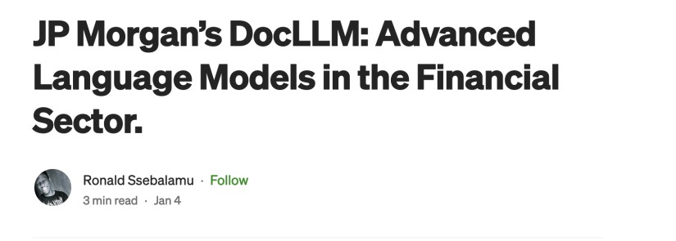
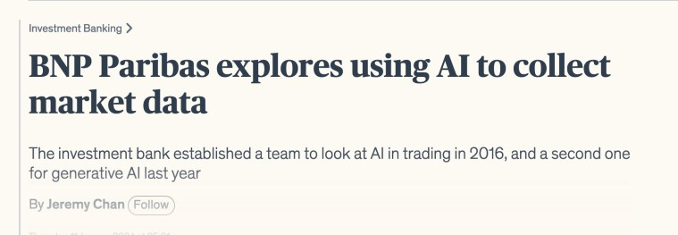
One year of ‘FOMO’
Over the last 12 months we’ve seen tens of billions of dollars poured into Gen AI
especially in customer-facing work.
We see is primarily experimentation on the customer side. Banks have used chatbots for years, but their functionality remains limited to much of the most basic customer interaction.
Internally, engineers are working with the most advanced LLMs, but most of their efforts are around efficiently parsing documents and interpreting data for trading, investment banking and research functions
The most powerful models are expensive and effort now about building most efficient in-house models instead of using expensive solutions like GPT-4 from e.g. OpenAI
Centralised models mean that a potential concentration of talent and tech is being created.
What about talent training & development vs job displacement?

Slide 8


Insurance
See the same pattern as in finance: investment into R&D, but caution in practice. As in lending, regulation and risk complicate implementation.
Can bulk analyse claims forms and other submissions, and could process legal and regulatory documents and filings to identify necessary process changes for products or clients.
But… regulation on underwriting means that risk assessment by LLM typically lacks legally and/or internally necessary explainability.
Wiz AI trained an insurance-specific LLM, attached it to a generative voice model, then deployed it with Indonesian insurer Jagadiri to remind customers of upcoming premium payments.
The strategy yielded an increase in contact rate, but – crucially – the
work remained more of a sales call.

Slide 9

Risk and reward – known and unknown
Example: Replacing customer-facing staff involves much more than dealing with basic queries.
It involves giving advanced AI systems direct access to many core banking
systems, and to customer accounts.
It involves advanced AI systems being able to understand, formulate language sophisticated enough to sell and market financial products, an activity governed by stringent regulation.
It involves the dispensing of advice by which the FI can be legally obliged to
stand in (almost) all circumstances
What risks does ‘hallucination’ pose here? How much control do we really want to hand over? How much is allowed?

Slide 10
AI as transformative risk and opportunity
Opportunities:
AI offers banks the possibility of ultra-personalised financial products, sold through generated interactions with customers supported by their own data and financial history.
Better models can mean better risk evaluations, transforming the credit market, reducing default rates and allocating more capital to those who can use it best.
But…

Slide 11
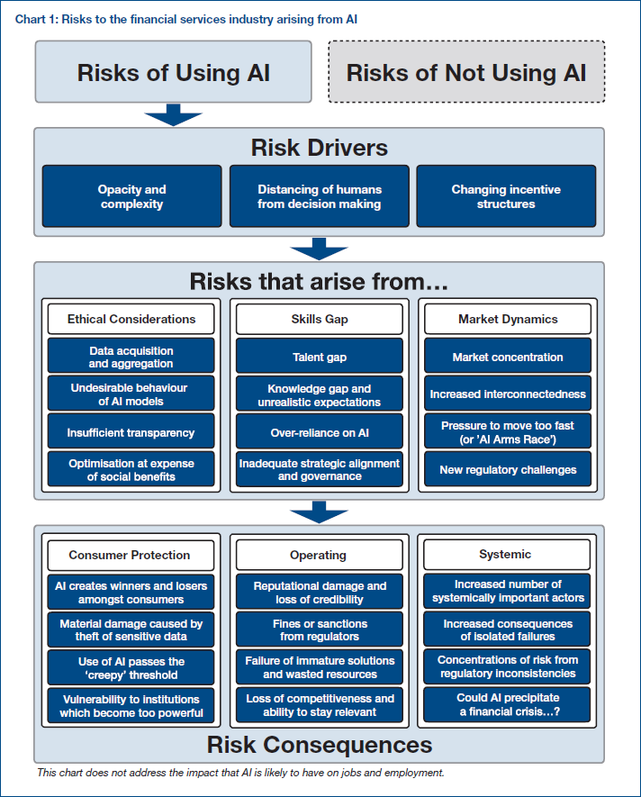

Risk drivers and consequences

Slide 12

AI as transformative risk and opportunity
New risks with newly deployed developments:
AI makes fraud, deepfakes, phishing and APP fraud more convincing
Increasing use without regulations means that unintended harms, bias, and prejudice may find a home in FS without awareness.
Allowing use of Gen AI with no training and deeper understanding has reputational, operational, regulatory, intellectual, and financial risks.

