Slide 1
A practical introduction to using Neural Networks in reserving on individual claims data
Machine Learning in Reserving Working Party
Sarah MacDonnell
Jacky Poon

Slide 2
About the speakers
Sarah MacDonnell
Chair of Machine Learning in Reserving Working Party
Actuarial Consultant at Lane Clark & Peacock LLP
Member of GI Board
Jacky Poon
Member of Machine Learning in Reserving Working Party
Head of Actuarial and Analytics at nib Health Funds (ASX:NHF)
Convenor for the Young Data Analytics Working Group (with Actuaries Institute in Australia)

Slide 3
MLR WP: Machine Learning in Reserving Working Party
The General Insurance Machine Learning in Reserving working party (MLR WP) aims
to look at ways that machine learning can be incorporated into reserving practice,
to support reserving actuaries to gain ML skills, and
to undertake our own research.
Over 70 volunteers
Data scientists, actuaries and academics
Worldwide
Over 30 blogs published since 2020

Slide 4
A reserving actuary’s introduction to neural networks: The Blogs
Why?
Explainer
Diagnostics
Hyperparameters
Creating a framework
Making it easier for reserving actuaries to develop the skills
Encourage research – run on your own data

Slide 5
2014 GIROC reserving survey
Reserving actuaries are doing better than they realised shock!
According to executive board members
actuarial advice is highly valued and actuarial opinions are sought out
fed into planning and strategy
Alert to issues when things go wrong
Key decisions in pricing : trends/uncertainties/risks
Engage in debates with business
Regulatory reforms
Segmentation
Understanding historic reserve releases - where from, what has driven them?
Helping understand and use outputs more effectively
Alert to issues in operational processes

Slide 6
A reserving actuary’s introduction to neural networks: The Blogs
Why?
Explainer
Diagnostics
Hyperparameters
Creating a framework
Making it easier for reserving actuaries to develop the skills
Encourage research – run on your own data
Not a panacea – you still need to invest time

Slide 7
What we will cover today
Where ML in reserving is
Why use machine learning and neural networks?
Our vision of actuarial ‘open source research’
Examples
Getting involved

Slide 8
Where machine learning in reserving is at
A practical introduction to using Neural Networks in reserving on individual claims data
GI Spring Conference

Slide 9
Where machine learning in reserving is at
2020 survey
time and resource constraints
difficulty in gaining the skills
Recent surveys by the FRC and the IFoA
Not a problem in pricing
Our own experience

Slide 10
Why use machine learning and neural networks?
A practical introduction to using Neural Networks in reserving on individual claims data
GI Spring Conference

Slide 11
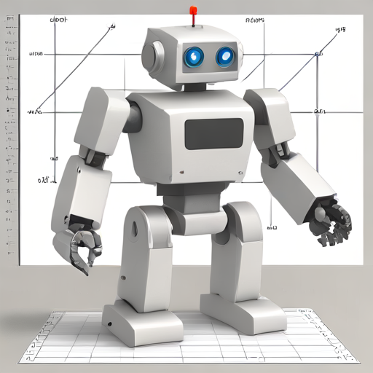
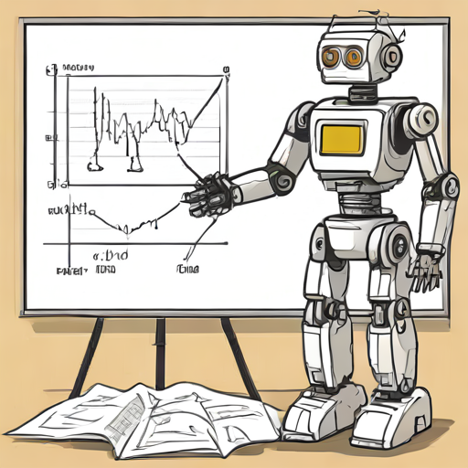
From triangles to granular models From linear models to machine learning
Triangle models
Machine learning models
Summarised data
Simple trends
Reliance on actuarial judgement
Granular data in a data driven world
Model complex interactions
AI models

Slide 12
Gradient Boosting Machines (GBM) vs Neural Networks
Gradient Boosting
Neural Networks
Strong on tabular data
Very good predictive performance (and very popular) for GI pricing
Fixed structure
Fast training and inference
Supports freeform text, images, audio data, probability distributions
Flexible structures
Requires GPUs
Detailed discussion: https://www.theactuary.com/2024/02/01/data-science-lab-gbms-or-neural-networks

Slide 13
Actuarial ‘open source research’
A practical introduction to using Neural Networks in reserving on individual claims data
GI Spring Conference

Slide 14
Replicable code, available to all
Why code?
Replicable analysis
Full access to version control tools
Why open source?
Research by the community, for the community
Make models accessible – “try it at home” (or at work)
Worked examples

Slide 15
Examples
A practical introduction to using Neural Networks in reserving on individual claims data
GI Spring Conference

Slide 16
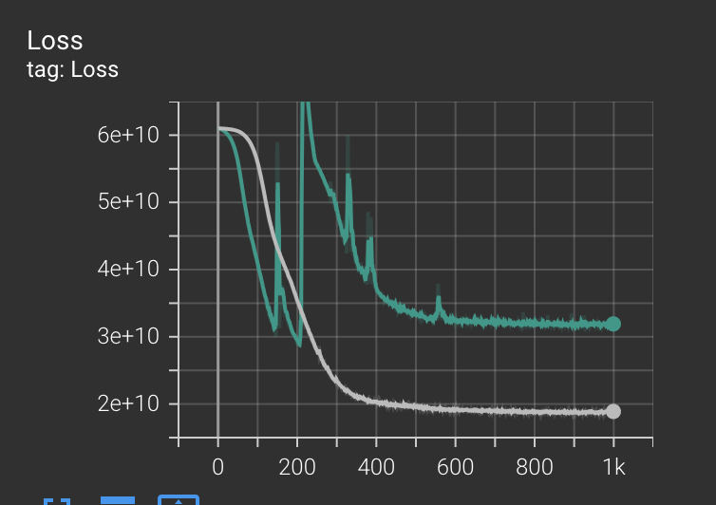
Learning rate

Slide 17
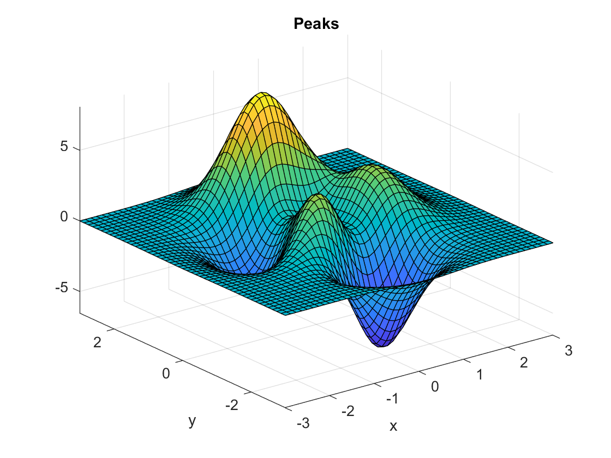

Slide 18
Learning rate

Slide 19
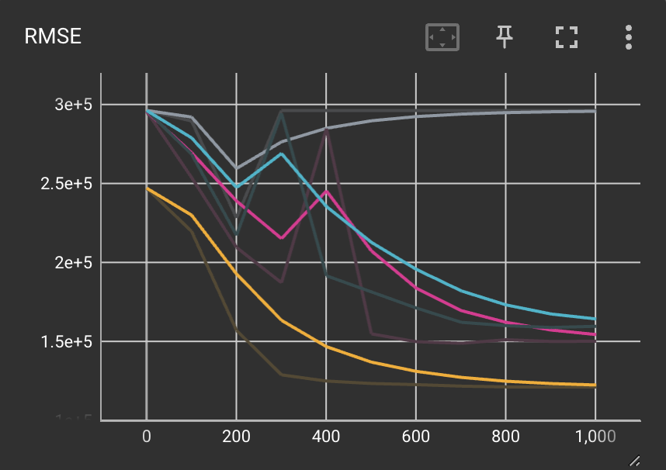
Initialisation

Slide 20
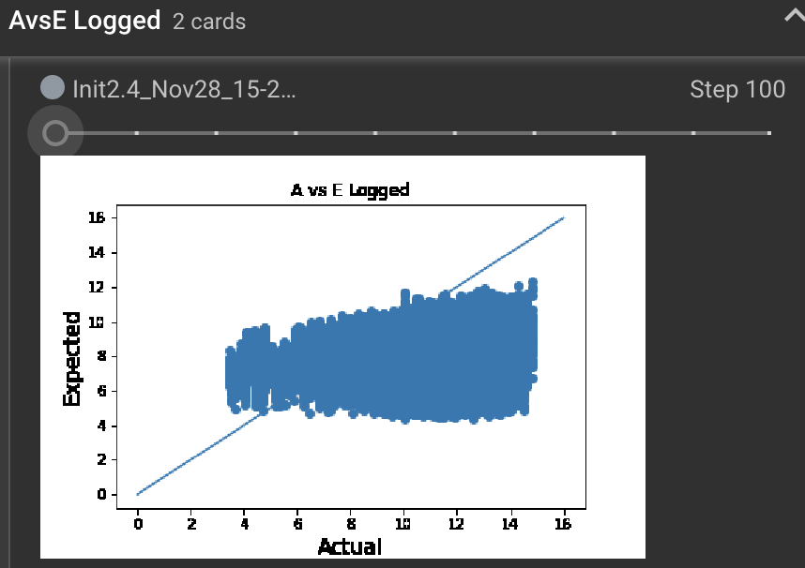
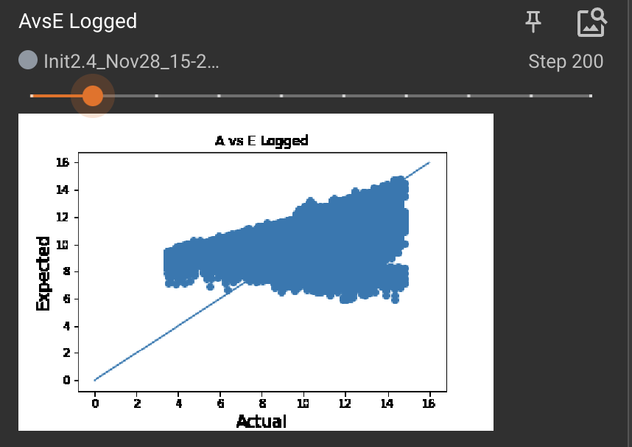
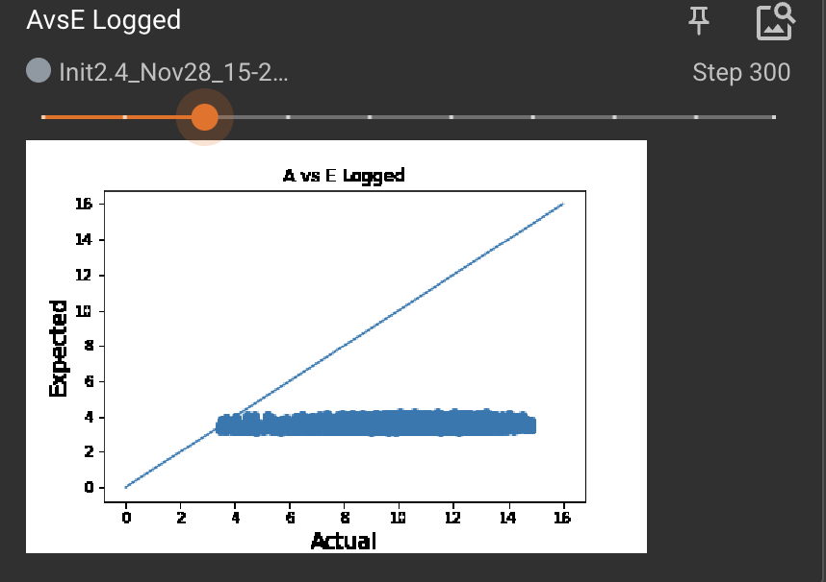
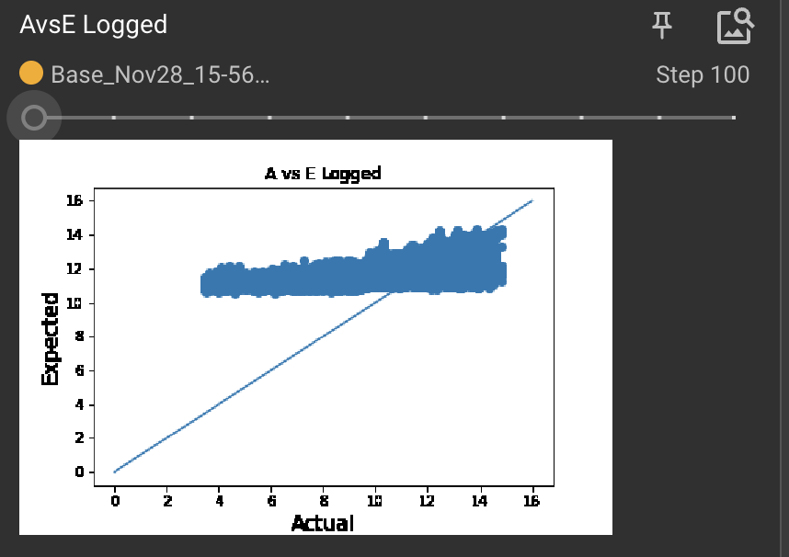
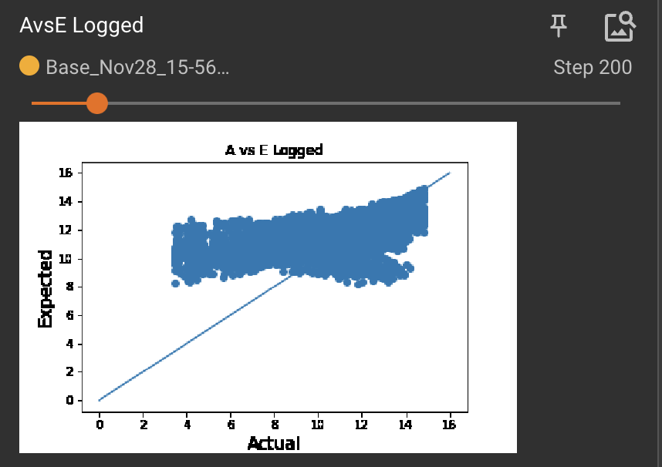
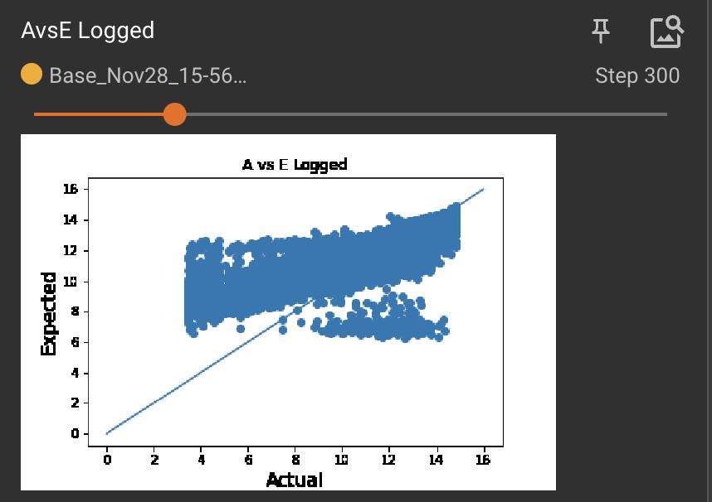
Initialisation

Slide 21
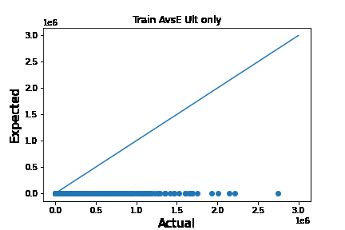
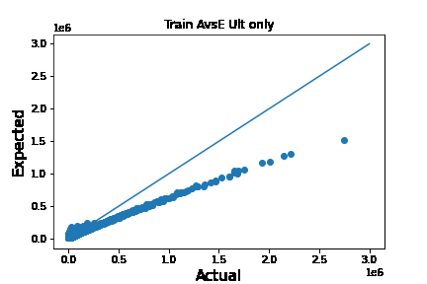
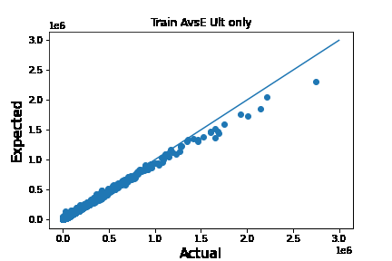
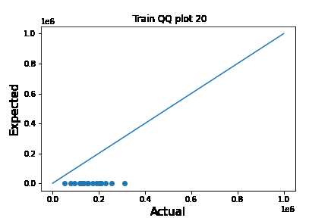
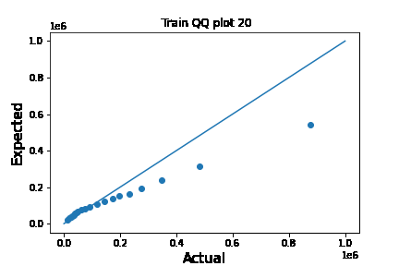
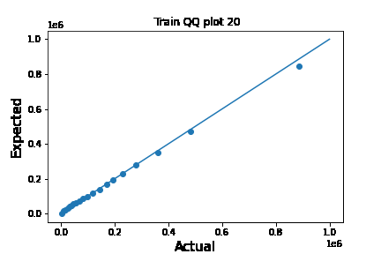
Initialisation
2.4 4.6 6.9 Mean
Output for different initial (logged) claim sizes shown

Slide 22
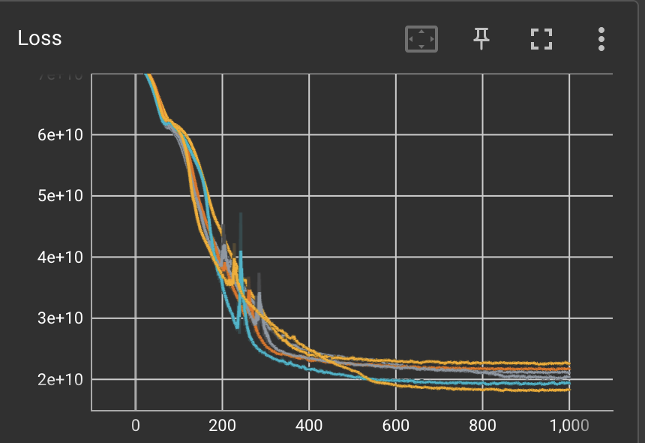
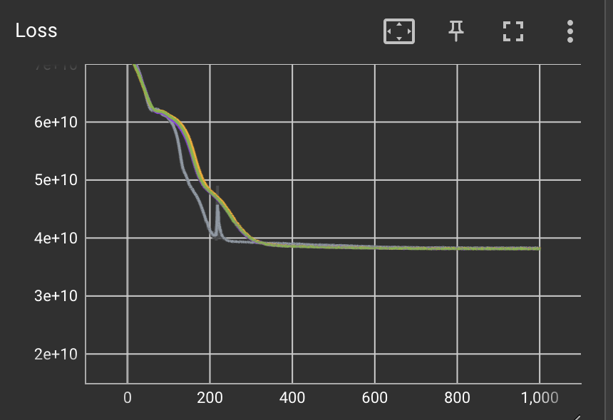
Activation function
ReLu
No activation function

Slide 23
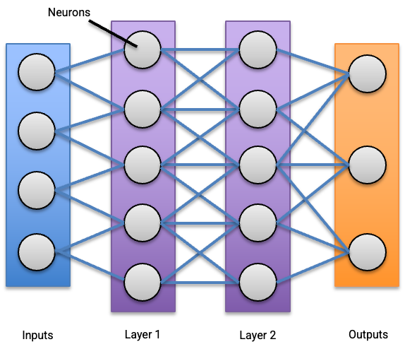
Activation function
Source: Activation Functions in Neural Networks [12 Types & Use Cases] (v7labs.com)

Slide 24
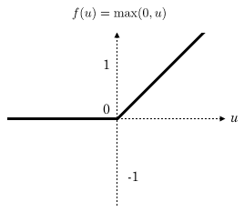
ReLu activation function

Slide 25
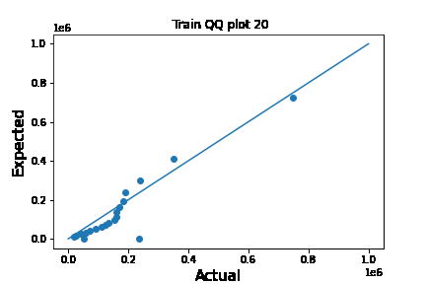
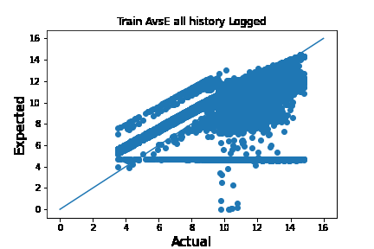
Activation function
ReLu None

Slide 26
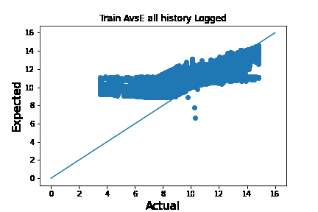
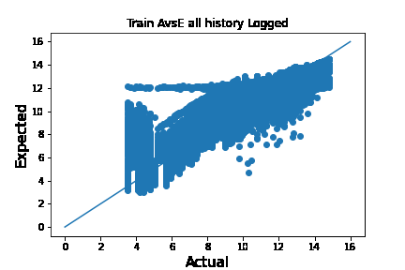
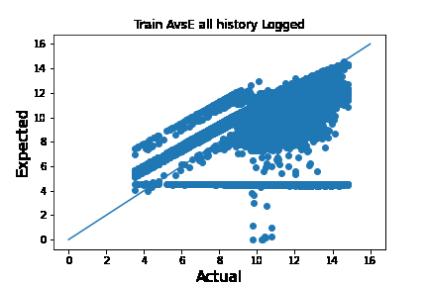
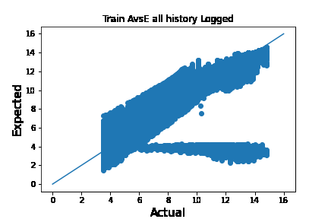
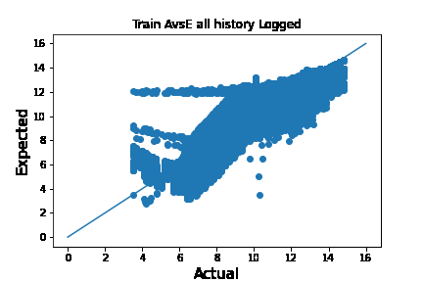
Activation function
ReLu None

Slide 27
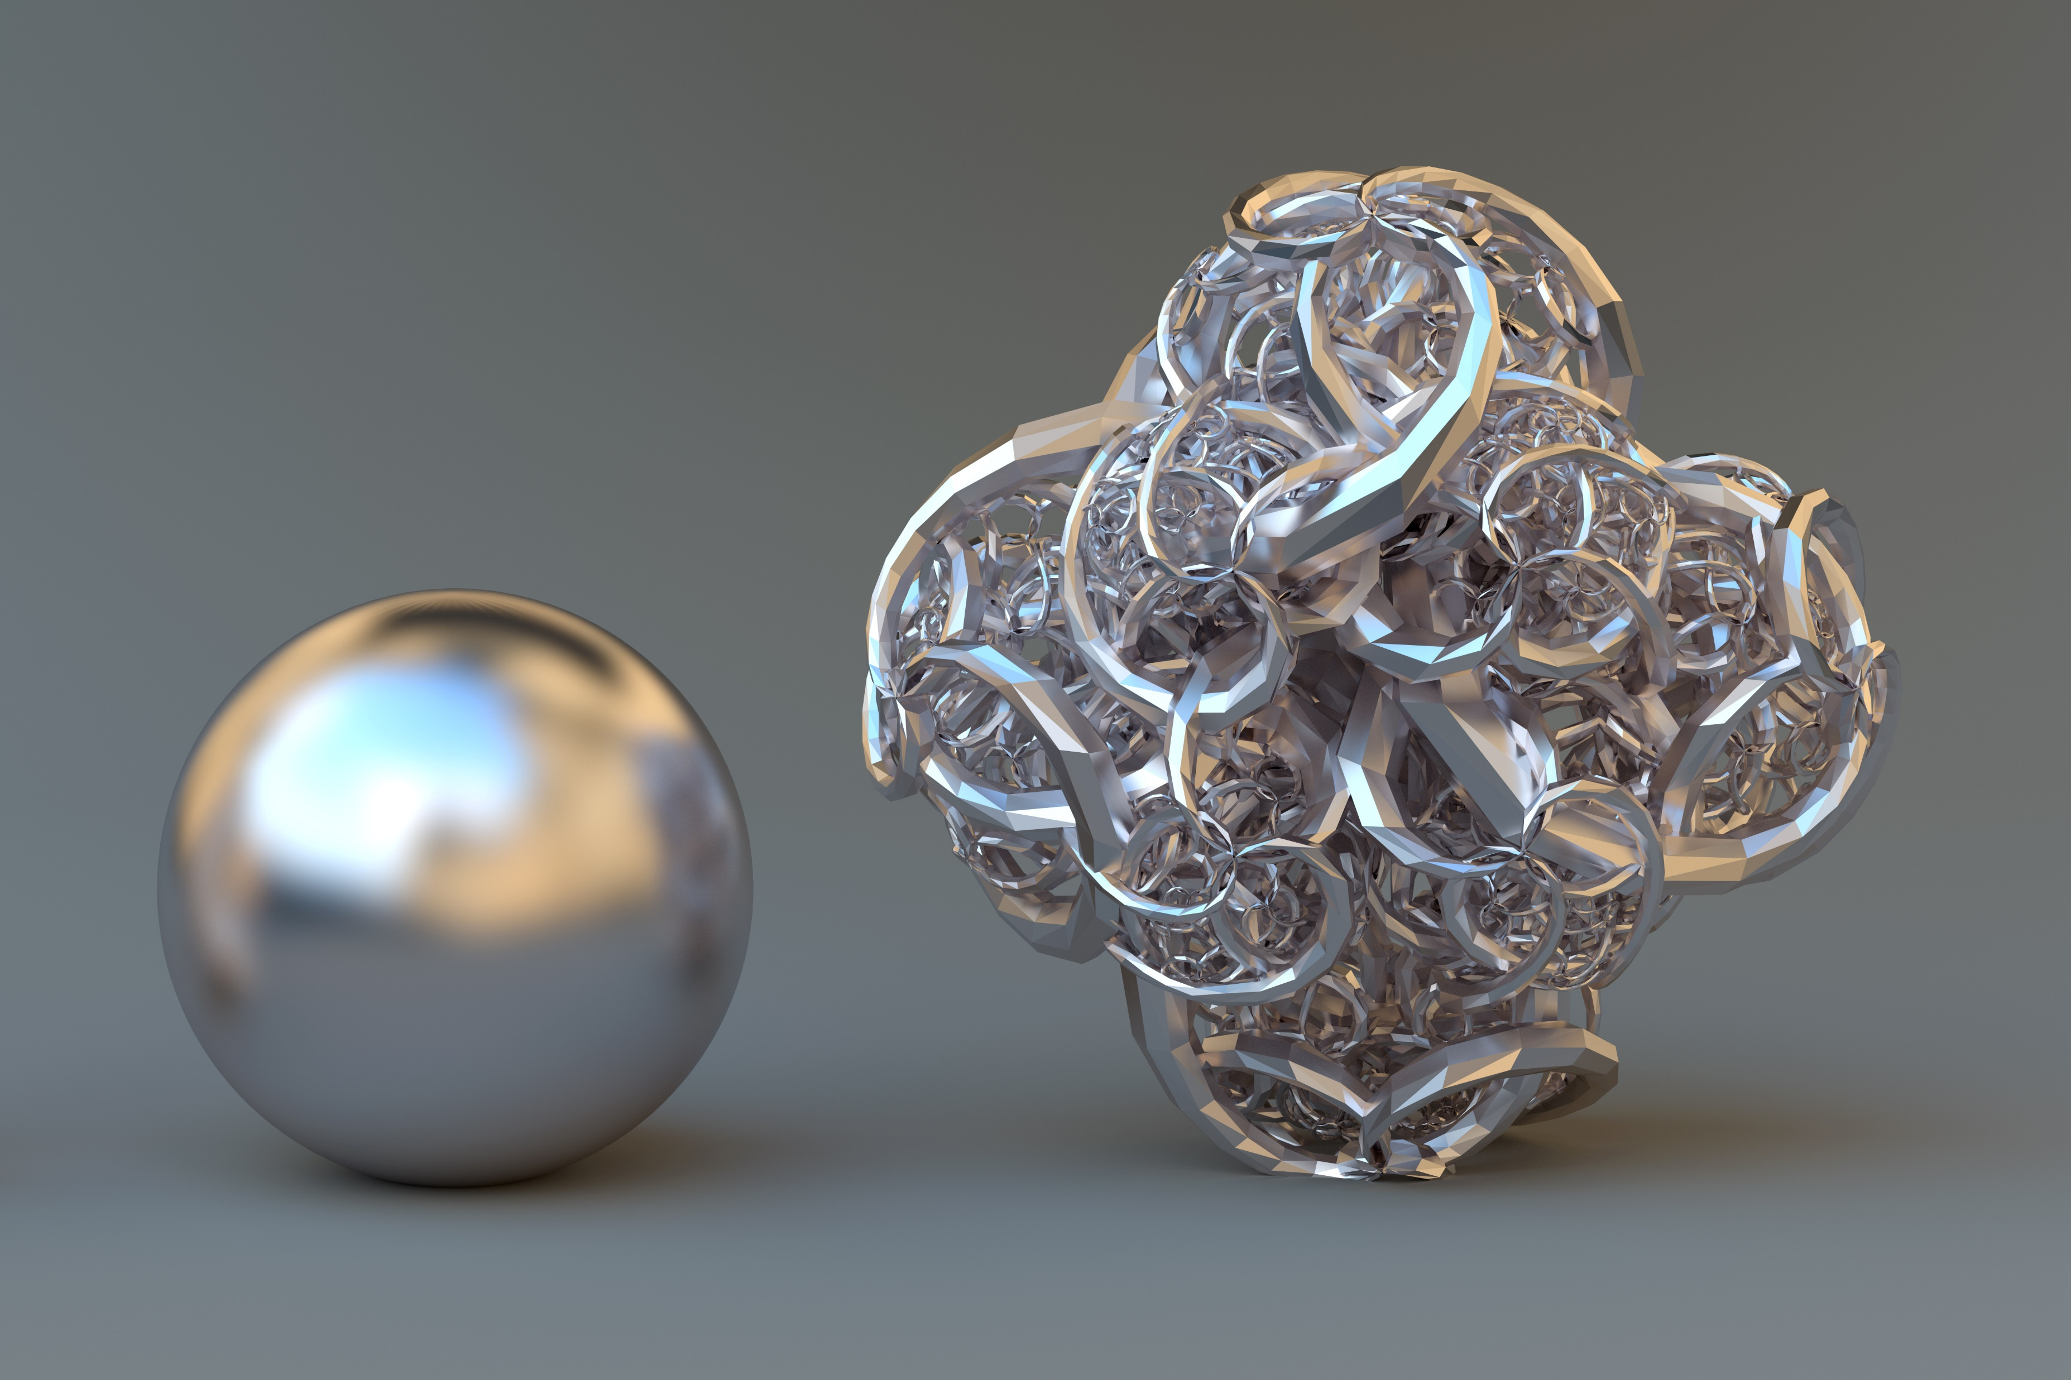
GLMs and Neural Networks

Slide 28
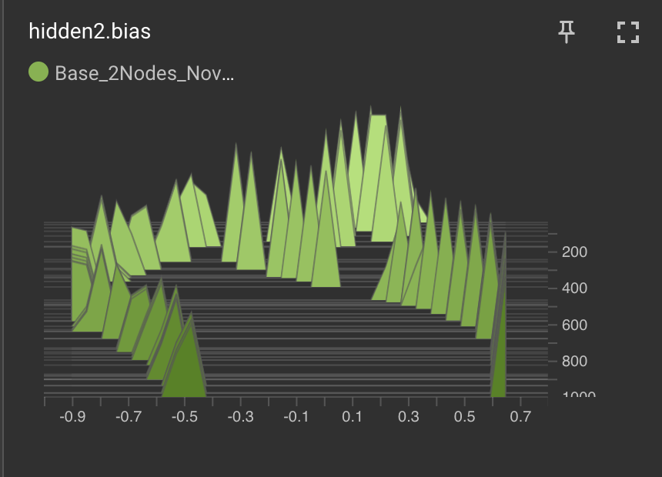
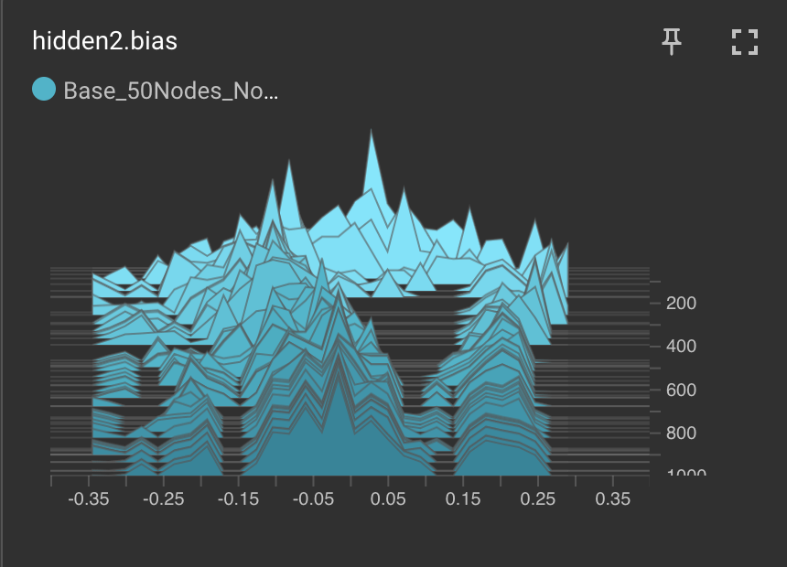
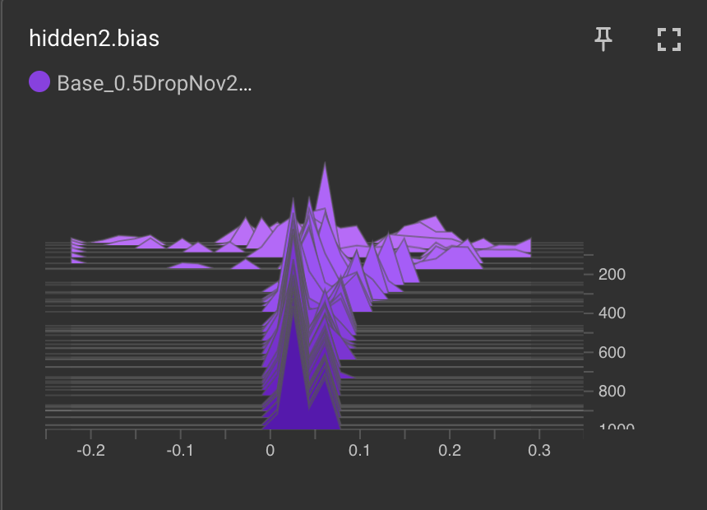
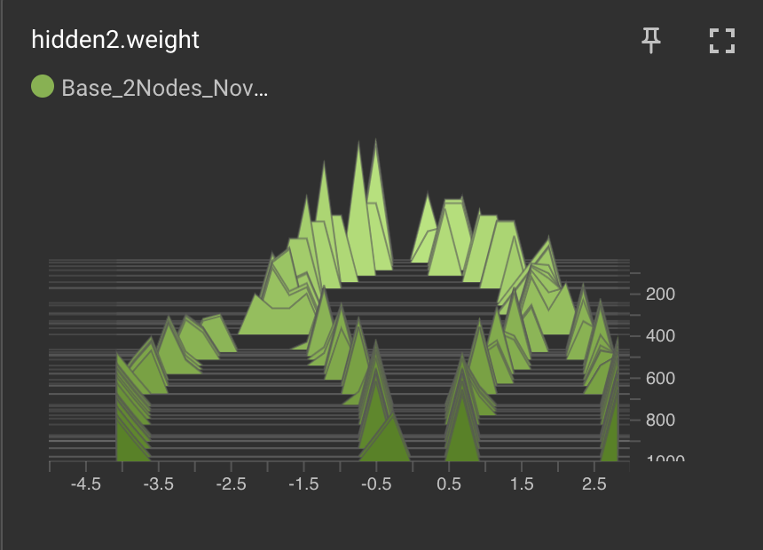
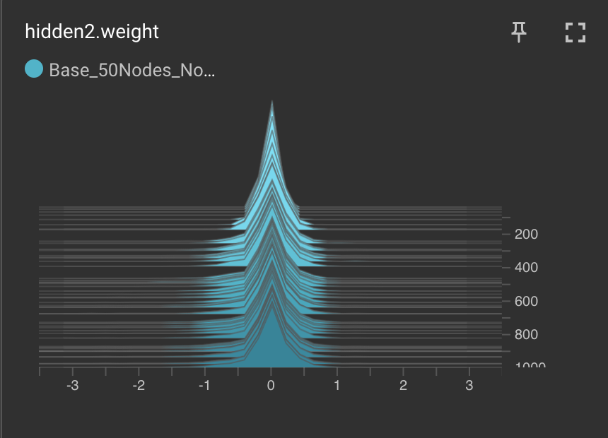
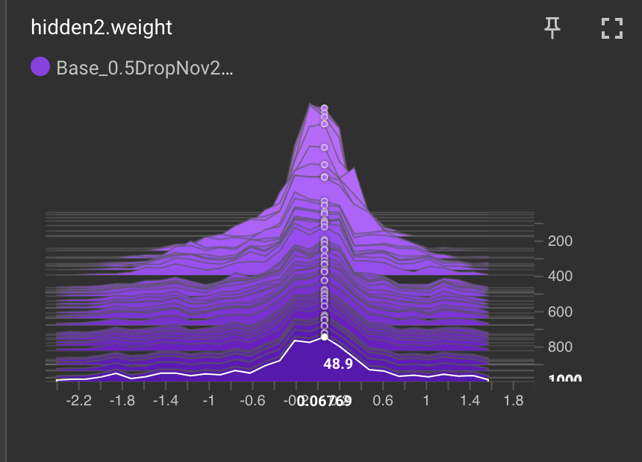
Weights and biases

Slide 29
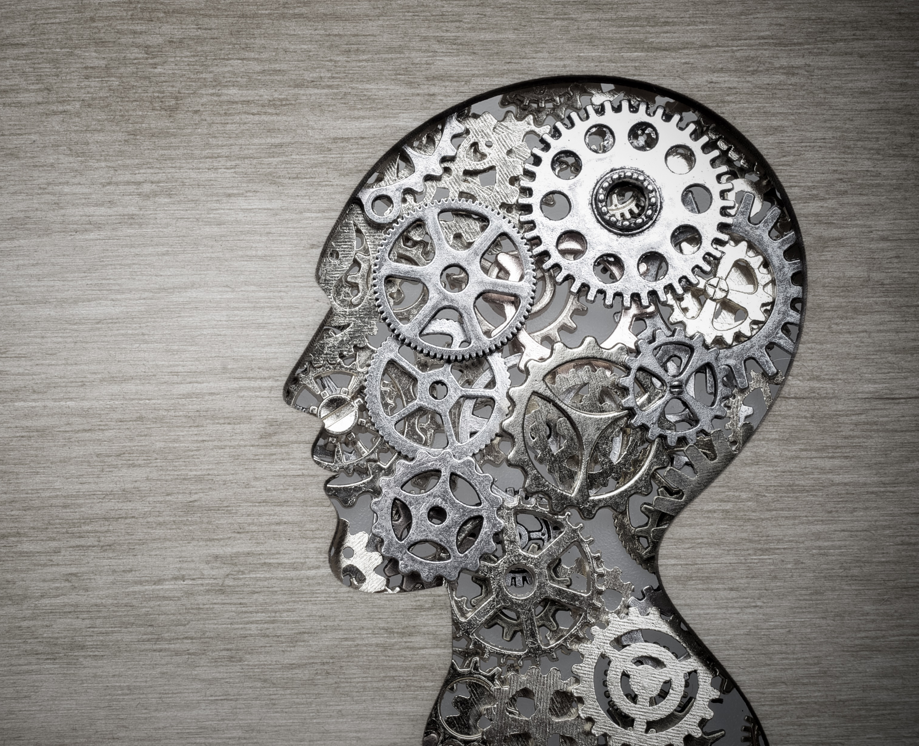
Building up knowledge and judgement
Personal Solving together

Slide 30
Still a way to go
Time series - RNN, LSTM, Transformers…
Not using the traditional development period approach at all…
Data structure
– models for different stages of the claim process…
Bring in more data – speed at collision, injury type, age of injured…
Lots to explore!
We plan to share our investigations – ‘open source research’

Slide 31
Getting Involved
A practical introduction to using Neural Networks in reserving on individual claims data
GI Spring Conference

Slide 32
Getting involved
Try it out for yourself
Try it out on your own data
Share your findings and ideas
Follow our work
Join the working party
The Blogs
Machine Learning in Reserving Working Party - A practical introduction to using neural networks in reserving on individual claims data (institute-and-faculty-of-actuaries.github.io)
Communities – GI and Data Science areas
LinkedIn
IFoA General Insurance Machine Learning in Reserving | Groups | LinkedIn
GitHub site
Machine Learning in Reserving Working Party - General Insurance Machine Learning in Reserving Working Party (institute-and-faculty-of-actuaries.github.io)
Book
Machine Learning in Non-Life Reserving (mlrwp.github.io)
IFoA volunteering page
Notes:
Still working it out

Slide 33
Questions
Comments
Expressions of individual views by members of the Institute and Faculty of Actuaries and its staff are encouraged.
The views expressed in this presentation are those of the presenter.

