Slide 1
LDI in 2024
The viewpoint of an
invesment consultant
Richard Lunt FIA
Hymans Robertson LLP,
Senior Investment Consultant
May 2024

Slide 2
Agenda
Part 1: LDI and background to the crisis
LDI – a reminder
Global market conditions and UK specific considerations
The 2022 Mini-Budget
Part 2: Where to from here (2024) – this consultant’s view
Where have we landed?
How has the investment case for LDI changed?
Where LDI fits into the new world

Slide 3
LDI – leveraged exposure to rates/inflation
LDI is an approach to investment designed to ensure that assets move in a similar way to liabilities given changing market conditions (in terms of long-term yields and inflation expectations).
The aim is to invest in assets that have the same sensitivity as the liabilities to interest rates and inflation expectations and change by the same amount in either direction, i.e. agnostic to which way interest rates or inflation expectations might change.
The level of matching between the sensitivity of the assets and the liabilities will depend on the level of hedging in place. Hedging and LDI are used interchangeably – LDI assets provide hedging.
LDI is leveraged exposure to interest rate and/or inflation expectations.
LDI strategies aim to keep leverage within pre-agreed bounds, often via transfers of cash in or out of LDI pooled funds or segregated portfolios.

Slide 4
LDI – illustration / leverage in practice
Client
has
Invests
£
leverage of
33m in a
1
fund
Leverage is where the level of exposure to a particular asset is more than the initial outlay or invested amount.
Leveraged funds in an LDI context provide the facility to hedge more liability exposure than the physical assets held permit.
Both examples of £100m exposure to gilts on the right are illustrated by the red bars, however, by using leverage, the second example only has a third of the initial outlay relative to the first example.
This means that the remaining assets can be freed up to invest in other ‘return-seeking’ assets.
1x leverage example
  Need £100m of gilt exposure
  Invest £100m in unlevered physical gilts
£100m
£80m
No leverage
£60m
£40m
£20m
Invests
£
1
3x leverage
Cash investment
Gilt exposure
3x leverage example
  Need £100m of gilt exposure
  Invest £33m in leveraged gilt fund with leverage of 3x and still gain £100m of gilt exposure
  Releases £67m of cash for investment
£100m
£80m
£60m
£40m
3x leverage
£20m
Cash investment
Gilt exposure
Notes:
This is a method that allows you to have more hedging than you would be able to achieve otherwise.
Using leverage would allow the Trustee to increase the Scheme’s gilt exposure without having to invest additional assets in gilts. LGIM offer leveraged gilt funds which the Scheme could use. The example above assumes a
leverage level of 3. In the example, an investment of £100 in a leveraged gilt fund would provide the Scheme £300 of gilt exposure; as interest rates move, the Scheme would be exposed to the change in value of £300 of gilts. This allows the Scheme to increase the sensitivity of the assets to interest rate changes to better hedge the sensitivity of the liabilities to interest rate changes without requiring further assets to be invested in bonds.

Slide 5
Collateral management in LDI
LDI managers typically manage the leverage ratio within certain bounds e,g. 2.5x – 3.5x leverage.
When leverage moves above this ratio, an LDI manager can reduce their gilt exposure or request a cash call to increase collateral.
Therefore, collateral is required to support LDI funds. Collateral most often refers to cash, which can be provided to an LDI manager at short notice. However, it can also involve other liquid assets, such as money market instruments, corporate bond funds or asset backed securities.
Leverage ratio too low
Lower leverage limit
Upper leverage limit
Leverage ratio too high
Target leverage range
Re-leverage
Manager returns cash to investor
De-leverage
Reduce gilt exposure; or
“Cash call” to increase collateral
Notes:
1) To manage these capital calls efficiently, the LDI portfolio typically has a collateral waterfall sitting alongside it, which can be used as the source for capital that may be needed. Capital will flow in and out of this cash fund as required.​
2)In normal conditions, an LDI portfolio would typically hold enough capital to be able to withstand a 200bps rise in interest rates before additional capital will be required.​
3)interest rates (gilt yields) increased by 400bps this year including swings of c100bps in a single day. This has led to a series of capital calls, some of which have been requested at very short notice. In response, pension schemes have had to sell their more liquid assets (typically gilts or equities) to meet these capital calls. In some instances, it has not been possible to provide the required capital in time and LDI managers have automatically reduced the level of hedging.

Slide 6
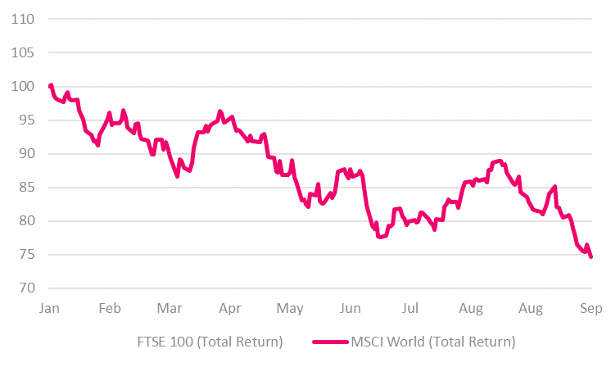


Global equity markets in 2022
Two key factors influencing markets
Data shown to September 2022

Slide 7
The September 2022 UK market in summary
Uncertainty associated with Brexit – the UK’s relationship with the EU unclear
Political uncertainty – political turmoil / multiple Prime Ministers
And also…
Relatively high levels of debt – debt to GDP of 102% with an 8% budgetary deficit
A depreciating currency – $1.40 to close to parity within a year
High inflation – and an expectation it would rise further
A backdrop of increasing interest rates – due to inflation and the domestic factors

Slide 8

Kwarteng’s September 2022 Mini-Budget
Significant cuts in tax…
  …an expansionary fiscal policy is inflationary
Significant additional borrowing…
  …from an already relatively indebted position
The initiatives were uncosted by the Office for Budget Responsibility (OBR)
This attempt by the Truss / Kwarteng administration to initiate growth was seen by some commentators as risky even on the day of the speech.

Slide 9
The 2022 Gilt shock
28 Sep – BoE announce 2-week intervention
Severe rate rises cause schemes to sell assets to maintain hedging
(or lose hedging levels)
14 Oct – Last day of BoE intervention
23 Sep – Government announce ‘mini-budget’
LDI managers use 2-week intervention window to reduce leverage in LDI funds, asking schemes for more cash (so more cash calls to maintain same hedging levels)
Notes:
Interest rates, as measured by gilt yields, have increased significantly – yields have increased by c400bps this year​
The pace of recent yield rises is unprecedented – intra-day swings of c100bps have been experienced in the last two weeks​
This is illustrated by the chart below, which tracks the 20 year index-linked gilt yield over the last 15 years. The right-hand side shows how quickly yields have risen. Source: Insight, Data to 28 September 2022.​
Liability values have fallen, LDI assets have fallen, leading to capital calls – the rise in yields has exceeded the 200bps “buffer” that has typically been incorporated into LDI portfolios and as a result managers have asked schemes for additional capital.​
Capital calls have been requested at very short notice – intra-days swings of c100bps have placed LDI portfolios under significant stress forcing managers to request additional capital with very limited notice. ​
Pension schemes have had to sell liquid assets to meet these capital calls – including the sale of gilts, which has placed further upward pressure on gilt yields ​
Some schemes have seen their hedges reduced – where capital is not provided in time, LDI managers can reduce the level of hedging exposing schemes to additional risk (most notably from a sharp reversal in yield rises).​
The Bank of England intervened in the gilts market on 28 September – to stem the rise in gilt yields, the Bank of England began purchasing long-dated gilts. This has provided some stability giving pension schemes time to shore up the level of capital in their LDI assets. ​
Bank of England support is temporary – support is expected to end on 14 October after which there could be further upward pressure on yields.​
General increase in risk buffers – given current volatility and uncertainty, pension schemes are building up larger risk buffers designed to be able to withstand interest rates rises of 300-400bps. At the same time, trustees may be asking sponsors whether they can support the scheme by providing additional liquidity.​
In orderly markets, Schemes are usually given c.2 weeks notice when their leverage levels are getting too high. Despite rapidly rising yields through the first half of the year this has held up well and Pension Funds have been able to provide capital in good time.
The extreme market volatility seen after the governments ‘mini’ budget saw timeframes compress drastically with managers calling capital with as little as daily notice.

Slide 10
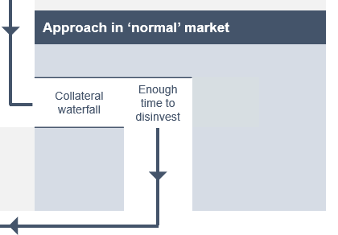
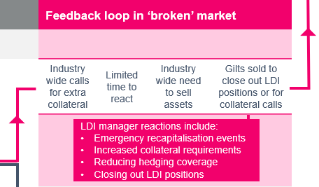
LDI operation – ‘normal’ vs ‘broken’ market
This is the ‘broken’ market scenario where gilts fall extremely quickly in value

Slide 11
Gilt crisis - ‘dust settled’ outcomes
Some of the key considerations influencing post-shock outcomes are set out below (non-exhaustive).
It is impossible to evaluate individual scheme outcomes without detailed analysis.
LDI provider
factors
Collateral decisions and other assets
Hedging purchase and sale decisions
Financial and hedging characteristics
Which LDI provider was used?
Which LDI approach and implementation route was used?
Which asset classes were used to meet LDI capital calls?
What were the trading terms / market timing?
Some schemes undertook trades, mostly buying hedging.
If trading took place, when did it occur?
Was the arrangement underfunded and/or underhedged?
Many arrangements experienced financial improvement

Slide 12
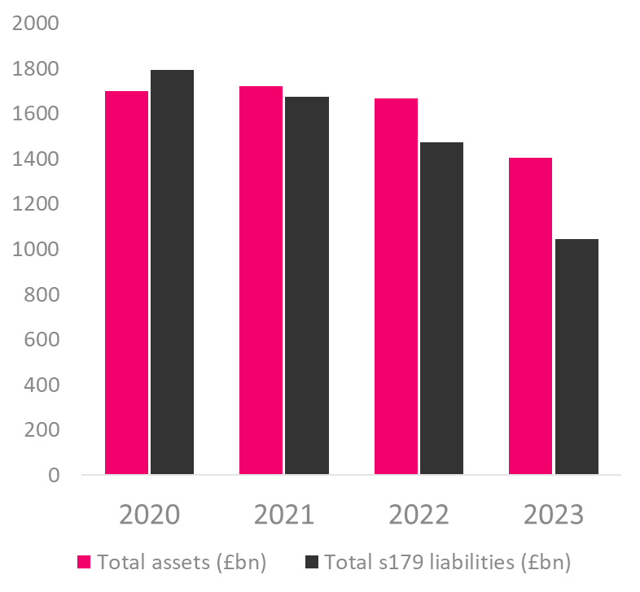
2024 – schemes are in a better place (generally)
The PPF collates asset and s179 basis liabilities for qualifying schemes on an annual basis (in their Purple Book).
The publication showing 2023 figures suggests that the aggregate financial position of pension schemes in the UK has improved materially.
Schemes are smaller and better funded, on average.
The insurance buyout market is also currently buoyant.

Slide 13
LDI in the new world (2024)
Does LDI still have a role to play in 2024?
Unquestionably yes.
It was possible to maintain protection for the significant majority of LDI approaches in 2022 and the class can now withstand an even larger market shock (lower leverage).
Additional focus on collateral availability (waterfalls, credit repo etc).
Leverage risk diversification now a theme.
It is still possible to justify a decision to accept LDI leverage risk in exchange for growth asset potential (with suitable advice)

Slide 14
The LDI investment case (my own views)
The LDI investment case
Capital efficient hedging of gilt-like liabilities
Freeing up (i.e. extra) capital for growth
Materially higher expected return for a given level of risk
In exchange for…
Leverage risk (with mitigations)
Some additional complexity
Some additional governance
Then (2022) Now (2024)
✓✓✓ ✓✓
✓✓✓ ✓✓
✓✓✓ ✓✓
Now lower
Broadly comparable?
More robust expectations
LDI has changed materially since 2022 but the fundamental investment case (more capital efficient hedging of rates / inflation expectations) is still intact.

Slide 15
LDI in the new world (2024)
What things should a potential 2024 LDI investor think about?
The features of LDI are well known and the risk mitigation protocols have now been tested in practice (and refined in various places).
No investment is without risk. Are the mitigated leverage risks of LDI acceptable given the potential benefits of the class (e.g. reduced chance of buyout deficit, materially increased potential for investment growth etc).
Modelling / scenario analysis can be very insightful to inform decisions.
LDI is not a commodity – be careful with the choice of manager in particular.
Carefully consider manager recapitalisation protocols / processes.
Fund manager people resource is important.
Extraordinary dealing date protocols are particularly important (pooled funds).

