Slide 1
Pensions on divorce thematic review
David Gordon and Alan Marshall
30 May 2024
Notes:
ALAN

Slide 2
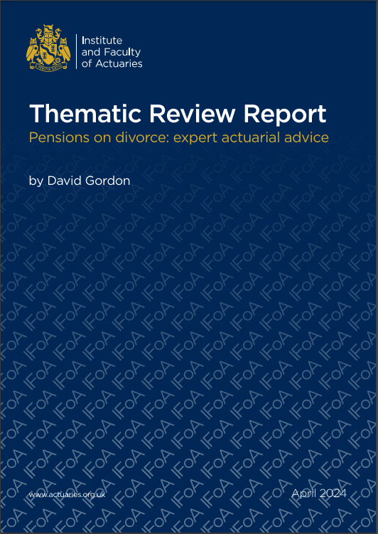
What we will cover today
Thematic Review Programme
Scope and approach
Report highlights
Questions (please use Q&A button)
Polls – no right/wrong answers!
2

Slide 3
Thematic Review Programme
Notes:
ALAN

Slide 4
Objectives of the Thematic Review programme
Quality
Promote best practices
Highlight the work of actuaries
Career-long learning
Standards / Guidance
Benefits
Independent objective feedback to members
To build a meaningful picture of actuarial work being undertaken
4

Slide 5
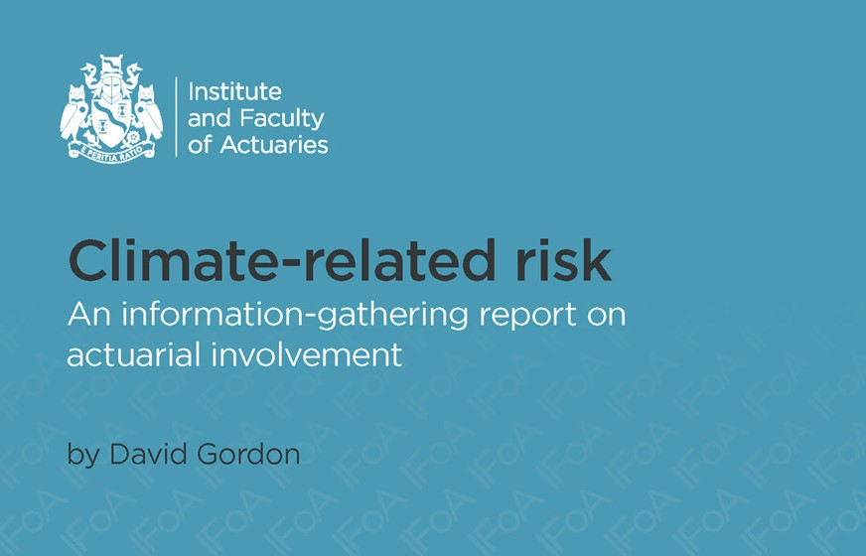
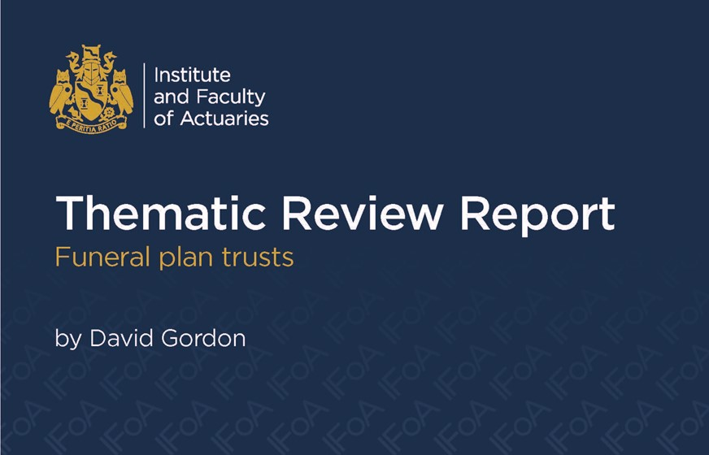
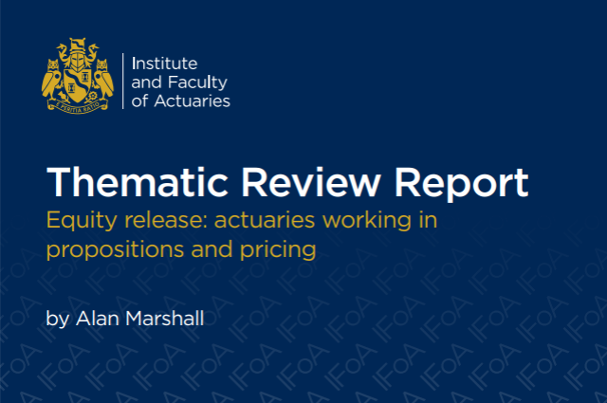
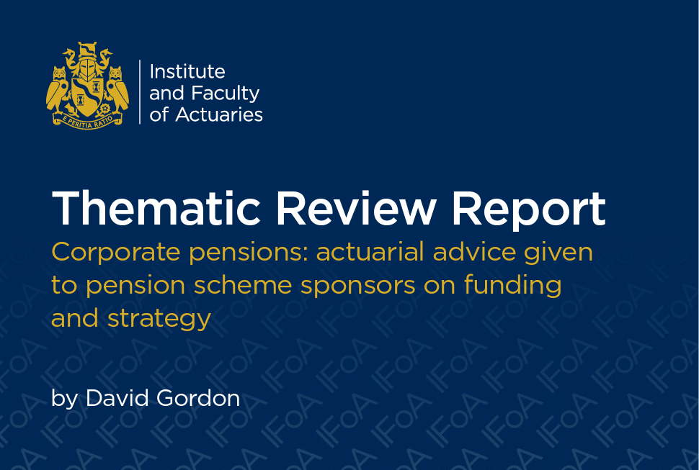
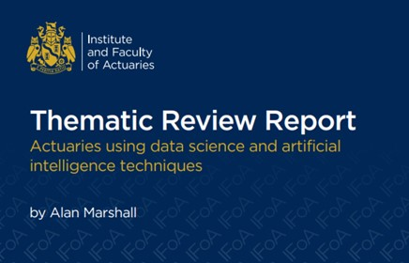
Our work to date
Pensions actuarial factors December 2020
General Insurance pricing June 2021
Climate-related risk November 2021
Funeral plan trusts March 2022
Equity release December 2022
Corporate pensions April 2023
Data science and AI February 2024
Notes:
Hands up if you’ve taken part in one of our past or current reviews?

Slide 6
Delegate Poll 1
What’s your experience with the thematic review programme?
TRP newbie
Haven’t taken part, but have read a report or watched a webinar
Taken part in at least one review

Slide 7
Ongoing and future activity
Topic | Brief description | Status
Cyber risk | Treatment and quantification of cyber risk by actuaries, including insurance of risks. | Scoping Q2
Pension scheme design | Advice given to trustees or sponsors on changes to member benefits. | Scoping Q3
Future reviews | More topics with high involvement of actuaries and significant risks to consider | Announce Q4

Slide 8
Pensions on divorce review Scope and approach
Notes:
DAVE

Slide 9
Published scope – announced December 2022
Pensions on divorce
Advice given to individuals to assist with treatment of pensions on divorce
This is a niche area of work where actuaries provide advice and calculations on pension sharing in divorce cases. This may include expert witness activity for court cases.
The review will look at current actuarial practice in this area. It will also cover the way actuaries provide their advice to customers.
This continues our ‘Actuaries as Experts’ series of reviews looking at narrower, or less typical, fields of expertise and/or actuaries providing advice directly to individual clients or consumers.

Slide 10
Review Scope and Approach
Actuaries’ Code and TAS 100
APS X2 Work Review
Ways of working
Interviews and feedback
Presentation and context of advice

Slide 11
Submissions
We asked for up to four pensions on divorce reports, based on business volumes.
We received 36 examples from 12 organisations:
Actuaries for Lawyers ~ Carlisle & Collins ~ Collins Actuaries ~ Collins Pension Actuaries ~ Excalibur ~ Expert Pension Solutions ~ IWC ~ Mathieson Consulting ~ Nigel Sloam ~ Paul G Meins ~ WBR ~ Windsor Actuarial
11

Slide 12
About the example reports
The total value of pensions considered ranged from £100k to £3m, although half were in the range £450k to £1.25m.

Slide 13
Survey of family lawyers
Over 70 responses
Follow up to 2018 PAG survey which had around 100 substantive responses
Full results available to download
 | 2018 survey | 2023 survey
From | 12 June 2018 | 16 October 2023
To | 10 August 2018 | 8 January 2024
Substantive responses | 100 | 73
Full results | PAG website | IFoA website
13

Slide 14
Delegate Poll 2
What’s your role in Pensions on Divorce?
Pensions on Divorce expert
Family lawyer
Active interest in pensions on divorce
Other
Notes:
Pensions on Divorce expert
Family lawyer
Active interest in pensions on divorce
Pensions adviser
Regulator
Other

Slide 15
How pensions are treated on divorce?
Notes:
DAVE

Slide 16
What happens to pensions on divorce?
Pension sharing
Part or all pension rights effectively transferred so that spouse’s have their own pensions
Available since 2000
Pension attachment
One spouse’s pension is earmarked to the other
Available since 1997
Now rarely used
Offsetting
Value of pension is offset against another asset, for example property or investments
Always available ... but how should the pension be valued?

Slide 17
Rules and guidance
Family Procedure Rules
Ministry of Justice
Letter of instruction
Pensions Advisory Group
Multi-disciplinary group
Guidance for lawyers, courts and experts
Actuarial standards
Code
TAS 100
Limited interaction with divorcing parties
Overriding duty to Court
Describes range of methods
APS X3 – The actuary as an expert in legal proceedings
APS X2 – Work review
Single joint expert
Version 2 published December 2023
Above applies to England & Wales; Northern Ireland similar. Family Law differs in Scotland.
Notes:
Actuarial standards still apply

Slide 18
Report highlights

Slide 19
Main findings
Overall standard of advice
Volumes
Involvement
Overall standard good
Evidence showing consistently sound compliance levels
Less than 1 in 20 divorcing couples obtain a report in England & Wales
Experts don’t need to be IFoA members
Good practice examples
Complexity
Data collection
Conclusions
Lengthy and complex reports
Major and increasing issue
Research needed on methodology
Multiple approaches
Standardise information?
Affected by public sector pension changes
Inconsistent terminology

Slide 20
Overall standard
Finding: The overall standard of advice was good. We found evidence to show consistently sound levels of compliance with relevant standards and guidance.
Good practice examples highlighted
Range of approaches to work review
Bespoke feedback provided to all review participants

Slide 21
Good practice examples
Conclusions up front
Clear cross references to instructions
Internal links
Links to PAG guidance
Links to org website
Tabular summary of benefits
Short sections
Notes:
The good practices being followed by some actuaries could be
adopted by others to help make reports more user friendly across the board

Slide 22
Involvement of actuaries
Finding: Reports provided to less than 1 in 20 divorcing couple in England & Wales each year
Typically significant DB benefits
<40 IFoA members currently provide advice
Half a dozen firms provide over 90% of reports

Slide 23
Qualifications
Finding: Despite the valuable and highly technical service being provided, there is no required qualification for this advice
No requirement for reports to be prepared by IFoA members
It’s critical courts receive appropriate expert advice in relation to the often complex pension arrangements of divorcing parties.
IFoA members, who benefit from extensive technical training and are subject to professional regulation, are particularly well placed for this type of work.

Slide 24
Lawyer views: professional body membership
95%
69%
95% thought it was at least important – up from 93% five years earlier
When asked specifically whether this was an IFoA member, the figure reduced to 69%, with 15% saying they didn’t know
Additionally, 75% agreed or strongly agreed that “it would be helpful for there to be some form of certification indicating the competence of divorce experts”.

Slide 25
Complexity of reports
Finding: Actuarial reports often need to quote figures on a range of scenarios in line with the instructions received. This typically leads to lengthy and complex reports.
The good practices being followed by some actuaries could be adopted by others to help make reports more user friendly across the board.
The absence of defined methodology and specific technical standards means there is a range of justifiable approaches adopted by actuaries.
This leads to inconsistencies between reports and the need for complex and lengthy explanations of preferred approaches.

Slide 26
Complexity of reports
A challenge to us is communicating complex pension issues to clients in a straightforward way ... to help them agree their divorce settlement.
Pension reports need to be simple for lawyers and clients to follow.

Slide 27
Methodologies
Different terms used for same offsetting methods
Clearest examples provided succinct explanation in everyday language:
The assumptions I have adopted which are consistent with my ‘Capital Value’ basis are designed to quantify the fund which would be required to secure broadly comparable net of tax benefits by purchase of an annuity at the assumed retirement age.
The investment return assumed over the period to retirement is on the basis that a relatively prudent investment approach is adopted.
The ‘Open Market Value’ is the amount of money that is required to replicate the pension promise at retirement, based upon assumed annuity purchase in the open market.

Slide 28
Views on standards
IFoA standards cover the broad outline that is needed. The PAG guide is the fuller document and covers much more the technical information needed.
Clients often comment that the summary of findings showing the percentages is what they need and that the 20 pages or so of granular detail confuses and adds little. There must be a way of producing these reports in a standard format which will benefit everyone.
There should be an interaction between a working party of the IFoA and family lawyers on this

Slide 29
Data collection
Finding: Collection of data from pension schemes and providers is a major issue.
Actuaries highlighted data collection as an issue
In the survey of lawyers, we heard a consistent view, with the timely collection of data being a bigger issue now than five years ago

Slide 30
Data collection
Reliance on third party providers for data and scheme information while under time pressure from solicitors is a challenge
Problem: 62%
The biggest problems I have experienced in the last 12 months are … the length of time it can take pension providers to give CETVs.
Problem: 68%
Problem: 57%

Slide 31
Feedback and complaints
Finding: Actuaries rarely receive feedback on their reports or on the outcome of the case
Little feedback despite by FPR requirement
Missed opportunity for continuous improvement
Finding: Although complaints are very rare, actuaries do not set out in their reports how to complain about their services
PAG report advocates experts have a “meaningful and operational complaints system in place”

Slide 32
Going forward
There are, however, examples where advice could be improved, to help divorcing parties understand the implications more clearly.
Commissioning research on the technical matters covered in this report
Research
Streamline information requested from pensions schemes and providers to help actuaries carrying out this important work
Pensions stakeholders
Room for improvements
Overall standard of the examples we reviewed was good with sound levels of compliance with standards
Overall

Slide 33
Delegate Poll 3
Who should carry out Pensions on Divorce advice?
Actuaries and other Pensions on Divorce experts (as now)
Actuaries only
Individuals with some new form of Pensions on Divorce certification

Slide 34
IFoA Regulatory Board
Welcomes Thematic Review report
Thanks members and organisations that took part – and family lawyers who completed survey
Critical courts receive appropriate expert advice – technically skilled and regulated actuaries well placed to provide
Board welcomes the finding that, in general, actuarial work was of good quality with sound levels of compliance with standards
No concerns with PAG guidance, but range of methods may benefit from more standardisation
Considering actions:
discuss with fellow regulators and other stakeholders
Encourages divorce actuaries to reflect on the review findings, including good practice examples, to further enhance their work
Given consumer-facing nature of this work, Board endorses PAG recommendation that actuaries should have a complaints process
Notes:
NEIL

Slide 35
Questions
Comments
The views expressed in this presentation are those of the contributors and not necessarily those of the IFoA. The IFoA do not endorse any of the views stated, nor any claims or representations made in this presentation and accept no responsibility or liability to any person for loss or damage suffered as a consequence of their placing reliance upon any view, claim or representation made in this presentation.
The information and expressions of opinion contained in this publication are not intended to be a comprehensive study, nor to provide actuarial advice or advice of any nature and should not be treated as a substitute for specific advice concerning individual situations. On no account may any part of this presentation be reproduced without the written permission of the IFoA.

