Slide 1
Transitional Measure on Technical Provisions IFoA Working Party
Andy Rogan
Susan Morgan

Slide 2
Agenda
4. How to recalculate the TMTP
1. What is the TMTP?
3. How is the TMTP calculated?
5. Recent Changes
2. Why do firms have a TMTP?

Slide 3
What is the Transitional Measure on Technical Provisions (TMTP)?
The Transitional Measure on Technical Provisions (TMTP) is a deduction made to the Solvency II Technical Provisions
It exists as a result of political compromise and broadly ensures that the solvency surplus under Solvency II is no worse than under Solvency I

Slide 4
Why do firms have a TMTP?
Risk Margin
Working party view is that the TMTP’s primary objective is to mitigate the introduction of the Solvency II risk margin
This can be between 10% - 25% of BEL for immediate and deferred annuity business
Soft landing
TMTP provided firms with a ‘soft landing’ into Solvency II regime over a 16 year period
Short term impact
Ensures risk margin required on back book does not have material short term impact
Ensure firms can continue to write new business, avoids detrimental impacts to policyholders and ensures proprietary firms can continue to pay dividends
Continuity

Slide 5
How is the TMTP calculated?
The Unrestricted Transitional is the excess of the Solvency II Technical Provisions over the Solvency I Pillar 2 Technical Provisions (after any ICG on technical provisions)
Solvency II Technical Provisions
Unrestricted Transitional
Solvency I Pillar 2 Technical Provisions
After any ICG applying to technical provisions
Key consideration:
The Unrestricted Transitional only applies to business written prior to the introduction to Solvency II
This can include all the business in a legal entity, or only specified homogeneous risk groups

Slide 6
How is the TMTP calculated (continued)?
A restriction of transitional is applied if the Solvency II Financial Resource Requirements (FRR) are below those of the more onerous of Solvency I Pillar 1 and Solvency I Pillar 2
FRR are the sum of technical provisions, other liabilities and capital requirements under the respective measure
Solvency I Pillar 2 Individual Capital Guidance
Restriction of Transitional
SI P1 LTICR & WPICC or RCR
Solvency II
SCR
SI P1 Other Liabilities
Solvency I Pillar 1 Mathematical Reserves
Solvency I Pillar 2 Other Liabilities
Solvency II
Other Liabilities
Key consideration:
The PRA have confirmed in policy statement PS11/17 that the FRR comparison test applies to all business in force at the recalculation date and not just business written prior to the introduction of Solvency II
Solvency I Pillar 2 Technical Provisions
After any ICG applying to technical provisions
Solvency II Technical Provisions
Including Unrestricted Transitional

Slide 7
How is the TMTP calculated (continued)?
The restricted transitional is determined as the unrestricted transitional less any restriction of transitional (if applicable)
Unrestricted Transitional
Restriction of Transitional
Restricted Transitional
Key consideration:
The restricted transitional cannot be higher in value than the unrestricted transitional, or lower in value than zero

Slide 8
TMTP recalculation
TMTP just running off?
Initially most firms did not consider how to recalculate the TMTP
But the Solvency II directive includes provision to allow TMTP recalculation
Risk profile change
Firms can apply to PRA for a TMTP recalculation if they can demonstrate that a material change in risk profile has occurred
Material risk profile changes include: Part VII transfers, use of matching adjustment, use of reinsurance and changes in operating conditions
Risk profile criteria
The main criteria is that impact of recalculation results in a 5% or greater change in solvency coverage ratio, and this is symmetrical
During 2016 falls in interest rates resulted in 16 of the 33 legal entities approved to use the TMTP applying for a TMTP recalculation as at 30/06/2017
2016 interest rates
In order to consider how firms (and the PRA) might manage the TMTP going forward the IFoA Life board commissioned a working party on TMTP recalculation

Slide 9
TMTP recalculation (continued)
The working party identified a number of themes which firms need to consider when recalculating the TMTP. Specific examples are covered on the next slide
Segregation of business
Recalculation of the TMTP requires the segregation of technical provisions to only allow for business written prior to 1 January 2016
Legacy regime
Recalculation of the TMTP requires firms to maintain aspects of models and methodology from the previous solvency regime and update where appropriate
Proportionate
Recalculation methodology and practices should capture the material features of the TMTP, whilst not being too onerous to implement and maintain
Recalculation methodology and practices will vary from firm to firm, reflecting the type of business written, whether the firm is open or closed to new business, the legacy reporting processes and the relative materiality of the firm’s TMTP
Firm specific

Slide 10
TMTP recalculation (continued)
Example practical challenges for a firm recalculating the TMTP are outlined below
Risk Margin
Materiality: Very material feature of Solvency II and sensitive to changes in level of interest rates
Segregation: Needs segregating to only include business written prior to 01/01/16
Potential solutions : include full recalculation only include business written prior to 01/01/16, or partially recalculating i.e. rerun 01/01/16 models or rerunning material risks
Illiquidity premium
Increase in the risk free liability discount rate by an illiquidity premium under Solvency I Pillar II (ILP), and equivalently a matching adjustment (MA) under Solvency II
Different allowance for best estimate bad debt: MA uses EIOPA fundamental spreads and ILP generally uses an internal view
Differences in eligible assets: MA tends to be based on a narrower range of assets than ILP
Potential solutions : include maintaining four ILP portfolios (split pre/post 01/01/16 and split MA/ILP) or simplify to maintain separate asset allocations for MA/ILP only
Solvency I Pillar II ICG
Restriction of Transitional: Needs to be considered as part of TMTP recalculation, particularly following a structural business change e.g. a Part VII transfer
Methodology: What assumptions, calibrations, aggregation methodology should be used? If an internal ICA view changes, should the PRA ICG add-on change or be reviewed?
Potential solutions : Align Solvency I Pillar II and Solvency II methodology. Derive Solvency I Pillar II ICG from adjusting the Solvency II SCR. PRA are continuing to review ICG on a proportionate basis

Slide 11
Recent changes
In April 2017, the PRA issued PS11/17 which had a number of implications on TMTP
Up-to-date information
The Solvency I and Solvency II positions should be derived based on up-to-date and credible best estimate assumptions
Consistency of assumptions
Whilst Solvency I and Solvency II positions should be derived on consistent assumptions, this need not mean an equalisation of all assumptions
In particular a firm’s ICG will have considered the aggregate strength of the basis
Amount of TMTP applied
The approved value of TMTP (less run-off) is viewed as the maximum amount. A firm may apply less than this maximum amount, subject to maintaining a transparent approach
As part of an effective risk management process, the TMTP should to be recalculated under a range of stresses and scenarios
The results of the stress and scenario testing would likely feature in the firm’s ORSA (Own Risk and Solvency Assessment)
ORSA

Slide 12
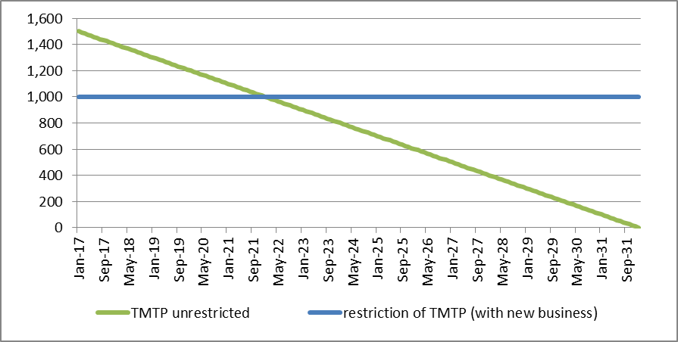
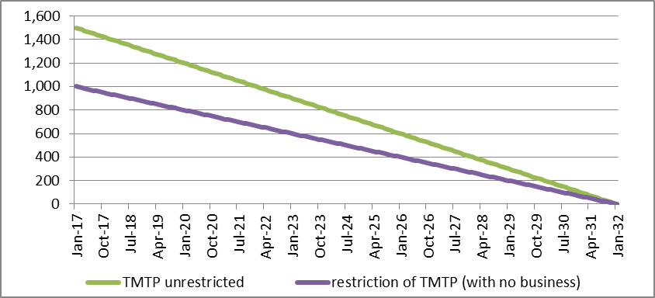
Recent changes (continued)
New business in FRR
The PRA clarified that the FRR should include all business, not just business written prior to the introduction of Solvency II
Where a legal entity has a TMTP with a restriction, new business will generally act to reduce this restriction and increase the TMTP
If the FRR test excludes business written after the introduction of Solvency II…
The TMTP may remain on a restricted basis with the restricted value running-off as the business runs off
If the FRR test includes business written after the introduction of Solvency II…
The restriction (pre TMTP) may remain broadly unchanged, whilst the unrestricted TMTP runs off
Under certain circumstances this may result in business written after the introduction of Solvency II benefiting from a TMTP

Slide 13
Recent changes (continued)
There are still a number of challenges remaining
Complexity
The TMTP is a complex calculation, reflecting the difference between large numbers
Firms need to aware of TMTP complexity when estimating benefits from potential capital initiatives. For example Part VII Transfers
Opportunity cost
TMTP recalculation is absorbing management time and resources, which could potentially be spent elsewhere
Application process
The need for a TMTP approval for changes in operating conditions (i.e. interest rate changes) is onerous
The IFoA working party believe TMTP recalculation should be more dynamic in response to changes in operation conditions and not require an application
Proportionality
No clear guidance on what proportionality means, and what calculation simplifications are deemed to be generally acceptable

Slide 14
Summary and key takeaways
Risk Margin | Working party view is that the TMTP’s primary objective is to mitigate the introduction of the Solvency II risk margin
Soft landing | TMTP provided firms with a ‘soft landing’ into Solvency II regime over 16 year period
Calculation | The calculation is complex and requires (at least) three stages
Recalculation | Is an ongoing challenge for firms. Simplification allowed and tends to be firm specific rather than standardised across firms
Recent changes | PS11/17 has brought clarity in a number of areas, but challenges remain
If you are interest in more detail on this topic please see the working party paper on TMTP recalculation available on:
https://www.actuaries.org.uk/practice-areas/life/research-working-parties/transitional-measures-tps

Slide 15
Questions
Comments
Expressions of individual views by members of the Institute and Faculty of Actuaries and its staff are encouraged.
The views expressed in this presentation are those of the presenter.
If you any feedback on this presentation or the working party please contact the working party chair on:
Jamie.Cooke@aviva.com

