Slide 1
CPD and Reflective Practice
Caoimhe McDonagh
CPD and Reflective Practice Manager

Slide 2
Today’s session
Recap of Continuing Professional Development (CPD) Scheme
Reflective Practice Discussion (RPD)
Exploring different Approaches
Darshika Agarwal FIA

Slide 3
Continuing Professional Development (CPD) Scheme

Slide 4
Continuing Professional Development (CPD) Scheme
The requirements in the CPD Scheme apply to all Members except: Student Members, QAS Members (who are part of the opt-in QAS CPD Scheme) and Non-Practising Members
Members must carry out 15 hours of CPD Activities during each CPD Period, two of those hours must relate to Professional Skills Training
Members should participate in a Reflective Practice Discussion with an Appropriate Person every CPD Period
Members, if selected to do so, must also participate in a Reflective Practice Discussion with the IFoA
Members must keep a record of their CPD Activities for the previous CPD Period
Members will be asked to declare their compliance with the CPD Scheme in their annual membership renewal notice
Any member can apply for Non-Practising status if they are not currently involved in technical actuarial work

Slide 5
CPD activities, what counts?
Any activity that involves learning relevant to your actuarial work (current or future) or professional development, which have an identifiable learning outcome count
Activities can be wide ranging and include, for example, lectures, seminars, workshops, webinars, personal reading and research
Carrying out actuarial work where there is a relevant learning outcome can be included
Don’t limit CPD to technical learning include soft skills training too
Any learning that builds on an area of interest or that you are considering moving into can be counted
Try to obtain CPD from different sources, so that you benefit from a range of different perspectives

Slide 6
How should I log my CPD activities?
You are required to keep a log of your CPD activities, this can be in a format of your choice
CPD logs will be used to facilitate RPD discussions
Reflect on your CPD log to identify where you have been able to, or where you plan to implement your learning/ key take aways

Slide 7

Justin Chan – FIA

Slide 8
Reflective Practice Discussion (RPDs)

Slide 9
Benefits of Reflective Practice
Increased Self Awareness By recognizing strengths and areas for improvement, individuals can make intentional choices to enhance their professional capabilities
Enhanced Problem Solving The process of reflection allows individuals to analyse past experiences, providing valuable insights for future decision-making and problem-solving
Improved Communication Through reflective practice, individuals can build empathy and improve their communication skills, fostering stronger and more effective workplace relationships
Increased Adaptability Reflective Practice instils a habit of continuous learning, making individuals more adaptable to new situations and challenges.

Slide 10
Reflective Practice Discussion (RPD) with an Appropriate Person

Slide 11
RPD with an Appropriate Person
As part of the IFoA CPD scheme members should carry out a Reflective Practice Discussion with an ‘Appropriate Person' of their choosing each CPD year
The Scheme defines an Appropriate Person as “An individual identified by the Member, who understands the nature of the Member’s Actuarial Work, their development and their Learning Outcomes. Such an individual could be a peer, a colleague, a line manager or a volunteer of the IFoA, amongst others.”
The aim of an RPD is to allow the member to reflect on how their CPD activities have helped to meet their learning objectives for the year, and how they have applied what was learnt

Slide 12
Possible Questions to use during RPDs:
CONTEXT
What is your area of practice?
What kind of work do you carry out?
Tell me about your duties and responsibilities.
OBJECTIVES
What were your main objectives for the year?
What areas did you want to learn about?
Which skills did you want to develop?
REFLECT ON OUTCOME
Why did you select this activity?
What did you learn from the activity?
Did this activity address the need/ objective you hoped it would?
How did you implement this learning?
Did you create a specific plan?
Would there be value in having a more structured approach?
What are your main areas of focus?
Do you have people management responsibilities?
Who did you speak to about your performance needs and objectives?
What did you hope to learn from this activity?
Are their remaining gaps in your knowledge?
Did you get other perspectives on this topic?
NEXT STEPS
Would other areas could you look in to?
Will you take a different approach when planning your CPD in the future?
What type of CPD activities do you favor or are most fruitful for you?
Does your CPD log capture your real learning?

Slide 13
Reflective Practice Discussion (RPD) with the IFoA

Slide 14
RPD with the IFoA
Each year a number of members will be selected to participate in a reflective practice discussion with the IFoA, this year a random selection process was adopted
The aim of the discussion is to reflect upon the member’s learning: what they have done over the last year and how they are applying that in practice
Members will reflect on their approach to CPD, how they chose relevant activities and how they identify or measure the success of a CPD activity
The discussions should also enable members to identify areas of focus for future learning
The member will have the opportunity to request support, or seek advice and suggestions from the IFoA

Slide 15
Reflective Practice Tips and Findings
Keep a reflective journal or use digital tools to document your thoughts.
Connect your learning to your professional goals.
Reflective practice works best when it is not a one-time activity.
If possible, seek feedback from colleagues or peers who also participated in the CPD activity.
Move beyond reflection to action planning and identifying specific actions you can take based on your reflections.
Be honest in your reflections, acknowledge areas where you may have struggled or where you need further development.
Use your reflections to identify specific areas for improvement or development.

Slide 16
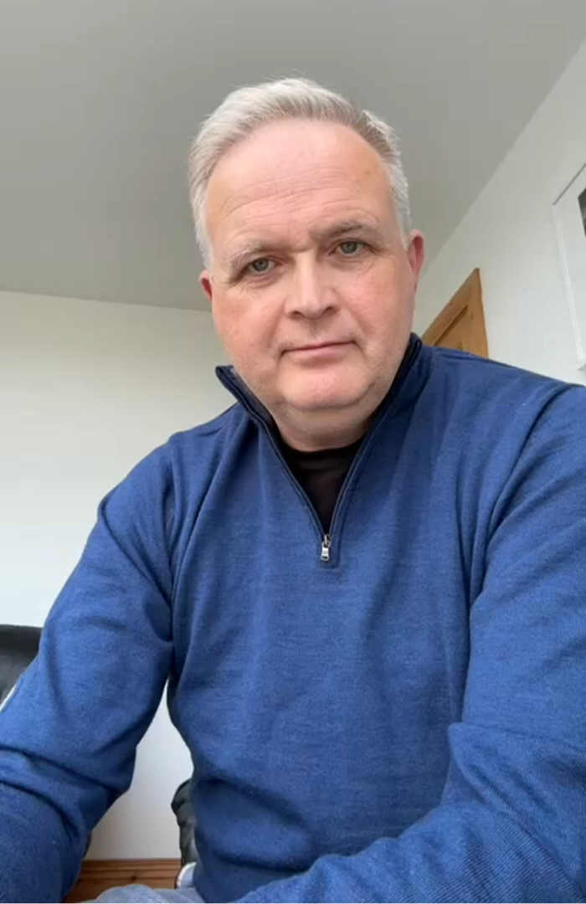
Euan Munro – FIA

Slide 17
Getting value from your CPD Activities: Exploring different Approaches

Slide 18
CPD CYCLE
CPD
Reflect
Plan
Do
Record
Conducting a self-assessment to identify any gaps in your understanding or competencies
Clearly define your learning goals
Explore various resources related to the subject matter
Determine the logical sequence for your learning plan and set deadlines or milestones
Engage in the learning process
Apply your acquired knowledge to reinforce your understanding
Evaluate your progress and reassess your learning needs
Reflect on the learning outcome and remaining learning needs

Slide 19
Structured Approach:
A structured approach to learning refers to a systematic and organized method of acquiring knowledge or developing skills. It involves breaking down the learning process into clear steps or stages, setting clear objectives, and following a well-defined plan to achieve those objectives.
Proactive in identifying a learning need
Create a learning plan and be goal orientated
Research available learning resources – be discerning
Active Engagement and Mindset
Reflect on learning
Plan how/ where to implement learning
Following a structured approach towards CPD, can help you to create a framework that enhances your learning efficiency, helping you to stay on target, and progress towards meeting your goals.

Slide 20
Experiential Approach
An experiential approach emphasizes learning through hands-on experiences, active participation, and reflection. It involves engaging in practical activities, projects, or real-world scenarios to acquire new knowledge, develop skills, and enhance professional growth.
According to the 70-20-10 model, in learning and development, people get 70% of their knowledge from workplace experiences, 20% from peer interactions, and only 10% from formal learning
Actively engaging with the learning process
Applying theoretical knowledge in practical contexts
Reflection plays an essential role in the experiential approach
Seeking feedback from mentors, peers, colleagues or subject experts
Collaborative learning, engage in group activities or projects – lessons learned
Continuous learning and adaptation
Evaluate, track progress, showcase professional growth

