Slide 1
Scheme Actuaries, Climate Change and the Risk Alert – how can we accelerate good practice?
Mike Clark, Ario Advisory
Simon Coomber, LCP
Lisa Deas, Hymans Robertson
Jenni Stott, Chair of the Sustainability Board, IFoA
Chaired by
Sophie Wright, Chair of the Risk Management Lifelong Learning Committee, IFoA

Slide 2
Background
Me
Sustainability Board Purpose
Group Finance, leader in Lloyds Banking Group.
Prior experience at AXA, KPMG, M&S Financial Services, Mercer.
Always been interested in conservation.
Sustainability interest formalised by
  Berkeley Law School Sustainable Capitalism
  Cambridge University: Institute for Sustainable Leadership
Sub editor to two risk notes
Chair IFoA Sustainability Board
Anticipate needs all IFoA members
  Those specialising in Sustainability and thought leaders
  Equip all member to embrace climate & sustainability risks relevant to their work / clients regardless of their practice areas
October 2024
Jennifer Stott, Chair IFOA Sustainability Board
Notes:
The purpose of the Sustainability Board is to anticipate the needs of all IFOA members, regardless of practice area, to equip members to embrace Sustainability into their professional role through understanding and addressing risks arising from climate change and other sustainability issues
In parallel the Board aims to create an enabling environment for actuaries specialising in sustainability with an emphasis on thought leadership, policy development and education.

Slide 3

Why is it important you are professionally conversant in this space?
Remember PEST? Modern version is PESTLE
Your clients and firm may talk about ESG
Regulatory Expectations
March 2023 Bank of England report on climate-related risks and the regulatory capital framework
“The unique characteristics of climate risks mean that their capture by capital frameworks requires a more forward-looking approach than used for many other risks. Scenario analysis and stress testing will play a key role in this.”
Environment
Social
Governance
Political
Economic
Social
Technological
Environmental
Legal
You may have heard talk on SDG’s
The UN’s 17 Sustainable Development Goals

Slide 4
You do not need to be ‘in Sustainability’ for two risk alerts to be relevant to you
Competency
This is a risk Actuaries need to consider in their work
21 April 2022 | Risk Alert: Climate change and sustainability related issues | There is a risk that actuaries may not appropriately consider, or communicate clearly, the impact of climate change and sustainability related issues in their actuarial work.
6 June 2024 | Risk alert: Climate change scenario analysis | Data on climate change is evolving rapidly and there is a risk, when using current published scenarios, that an actuary will underestimate climate risk.
Care and Communication

Slide 5
Using Scenarios is a great way of exploring possible outcomes
June 2024
As such Actuaries should
Risk Alert Climate change scenario analysis Key message The financial risks from climate change should be considered within the context of scenarios when referring to, relying on, or performing climate change analysis.
Data is evolving rapidly and there is a risk, when using current published scenarios, that an Actuary will underestimate climate risk.
Ensure that they demonstrate an understanding of the sensitivities, limitations and uncertainties when evaluating climate related financial risks.
Refer to the limitations and uncertainties when communicating outputs to users of the information.
Consider whether the impacts of a realistic worst-case scenario may be greater than currently anticipated in the standard climate scenarios used in financial services, and if so, communicate this
October 2024
Jennifer Stott, Chair IFOA Sustainability Board

Slide 6
Further Reading and CPD
We try to make it easy
Plus… other ideas
Join the LinkedIn Sustainable Finance Community : weekly easy to read bulletin
https://www.linkedin.com/company/sustainable-finance-community-ifoa/?lipi=urn%3Ali%3Apage%3Ad_flagship3_pulse_read%3BJ1Sgbzu%2FQH%2Bnp5nvhQ9yCw%3D%3D
Climate Risk and Sustainability Course (actuaries.org.uk)
Sustainability practice area: practical guides | Institute and Faculty of Actuaries
Coming soon, new thought leadership paper (Oct).
IFoA Thought Leadership
https://actuaries.org.uk/media/g1qevrfa/climate-scorpion.pdf
https://actuaries.org.uk/media/qeydewmk/the-emperor-s-new-climate-scenarios.pdf
Notes:
global warming and the possibility that Earth’s climate may be more sensitive to elevated concentrations of greenhouse gases than we thought. https://actuaries.org.uk/media/g1qevrfa/climate-scorpion.pdf
• Trust, S., Joshi, S., Lenton, T., Oliver, J. (2023). “The Emperor’s New Climate Scenarios” Limitations and assumptions of commonly used climate-change scenarios in financial services. https://actuaries.org.uk/media/qeydewmk/the-emperor-s-new-climate-scenarios.pdf
•

Slide 7
Questions
Comments
Expressions of individual views by members of the Institute and Faculty of Actuaries and its staff are encouraged.
The views expressed in this presentation are those of the presenter.

Slide 8
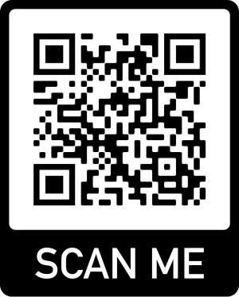
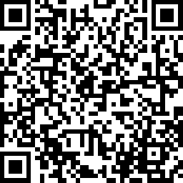
Feedback
Notes:
We would welcome your feedback on this event so we can ensure that we are delivering events that work for you, our members, so please do let us know how we are doing….

