Slide 1
Climate & Nature Risk Reporting Working Party
Paul Klumpes
Kirstie Mok
Sachal Gandotra
Chair: Donna Matteucci

Slide 2

Agenda
1
Overview of WP
Terms of Reference
Survey
Transition Plan research
Nature & TPT
Q&A
2
3
4
5
6

Slide 3
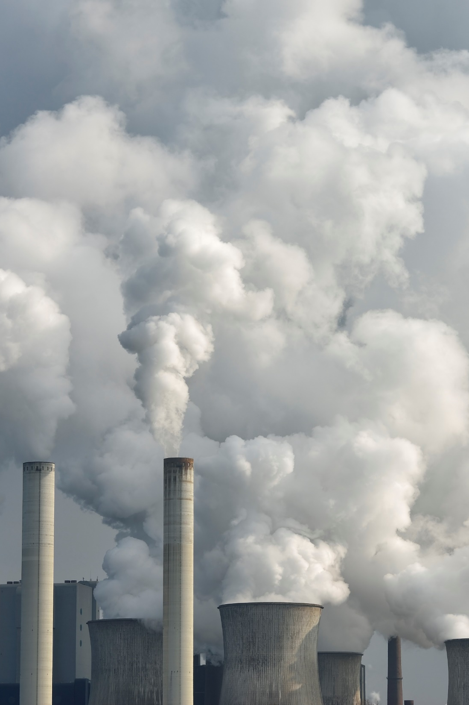
Overview of WP
Background
Terms of Reference
Survey

Slide 4
Climate & Nature Risk Reporting WP
Established at the start of 2023
Met 16 times to date
Research so far based on 3 Terms of Reference
Propose a shift in orientation:
  From “stewardship focused reporting” towards more forward-looking reporting of climate and/or nature transition plans
  Operational resilience issues as they relate to climate and/or nature reporting

Slide 5
Term of Reference 1
Objectives
Overview of current UK and relevant international regulations & guidelines, both industry-specific and generic e.g. International Sustainability Standards Board, TCFD, TNFD
Progress to date
Significant changes in regulatory landscape since WP started e.g.
TCFD closed in October 2023
Largely replaced by ISSB Climate Standard 2 (IFRS S2 - effective 2024)
TNFD standard (issued September 2023)

Slide 6
Term of Reference 2
Objectives
Evaluate good climate and nature-related risk reporting practices by various types of financial institutions to regulators (e.g. PRA, TPR) and stakeholders.
Focus on the largest financial institutions based in both the UK and in other regions of the world.
Progress to date
Identifying globally largest financial institutions (UK and international)
Study of TCFD alignment published in The Actuary May 2024 (Paul & Sachal)
Sub-groups have been formed to analyse the quality of climate transition plan reporting in relation to relevant frameworks e.g. TPT, GFANZ

Slide 7
Term of Reference 3
Objectives
Survey of good practice internal capabilities in climate and nature-related risk reporting, following key aspects related to:
Governance
Fit for purpose
Link to risk appetite framework
Use of climate and nature-related risk reporting
Reporting capabilities
Progress to date
Survey now available online – awaiting responses!

Slide 8

Term of Reference 3 - Survey on TCFD
Focuses on the four TCFD themes with 10 questions on each of the below:
Governance
Strategy
Risk Management
Metrics and Targets
Our intention
Collate and analyse
The Survey is now live
https://www.surveymonkey.com/r/IFoA_TCFD
Upcoming IFoA Newsletter (date to be confirmed)
Update on the progress and create alignment
Highlight instances of good practices
WP members’ LinkedIn
Closing date: 22nd November 2024

Slide 9
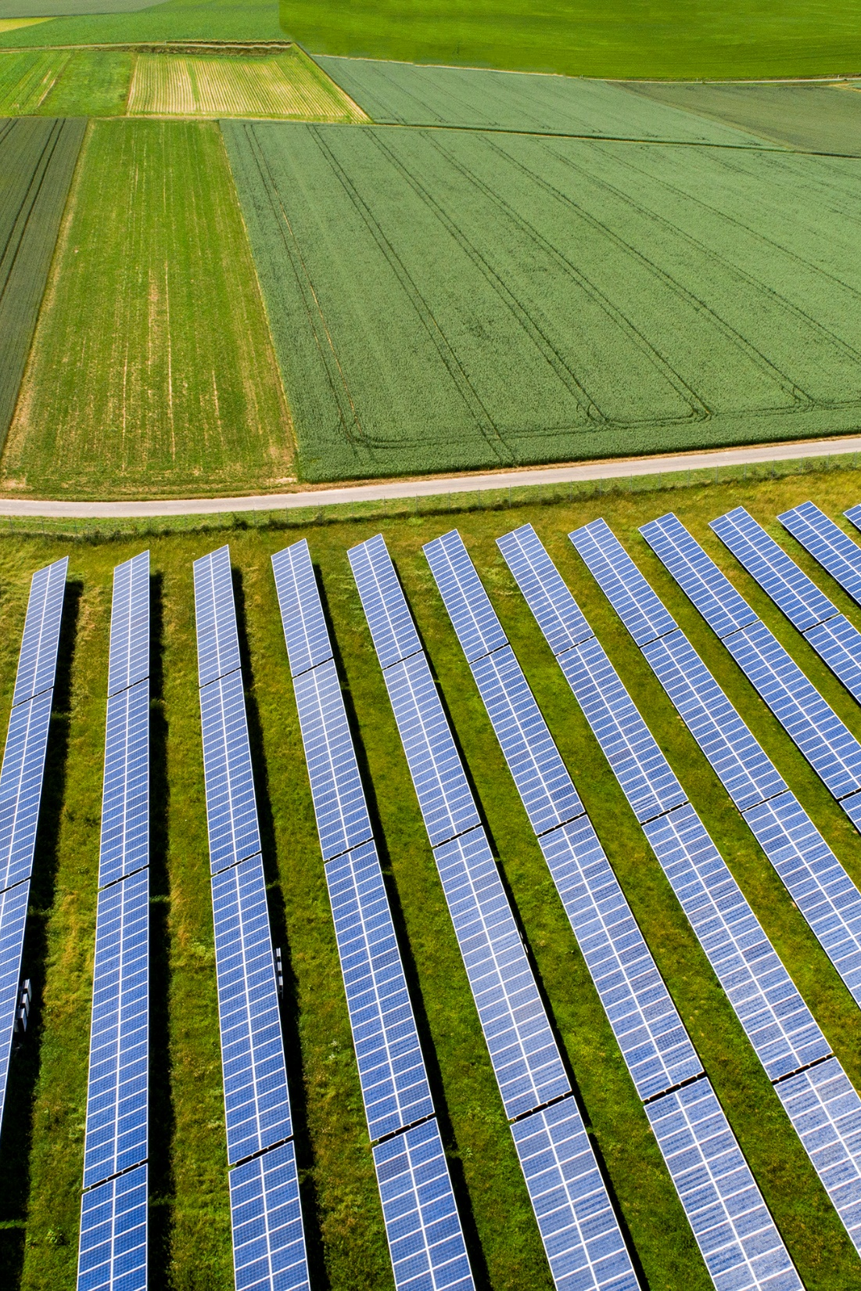
Transition Plans
Current landscape
Research activities

Slide 10
Current landscape
Transition plans are (ESRS E1):
“an aspect of the undertaking’s overall strategy that lays out the entity’s targets and actions for its transition towards a lower-carbon economy, including actions such as reducing its GHG emissions and with the objective of limiting climate change to 1.5°C and climate neutrality
Mandatory under EU firms (per EU Directives CSRD and CSDDD), but not UK firms
Initially proposed by GFANZ, subsequently more detailed guidance provided for UK firms by Transition Plan Taskforce (TPT)
Climate change litigation (NGOs v Shell Netherlands – on appeal?)
Climate-related commitments – constructive obligations per IAS 37? (IASB 25 April 2024)
Implications for auditors and attestation service providers?

Slide 11
TPT (& GFANZ) Disclosure Framework
1. Foundations
2. Implementation strategy
3. Engagement strategy
4. Metrics & Targets
5. Governance

Slide 12


Research activities
Prior research
TCFD climate-related reporting practices
TCFD’s own analysis
GFANZ studies
Empirical evidence (prior WP 2019)
  Asset owners and asset managers
  Pension funds
Current research
Case study analysis of transition plans
Sample: Forbes 500 global companies (publicly listed, CDP climate risk rating)
  High-emitting industries: (1) oil and gas (2) mining (3) food (4) power-utility (79 firms)
  Financial institutions: (1) banks (2) insurers (3) asset managers (4) pension funds (72 firms)
Empirical factors which explain whether the firm produces a credible transition plan:
  Firm level: CDP rating, credit rating, market-to book, return on assets, asset turnover
  International: cultural factors, institutional quality, stock market development
  Government policy: whether transition plan reporting is encouraged or mandatory (UK & EU)
12

Slide 13
Hypotheses
Theoretical antecedents
Development of hypotheses
Reputation, legitimacy
H1: There is a positive association between the quality of transition plan reporting and the quality of their climate risk engagement
Cultural explanations
H2: Country-level institutional-cultural characteristics have explanatory power over the observed international variations in transition plan reporting quality
Neo-institutional (public policy)
H3: International variations in public policy that encourages or requires transition plan reporting have explanatory power over the observed international variations in transition plan reporting quality.
13

Slide 14
%Transition plans and CDP rating - by industry
Financial institutions
Industrial firms
14

Slide 15
%Transition plans and CDP rating – by country
Industrial firms
Financial institutions
15

Slide 16
Empirical findings
Firm-level factors
Quality of climate transition risk reporting is related to:
CDP climate score quality
Investment risk (industrial firms)
Firm size (financial institutions)
International-level factors
Propensity to produce credible transition plan reporting is related to:
National level: cultural factors
Institutional level: Whether firm is UK and/or EU based

Slide 17
Conclusion – overall findings
Transition plan reporting is very limited in scope
European and UK firms
Highly polluting industry sectors
Considerable international variation in quality of transition plans (WIP)
Very low quality/absent: UK pension funds
Mixed quality: other types of financial institutions
Higher quality – credible: industrial firms (e.g. food sector)

Slide 18
Challenges – issues for consideration
Factors affecting reliability and validity of WP research and findings:
Assessing firms’ internal risk capabilities and role of actuaries (low response rates)?
Governance and unit of analysis: “regulated” entity level, or global consolidated firm level?
Limits and boundaries of WP: may need a separate research project or new ToR?
Double materiality issues (currently not considered in ISSB)
Linking climate and nature related risks to firm’s overall operational resilience?

Slide 19
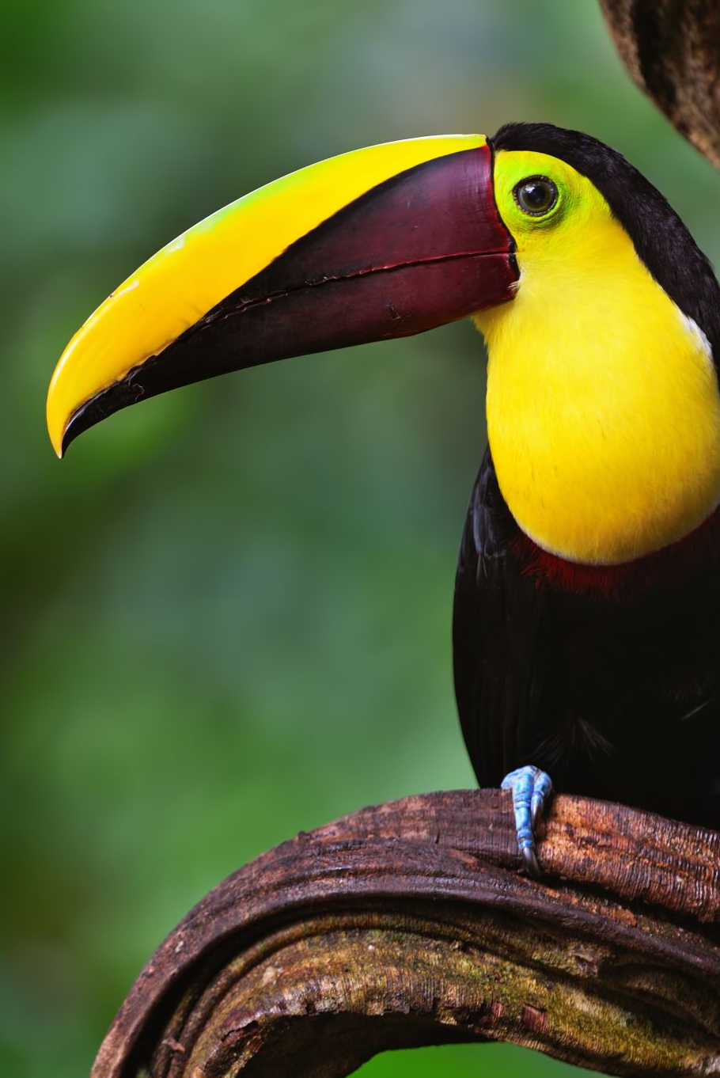
Nature
Context
TPT advisory paper

Slide 20
Putting nature into context
1
2
Why this matters
Over half of global GDP is moderately or highly dependent on the healthy functioning of the natural world
Biodiversity loss has been ranked as the
3rd most severe risk in the next 10 years
Nature-positive transitions could generate up to US$10 trillion of annual business opportunities by 2030
In 2022, the private sector spent
US$5 trillion on activities that harm nature vs US$35 billion on nature-based solutions – 140x margin
3
4
WEF, Nature Risk Rising (2020): https://www.weforum.org/publications/new-nature-economy-report-series/nature-risk-rising/
WEF, Global Risks Report (2024): https://www.weforum.org/publications/global-risks-report-2024/
WEF, The Future of Nature and Business (2020): https://www.weforum.org/publications/new-nature-economy-report-series/future-of-nature-and-business/
UNEP, State of Finance for Nature (2023): https://www.unep.org/resources/state-finance-nature-2023
20

Slide 21


TPT advisory paper
Recommends holistic transition plans – integrating climate and nature
“The majority of businesses who do not see a convincing competitive advantage that compensates for the costs, risks and uncertainty [of producing a transition plan] may be less likely to act, without a clear framework and a level playing field.”
Barriers to development
Lacking C-suite mandate – lack of awareness vs upfront costs & data constraints
Cost & resource uncertainty – lack of existing guidelines or standards → decisions delayed
Barriers to disclosure
Short-term competitive risk e.g. if peers are not undertaking similar action
Reputational risk e.g. objectives deemed insufficient, greenwashing fears, legal action
Paper sets out a number of policy recommendations to tackle these barriers e.g. mandatory TNFD, NBSAP
Also some non-policy solutions e.g. technical bodies and NGOs to provide sector-specific C-suite training
TPT Nature Working Group, The Future for Nature in Transition Planning (2024): https://transitiontaskforce.net/nature/
21
Notes:
Holistic TP:
Strategic approach that considers synergies and trade-offs between climate and nature goals
Solar panels in deserts require high water usage for removing dust and sand, but if managed well in other areas could boost pollinator biodiversity (microclimates)
How solar farms took over the California desert: ‘An oasis has become a dead sea’ | California | The Guardian
Solar farms a ‘blight on the landscape’? Research shows they can benefit wildlife
Barriers to development:
C-suite lack of awareness of company’s nature-related dependencies, impacts, risks & opportunities
Lack of standardisation: there are currently over 600 nature metrics covering Land, Freshwater and Ocean (Nature Positive Initative)
Solutions:
Staged approach - implement mandatory TNFD disclosures and then holistic TPs -> businesses need time to build capabilities
National Biodiversity Strategy and Action Plan (NBSAP) - publish plan outlining how it will meet goals of GBF (outlining economic and fiscal strategies) -> incentivise private sector action
Other non-policy solutions - standardised nature risk scenarios

Slide 22
Questions
Comments
Expressions of individual views by members of the Institute and Faculty of Actuaries and its staff are encouraged.
The views expressed in this presentation are those of the presenter.

